Slide 1
Engineering and Manufacturing: Core
Route: Engineering and Manufacturing
Topic: Project management
Lesson 6: Project controls
Notes:
Image © Shutterstock/Gorodenkoff

Slide 2
In this lesson we will:
Introduction
Skills:
CSA. Planning and scoping project parameters (e.g. timescales, resources, costs)
CSD. Evaluating how well project requirements have been met.
General competencies:
English:
EC2. Present information and ideas
EC4. Summarise information/ideas
Maths:
MC6. Understanding data and risk
identify interdependencies in project tasks and explain the potential impact of a delay on the critical path;
develop a contingency plan to manage delays, risks or changing requirements;
explain how engineers monitor and control projects;
evaluate the success of a project.
Lesson 6: Project controls

Slide 3
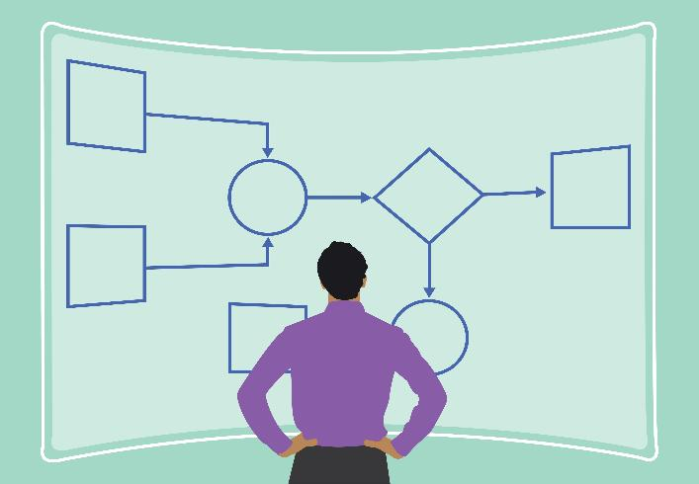
Introduction
Interdependencies and impact of delays
Projects rarely follow a straight line – a delay in one task often impacts several others.
A task which depends on another task is said to be interdependent.
For example:
If the final design is delayed
Prototype build is delayed
Testing is delayed
Evaluation/reporting may fall behind
Lesson 6: Project controls controls
Notes:
Image © Shutterstock/Shobhit_Designer

Slide 4
Introduction
Task dependencies
Finish-to-Start (FS): Task 1 must finish before Task 2 can start. For example, design must finish before ordering components can start.
Start-to-Start (SS): Task 1 must start before Task 2 can start. For example, machining starts and then quality control setup can also start.
Finish-to-Finish (FF): Task 1 must finish before Task 2 can finish. This is less common, but important. For example, technical documentation cannot be completed until the final system test is done.
1
2
1
2
1
2
Lesson 6: Project controls

Slide 5
Activity 1
Identify the Critical Path – example
Critical Path = Produce final design →
Build Prototype → Test
Task | Duration | Cumulative duration | Dependency? | Float? | Critical?
Produce final design | 3 days | 3 days | Must be done before building | 0 days | Yes
Build prototype | 4 days | 7 days | Depends on final design | 0 days | Yes
Test prototype | 2 days | 9 days | Depends on prototype build | 0 days | Yes
Lesson 6: Project controls

Slide 6

Interdependency chain
Activity 1
Choose one task in your project.
Describe three other tasks it affects if delayed.
Lesson 6: Project controls
Notes:
Image © Shutterstock/Videophilia

Slide 7

Contingency planning
Activity 2
Engineering teams plan buffers so unexpected problems do not derail the project.
Examples of contingency:
Ordering spare components
Allocating extra test time
Backup communication plan
Alternative tooling or workshop slots
Contingency budget (for example, ± 5%)
Lesson 6: Project controls
Notes:
Image © Shutterstock/Miha Creative

Slide 8
Writing a contingency plan
Activity 2
Choose one potential delay from your pneumatic gripper project.
Write your contingency plan:
Detail the issue.
Describe the impact on the Critical Path.
Describe the specific action (Plan B) to resolve it.
Lesson 6: Project controls

Slide 9

Activity 3
Monitoring projects
Engineering teams monitor projects through:
budget reports
quality inspection logs
time tracking
progress monitoring against milestones
stage reviews.
Lesson 6: Project controls
Notes:
Image © Shutterstock/Gorodenkoff

Slide 10
Managing projects by exception
Activity 3
A delegation-focused, highly-efficiency management approach where the Project Manager makes decisions and handles issues independently within agreed tolerances.
The senior management/project board is only involved when a breach of these tolerances occurs.
Core principle is Exception vs. Normal:
  Normal (within tolerance): Minor, day-to-day engineering issues (e.g., a component arrives a few days late, a small cost increase) are handled by the Project Manager
  Exception (outside tolerance): Major deviations which threaten project success, such as large cost overruns (more than 5%) or significant brief changes requiring formal escalation
Lesson 6: Project controls

Slide 11
Justifying decisions
Activity 3
Every engineering decision must be justified and have a reason for being undertaken.
Examples of strong justification
“We selected soft polymer grip pads to reduce contact stress on the housing.”
“A single-acting cylinder was chosen to simplify the design and reduce cost.”
“A flow control valve is required to avoid rapid actuation, which may damage parts.”
“A regulator ensures consistent operating pressure within required tolerance.”
Examples of weak justification
“It was easier.”
“We thought it would work.”
“We used this because it seemed best.”
Lesson 6: Project controls

Slide 12
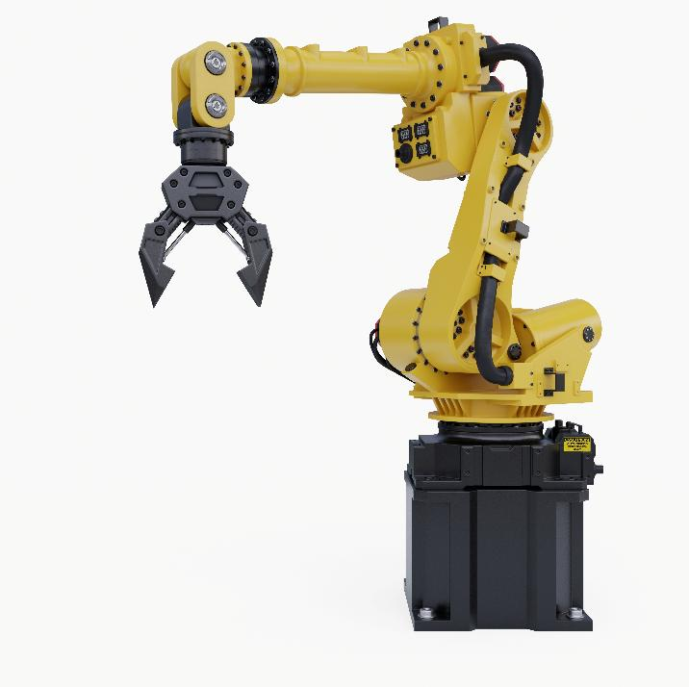
Workbook
Activity 3
Complete Lesson 6 Activity 3:
Justifying engineering decisions
Lesson 6: Project controls
Notes:
Image © Shutterstock/vanitjan

Slide 13
Workbook
Activity 4
Complete Lesson 6 Activity 4:
Testing
Lesson 6: Project controls
Notes:
Image © Shutterstock/vanitjan

Slide 14
Sample testing data
Activity 4
Test | Expected Outcome | Actual Outcome | Notes
10 grip cycles | No damaged parts | No damaged parts
Opening/ closing speed | Smooth, controlled | Slightly fast
Alignment test | Gripper holds parts centrally | Slight misalignment
Lesson 6: Project controls

Slide 15
Workbook
Plenary
Complete Lesson 6 Plenary:
Reflection and evaluation
Lesson 6: Project controls
Notes:
Image © Shutterstock/vanitjan

Slide 16
In this lesson we have:
Plenary
Skills:
CSA. Planning and scoping project parameters (e.g. timescales, resources, costs)
CSD. Evaluating how well project requirements have been met.
General competencies:
English:
EC2. Present information and ideas
EC4. Summarise information/ideas
Maths:
MC6. Understanding data and risk
identified interdependencies in project tasks and explained the potential impact of a delay on the critical path;
developed a contingency plan to manage delays, risks or changing requirements;
explained how engineers monitor and control projects;
evaluated the success of a project.
Lesson 6: Project controls

Slide 17
Follow-up task
Consolidation
Reflect on your project. Write a one-page evaluation reflecting on what went well and things you could improve in the future.
Questions to think about:
Did your design meet the brief? Provide evidence.
Which decisions were most effective, and why?
What improvements would you make in a second iteration?
How well did your team communicate?
How did maths/digital tools help your planning?
Lesson 6: Project controls

