Slide 1
Engineering and Manufacturing: Core
Route: Engineering and Manufacturing
Topic: Project management
Lessons 5: Project planning tools
Notes:
Image © Shutterstock/Gorodenkoff

Slide 2
In this lesson we will:
Introduction
Skills:
CSA. Developing project plans
General competencies:
English:
EC2. Present information and ideas
EC4. Summarise information/ideas
Maths:
MC2. Estimating, calculating and error spotting
MC8. Communicating using mathematics
MC10. Optimising work processes
Digital:
DC4. Process and analyse numerical data
identify the resource requirements for a project, including time, budget, human resources, communication needs and production facilities;
create a Gantt chart showing tasks, durations, dependencies and milestones for the pneumatic gripper project;
explain and apply Critical Path Analysis (CPA) and Program Evaluation and Review Technique (PERT) to the pneumatic gripper project.
Lesson 5: Project planning tools

Slide 3
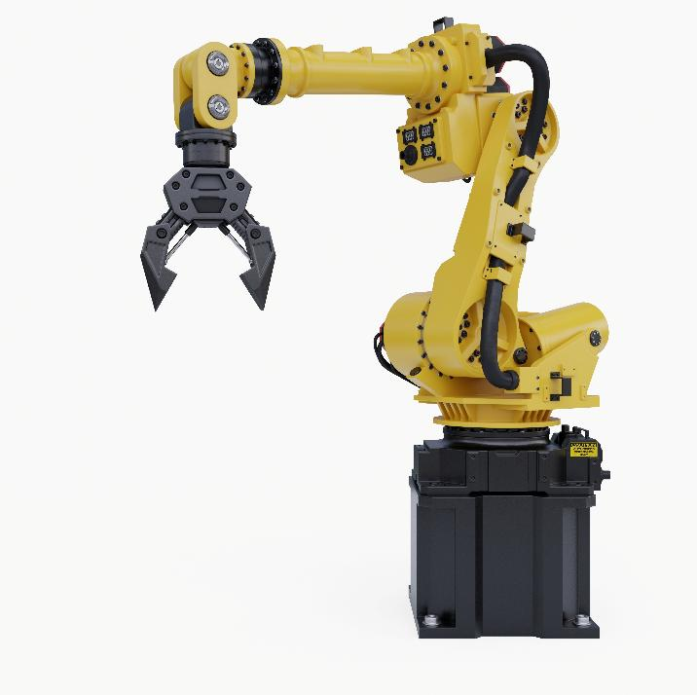
Pneumatic gripper project
Introduction
What do you need to do?
What would you need to carry out this project?
Lesson 5: Project planning tools
Notes:
Image © Shutterstock/vanitjan

Slide 4
Key resources
Activity 1
Time: total duration, task timings, deadlines
Budget: cost of components, tools, materials
Human resources: project manager, Health & Safety officer
Training needs: how to use specialist equipment, safety protocols
Communication needs: meetings, communication tools (such as Teams)
Facilities & equipment: workshop space, Computer Aided Design (CAD) access
Lesson 5: Project planning tools

Slide 5
Workbook
Activity 1
Complete Lesson 5 Activity 1: Resource planning
Lesson 5: Project planning tools
Notes:
Image © Shutterstock/vanitjan

Slide 6
Gantt Charts
Activity 2
A Gantt chart visually maps tasks, durations, start/end dates, dependencies and milestones.
A Gantt chart must include:
a breakdown of all major tasks;
start and finish dates;
task durations;
dependencies (A must finish before B starts);
milestones (key deadlines);
contingency time (buffers).
Lesson 5: Project planning tools

Slide 7
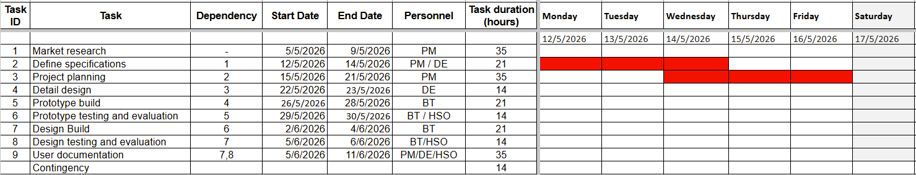
Example Gantt Chart
Activity 2
Lesson 5: Project planning tools

Slide 8
Workbook
Activity 2
Complete Lesson 5 Activity 2: Project planning using digital tools
Lesson 5: Project planning tools
Notes:
Image © Shutterstock/vanitjan

Slide 9
Tips for creating a Gantt Chart
Activity 2
Use the tasks provided in the project brief document.
Estimate durations for each task (e.g. two days).
Identify dependencies to help you sequence your project, such as:
  concept designing must finish before prototype building;
  testing must finish before evaluation.
Add at least two milestones (e.g. Prototype complete).
Add buffer/contingency time of one to two days.
Lesson 5: Project planning tools

Slide 10
Activity 3
Critical Path Analysis (CPA)
CPA identifies the longest sequence of dependent tasks in a project – the Critical Path. Completion of these tasks dictates the minimum project duration. Any delay in these tasks directly delays the final deadline.
Why CPA matters:
Shows which tasks must NOT be delayed
Helps allocate resources efficiently
Supports contingency planning
Lesson 5: Project planning tools

Slide 11
Activity 3
CPA terminology
Earliest Start Time (EST) – earliest time the project can begin
Latest Finish Time (LFT) – latest time the project can finish
Float – spare time before delaying the project
Critical Path – zero float
Lesson 5: Project planning tools

Slide 12
Activity 3
Identify the Critical Path – Example
Critical Path = Produce final design → Build Prototype → Test
Task | Duration | Cumulative duration | Dependency? | Float? | Critical?
Produce final design | 3 days | 3 days | Must be done before building | 0 days | Yes
Build prototype | 4 days | 7 days | Depends on final design | 0 days | Yes
Test prototype | 2 days | 9 days | Depends on prototype build | 0 days | Yes
Lesson 5: Project planning tools

Slide 13
Activity 3
Identify the Critical Path
Using your Gantt chart:
Choose three tasks that are clearly dependent on each other.
Estimate their durations.
Identify the Critical Path and its total duration.
Lesson 5: Project planning tools

Slide 14
Activity 4
Project Evaluation Review Technique
CPA assumes perfect time estimates, but engineering tasks are uncertain.
Project Evaluation Review Technique (PERT) uses three-point time estimating to give a more realistic, weighted expected time it will take for a task to be completed.
PERT uses:
Optimistic time – fastest it could possibly be done (everything goes smoothly)
Most likely time – best estimate at how long the task will take (usual working conditions)
Pessimistic time – slowest time the task should be completed in (delays or issues occur).
Lesson 5: Project planning tools

Slide 15
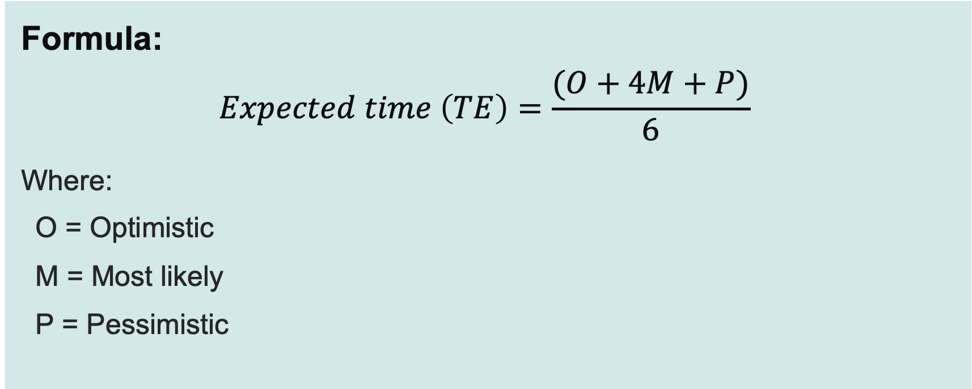
Activity 4
Project Evaluation Review Technique
Formula:
$$Expected time \left(TE\right)=\frac{(O+4M+P)}{6}$$
Where:
O = Optimistic
M = Most likely
P = Pessimistic
Lesson 5: Project planning tools

Slide 16
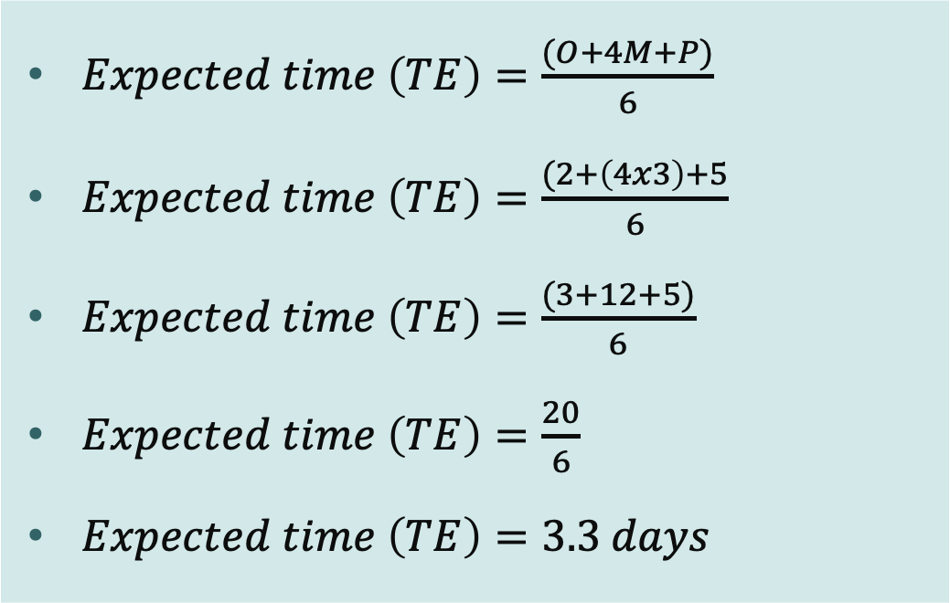
Activity 4
PERT – Worked example
Task selected: Build Prototype
$Expected time \left(TE\right)=\frac{(O+4M+P)}{6}$
$Expected time \left(TE\right)=\frac{(2+\left(4x3\right)+5}{6}$
$Expected time \left(TE\right)=\frac{(3+12+5)}{6}$
$Expected time \left(TE\right)=\frac{20}{6}$
$Expected time \left(TE\right)=3.3 days$
Estimate Type | Time
Optimistic (O) | 2 days
Most Likely (M) | 3 days
Pessimistic (P) | 5 days
Lesson 5: Project planning tools

Slide 17
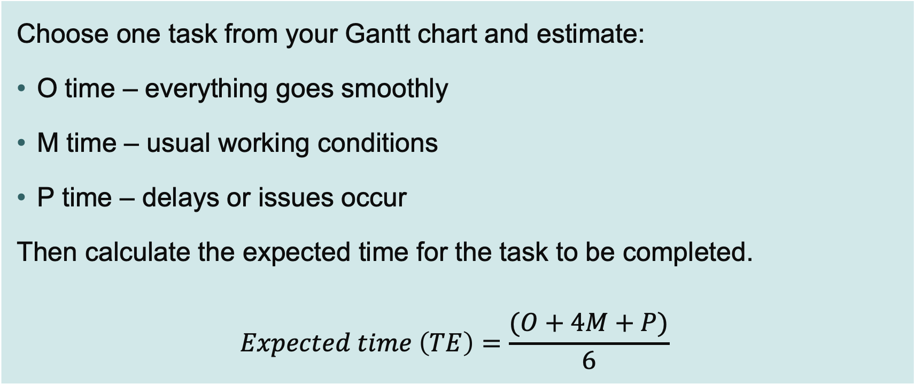
Activity 4
PERT calculation
Choose one task from your Gantt chart and estimate:
O time – everything goes smoothly
M time – usual working conditions
P time – delays or issues occur
Then calculate the expected time for the task to be completed.
$$Expected time \left(TE\right)=\frac{(O+4M+P)}{6}$$
Lesson 5: Project planning tools

Slide 18
Plenary
Discussion
You will be put into three groups:
Group One – Gantt Chart
Group Two – Critical Path Analysis
Group Three – Programme Evaluation and Review Technique.
In your group, create a brief presentation (two mins) on the benefits of your project planning tool.
Whilst listening to the other groups’ presentations, think of some questions you could ask about the limitations of their project tool.
Lesson 5: Project planning tools

Slide 19
Plenary
To summarise
Explain, in one sentence, how the resources, Gantt charts, CPA and PERT are all connected.
Lesson 5: Project planning tools

Slide 20
In this lesson we have:
Plenary
Skills:
CSA. Developing project plans
General competencies:
English:
EC2. Present information and ideas
EC4. Summarise information/ideas
Maths:
MC2. Estimating, calculating and error spotting
MC8. Communicating using mathematics
MC10. Optimising work processes
Digital:
DC4. Process and analyse numerical data
identified the resource requirements for a project, including time, budget, human resources, communication needs and production facilities;
created a Gantt chart showing tasks, durations, dependencies and milestones for the pneumatic gripper project;
explained and applied Critical Path Analysis (CPA) and Program Evaluation and Review Technique (PERT) to the pneumatic gripper project.
Lesson 5: Project planning tools

