Slide 1
Engineering and Manufacturing: Core
Route: Engineering and Manufacturing
Topic: Project management
Lesson 4: Teamwork and communication
Notes:
Image © Shutterstock/Gorodenkoff

Slide 2
In this lesson we will:
Introduction
Skills:
CSA. Interpreting and confirming project requirements
Planning and scoping project parameters (e.g. timescales, resources, costs)
Developing project plans
CSB. Communicating with technical and non-technical audiences using technology
CSC. Designing proposals to meet set requirements
General competencies:
English:
EC2. Present information and ideas
EC6. Take part in/lead discussions
Maths:
MC2. Estimating, calculating and error spotting
explain the importance of good communication within engineering teams;
produce 2D drawings to effectively communicate ideas;
create a role interaction map to summarise the flow of information between the key roles in an engineering project.
Lesson 4: Teamwork and communication

Slide 3
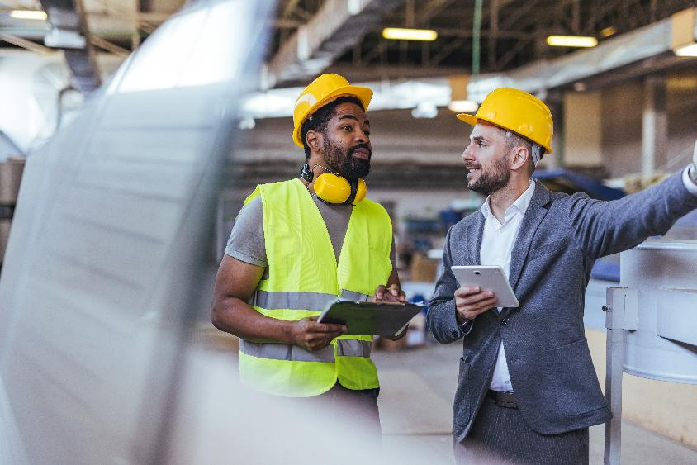
Teamwork and communication
Introduction
Communication methods include:
daily stand-ups;
weekly progress updates;
shared documents:
messaging tools;
task boards;
shared Gantt charts.
Lesson 4: Teamwork and communication
Notes:
Image © Shutterstock/Dragana Gordic

Slide 4

Contacting a client
Introduction
Scenario: You must contact the client to advise them that the expected delivery date is going to be pushed back by five working days.
Discuss in your project teams how you will complete this task. Think about:
how you will deliver the message, for example, as an email or video call;
the way the information will be presented, for example, the level of detail.
Lesson 4: Teamwork and communication
Notes:
Image © Shutterstock/BearFotos

Slide 5
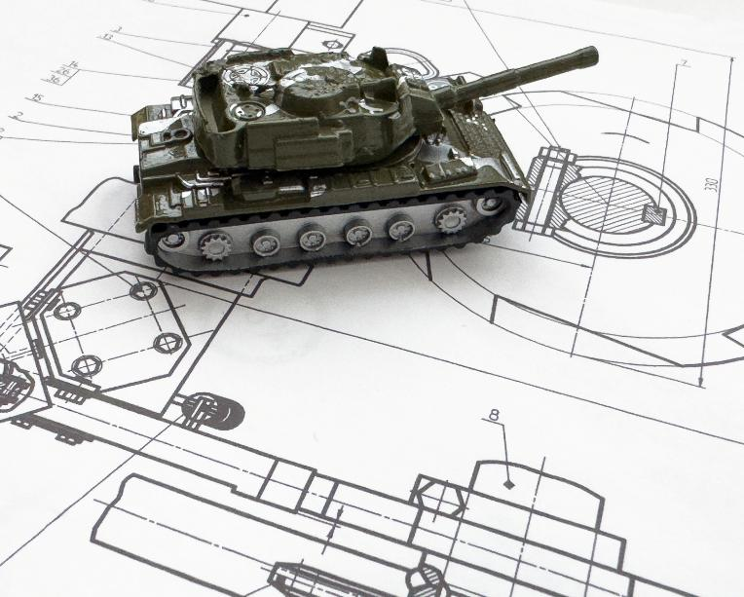

2D drawings
Activity 1
How are 2D drawings a useful way of communicating technical engineering
Information?
Lesson 4: Teamwork and communication
Notes:
Image (left) © Shutterstock/MeshCube
Image (right) © Shutterstock/Andrew Angelov

Slide 6
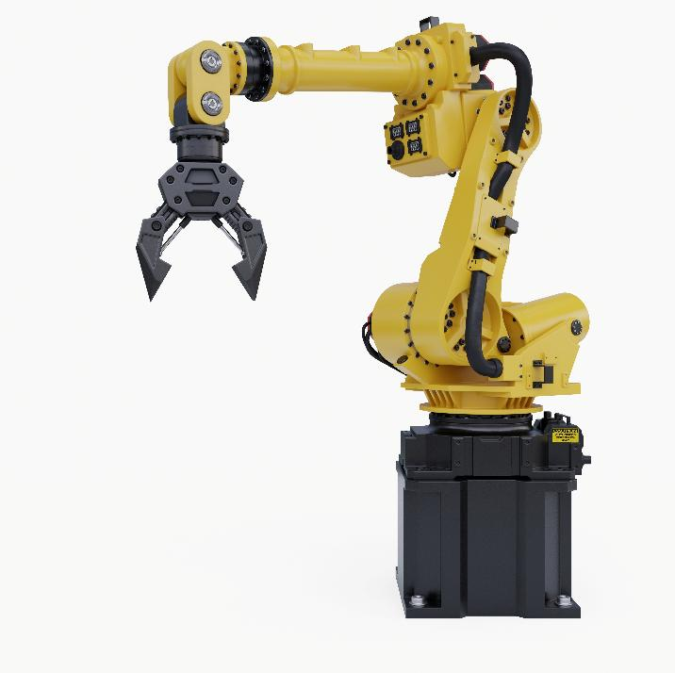
Workbook
Activity 1
Complete Lesson 4 Activity 1: Concept development
Lesson 4: Teamwork and communication
Notes:
Image © Shutterstock/vanitjan

Slide 7
Mini scenario challenge
Activity 2
The Design Engineer realises the cylinder length may exceed the
300 × 300 × 400mm working envelope. Testing must be delayed
by 48 hours.
How should each of the following people respond?
Project Manager
Health & Safety officer
Finance / Resource Lead
Build Technician
Lesson 4: Teamwork and communication

Slide 8
Priorities challenge
Activity 2
Get together in your project teams. For this activity, assume the role you were assigned within this team: Project Manager, Finance / Resource lead, Design Engineer, Health & Safety officer or Build Technician.
You have ten minutes to:
discuss the concerns from your unique viewpoint of this delay;
create a plan for each person in the group of an immediate takeaway and what they need to do as a priority.
Lesson 4: Teamwork and communication

Slide 9
Activity 3
Mapping team interactions
Project Manager
Finance / Resource Lead
Design Engineer
Health & Safety officer
Build Technician
Design change affecting dimensions
Timings – Immediate
Updated safety controls
Timings – Before any physical testing
Lesson 4: Teamwork and communication

Slide 10
Plenary
Reflection
Which role do you think is most critical to the success of an engineering project, and why?
Lesson 4: Teamwork and communication

Slide 11
In this lesson we have:
Plenary
Skills:
CSA. Interpreting and confirming project requirements
Planning and scoping project parameters (e.g. timescales, resources, costs) Developing project plans
CSC. Designing proposals to meet set requirements
General competencies:
English:
EC2. Present information and ideas
EC6. Take part in/lead discussions
Maths:
MC2. Estimating, calculating and error spotting
explained the importance of good communication within engineering teams;
produced 2D drawings to effectively communicate ideas;
created a role interaction map to summarise the flow of information between the key roles in an engineering project.
Lesson 4: Teamwork and communication

