Slide 1
Engineering and Manufacturing: Core
Route: Engineering and Manufacturing
Topic: Manipulating equations and calculus
Resource 1: Unit conversions
Notes:
Image © Shutterstock/Gorodenkoff

Slide 2
In this resource, we will:
Introduction
Skills
CSE (Communicate and present outcomes and evidence)
General competencies
English:
EC1 Convey technical information to different audiences.
EC6 Take part in/lead discussions
Maths:
MC1 Measuring with precision
MC2 Estimating, calculating and error spotting.
Digital:
DC4 Process and analyse numerical data
explain the importance of SI units;
calculate quantities in desired units by converting between metric and imperial units;
calculate length, volume, force and temperature in desired units by using unit conversions.
Resource 1: Unit conversions

Slide 3
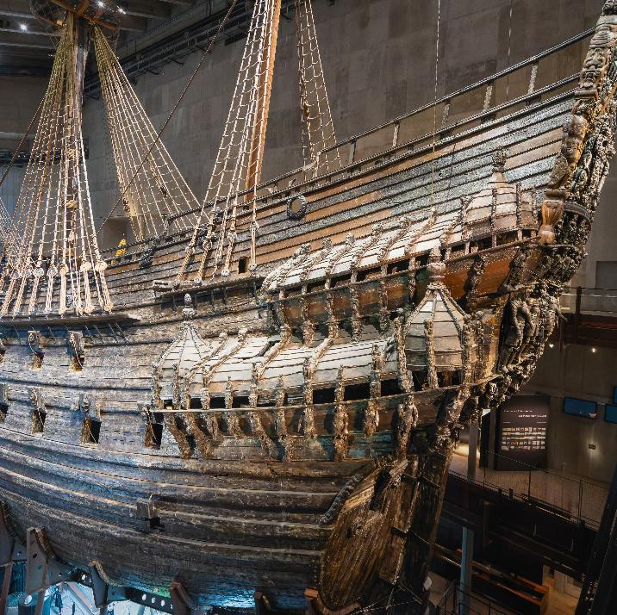
The Vasa Warship
Introduction
In 1628, Sweden launched the Vasa – a huge, beautifully decorated warship.
At the time, many people thought it was the most powerful warship in the world.
However, it sank after sailing for less than a mile, killing 30 people on board.
Why?
Resource 1: Unit conversions
Notes:
Image © Shutterstock/twabian

Slide 4
The Vasa Warship
Introduction
Archaeologists found that different workers used different rulers.
Two rulers measured Swedish feet
(12 inches), whereas two others measured Amsterdam feet (11 inches).
The ship ended up asymmetrical, unstable and ultimately doomed.
Resource 1: Unit conversions
Notes:
Image © Shutterstock/twabian

Slide 5
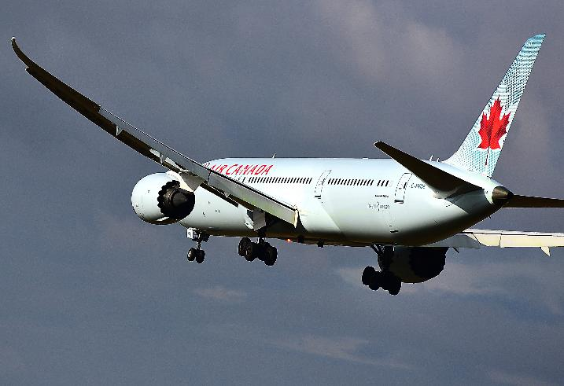
The Gimli Glider
Introduction
In 1983, an Air Canada flight ran out of fuel mid-air.
The engines shut down mid-flight and turned the aircraft into a giant glider.
Due to the pilots’ skill, they landed safely on an old airfield in Gimli, hence its name the Gimli Glider.
How did this happen?
Resource 1: Unit conversions
Notes:
Image © Shutterstock/Vytautas Kielaitis

Slide 6
The Gimli Glider
Introduction
The airline had just switched to using metric units. The plane’s onboard fuel gauge was not working, so the crew had to calculate how much fuel was added when refuelling.
However, the crew used pounds of fuel instead of kilograms.
This meant they loaded only around half the fuel they needed.
Resource 1: Unit conversions
Notes:
Image © Shutterstock/Vytautas Kielaitis

Slide 7
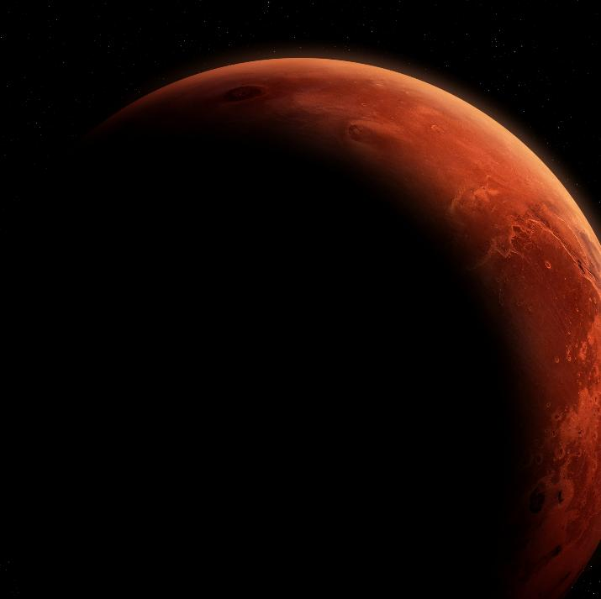
NASA’s Mars Climate Orbiter
Introduction
In 1999, NASA lost a $125 million spacecraft.
The probe flew too close to Mars, hit the atmosphere, and was never heard from again.
Why?
Resource 1: Unit conversions
Notes:
Image © Shutterstock/buradaki

Slide 8
NASA’s Mars Climate Orbiter
Introduction
NASA used the metric system of measurement and calculated the spacecraft’s thruster force using newtons. However, one of its contractors used the imperial system unit pounds of force.
A NASA software program failed to interpret the data correctly as it assumed it was receiving measurements in newtons.
As a result, the spacecraft flew too close to Mars and burned up in the atmosphere.
Resource 1: Unit conversions
Notes:
Image © Shutterstock/buradaki

Slide 9
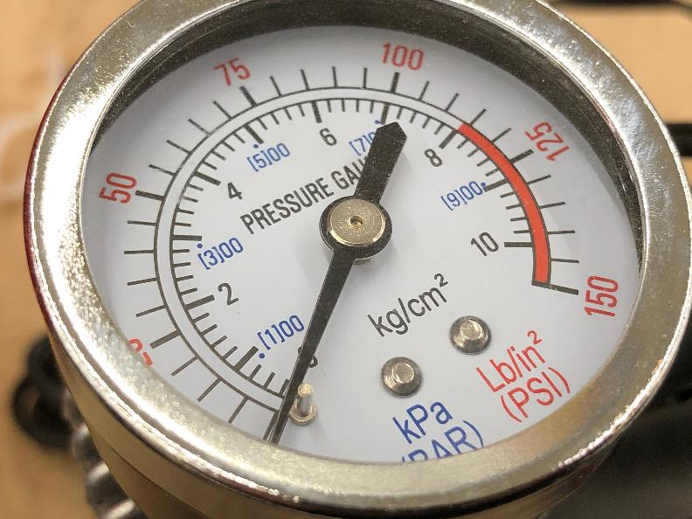
Issues with non-standard units
Introduction
Quantities such as force, pressure, volume, length and temperature must be measured in a clear and consistent way to avoid miscalculations.
Units help communicate how to measure quantities. Without consistent units, misunderstandings or costly accidents can happen.
What is the problem with using inconsistent units?
Resource 1: Unit conversions
Notes:
Image © Shutterstock/XanderSt

Slide 10
Activity 1: Metric vs non-metric measurements
Activity 1
Break into groups.
Measure the length of a book:
using non-standard units, such as hands
using standard units, such as cm.
Determine the volume of a mug:
using non-standard units, such as spoonfuls
using standard units, such as ml.
Compare the measurements from each group. What do you notice?
Resource 1: Unit conversions

Slide 11
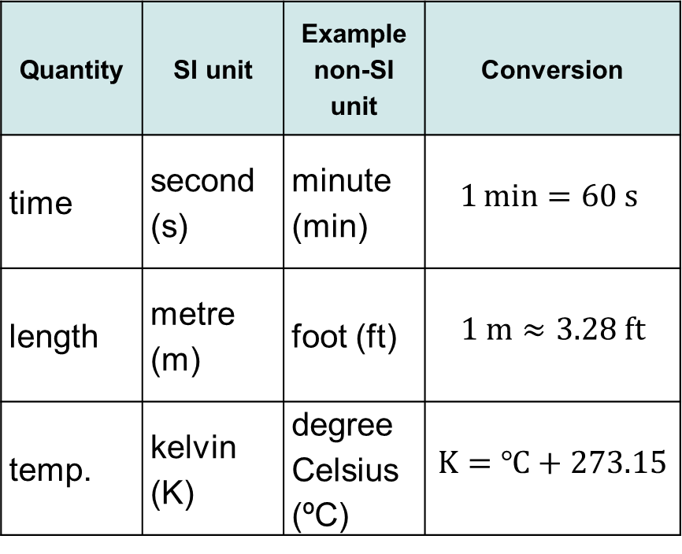
Converting between units
Activity 1
A unit is a standardised quantity used to measure a physical quantity.
SI units are an internationally agreed system of measurement.
Many quantities have non-SI units and converting between them requires using conversion rules.
Quantity | SI unit | Example non-SI unit | Conversion
time | second (s) | minute (min) | $$1\min{=60 \text{s} }$$
length | metre (m) | foot (ft) | $$1 m≈3.28 ft$$
temp. | kelvin (K) | degree Celsius (ºC) | $$K=℃+273.15$$
Resource 1: Unit conversions

Slide 12

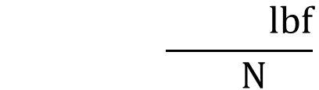

Multiplicative conversion
Recap and Worked examples
Most conversions are multiplicative, which shows the ratio between the units.
Rearrange the conversion into a fraction that shows the ratio between the units.
Place the original unit in the denominator of the conversion factor.
Show that the conversion from pound-force to newtons can be rearranged as the following fractions:
?
?
$$\frac{4.45 N}{1 lbf}$$
$$\frac{1 lb}{4.45 N}=\frac{0.225 lbf}{1 N}$$
  $$1 lbf=4.45 N$$
?
?
The denominator is the bottom number in a fraction.
Resource 1: Unit conversions

Slide 13
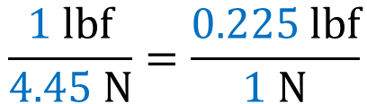
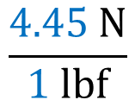
Multiplicative conversion
Recap and Worked examples
Most conversions are multiplicative, which shows the ratio between the units.
Rearrange the conversion into a fraction that shows the ratio between the units.
Place the original unit in the denominator of the conversion factor.
Show that the conversion from pound-force to newtons can be rearranged as the following fractions:
$$\frac{4.45 N}{1 lbf}$$
$$\frac{1 lbf}{4.45 N}=\frac{0.225 lbf}{1 N}$$
$$1 lbf=4.45 N$$
The denominator is the bottom number in a fraction.
Resource 1: Unit conversions

Slide 14
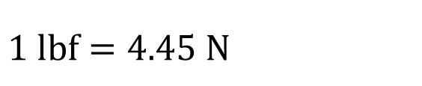
Worked example 1: Pound-force to newtons
Recap and Worked examples
Convert 30 lbf (pound-force) into newtons.
$$1 lbf=4.45 N, so\frac{4.45 N}{1 lb}.$$
Resource 1: Unit conversions

Slide 15
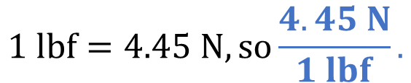

Worked example 1: Pound-force to newtons
Recap and Worked examples
Convert 30 lbf (pound-force) into newtons.
$$1 lbf=4.45 N, so\frac{4.45 N}{1 lbf}.$$
Arrange the conversion factor so that the original unit lbf is in the denominator.
$$30 lbf=30 lbf ×\frac{4.45 N}{1 lbf} \\ 30 lbs=30 × 4.45 N$$
$$30 lbs=133.5 N$$
Multiply the quantity by the conversion factor.
The units lbf cancel.
The result is now in newtons.
Resource 1: Unit conversions

Slide 16

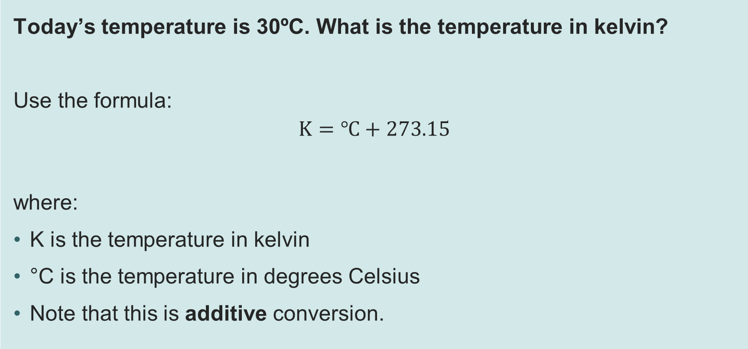
Worked example 2: Celsius to kelvin
Recap and Worked examples
Today’s temperature is 30ºC. What is the temperature in kelvin?
Use the formula:
$$K=℃+273.15$$
where:
K is the temperature in kelvin
°C is the temperature in degrees Celsius
Note that this is additive conversion.
Resource 1: Unit conversions

Slide 17
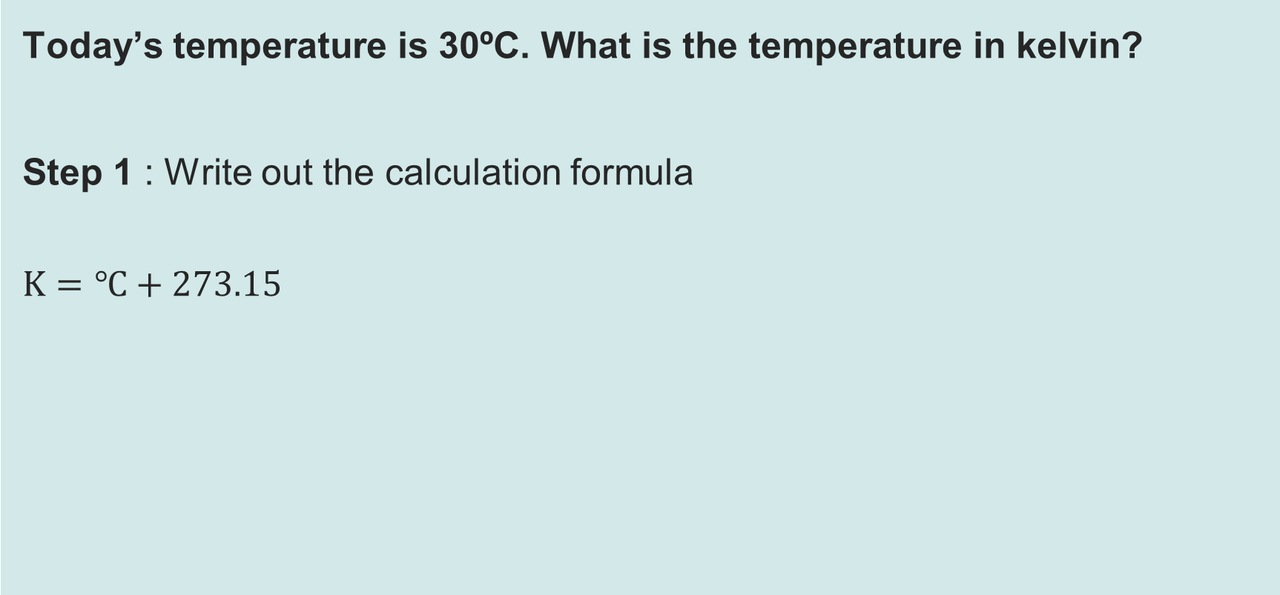
Worked example 2: Celsius to kelvin
Recap and Worked examples
Today’s temperature is 30ºC. What is the temperature in kelvin?
Step 1 : Write out the calculation formula
$$K=℃+273.15$$
This means that the temperature in Kelvin = temperature in Celsius + 273.15
Resource 1: Unit conversions

Slide 18
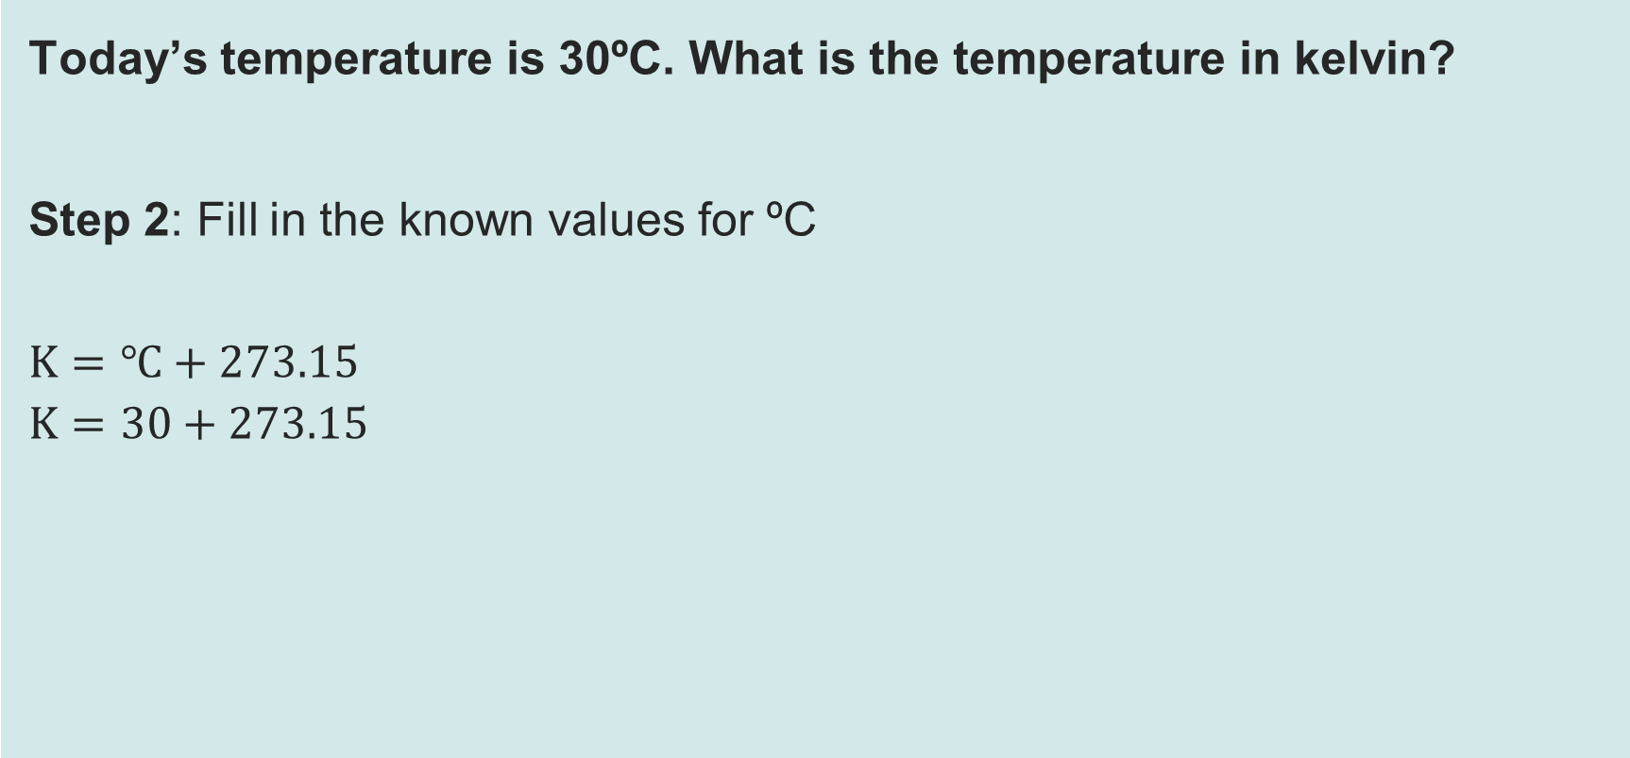
Worked example 2: Celsius to kelvin
Recap and Worked examples
Today’s temperature is 30ºC. What is the temperature in kelvin?
Step 2: Fill in the known values for ºC
$$K=℃+273.15$$
$$K=30+273.15$$
Resource 1: Unit conversions

Slide 19
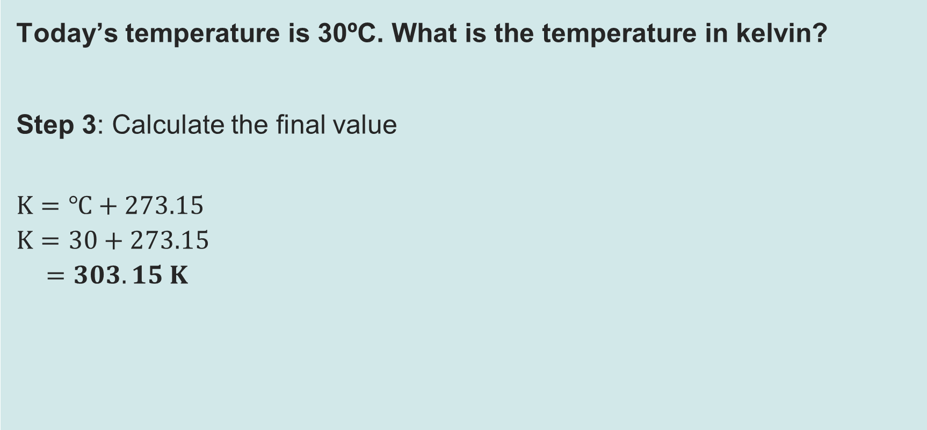
Worked example 2: Celsius to kelvin
Recap and Worked examples
Today’s temperature is 30ºC. What is the temperature in kelvin?
Step 3: Calculate the final value
$$K=℃+273.15$$
$$K=30+273.15$$
$$=303.15 K$$
Remember, do not add a degree sign to your answer. The unit of kelvin is K.
Resource 1: Unit conversions

Slide 20
Activity 2: Unit conversions
Activity 2
1) Complete the table of five unit conversions.
2) Complete the four practice questions, using conversion factors from the table.
Show full working and correct units.
Sense-check your answers.
Resource needed
R1 Worksheet
Resource 1: Unit conversions

