Slide 1
Health
Route: Health and Science
Topic: Physiological Measurements
Introductory lesson: Physiological measurements
Notes:
Image © Shutterstock/Monkey Business Images

Slide 2
In this lesson, we will:
Introduction
name the physiological measurements commonly measured by the healthcare support worker;
explain why, when and how these measurements are taken;
state the normal range for each measurement in adults;
correctly use a range of equipment to take physiological measurements.
Skills:
CS4 Reflective evaluation
General competencies:
English:
GEC5 Synthesise information
Maths:
GMC5 Processing data
Digital:
GDC1 Use digital technology and media effectively

Slide 3

Physiological measurements
Introduction
On the Introduction Worksheet, list physiological measurements that are regularly taken by healthcare professionals.
Resources needed
Introduction Worksheet
Notes:
Image © University Hospitals Bristol and Weston NHS Foundation Trust

Slide 4
Physiological measurements
Introduction
Blood pressure
Weight (mass) and height (used to calculate body mass index – BMI)
Body temperature
Urinary output
Respiration rate
Oxygen saturation
Heart rate
Blood sugar (glucose) levels
Question:
Why and when are these measurements taken?

Slide 5
Physiological measurements
Introduction
Why?
These measurements are taken to:
assess body functions and overall health;
determine the extent of a disease or disability;
track changes over time and identify deterioration or improvement;
inform other professionals involved in the individual’s care;
support clinical decision-making and guide/evaluate treatments or interventions;
provide a legal and professional record of care delivered.

Slide 6
Physiological measurements
Introduction
When?
These measurements are taken in hospital:
on arrival to the emergency department (ED);
on admission to a ward;
at regular intervals during a patient’s stay;
before, during and after procedures (e.g. pacemaker fitting);
when there is a change in patient condition or deterioration and before, during or after treatment or certain medications;
before, during and after surgery;
back on the ward at specified intervals;
at pre-operative clinics.
Plus other healthcare settings such as during a GP appointment or a district nurse home visit.

Slide 7
Physiological measurements
Activity 1
Blood pressure
Weight (mass)/height/body mass index (BMI)
Body temperature
Urinary output
Respiration rate
Oxygen saturation
Heart rate
Blood sugar (glucose) levels
On the worksheet, write the correct units used to measure each physiological measurement.

Slide 8
Units of physiological measurements
Activity 1
Blood pressure: mmHg (millimetres of mercury)
Weight (mass): kg (kilograms)
Height: m or cm (metres or centimetres)
Body mass index (BMI): kg/m² (kilograms per metre squared)
Body temperature: °C (degrees Celsius)
Urinary output: mL/day (millilitres per day)
Respiration rate: breaths per minute
Oxygen saturation: %
Heart rate: BPM (beats per minute)
Blood sugar levels: mmol/L (millimoles per litre)

Slide 9
Taking physiological measurements
Activity 1
Complete the Introduction Worksheet by using the information on slides 10–29 to add:
how each physiological measurement is measured;
normal values for adults;
what affects the measurement.

Slide 10
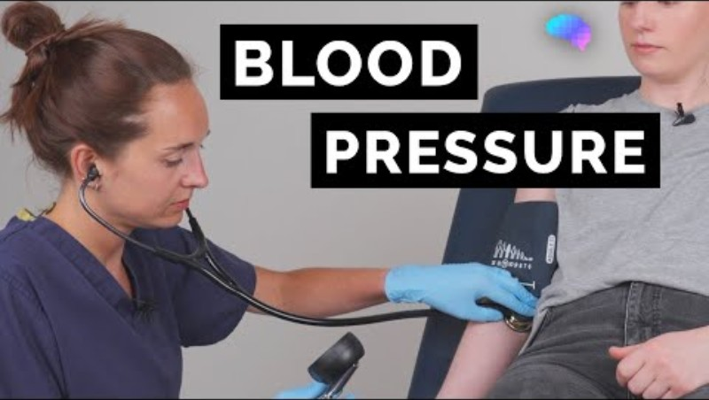

Activity 1
Blood pressure measurement
Measured using a sphygmomanometer.
This can be manual or digital.
Manual
Digital
Notes:
Manual blood pressure video: www.youtube.com/watch?v=HMSTSZVWhMI (with permission)
Digital blood pressure video: youtu.be/ZzRW70uc-EU?si=xweMBKUdMFJxaJmu&t=122

Slide 11
Activity 1
Blood pressure normal range
Recorded as two numbers: systolic and diastolic.
Normal adult blood pressure: 90/60 mmHg to 120/80 mmHg.
Readings may vary due to activity, stress/anxiety, age, disease, medication and health status.
Persistent readings above or below normal ranges may indicate a cardiovascular disorder.

Slide 12
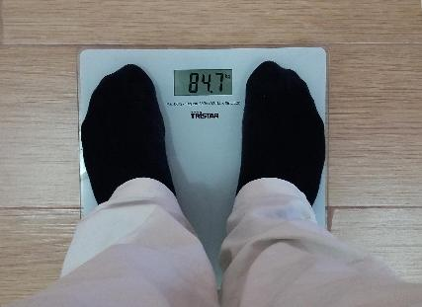

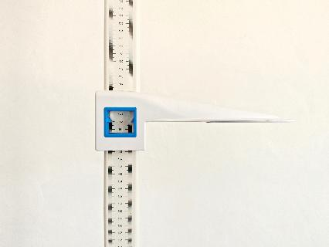
Activity 1
Weight and height measurement
Weight (mass)
Measured using scales (sitting scales are used for people with mobility issues)
Height
measured using a tape measure or stadiometer
Notes:
Image (top) © Pixabay/Tumisu
Image (bottom) © Shutterstock/engkyxavier
Height and weight video: www.youtube.com/watch?v=A-VahMS0M2s

Slide 13
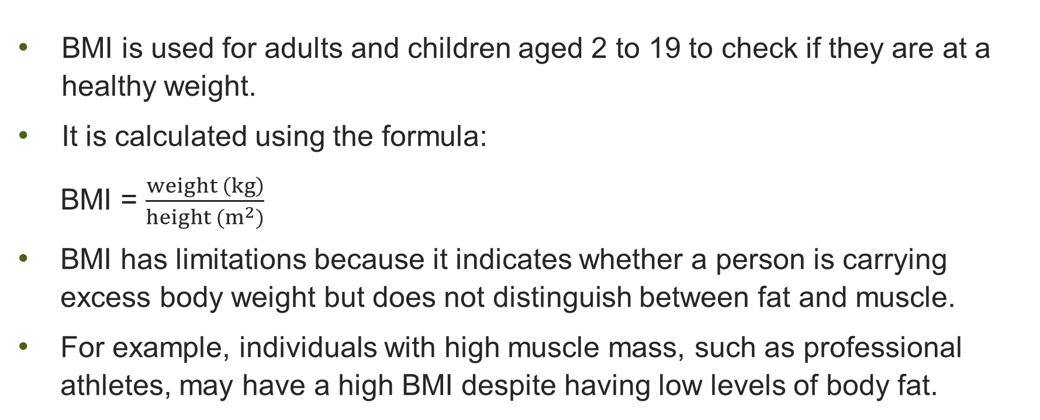
Activity 1
BMI calculation
BMI is used for adults and children aged 2 to 19 to check if they are at a healthy weight.
It is calculated using the formula:
BMI = $\frac{weight \left(kg\right)}{height (m^{2})}$
BMI has limitations because it indicates whether a person is carrying excess body weight but does not distinguish between fat and muscle.
For example, individuals with high muscle mass, such as professional athletes, may have a high BMI despite having low levels of body fat.

Slide 14
Activity 1
BMI values
below 18.5 | Underweight
18.5–24.9 | Healthy weight
25–29.9 | Overweight
30 and above | Obese

Slide 15
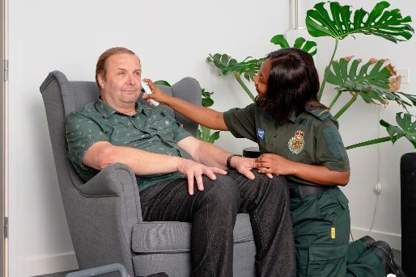
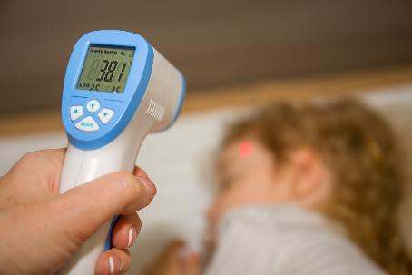
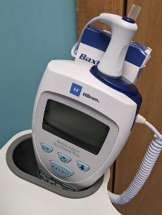
Activity 1
Activity 1
Body temperature measurement
Measured using a digital thermometer.
Armpit (axillary), mouth (oral), ear (tympanic) more accurate – measures core body temperature)
Infrared forehead thermometers (for speed but less accurate – measures skin temperature)
Infrared
Axillary/oral
Tympanic
Notes:
Image (left) © Shutterstock/Dande_lion_studio
Image (centre) © Author, with permission
Image (right) © Reframe Image Library/University Hospitals Bristol and Weston NHS Foundation trust

Slide 16

Activity 1
Activity 1
Body temperature measurement
Notes:
Temperature video: youtu.be/NPxmGTQhP80?si=A1xR1GyucbDWRMON&t=97

Slide 17
Activity 1
Body temperature normal value
Normal adult core body temperature is around 37°C (typically 36–37.5°C)
High temperature (fever), anything above 38°C, may be caused by the body fighting infection, some medications or heat stroke.
Low body temperature (hypothermia) may indicate prolonged exposure to a cold temperature, shock or illness like diabetes or thyroid disease.

Slide 18
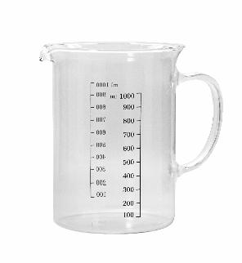
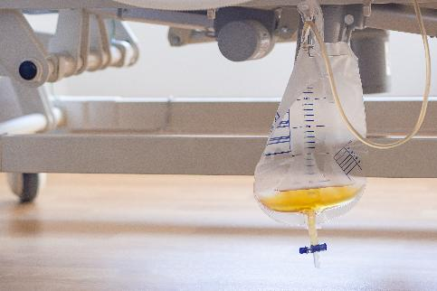
Activity 1
Urinary output measurement
Urinary output is a measure of the volume of urine produced over time.
A patient's urine is collected in a container that can measure volume.
This, along with volume of liquids drunk, is recorded in a bladder record (also called an ‘input and output chart’ and a ‘fluid balance chart’).
Notes:
Image (left) © Shutterstock//tanuStockPhoto
Image (right) © Shutterstock/meeboonstudio

Slide 19
Activity 1
Urinary output normal values
Normal adult urinary output is 800 to 2000 mL per day.
Urinary output can vary depending on fluid intake, environmental conditions (e.g. heat), physical activity and illness.
Low urinary output (oliguria) may indicate dehydration, kidney impairment or shock.
Very high output (polyuria) may indicate diabetes or fluid imbalance.

Slide 20

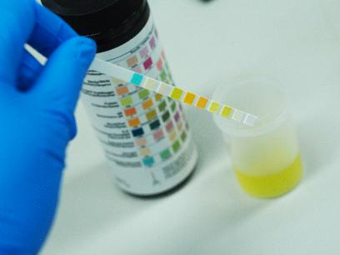
Activity 1
Testing urine using a dip stick (urinalysis)
A dip stick is a small, chemically treated strip used to test urine.
It can detect substances in urine such as glucose, protein, ketones, blood, pH or signs of infection. Each strip has pads that change colour depending on what is present.
The presence of these substances in the urine may indicate health issues, e.g. protein can indicate kidney problems (but further testing is needed for a diagnosis).
Notes:
Image © Shutterstock/Pee Paew
Urine dip stick (urinalysis) video: www.youtube.com/watch?v=Kg-8D7_3R3w (with permission)

Slide 21

Activity 1
Respiration rate
Measured by visually counting the number
of chest rises and falls (one breath) in 60
seconds.
Gain consent for the set of observations and
explain that breathing may be observed as
part of routine vital signs. To avoid altering
the reading, count respirations unobtrusively
while the patient is relaxed, for example, while also checking pulse or oxygen saturation.
Therefore, it is often measured while taking other observations (such as oxygen saturation or pulse).
Notes:
Respiratory rate video: www.youtube.com/watch?v=ccKGzZXNKYs&t=47s

Slide 22
Activity 1
Respiration rate normal values
Normal adult respiration rate: 12–20 breaths per minute.
Respiration rate can vary with activity, stress, pain, environmental conditions and health status.
High respiration rate (tachypnoea) may indicate infection, fever, anxiety or respiratory distress.
Low respiration rate (bradypnoea) may indicate drug effects, neurological issues or respiratory depression.

Slide 23

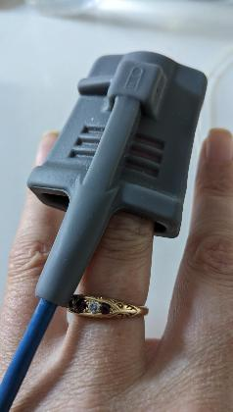
Activity 1
Oxygen saturation (SpO₂) measurement
Oxygen saturation measures the percentage of haemoglobin in the blood carrying oxygen.
Measured by using a pulse oximeter.
The clip is put on the finger closest to the thumb or middle finger. Other places include an earlobe or toe.
Notes:
Image © Author, with permission
Oxygen saturation video: www.youtube.com/watch?v=Pyjbd_-kayA

Slide 24
Activity 1
Oxygen saturation (SpO₂) normal values
Normal adult range: 95–100%
Oxygen saturation can be affected by activity, altitude, illness or poor circulation.
Anything <94% is usually a clinical concern in adults.
Low oxygen saturation (hypoxaemia) may occur in:
  chronic obstructive pulmonary disease (COPD);
  pneumonia;
  asthma attack;
  heart failure;
  COVID-19 or other respiratory infections.
COPD/chronic lung disease patients may have a lower target range
(e.g. 88–92%).

Slide 25
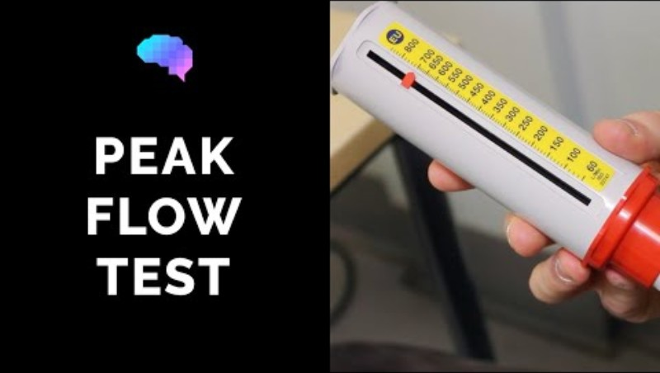
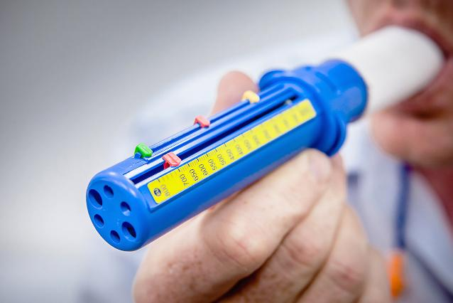
Activity 1
Peak flow
Peak flow is a measure of how fast a person can exhale air from their lungs (peak expiratory flow rate (PEFR)).
It is measured using a peak flow monitor.
It is mainly used to monitor lung function, especially in conditions like asthma.
Readings over time are recorded on a peak flow chart.
Notes:
Image © Shutterstock/Oxford Media Library
Peak flow video: www.youtube.com/watch?v=jdA8KU_D9JU (with permission)

Slide 26
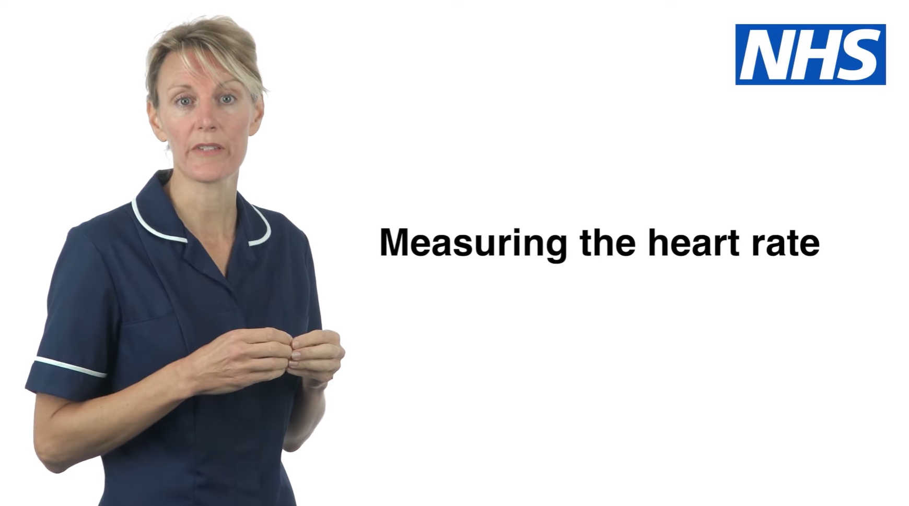
Activity 1
Heart rate measurement
Heart rate can be measured by counting pulse beats in the wrist for one minute using a watch with second hand.
A pulse oximeter or electrocardiogram (ECG) provides an accurate heart rate.
Notes:
Heart rate video: www.youtube.com/watch?v=gfR4N_s-8-0

Slide 27
Activity 1
Heart rate normal values
Normal adult resting heart rate: 60–100 beats per minute (BPM)
Heart rate can vary with activity, stress, medications, illness and environmental conditions
High heart rate (tachycardia) may occur in individuals with:
  fever or infection;
  anxiety or stress;
  heart conditions (e.g., arrhythmia, heart failure);
  hyperthyroidism.
Low heart rate (bradycardia) may occur in:
  athletic individuals (normal in well-trained athletes);
  heart conduction problems;
  individuals taking certain drugs (e.g. beta-blockers).

Slide 28
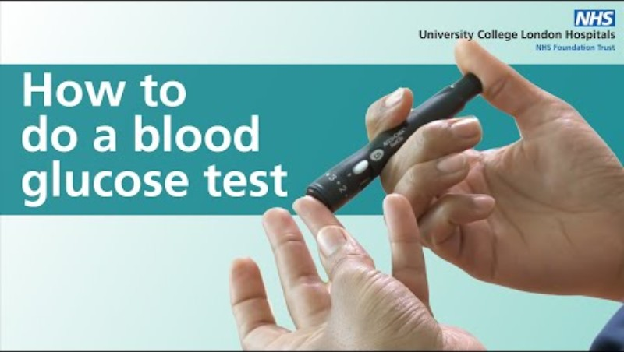
Activity 1
Blood sugar (glucose) levels measurement
In a finger-prick test, a fingertip is pierced using a needle called a lancet.
A drop of blood is added to a test strip and inserted in a portable glucometer.
Notes:
Blood glucose video: www.youtube.com/watch?v=GoV2p1y6flI (with permission)

Slide 29
Activity 1
Blood sugar (glucose) levels normal values
Normal adult range (before eating): For most healthy adults, fasting blood glucose is approximately 4.0-5.4/5.9 mmol/L; for people with diabetes, common pre-meal targets are 4.0-7.0 mmol/L, but individual targets may vary.
High blood glucose (hyperglycaemia) may occur with:
  diabetes;
  stress or infection;
  after a high-sugar meal.
Low blood glucose (hypoglycaemia) may occur with:
  excess insulin or diabetes medication;
  prolonged fasting;
  strenuous exercise.

Slide 30
Practising taking measurements
Activity 2
Work in pairs/small groups to practise taking the measurements on each other, as well as recording.
Make sure you check that each device is in working order.
Resources needed
Activity 2 Procedure sheet
Activity 2 Observation sheet
Range of equipment

Slide 31
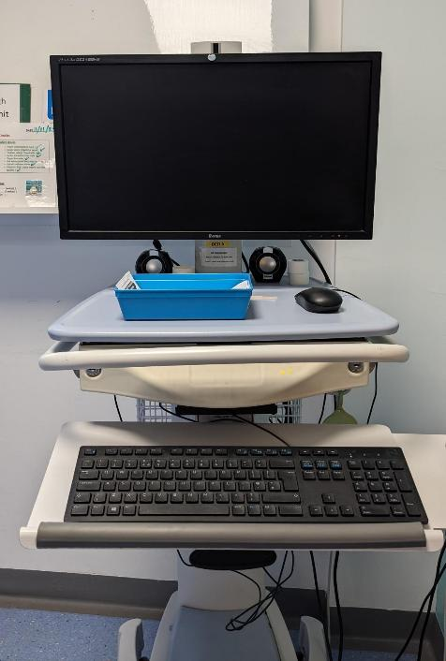
Activity 2
Recording results
Recording results from physiological measurement tests is essential to ensure safe, effective and continuous care.
Electronic records
  Electronic Patient Records (EPR)
  Digital monitoring systems linked to devices
  Allow faster access and sharing of information
Paper-based records
  Observation charts (e.g. NEWS2 charts)
  Used in some settings who do not have access to EPR, as a backup or during system downtime
Notes:
Image © Author, with permission

Slide 32
Activity 2
Recording results
What should be recorded
Regular readings to establish a baseline and monitor trends
Any deviations from normal or usual readings
Relevant contextual information, such as:
  activity level;
  symptoms reported;
  environmental factors (e.g. heat, stress).
Prompt recording helps ensure early intervention if abnormal results are identified.

Slide 33
Activity 2
Reporting results: outside normal values
When physiological measurements fall outside normal levels, it is essential that they are reported promptly and accurately to ensure patient safety.
Follow local policies and procedures for reporting abnormal results.
Know:
  who to report to (e.g. nurse in charge, senior clinician, supervisor);
  how to report (verbal handover, escalation tools, electronic alerts);
  where to document reporting/escalation of abnormal results.
Use recognised escalation frameworks where applicable (e.g. NEWS2)

Slide 34
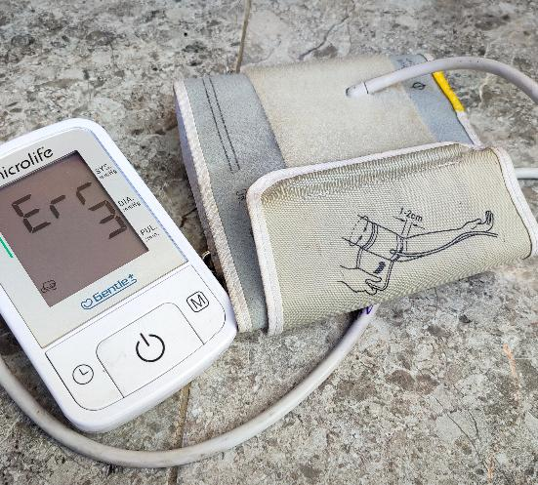
Activity 2
Reporting results: seeking clarification
Seek clarification if:
  a reading seems unexpected or inconsistent;
  you are unsure how to interpret the result;
  faulty equipment may have affected accuracy;
  you were unsure if your technique was correct.
Clarification may involve:
  rechecking the measurement;
  asking a more experienced colleague;
  reviewing normal ranges or baseline values.
Notes:
Image © Shutterstock/Hadifa Art

Slide 35
Activity 2
Reporting results: when you are unable to obtain or read measurements
Report immediately if:
  a measurement cannot be obtained;
  equipment fails or readings are unclear.
Record:
  the reason the measurement could not be taken;
  any actions taken (e.g. equipment change, escalation).
Never ignore or omit abnormal or missing data.
Accurate reporting and escalation are part of professional responsibility and safe practice.

Slide 36
Activity 2
What should you do? (Local escalation route)
1. Recognise the problem (abnormal reading)
2. Repeat/check the measurement (if appropriate and safe to do so)
3. Escalate immediately (inform the nurse/clinician)
4. Record the observations (as soon as possible after escalating)
5. Continue monitoring the patient

Slide 37
Plenary
Reflection
Which measurement(s) do you feel most confident in performing?
Which measurement(s) do you need more practice with?
Do you feel confident you would know what to do if a measurement you took was outside normal levels?

Slide 38
In this lesson, we:
Plenary
named the physiological measurements commonly measured by the healthcare support worker;
explained why, when and how these measurements are taken;
stated the normal range for each measurement in adults;
correctly used a range of equipment to take physiological measurements.
Skills:
CS4: Reflective evaluation
General competencies:
English:
GEC5. Synthesise information
Maths:
GMC5. Processing data
Digital:
GDC1. Use digital technology and media effectively

Slide 39
BMI and urinary output
Consolidation
Complete the worksheet, which covers two of the measurements that you didn’t take in the lesson (BMI and urinary output).
You will complete a bladder chart by calculating total fluid intake and urine output, compare the results with normal ranges, explain your findings to a patient and decide whether escalation is needed.
You will also calculate BMI, classify the patient’s weight category, and link these measurements to potential health risks.
Resources needed
Consolidation worksheet

