Slide 1
Building Services Engineering
Route: Construction
Topic: Practical mathematics
Resource 3: Key mathematical electrical principles
Notes:
Image © Shutterstock/Gorodenkoff

Slide 2
Quiz questions
Quiz questions
Resource 3: Key mathematical electrical principles

Slide 3
Question 1
Quiz questions
During a routine test of a newly installed air-handling unit (AHU), you are asked to confirm that the supply fan is operating within its designed electrical load. You connect a clamp meter around the live conductor to measure the current being drawn by the motor.
Which SI unit is used to measure electric current?
A ohms (Ω)
B teslas (T)
C amps (A)
D joules (J)
Resource 3: Key mathematical electrical principles

Slide 4
Question 1: Answer
Quiz questions
During a routine test of a newly installed air-handling unit (AHU), you are asked to confirm that the supply fan is operating within its designed electrical load. You connect a clamp meter around the live conductor to measure the current being drawn by the motor.
Which SI unit is used to measure electric current?
A ohms (Ω)
B teslas (T)
C amps (A)
D joules (J)
ohms measure resistance,
teslas measure magnetic flux density,
amps measure current,
joules measure energy.
Resource 3: Key mathematical electrical principles

Slide 5
Question 2
Quiz questions
A current of 2 A flows through a circuit that has a total resistance of 50 ohms.
Calculate the power in the circuit.
A 100 W
B 100 V
C 0.04 W
D 200 W
Resource 3: Key mathematical electrical principles

Slide 6

Question 2: Answer
Quiz questions
A current of 2 A flows through a circuit that has a total resistance of 50 ohms.
Calculate the power in the circuit.
A 100 W
B 100 V
C 0.04 W
D 200 W
The formula used to find power is $P=I2R$
Resource 3: Key mathematical electrical principles

Slide 7
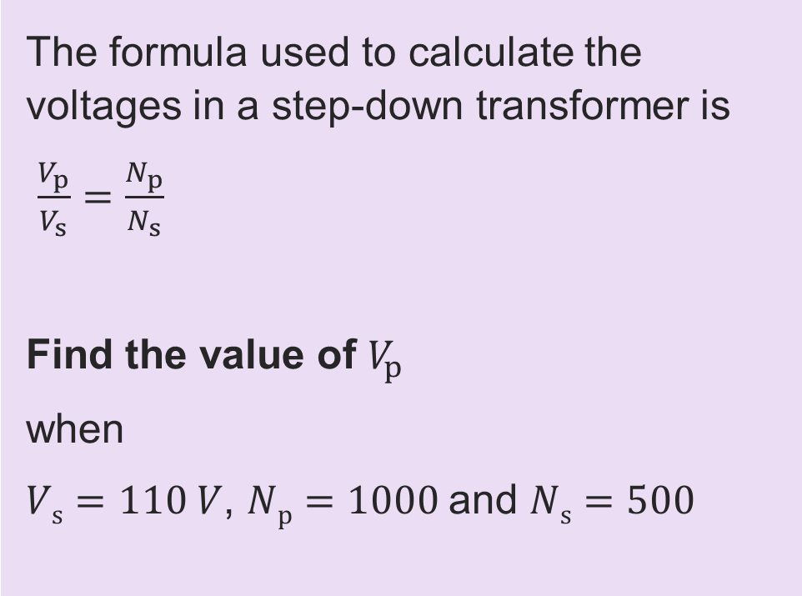
Question 3
Quiz questions
The formula used to calculate the voltages in a step-down transformer is
$\frac{V_{p}}{V_{s}}=\frac{N_{p}}{N_{s}}$
Find the value of $V_{p}$
when
$Vs=110 V$, $Np=1000$and $Ns=500$
Resource 3: Key mathematical electrical principles

Slide 8

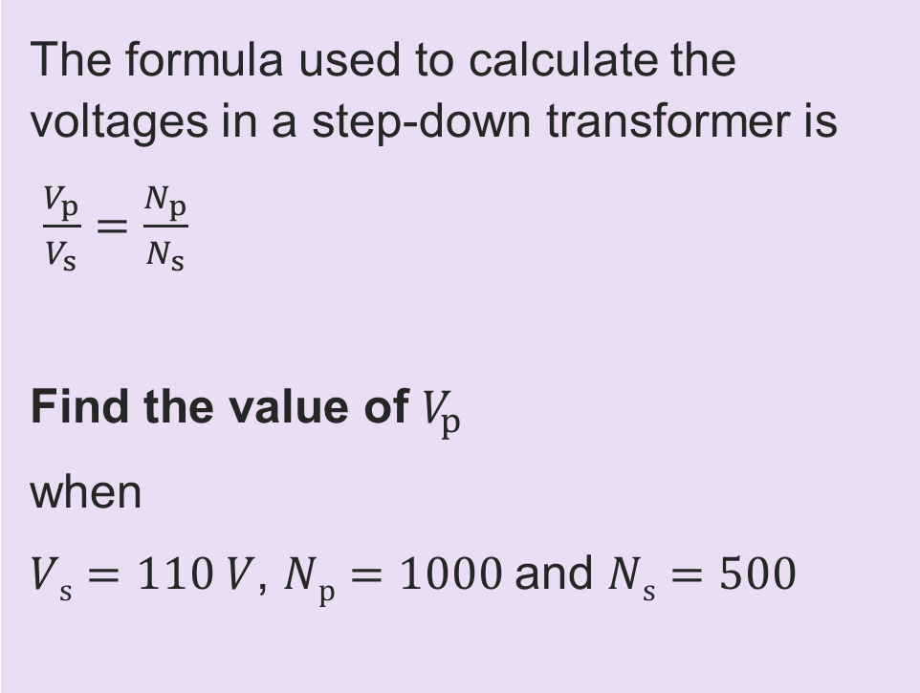
Question 3: Answer
Quiz questions
The formula used to calculate the voltages in a step-down transformer is
$\frac{V_{p}}{V_{s}}=\frac{N_{p}}{N_{s}}$
Find the value of $V_{p}$
when
$Vs=110 V$, $Np=1000$and $Ns=500$
$$\frac{V_{p}}{V_{s}}=\frac{N_{p}}{N_{s}}$$
$$\frac{V_{p}}{110}=\frac{1000}{500}$$
$$V_{p}=\frac{1000×100}{500}=220 V$$
Resource 3: Key mathematical electrical principles

Slide 9
Question 4
Quiz questions
A circuit contains four identical resistors of 10 ohms in parallel in a circuit.
Calculate the effective resistance in the circuit.
Resource 3: Key mathematical electrical principles

Slide 10
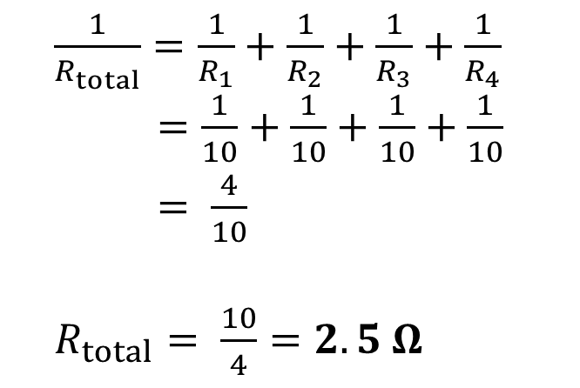
Question 4: Answer
Quiz questions
A circuit contains four identical resistors of 10 ohms in parallel in a circuit.
Calculate the effective resistance in the circuit.
$\frac{1}{R_{total}}=\frac{1}{R_{1}}+\frac{1}{R_{2}}+\frac{1}{R_{3}}+\frac{1}{R_{4}}$
$\frac{1}{R_{total}}=\frac{1}{10}+\frac{1}{10}+\frac{1}{10}+\frac{1}{10}$
$\frac{1}{R_{total}}= \frac{4}{10}$
$R_{total}= \frac{10}{4}=2.5 Ω$
For resistors in parallel, add the reciprocals of the resistances and take the reciprocal of the result.
Resource 3: Key mathematical electrical principles

Slide 11
Question 5
Quiz questions
A circuit contains two resistors,
one of 100 ohms and one of 200 ohms, and a supply voltage of 450 V
all in series.
Calculate the current in the circuit.
Resource 3: Key mathematical electrical principles
Notes:
<

Slide 12
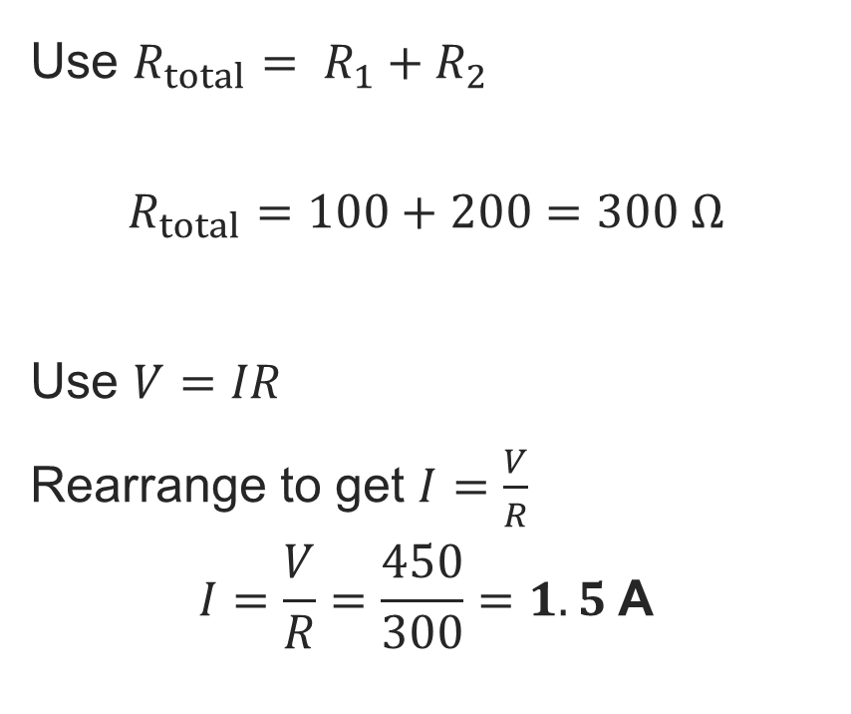
Question 5: Answer
Quiz questions
For resistors in series, add the individual resistances.
Use $R_{total}= R_{1}+R_{2}$
$$R_{total}=100+200=300 Ω$$
Use $V=IR$
Rearrange to get $I=\frac{V}{R}$
$$I=\frac{V}{R}=\frac{450}{300}=1.5 \text{A}$$
A circuit contains two resistors,
one of 100 ohms and one of 200 ohms, and a supply voltage of 450 V
all in series.
Calculate the current in the circuit.
Resource 3: Key mathematical electrical principles

Slide 13
Question 6
Quiz questions
The power in a circuit is 10 kW and the resistance is 100 Ω.
Calculate the current in the circuit.
Resource 3: Key mathematical electrical principles

Slide 14
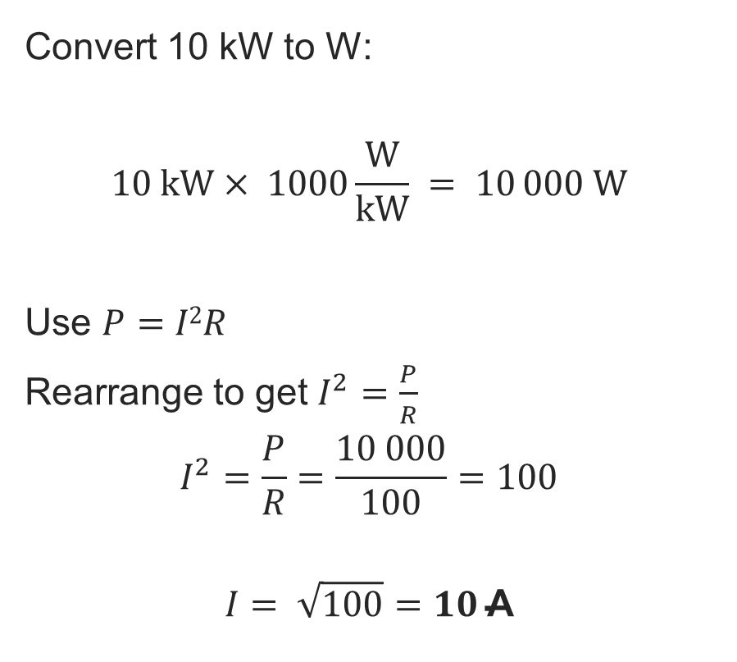
Question 6: Answer
Quiz questions
Convert 10 kW to W:
$$10 kW× 1000\frac{W}{kW} = 10 000 W$$
Use $P=I2R$
Rearrange to get $I^{2}=\frac{P}{R}$
$$I^{2}=\frac{P}{R}=\frac{10 000}{100}=100$$
$$I= \sqrt{100}=10 \text{A}$$
The power in a circuit is 10 kW and the resistance is 100 Ω.
Calculate the current in the circuit.
Remember to convert to SI units first.
Resource 3: Key mathematical electrical principles

