Slide 1
Building Services Engineering
Route: Construction
Topic: Practical mathematics
Resource 3: Key mathematical electricity principles
Notes:
Image © Shutterstock/Gorodenkoff

Slide 2
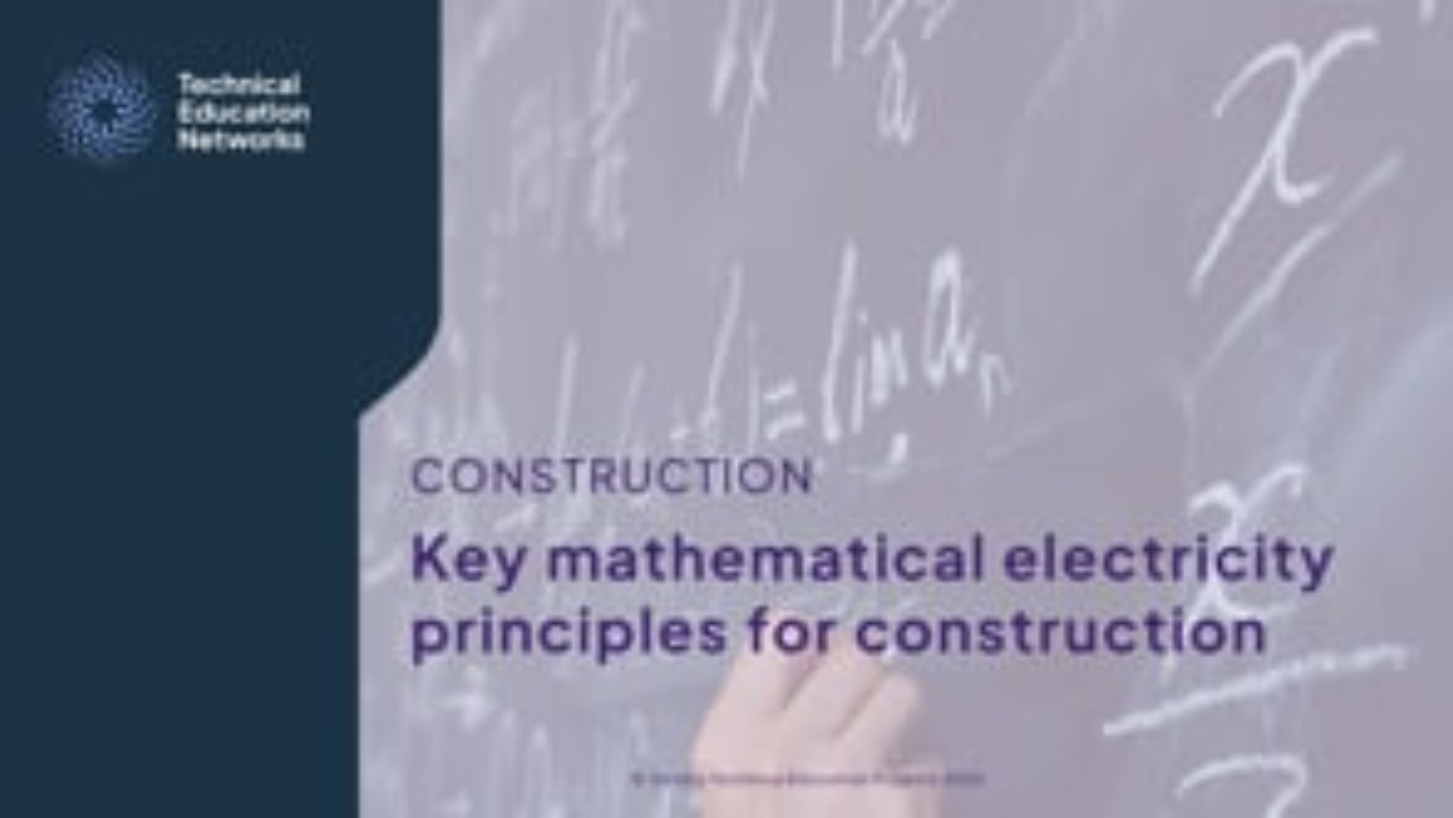
Key mathematical electricity principles for construction
Video
Resource 3: Key mathematical electrical principles
Notes:
Key mathematical electricity principles for construction video: https://vimeo.com/1206421590/4643d373fd

Slide 3
In this resource, we will:
Introduction
Explain key mathematical electricity science principles and their importance
Describe and recall the rules of electrical circuits
Calculate with and recall Ohm’s law (V = IR) for a variety of different scenarios
Complete calculations involving key formulae
Calculate problems involving electrical power and its relationship with voltage
Calculate problems involving electrical power dissipation
Describe the basics of transformers
Calculate problems involving step-up and step-down transformers
General competencies:
MC4 Using rules and formulae
MC5 Processing data
MC7 Interpreting and representing with mathematical diagrams
MC8 Communicating using mathematics
Resource 3: Key mathematical electrical principles

Slide 4
Electrical quantities
Series and parallel circuits
A circuit is a closed loop where electricity can flow.
Key circuit quantities:
Voltage: The push that makes electricity move around the circuit. You may see the terms potential difference or electromotive force in different contexts.
Current: The flow of electric charge in the circuit.
Resistance: How much a component resists the flow of current.
Can you match the SI units to the quantity?
Ω, ohms
A, amperes
V, volts
Resource 3: Key mathematical electrical principles

Slide 5
Basic circuit components
Series and parallel circuits
Resistor
Switch
+
–
Battery
Wire
+
–
Resource 3: Key mathematical electrical principles

Slide 6
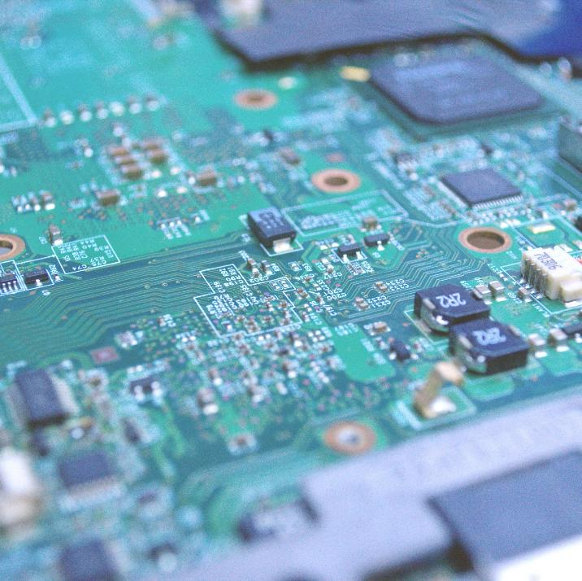
Parallel and series circuits
Series and parallel circuits
Before learning how to do calculations for electrical circuits, it is important to understand parallel and series circuits.
The relationship between voltage, current, resistance and power depends on the circuit arrangement.
Resource 3: Key mathematical electrical principles
Notes:
Image © Shutterstock/Jesus Linares

Slide 7
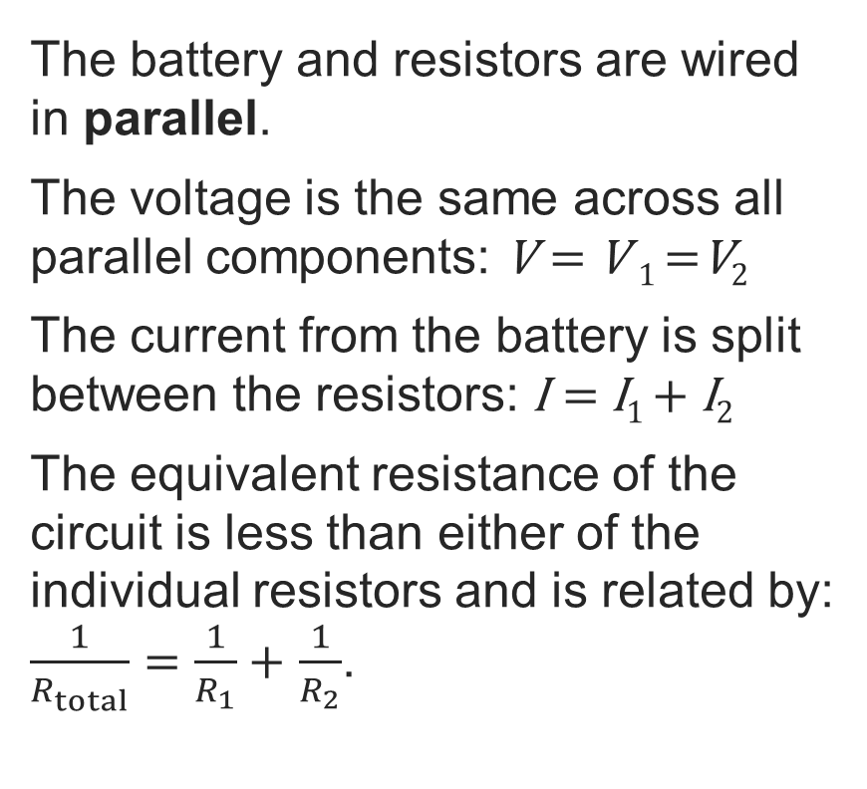
Parallel circuits
Series and parallel circuits
I
The battery and resistors are wired in parallel.
The voltage is the same across all parallel components: V = V ₁ =V₂
The current from the battery is split between the resistors: I = I₁ + I₂
The equivalent resistance of the circuit is less than either of the individual resistors and is related by: $\frac{1}{R_{total}}=\frac{1}{R_{1}}+$ $\frac{1}{R_{2}}$.
+
–
R₁
R₂
V
I₁
I₂
V₁
V₂
Socket outlets are wired in parallel.
If you plug a drill into Socket A, it does not affect the voltage at Socket B.
Resource 3: Key mathematical electrical principles

Slide 8
Series circuits
Series and parallel circuits
I
The battery and resistors are wired in series.
The current flows through all of the components: I
The voltage from the battery is divided between the resistors: V =V₁ +V₂
The total resistance is the sum of the individual resistances: R_{total} = R₁ + R₂
V
+
–
R₂
V₂
R₁
V₁
If one component fails, electricity does not flow.
This is why we rarely use series for power, but it is useful for safety interlocks.
Resource 3: Key mathematical electrical principles

Slide 9

Ohm’s Law
Ohm’s Law
An important formula used in electricity principles is Ohm's Law.
This formula describes the relationship between voltage, current and resistance.
On site, we use a multimeter set to:
Ω to find Resistance (Continuity Check).
V to check if a circuit is Live (Safe Isolation).
Practice
Rearrange Ohm’s Law as:
$$V=I×R$$
$$I=\frac{V}{R}$$
$$R=\frac{V}{I}$$
Resource 3: Key mathematical electrical principles

Slide 10
Ohm’s Law in a parallel circuit
Ohm’s Law
Consider the diagram. If a total current of
9 A is required, what is the required voltage?
Hint: first find the equivalent resistance of the circuit.
I
+
–
V
R₁ = 6 Ω
R₂ = 3 Ω
Resource 3: Key mathematical electrical principles

Slide 11
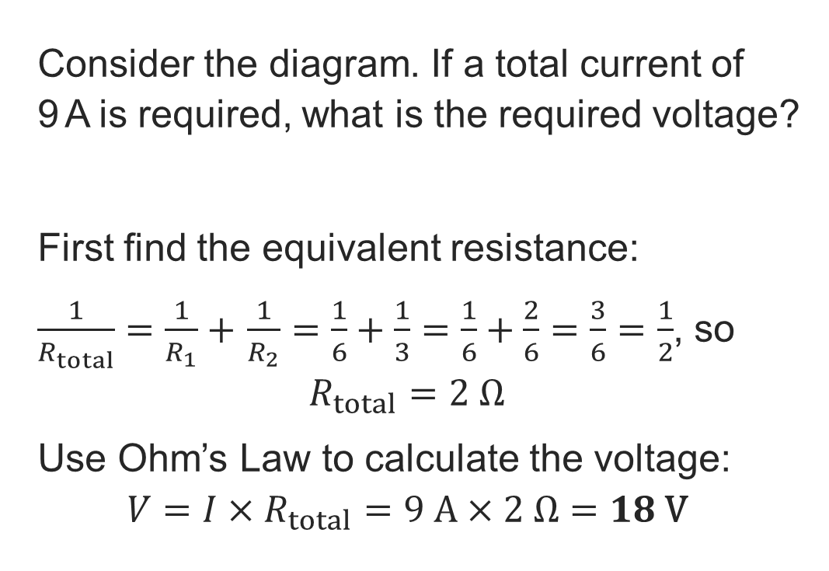
Ohm’s Law in a parallel circuit: Answer
Ohm’s Law
Consider the diagram. If a total current of
9 A is required, what is the required voltage?
First find the equivalent resistance:
$\frac{1}{R_{total}}=\frac{1}{R_{1}}+$ $\frac{1}{R_{2}}=\frac{1}{6}+\frac{1}{3}=\frac{1}{6}+\frac{2}{6}=\frac{3}{6}=\frac{1}{2}$, so
$$R_{total}=2 Ω$$
Use Ohm’s Law to calculate the voltage:
$$V=I×R_{total}=9 \text{A}×2 Ω=18 \text{V}$$
I
+
–
V
R₁ = 6 Ω
R₂ = 3 Ω
Resource 3: Key mathematical electrical principles

Slide 12
Ohm’s Law in a series circuit
Ohm’s Law
Consider the diagram. Work out the current in the circuit, to one decimal place.
Hint: first find the equivalent resistance of the circuit, then rearrange Ohm’s Law to make current the subject.
R₁ = 4 Ω
+
–
V = 230V
R₂ = 5 Ω
R₃ = 6 Ω
Resource 3: Key mathematical electrical principles

Slide 13
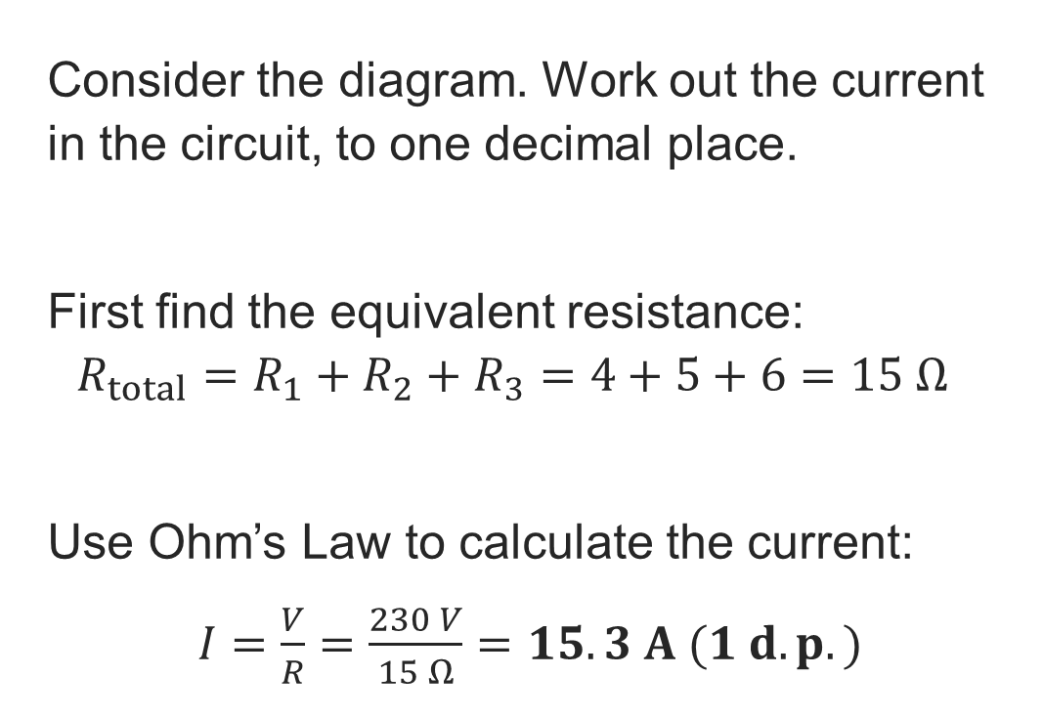
Ohm’s law in a series circuit: Answer
Ohm’s Law
Consider the diagram. Work out the current in the circuit, to one decimal place.
First find the equivalent resistance:
$$R_{total}=R_{1}+R_{2}+R_{3}=4+5+6=15 Ω$$
Use Ohm’s Law to calculate the current:
$I=\frac{V}{R}=\frac{230 V}{15 Ω}=15.3 A (1 d.p.)$
R₁ = 4 Ω
+
–
V = 230V
R₂ = 5 Ω
R₃ = 6 Ω
Resource 3: Key mathematical electrical principles

Slide 14
Ohm’s Law for identifying hazards
Ohm’s Law
The wrong resistance for a circuit can be dangerous.
If the resistance is too low, the resulting high current can lead to heat damage of components and even fires.
If the resistance is too high, the current may be insufficient for circuit components to operate.
Accurate calculations are essential to ensure the safety and efficiency of electrical systems.
YOU TRY
When the insulation on a wire gets damaged, its resistance might decrease.
What happens to the current?
What hazards could this create?
Resource 3: Key mathematical electrical principles

Slide 15

Ohm’s Law for identifying hazards
Ohm’s Law
An electric cable in an industrial grinder has a resistance of 0.6 Ω and a DC supply of 100 V. Is this setup potentially hazardous?
TIP Most power tools are designed for a current of around 20 A or less.
Resource 3: Key mathematical electrical principles
Notes:
Image © Shutterstock/maroke

Slide 16
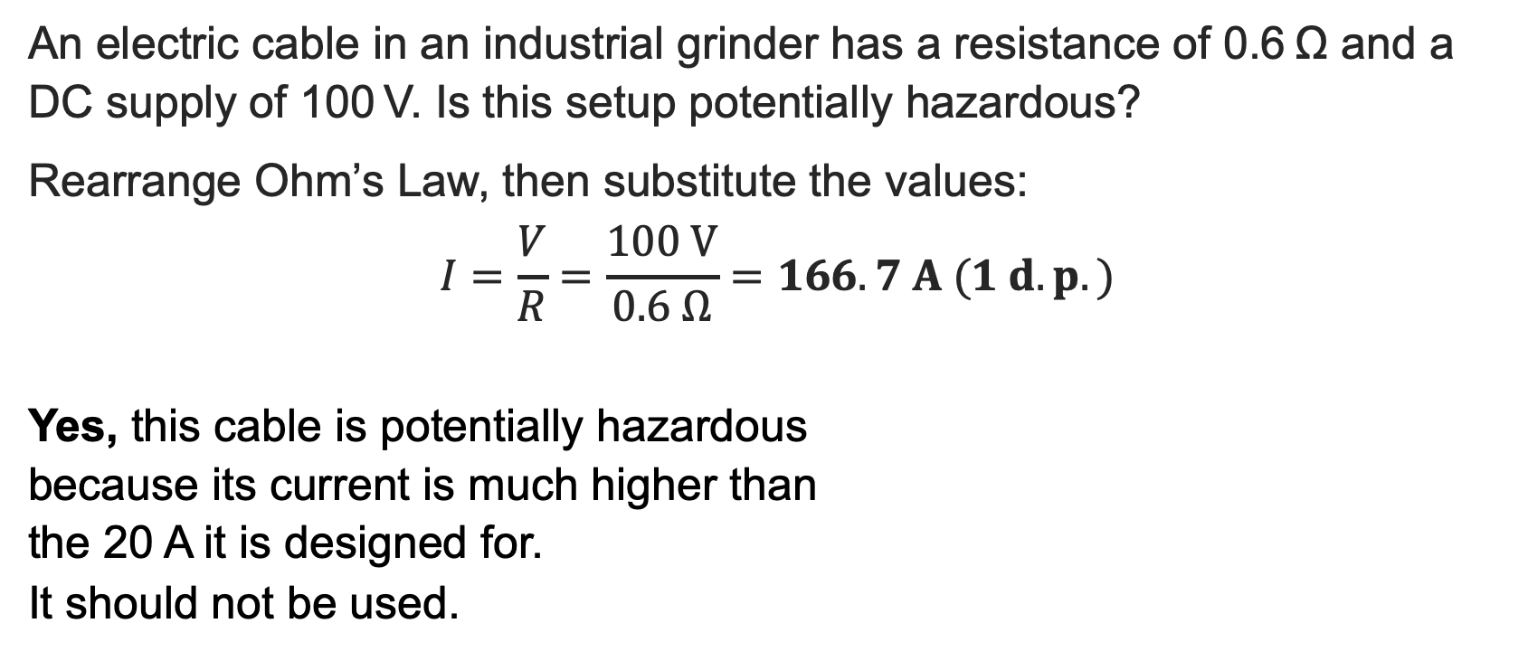
Ohm’s Law for identifying hazards: Answer
Ohm’s Law
An electric cable in an industrial grinder has a resistance of 0.6 Ω and a DC supply of 100 V. Is this setup potentially hazardous?
Rearrange Ohm’s Law, then substitute the values:
$$I=\frac{V}{R}=\frac{100 \text{V}}{0.6 Ω}=166.7 A (1 d.p.)$$
Yes, this cable is potentially hazardous
because its current is much higher than
the 20 A it is designed for.
It should not be used.
TIP Most power tools are designed for a current of around 20 A or less.
Resource 3: Key mathematical electrical principles
Notes:
.

Slide 17
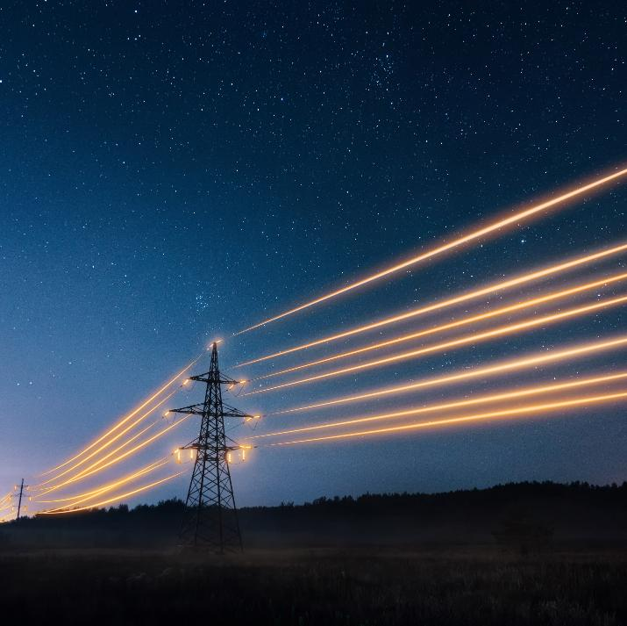
What is power and how is it relevant?
Power
Power is the rate at which energy
is transferred.
Power and energy both can take various forms, mechanical and electrical being the main categories.
It is essential to be able to calculate power for the design of safe and efficient electrical circuits.
Resource 3: Key mathematical electrical principles
Notes:
Image © Shutterstock/arturnichiporenko

Slide 18
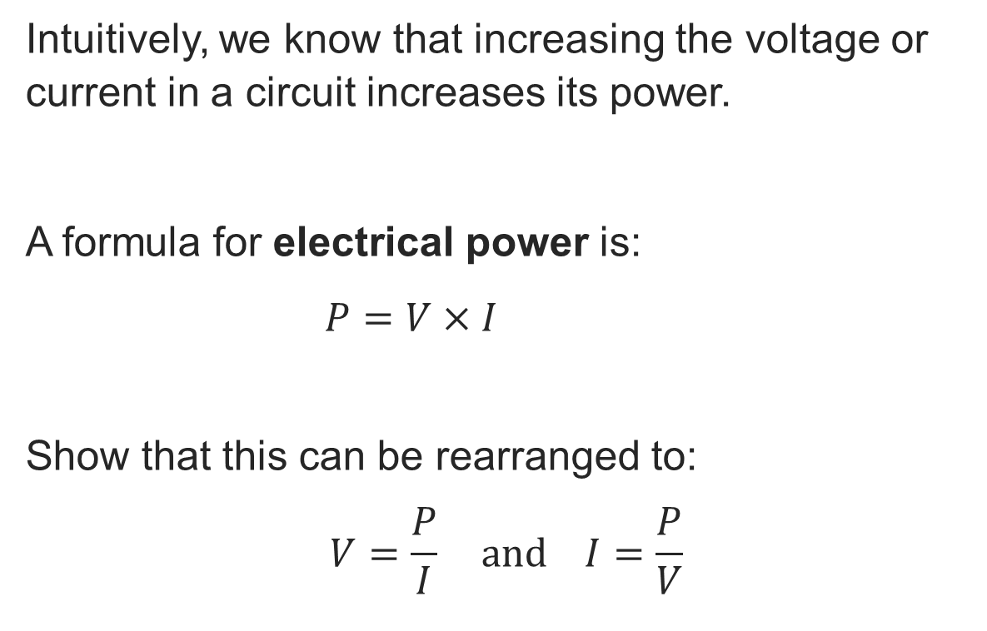
Calculating power
Power
Intuitively, we know that increasing the voltage or current in a circuit increases its power.
A formula for electrical power is:
$P=V×I$
Show that this can be rearranged to:
$$V=\frac{P}{I} \text{and} I=\frac{P}{V}$$
The SI unit for power is watts (W).
Resource 3: Key mathematical electrical principles

Slide 19
Using the electrical power formula
Power
An air conditioner has a power rating of 1500 W and is supplied by a 208 V single-phase system.
Assuming the circuit is purely resistive, calculate the current, giving your answer to two significant figures.
Key point
Current is in the opposite direction to electron flow.
We avoid referring to ‘current flow’ because it is the electrons that flow.
Resource 3: Key mathematical electrical principles

Slide 20
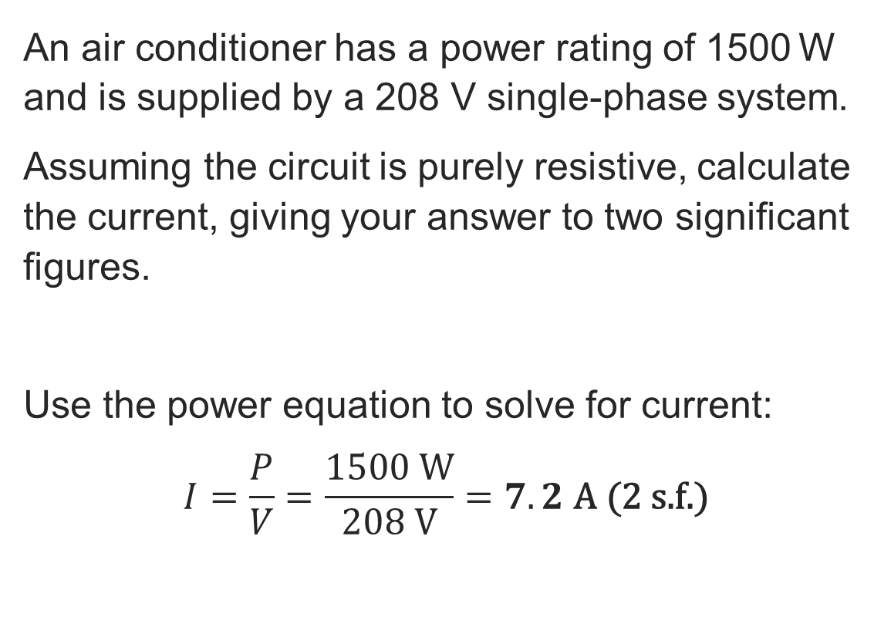
Using the electrical power formula: Answer
Power
An air conditioner has a power rating of 1500 W and is supplied by a 208 V single-phase system.
Assuming the circuit is purely resistive, calculate the current, giving your answer to two significant figures.
Use the power equation to solve for current:
$$I=\frac{P}{V}=\frac{1500 \text{W}}{208 \text{V}}=7.2 \text{A}\text{ (2 }\text{s}\text{.}\text{f}\text{.)}$$
Key point
Current is in the opposite direction to electron flow.
We avoid referring to ‘current flow’ because it is the electrons that flow.
Resource 3: Key mathematical electrical principles

Slide 21
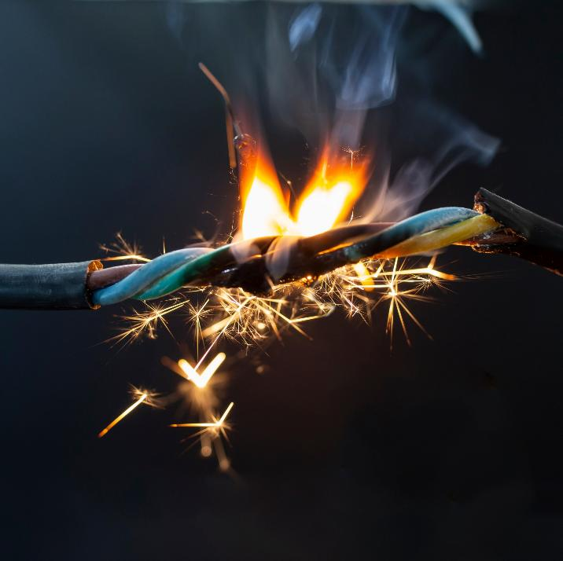
What is power dissipation?
Power
Power dissipation in electrical systems is often referred to as ‘lost’ energy or power, but energy is never lost.
Instead, it is converted into different energy forms, such as heat and light due to resistance in the circuit.
Accurate calculations are key for avoiding too much heat generation resulting in damage, electrical failure
or even fire.
Resource 3: Key mathematical electrical principles
Notes:
Image © Shutterstock/puha dorin

Slide 22
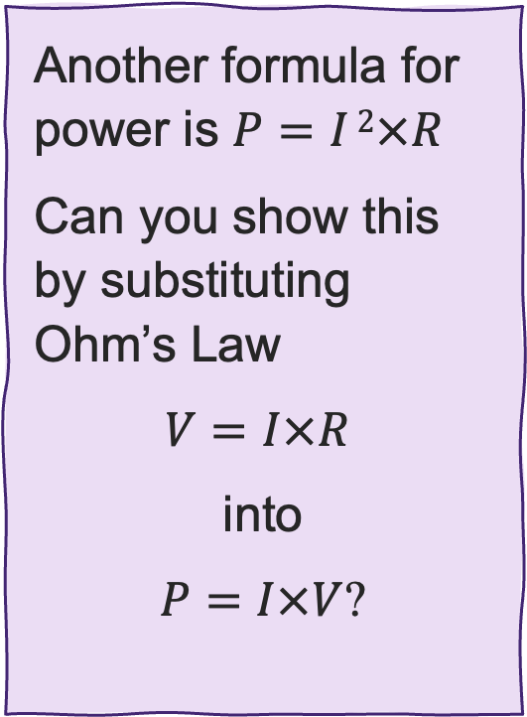
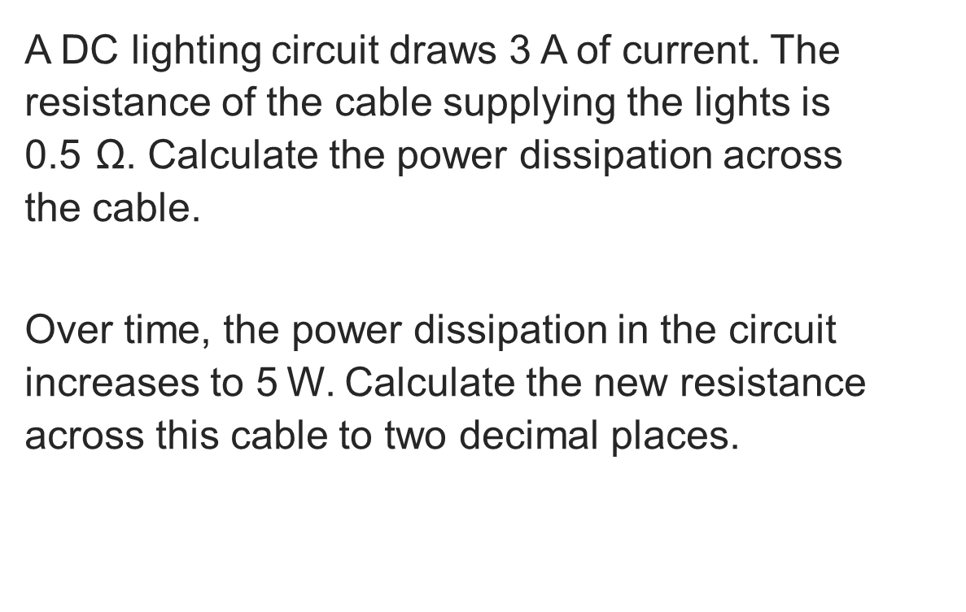
Calculating power dissipation
Power
A DC lighting circuit draws 3 A of current. The resistance of the cable supplying the lights is
0.5 Ω. Calculate the power dissipation across
the cable.
Over time, the power dissipation in the circuit increases to 5 W. Calculate the new resistance across this cable to two decimal places.
Another formula for power is $P=I 2×R$
Can you show this by substituting Ohm’s Law
$V=I×R$
into
$P=I×V$?
Resource 3: Key mathematical electrical principles

Slide 23
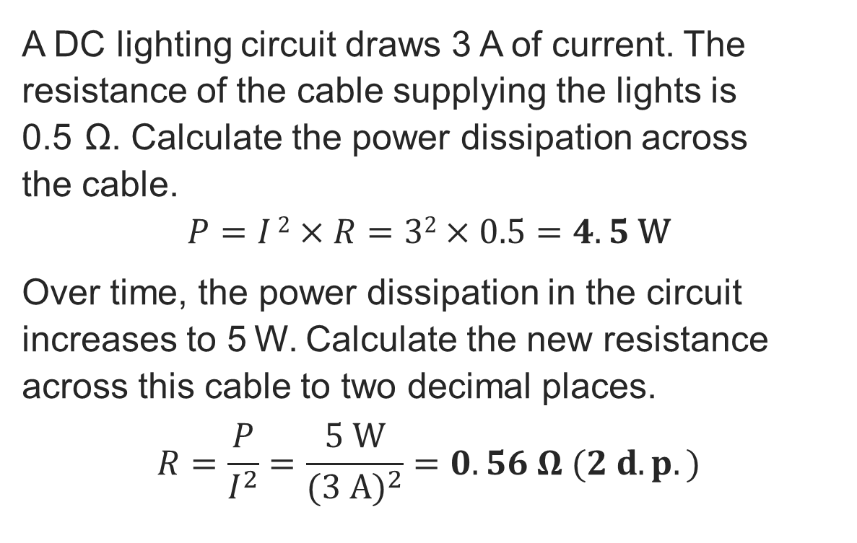
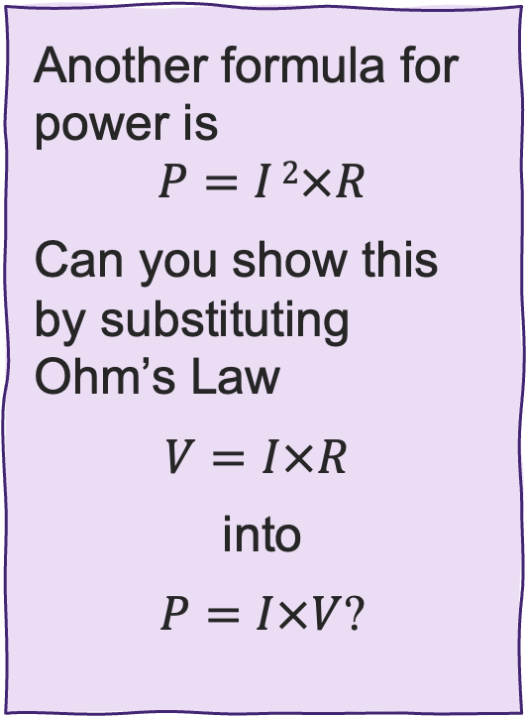
Calculating power dissipation: Answer
Power
A DC lighting circuit draws 3 A of current. The resistance of the cable supplying the lights is
0.5 Ω. Calculate the power dissipation across
the cable.
$$P=I 2×R=32×0.5=4.5 \text{W}$$
Over time, the power dissipation in the circuit increases to 5 W. Calculate the new resistance across this cable to two decimal places.
$$R=\frac{P}{I^{2}}=\frac{5 \text{W}}{{(3 \text{A})}^{2}}=0.56 Ω (2 d.p.)$$
Another formula for power is
$$P=I 2×R$$
Can you show this by substituting Ohm’s Law
$V=I×R$
into
$P=I×V$?
Resource 3: Key mathematical electrical principles

Slide 24
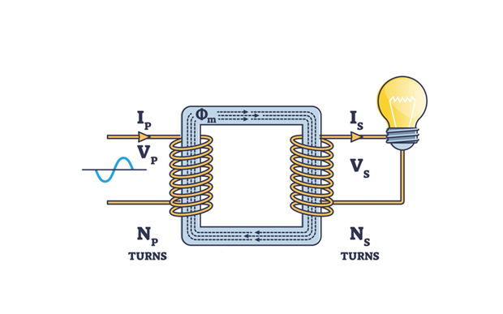
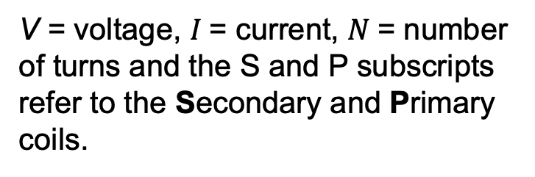
Basics of a transformer
Transformers
A transformer uses electromagnetic induction to change the voltage level of an AC current whilst keeping the frequency constant.
A transformer has:
a primary coil connected to the input AC voltage
a secondary coil that delivers the transformed output voltage
an iron core.
V = voltage, $I$= current, $N$= number of turns and the S and P subscripts refer to the Secondary and Primary coils.
Resource 3: Key mathematical electrical principles
Notes:
Image © Shutterstock/VectorMine

Slide 25
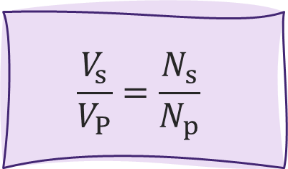
Transformer formulae
Transformers
A step-up transformer has more turns in the secondary coil than the primary coil, resulting in a higher voltage on the secondary.
A step-down transformer has fewer turns in the secondary than the primary coil, resulting in a lower voltage on the secondary.
$$\frac{V_{s}}{V_{P}}=\frac{N_{s}}{N_{p}}$$
Resource 3: Key mathematical electrical principles
Notes:
Image © Shutterstock/VectorMine

Slide 26

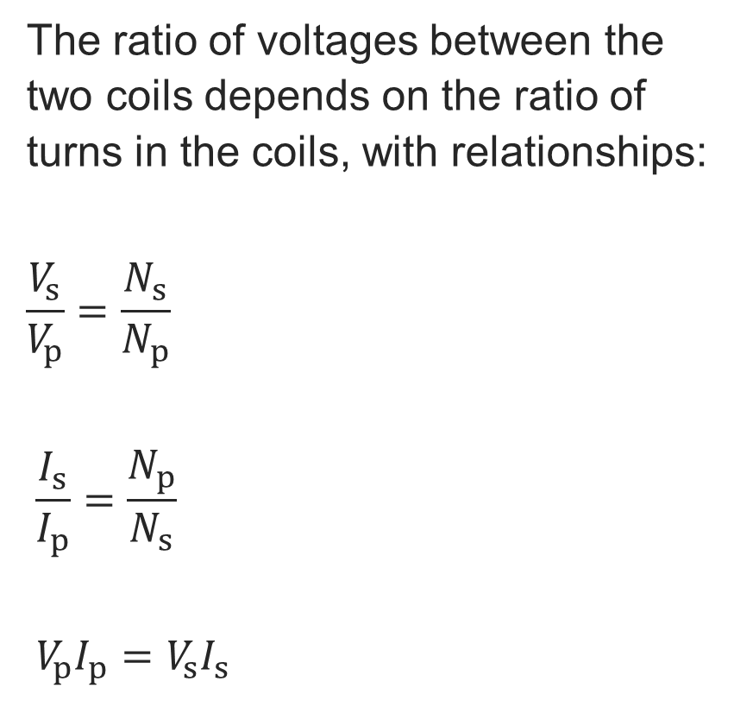
Transformer formulae
Transformers
The ratio of voltages between the two coils depends on the ratio of turns in the coils, with relationships:
$$\frac{V_{s}}{V_{p}}=\frac{N_{s}}{N_{p}}$$
$$\frac{I_{s}}{I_{p}}=\frac{N_{p}}{N_{s}}$$
$$V_{p}I_{p}=V_{s}I_{s}$$
V = voltage,
$I$= current,
$N$= number of turns
subscripts refer to Secondary and Primary coils.
Which formula relates the power of the primary and secondary coils?
Resource 3: Key mathematical electrical principles
Notes:
Image © Shutterstock/VectorMine

Slide 27
Exam-style question 1
Exam-style question
A house is supplied by solar panels that produce 240 V AC, but the building’s appliances operate at 400 V.
(a) Explain whether a step-up or step-down transformer is needed to connect the solar panels to the electrical system of the house.
The building requires 12 kW of power. Work out the current on the side of the transformer connected to the:
(b) solar panels
(c) house.
Resource 3: Key mathematical electrical principles

Slide 28
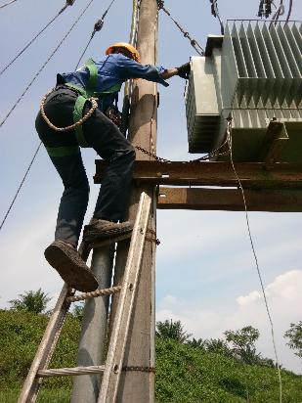
Exam-style question 1: Answer
Exam-style question
A house is supplied by solar panels that produce 240 V AC, but the building’s appliances operate at 400 V.
(a) Explain whether a step-up or step-down transformer is needed to connect the solar panels to the electrical system of the house.
It requires a step-up transformer because it must ‘step up’ the voltage from 240 V to 400 V.
Resource 3: Key mathematical electrical principles
Notes:
Image © Shutterstock/ASyamil

Slide 29
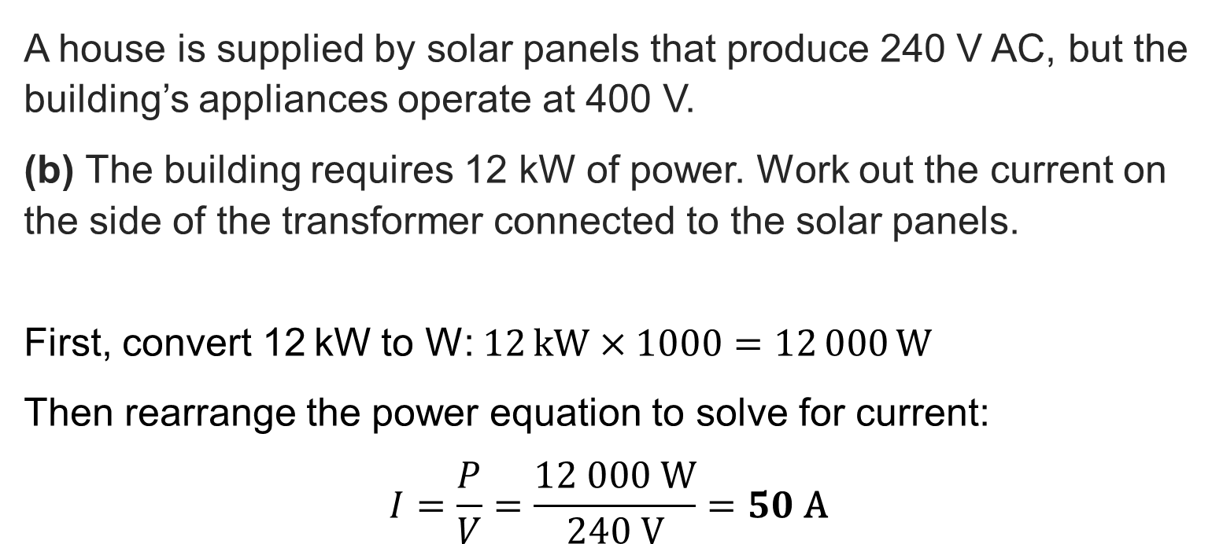
Exam-style question 1: Answer
Exam-style question
A house is supplied by solar panels that produce 240 V AC, but the building’s appliances operate at 400 V.
(b) The building requires 12 kW of power. Work out the current on the side of the transformer connected to the solar panels.
First, convert 12 kW to W: $12 kW×1000=12 000 \text{W}$
Then rearrange the power equation to solve for current:
$$I=\frac{P}{V}=\frac{12 000 \text{W}}{240 \text{V}}=50 \text{A}$$
Resource 3: Key mathematical electrical principles

Slide 30
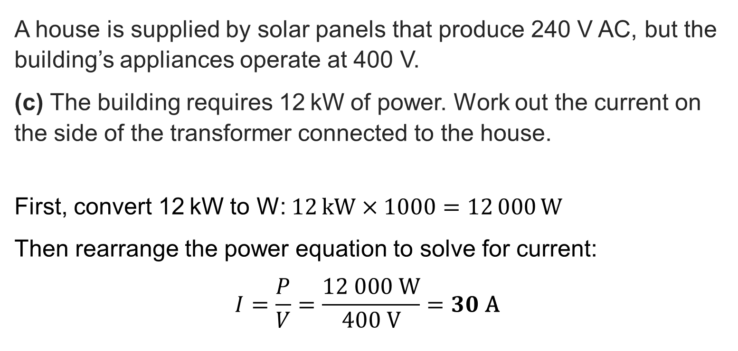
Exam-style question 1: Answer
Exam-style question
A house is supplied by solar panels that produce 240 V AC, but the building’s appliances operate at 400 V.
(c) The building requires 12 kW of power. Work out the current on the side of the transformer connected to the house.
First, convert 12 kW to W: $12 kW×1000=12 000 \text{W}$
Then rearrange the power equation to solve for current:
$$I=\frac{P}{V}=\frac{12 000 \text{W}}{400 \text{V}}=30 \text{A}$$
Resource 3: Key mathematical electrical principles

Slide 31
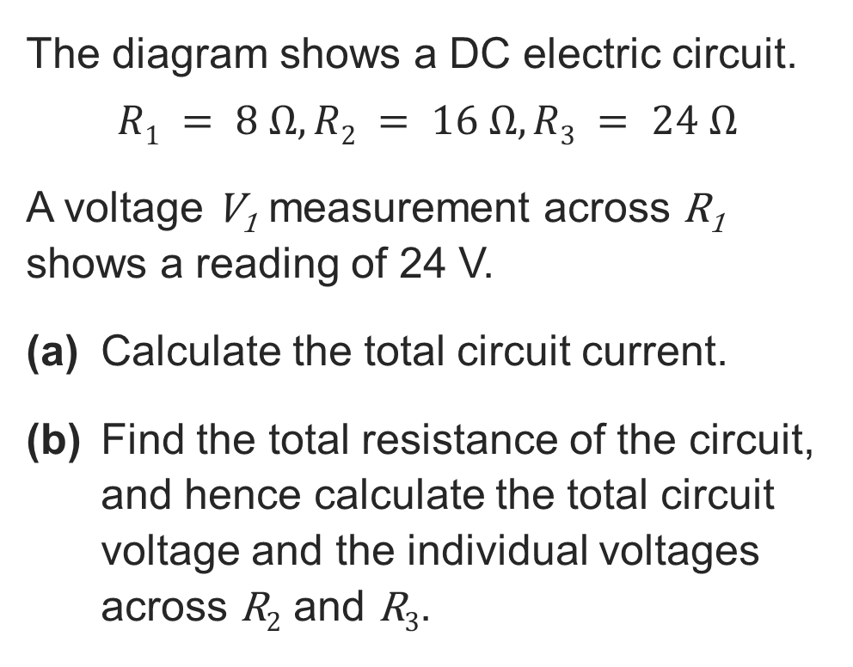
Exam-style question 2
Exam-style question
The diagram shows a DC electric circuit.
$$R1 = 8 Ω, R2 = 16 Ω, R3 = 24 Ω$$
A voltage V₁ measurement across R₁ shows a reading of 24 V.
(a) Calculate the total circuit current.
(b) Find the total resistance of the circuit, and hence calculate the total circuit voltage and the individual voltages across R₂ and R₃.
V₁
V₂
V₃
R₁
R₂
R₃
+
–
V
Resource 3: Key mathematical electrical principles

Slide 32

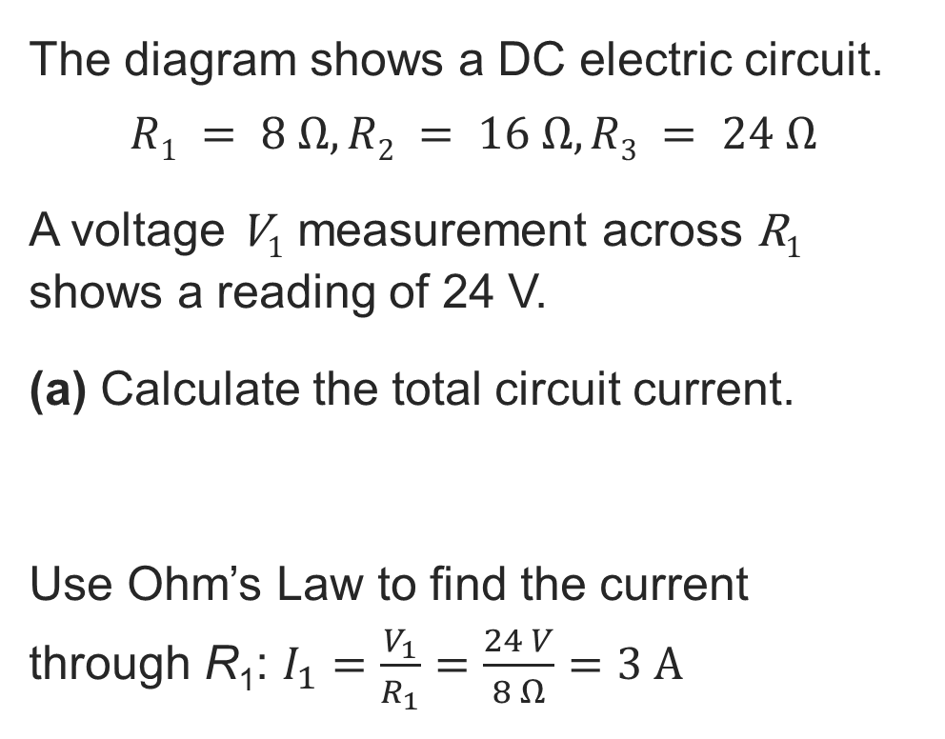
Exam-style question 2: Answer
Exam-style question
The diagram shows a DC electric circuit.
$$R1 = 8 Ω, R2 = 16 Ω, R3 = 24 Ω$$
A voltage V₁ measurement across R₁ shows a reading of 24 V.
(a) Calculate the total circuit current.
Use Ohm’s Law to find the current through R₁: $I_{1}=\frac{V_{1}}{R_{1}}=\frac{24 V}{8 Ω}=3 \text{A}$
V₁
V₂
V₃
R₁
R₂
R₃
I₁
+
–
I
V
This is a series circuit, so the current is the same through all paths, therefore the total current is $I=3 \text{A}$.
Resource 3: Key mathematical electrical principles

Slide 33
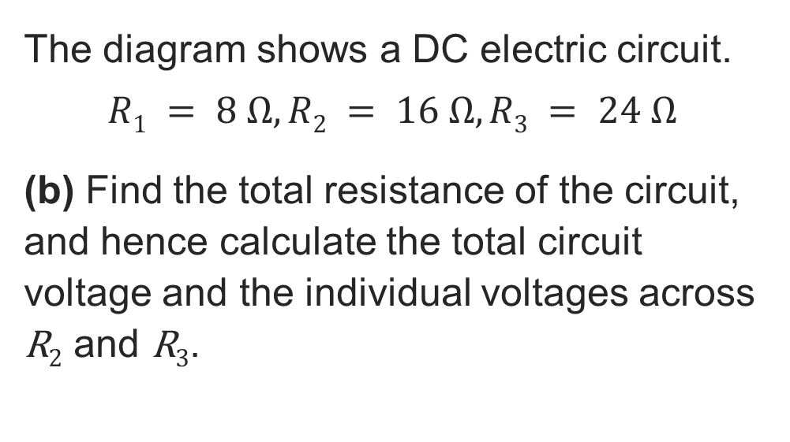
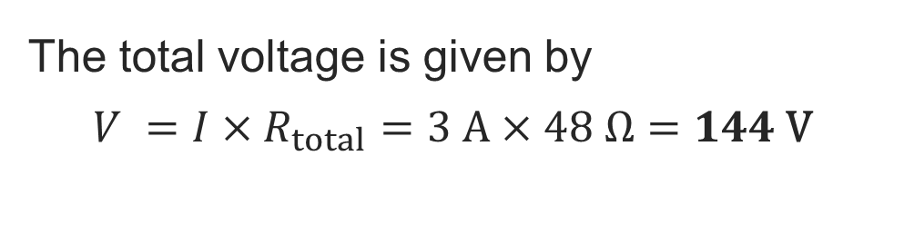
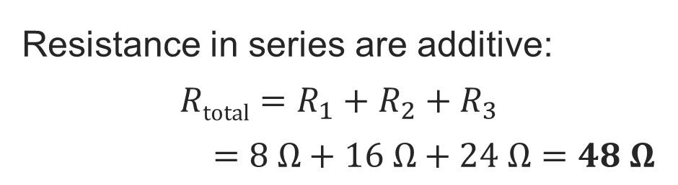
Exam-style question 2: Answer
Exam-style question
The diagram shows a DC electric circuit.
$$R1 = 8 Ω, R2 = 16 Ω, R3 = 24 Ω$$
(b) Find the total resistance of the circuit, and hence calculate the total circuit voltage and the individual voltages across R₂ and R₃.
V₁
V₂
V₃
R₁
R₂
R₃
+
–
V
Resistance in series are additive:
$$Rtotal=R_{1}+R_{2}+R_{3}$$
$$=8 Ω+16 Ω+24 Ω=48 Ω$$
The total voltage is given by
$$V =I×R_{total}=3 \text{A}×48 Ω=144 \text{V}$$
Resource 3: Key mathematical electrical principles

Slide 34
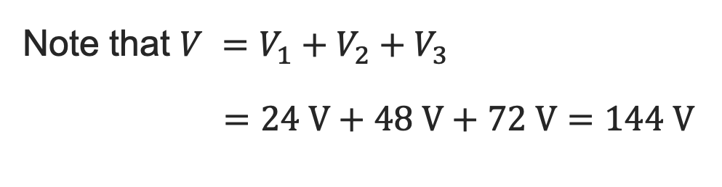
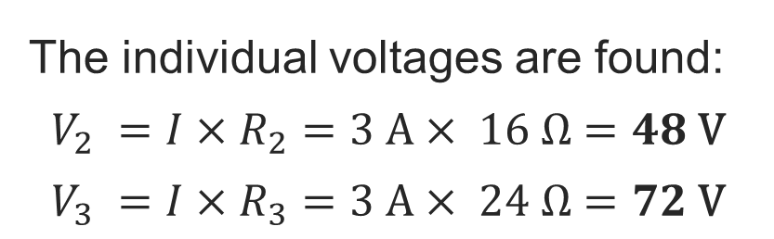
Exam-style question 2: Answer
Exam-style question
The diagram shows a DC electric circuit.
$$R1 = 8 Ω, R2 = 16 Ω, R3 = 24 Ω$$
(b) Find the total resistance of the circuit, and hence calculate the total circuit voltage and the individual voltages across R₂ and R₃.
V₁
V₂
V₃
R₁
R₂
R₃
+
–
V
The individual voltages are found:
$$V_{2} =I×R_{2}=3 A× 16 Ω=48 \text{V}$$
$$V_{3} =I×R_{3}=3 A× 24 Ω=72 \text{V}$$
Note that $V =V_{1}+V_{2}+V_{3}$
$=24 \text{V}+48 \text{V}+72 \text{V}=144 \text{V}$
Resource 3: Key mathematical electrical principles

Slide 35
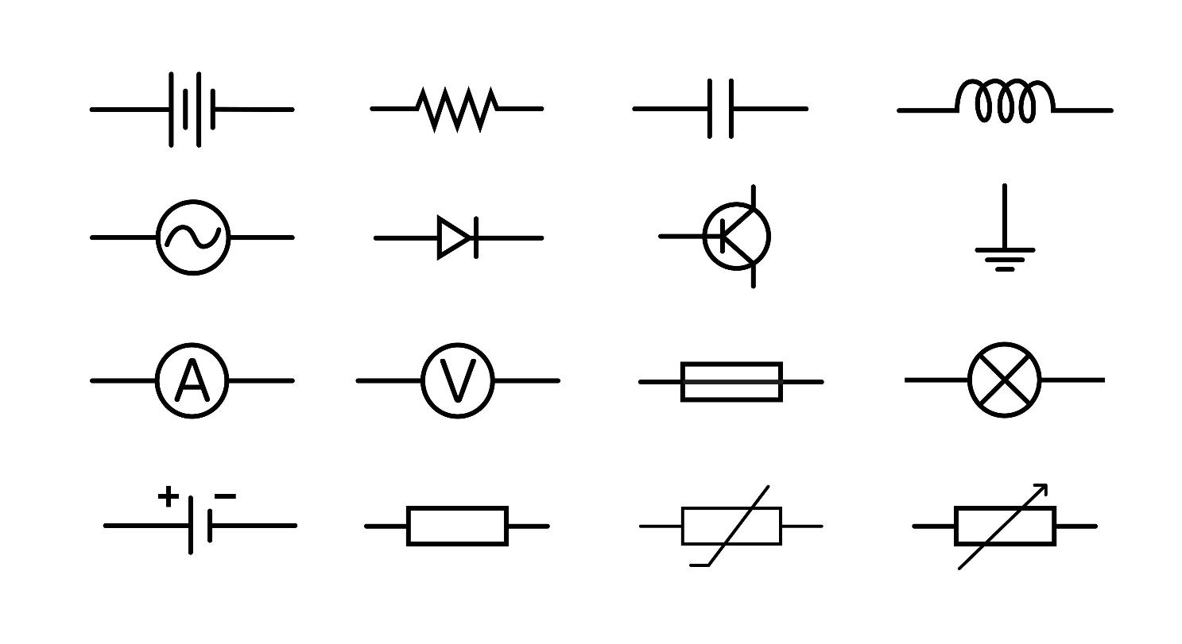
Name the components
Name the components
Resource 3: Key mathematical electrical principles
Notes:
Shutterstock Asset id: 2652657185

Slide 36
Name the components: Answers
Name the components
Batteries | Resistor | Capacitor | Inductor, coil
ACV source | Diode, LED | Transistor | Ground
Ammeter | Voltmeter | Fuse | Lamp, bulb
One cell | Fixed resistor | Variable resistor | Potentiometer
Resource 3: Key mathematical electrical principles
Notes:
Image © Shutterstock/Mohamad_Trend

Slide 37
In this resource, we have:
Plenary
Explained key mathematical electricity science principles and their importance
Described and recalled the rules of electrical circuits
Calculated with and recalled Ohm’s law (V = IR) for a variety of different scenarios
Completed calculations involving key formulae
Calculated problems involving electrical power and its relationship with voltage
Calculated problems involving electrical power dissipation
Described the basics of transformers
Calculated problems involving step-up and step-down transformers
General competencies:
MC4 Using rules and formulae
MC5 Processing data
MC7 Interpreting and representing with mathematical diagrams
MC8 Communicating using mathematics
Resource 3: Key mathematical electrical principles

Slide 38
Consolidation
Consolidation
Choose one of the research topics below to prepare a short presentation:
  Well-known disasters as a result of other types of electrical failure relating to the maths and principles you are studying.
Present your findings in a subsequent lesson, either in small groups or to the class.
Resource 3: Key mathematical electrical principles

