Slide 1
Building Services Engineering
Route: Construction
Topic: Practical mathematics
Resource 4: Key mathematical heat principles
Notes:
Image © Shutterstock/Gorodenkoff

Slide 2
Quiz questions
Quiz questions
Resource 4: Key mathematical heat principles

Slide 3
Question 1
Quiz questions
You are carrying out commissioning checks on a laboratory climate-control system in a pharmaceutical facility. The environmental monitoring software requires all temperature inputs to be entered in base SI units so the data can integrate correctly with the building management system (BMS).
State the base SI unit of temperature.
A kelvin (K)
B degrees Fahrenheit (ºF)
C degrees Celsius (ºC)
D degrees (º)
Resource 4: Key mathematical heat principles

Slide 4
Question 1: Answer
Quiz questions
You are carrying out commissioning checks on a laboratory climate-control system in a pharmaceutical facility. The environmental monitoring software requires all temperature inputs to be entered in base SI units so the data can integrate correctly with the building management system (BMS).
State the base SI unit of temperature.
A kelvin (K)
B degrees Fahrenheit (ºF)
C degrees Celsius (ºC)
D degrees (º)
Celsius is commonly used, but it is not an SI unit.
You may see it with temperature differences because 1ºC = 1K.
Resource 4: Key mathematical heat principles

Slide 5
Question 2
Quiz questions
You are carrying out commissioning checks on a newly installed underfloor heating system.
As part of the performance testing, you must confirm that the insulation beneath the floor is adequate by reviewing the rate of heat loss through the slab. The project manager reminds you that all measurements must use SI units.
State the SI unit used to measure the rate of heat loss.
A W (watts)
B kJ (kilojoules)
C K (kelvin)
D Nm (newton-metre)
Resource 4: Key mathematical heat principles

Slide 6
Question 2: Answer
Quiz questions
You are carrying out commissioning checks on a newly installed underfloor heating system.
As part of the performance testing, you must confirm that the insulation beneath the floor is adequate by reviewing the rate of heat loss through the slab. The project manager reminds you that all measurements must use SI units.
State the SI unit used to measure the rate of heat loss.
A W (watts)
B kJ (kilojoules)
C K (kelvin)
D Nm (newton-metre)
Note: Rate of heat loss is a measure of power.
1 W = 1 J/s.
Resource 4: Key mathematical heat principles

Slide 7
Question 3
Quiz questions
Over a 20-hour period, a house loses 120 Wh of energy.
State this quantity in joules.
Resource 4: Key mathematical heat principles

Slide 8
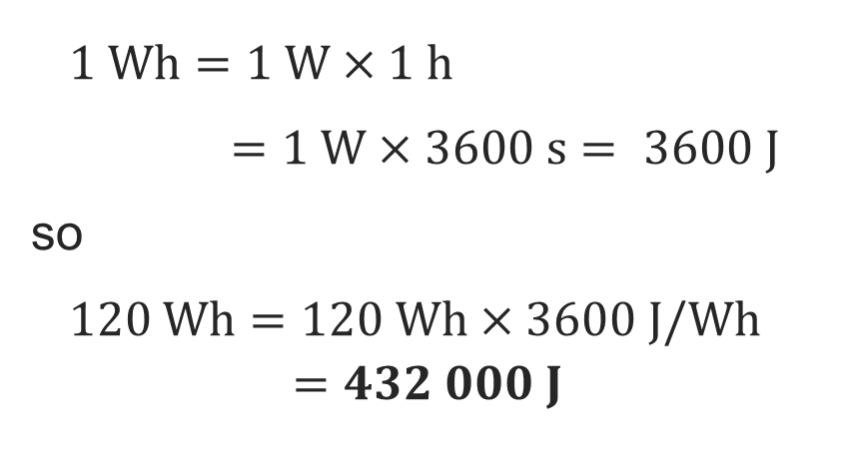
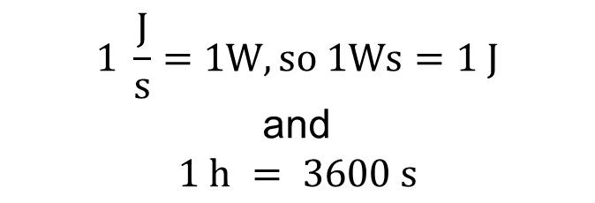
Question 3: Answer
Quiz questions
Over a 20-hour period, a house loses 120 Wh of energy.
State this quantity in joules.
$$1 \frac{J}{s}=1W, so 1Ws=1 J$$
and
$$1 h = 3600 s$$
$1 \text{W}\text{h}=1 \text{W}×1 \text{h}$
$1 \text{W}⋅\text{h}=1 \text{W}×3600 \text{s}= 3600 \text{J}$
so
$120 Wh=120 Wh×3600 J/Wh$
$=432 000 J$
Resource 4: Key mathematical heat principles

Slide 9
Question 4
Quiz questions
A workshop has a flat roof of area
160 m² that has a U-value 0.18 W/m²K.
The indoor temperature is set to 21°C.
Calculate the rate of heat loss through the roof when the external temperature is 6°C.
Resource 4: Key mathematical heat principles

Slide 10
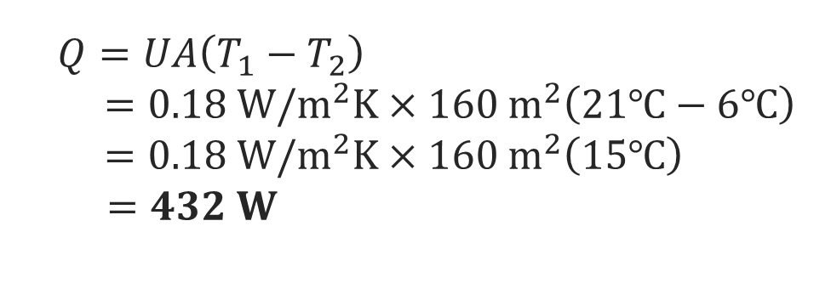
Question 4: Answer
Quiz questions
$Q=UA\left(T_{1}−T_{2}\right)$
$=0.18 W/m^{2}K×160{ m}^{2}\left(21℃−6℃\right)$
$=0.18 W/m^{2}K×160 m^{2}\left(15℃\right)$
$=432 W$
A workshop has a flat roof of area
160 m² that has a U-value 0.18 W/m²K.
The indoor temperature is set to 21°C.
Calculate the rate of heat loss through the roof when the external temperature is 6°C.
Heat loss is power: rate of losing heat.
You don’t need to convert to K because it’s a temperature difference.
The U-value gives heat loss as proportional to area and temperature difference. Thickness is built into the U-value.
Resource 4: Key mathematical heat principles

Slide 11
Question 5
Quiz questions
The window in the living room of a house loses heat at an average rate of 32 W.
Calculate the amount of heat lost in two hours.
Give your answer in kilojoules correct to three significant figures.
Resource 4: Key mathematical heat principles

Slide 12
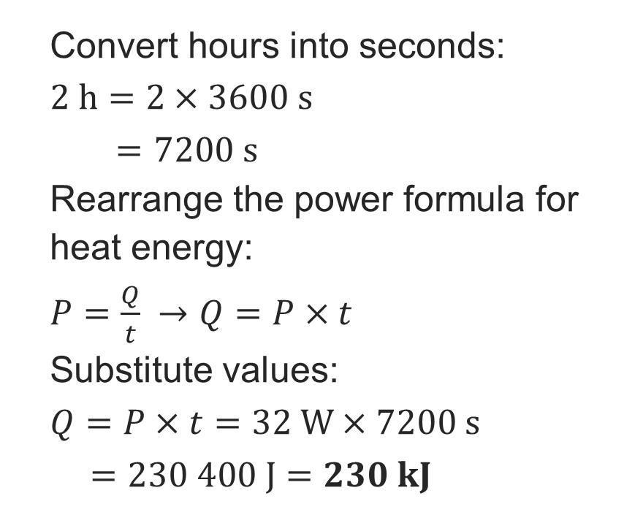
Question 5: Answer
Quiz questions
The window in the living room of a house loses heat at an average rate of 32 W.
Calculate the amount of heat lost in two hours.
Give your answer in kilojoules correct to three significant figures.
Convert hours into seconds:
$2 h=2×3600 s$
$2 h =7200 s$
Rearrange the power formula for heat energy:
$P=\frac{Q}{t} →Q=P×t$
Substitute values:
$Q=P×t=32 W×7200 s$
$=230 400 J=230 kJ$
Resource 4: Key mathematical heat principles

Slide 13
Question 6
Quiz questions
A rectangular wall has dimensions
4 m × 8 m. The U-value of the wall is 0.15 W/m²K.
Given that the heat loss is 48 W, calculate the difference in temperature between the inside and outside of the wall.
Resource 4: Key mathematical heat principles

Slide 14

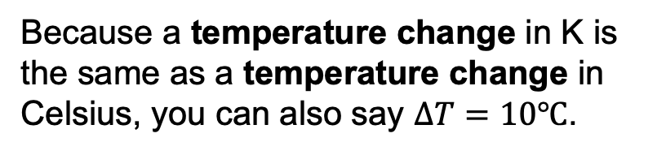
Question 6: Answer
Quiz questions
A rectangular wall has dimensions
4 m × 8 m. The U-value of the wall is 0.15 W/m²K.
Given that the heat loss is 48 W, calculate the difference in temperature between the inside and outside of the wall.
$area, A=4×8=32 m2$
Rearrange $Q=UAΔT$as
$ΔT= \frac{Q}{UA}$
$=\frac{48}{0.15 × 32}$
$=10 K$
Because a temperature change in K is the same as a temperature change in Celsius, you can also say $ΔT=10℃$.
Resource 4: Key mathematical heat principles

