Slide 1
Building Services Engineering
Route: Construction
Topic: Practical mathematics
Resource 4: Key mathematical heat principles
Notes:
Image © Shutterstock/Gorodenkoff

Slide 2

Key mathematical heat principles: glazing company
Video
Resource 4: Key mathematical heat principles
Notes:
Key mathematical heat principles: glazing company video: https://vimeo.com/1206421925/83af139629

Slide 3
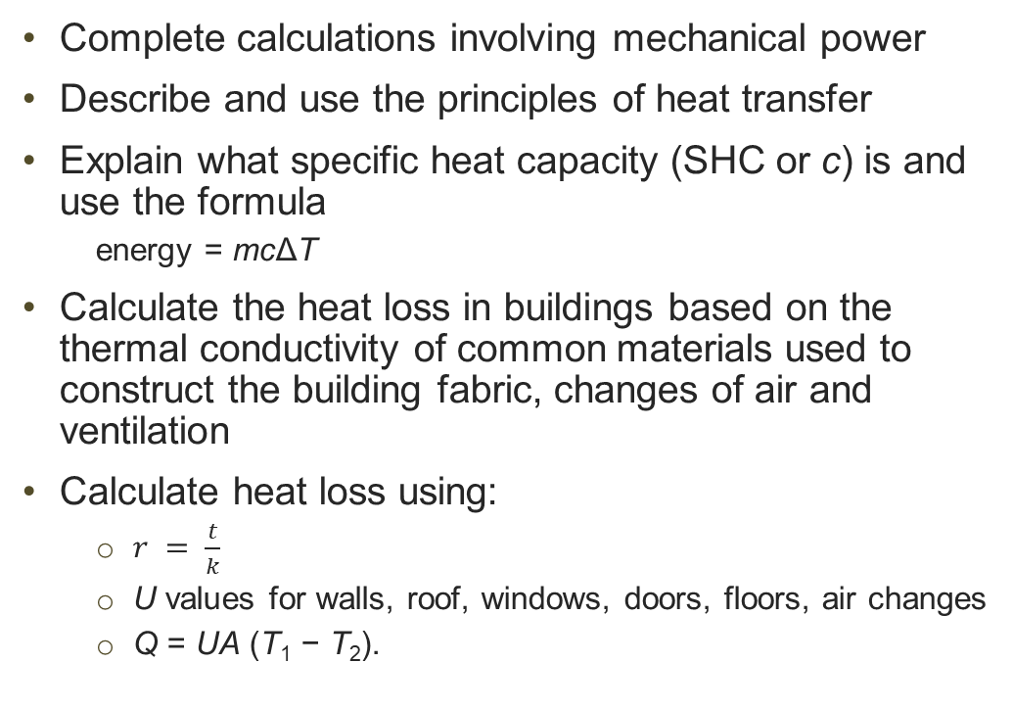
In this resource, we will:
Introduction
Complete calculations involving mechanical power
Describe and use the principles of heat transfer
Explain what specific heat capacity (SHC or c) is and use the formula
  energy = mcΔT
Calculate the heat loss in buildings based on the thermal conductivity of common materials used to construct the building fabric, changes of air and ventilation
Calculate heat loss using:
  $r = \frac{t}{k}$
  U values for walls, roof, windows, doors, floors, air changes
  Q = UA (T₁ − T₂).
General competencies:
MC4 Using rules and formulae
MC5 Processing data
MC7 Interpreting and representing with mathematical diagrams
MC8 Communicating using mathematics
Resource 4: Key mathematical heat principles

Slide 4
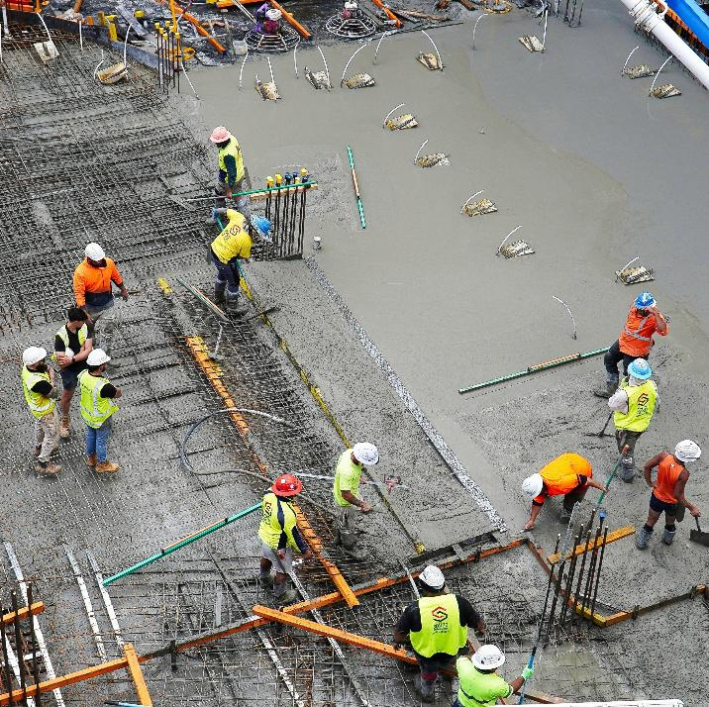
Heat in construction
Heat transfer overview
Understanding heat is important to construction and building design.
Chemical reactions in concrete generate heat (exothermic). If it gets too hot, it cracks. Civil engineers manage the pour.
Solar gains from windows can cause a building to heat up and must be mitigating with shading and ventilation.
Resource 4: Key mathematical heat principles
Notes:
Image © Shutterstock/Stepan Skorobogadko

Slide 5
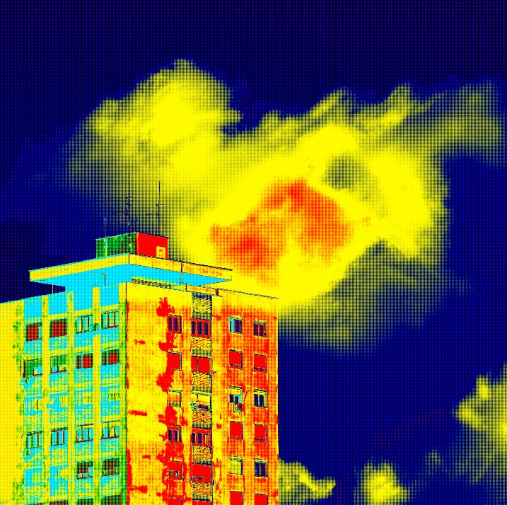
Types of heat transfer
Heat transfer overview
Conduction
  Example: cold bridging through steel beams
Convection
  Example: radiator circulation
Radiation
  Example: gain through glazing
These may occur at the same time.
Can you identify the types of heat transfer in the thermal image?
Resource 4: Key mathematical heat principles
Notes:
Image © Shutterstock/Ivan Smuk

Slide 6
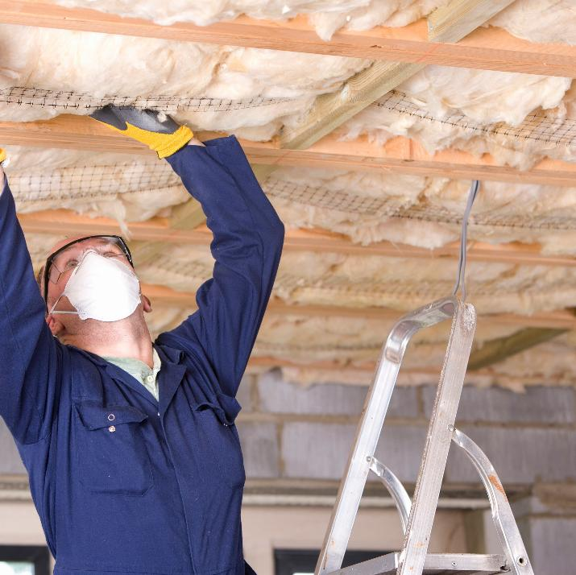
Applications of heat formulae
Heat transfer overview
Heat calculations are used to:
design heating and ventilation systems;
select the most suitable types and thicknesses of insulation materials
(such as fiberglass, mineral wool, rigid foam);
consider energy efficiency and comply with regulations;
create a comfortable living or working space.
Resource 4: Key mathematical heat principles
Notes:
Image © Shutterstock/Juice Verve

Slide 7
Properties of materials
Heat transfer overview
An important consideration in construction is how to keep a building within a desired temperature range.
We need to work out which materials would be the most useful for the context.
We need to understand properties of materials that are used in the relevant heat calculation formulae.
Compromise
When choosing materials, compromises need to be made. A very lightweight but fragile material might be the best insulator or conductor, but not useful for load bearing, or it might be too expensive.
Material properties quantify these ideas.
Resource 4: Key mathematical heat principles

Slide 8
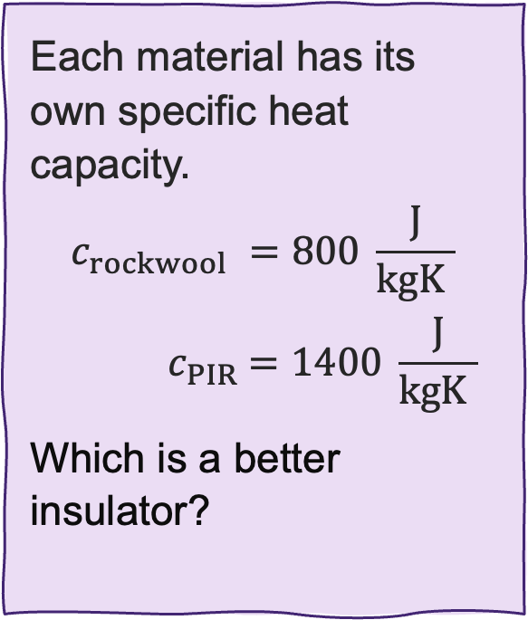
Specific heat capacity
Specific heat capacity
Each material has its own specific heat capacity.
$$c_{rockwool} =800 \frac{\text{J}}{\text{kg}\text{K} }$$
$${ c}_{PIR} =1400 \frac{\text{J}}{\text{kg}\text{K} }$$
Which is a better insulator?
Specific heat capacity (SHC), with symbol c, is a property that measures how much heat energy a substance needs to change its temperature.
Specifically, it is the amount of heat energy required to raise the temperature of 1 kilogram of a substance by 1 degree Kelvin.
Its units are joules per kilogram Kelvin (J/kgK)
You may also see J/kgºC.
Resource 4: Key mathematical heat principles

Slide 9
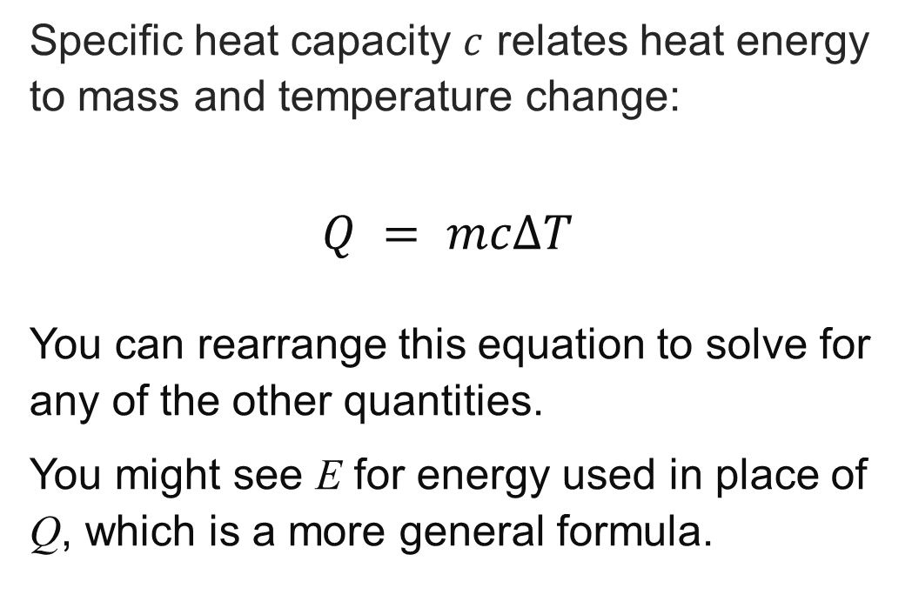
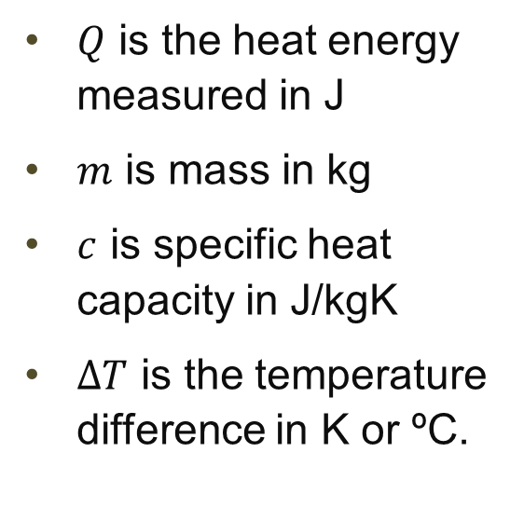
The energy formula using SHC (c)
Specific heat capacity
Specific heat capacity $c$ relates heat energy to mass and temperature change:
$$Q = mcΔT$$
You can rearrange this equation to solve for any of the other quantities.
You might see E for energy used in place of Q, which is a more general formula.
The variables
$Q$ is the heat energy measured in J
$m$ is mass in kg
$c$ is specific heat capacity in J/kgK
$ΔT$ is the temperature difference in K or ºC.
Resource 4: Key mathematical heat principles

Slide 10
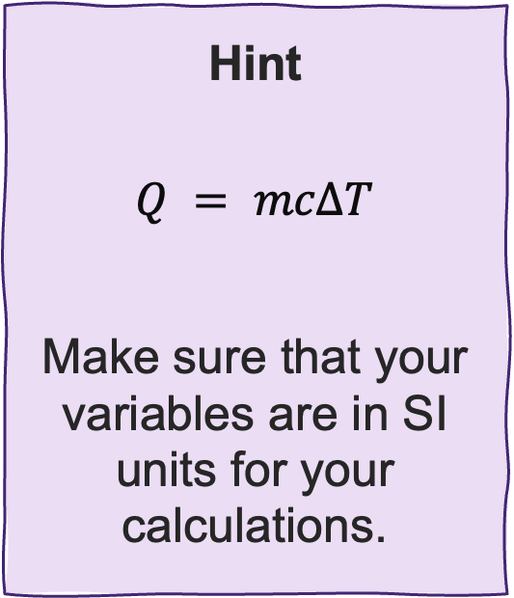
Using specific heat capacity
Specific heat capacity
A concrete floor has a mass of 920 kg and a specific heat capacity of 300 J/kgK.
If the floor absorbs 700 kJ of heat per square metre, by how much will its temperature rise?
Hint
$$Q = mcΔT$$
Make sure that your variables are in SI units for your calculations.
Resource 4: Key mathematical heat principles

Slide 11
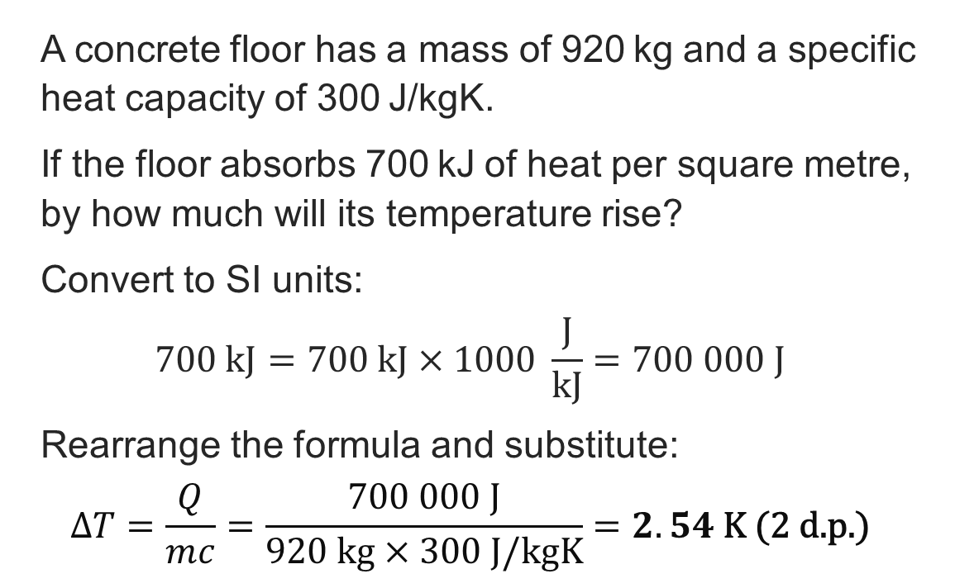
Using specific heat capacity: Answer
Specific heat capacity
A concrete floor has a mass of 920 kg and a specific heat capacity of 300 J/kgK.
If the floor absorbs 700 kJ of heat per square metre, by how much will its temperature rise?
Convert to SI units:
$$700 \text{kJ}=700 \text{kJ}×1000 \frac{\text{J}}{\text{kJ}}=700 000 \text{J}$$
Rearrange the formula and substitute:
$$ΔT=\frac{Q}{mc}=\frac{700 000 \text{J}}{920 \text{kg}×300 J/kgK}=2.54 \text{K}\text{ (2 }\text{d}\text{.}\text{p}\text{.)}$$
Hint
$$Q = mcΔT$$
Make sure that your variables are in SI units for your calculations.
Resource 4: Key mathematical heat principles

Slide 12
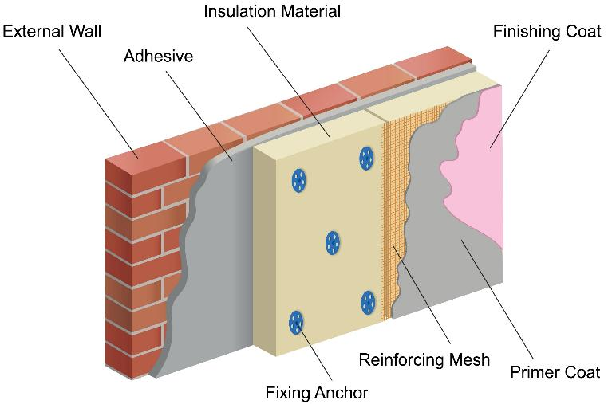
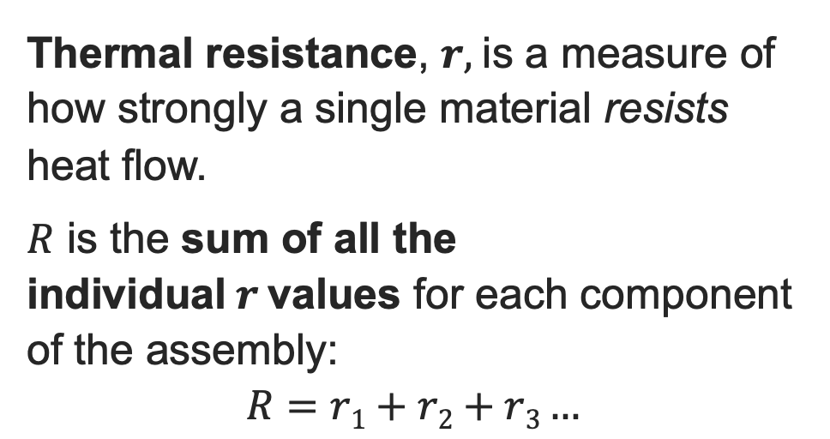
Thermal resistance
Thermal resistance and conductivity
Insulation Material
External Wall
Finishing Coat
Thermal resistance, $r,$is a measure of how strongly a single material resists heat flow.
$R$ is the sum of all the individual$r$values for each component of the assembly:
$$R=r1+r2+r3…$$
Adhesive
Reinforcing Mesh
Primer Coat
Fixing Anchor
An assembly is a combination of materials, such as found in a wall, door or floor.
Can you identify how adding external wall insulation helps resist heat flow?
Resource 4: Key mathematical heat principles
Notes:
Image © Shutterstock/Radzas2008

Slide 13
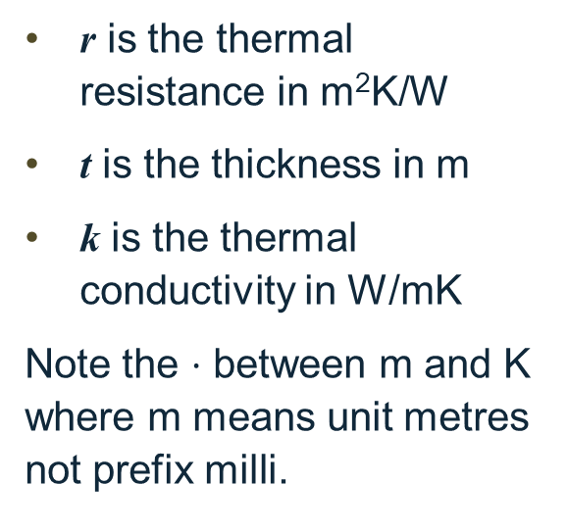
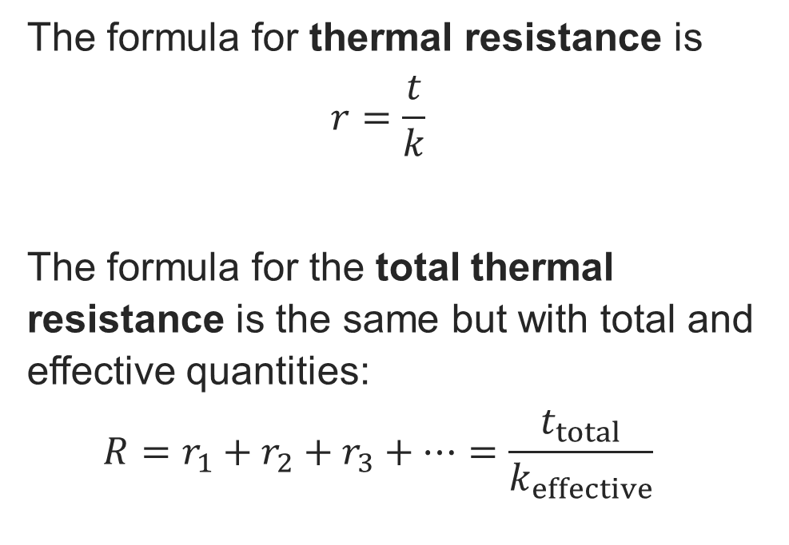
The formula for thermal resistance
Thermal resistance and conductivity
The formula for thermal resistance is
$$r=\frac{t}{k}$$
The formula for the total thermal resistance is the same but with total and effective quantities:
$$R=r_{1}+r_{2}+r_{3}+…=\frac{t_{total}}{k_{effective}}$$
The variables
r is the thermal resistance in m²K/W
t is the thickness in m
k is the thermal conductivity in W/mK
Note the $⋅$ between m and K where m means unit metres not prefix milli.
Resource 4: Key mathematical heat principles

Slide 14
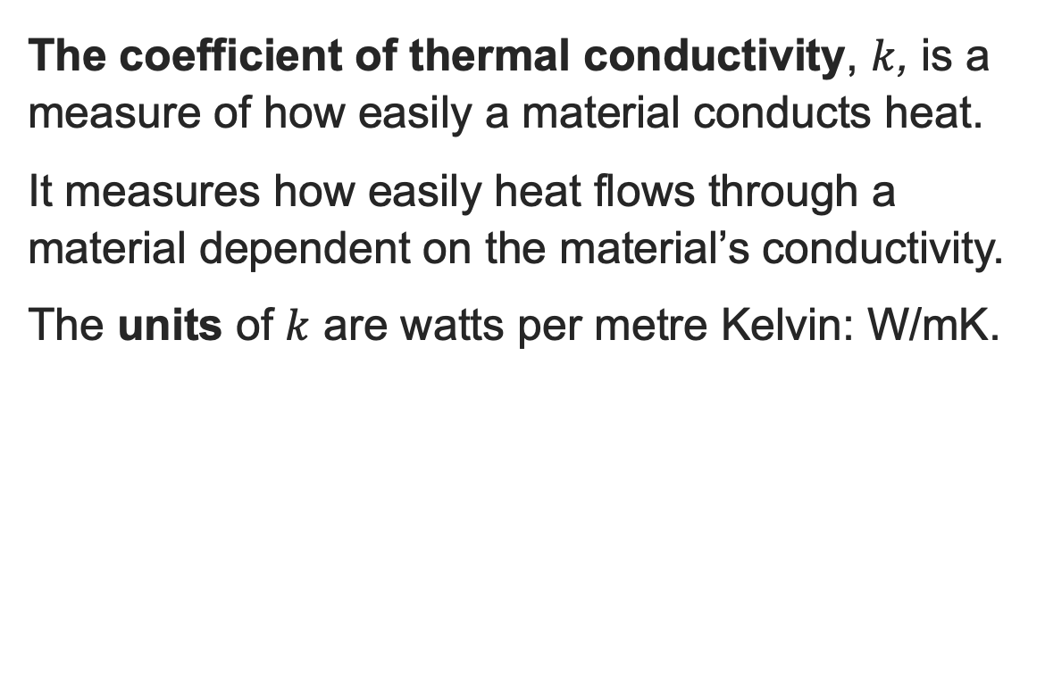
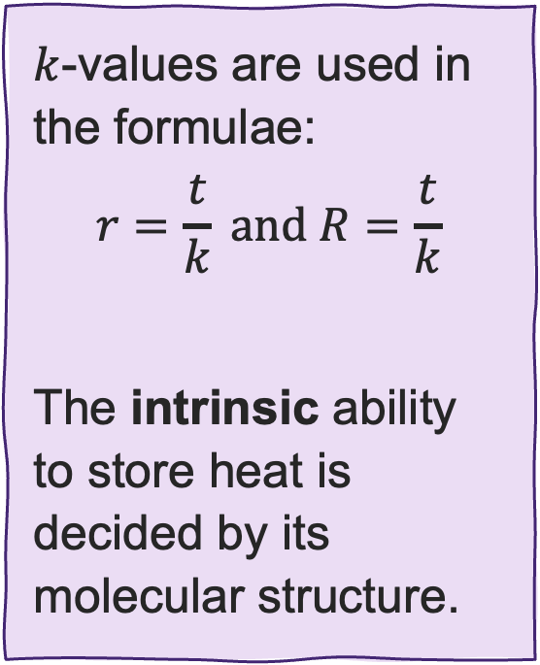
The coefficient of thermal conductivity
Thermal resistance and conductivity
The coefficient of thermal conductivity, $k$, is a measure of how easily a material conducts heat.
It measures how easily heat flows through a material dependent on the material’s conductivity.
The units of $k$ are watts per metre Kelvin: W/mK.
$k$-values are used in the formulae:
$$r=\frac{t}{k} \text{and} R=\frac{t}{k}$$
The intrinsic ability to store heat is decided by its molecular structure.
Site tip k-values are found on the manufacturer's datasheet. You need these sheets to prove to the Building Inspector that the wall meets regulations.
Resource 4: Key mathematical heat principles

Slide 15

Using the thermal resistance formula
Thermal resistance and conductivity
A wall in a school has a 60 mm layer of insulation with a thermal conductivity ($k$-value) of 0.056 W/mK.
Calculate the thermal resistance of the layer.
Resource 4: Key mathematical heat principles

Slide 16
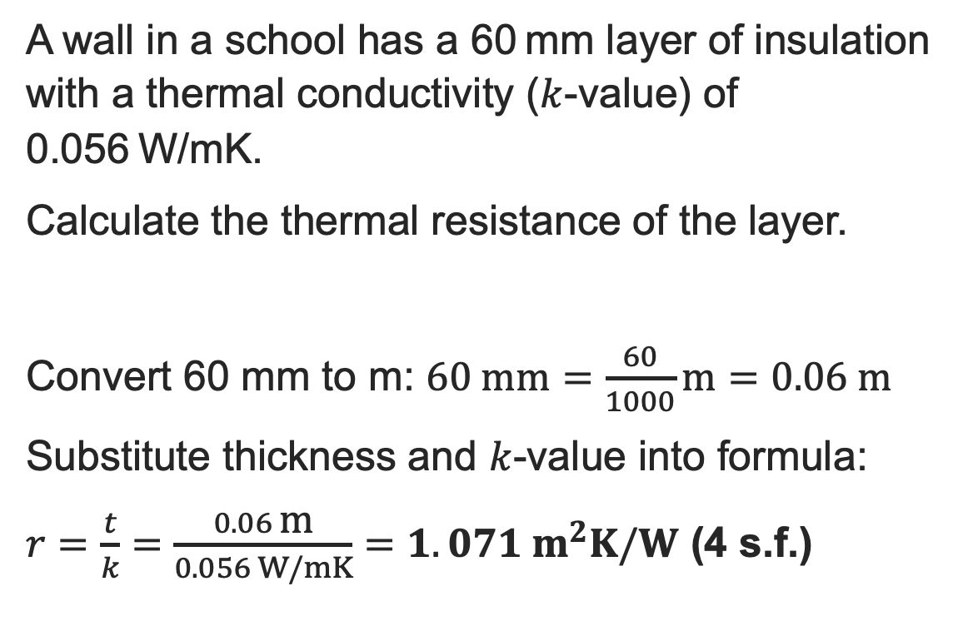
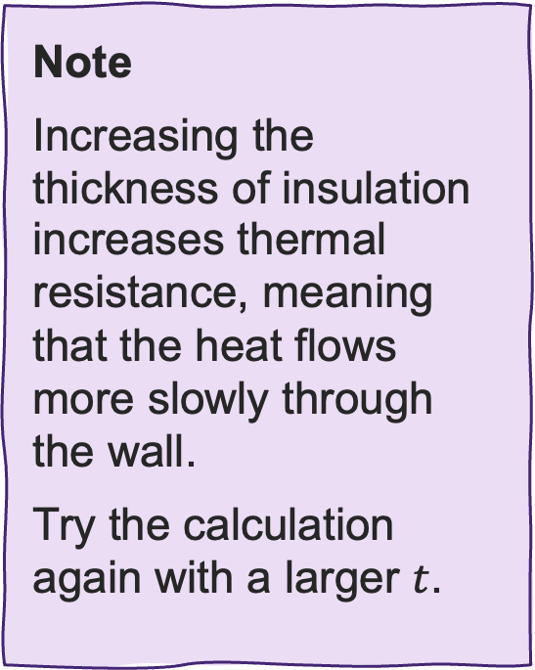
Using the thermal resistance formula: Answer
Thermal resistance and conductivity
A wall in a school has a 60 mm layer of insulation with a thermal conductivity ($k$-value) of 0.056 W/mK.
Calculate the thermal resistance of the layer.
Convert 60 mm to m: $60 \text{mm}=\frac{60}{1000}\text{m}=0.06 \text{m}$
Substitute thickness and $k$-value into formula:
$r=\frac{t}{k}=\frac{0.06 \text{m}}{0.056 W/mK}=1.071 m^{2}K/W$ (4 s.f.)
Note
Increasing the thickness of insulation increases thermal resistance, meaning that the heat flows more slowly through the wall.
Try the calculation again with a larger $t$.
Resource 4: Key mathematical heat principles

Slide 17
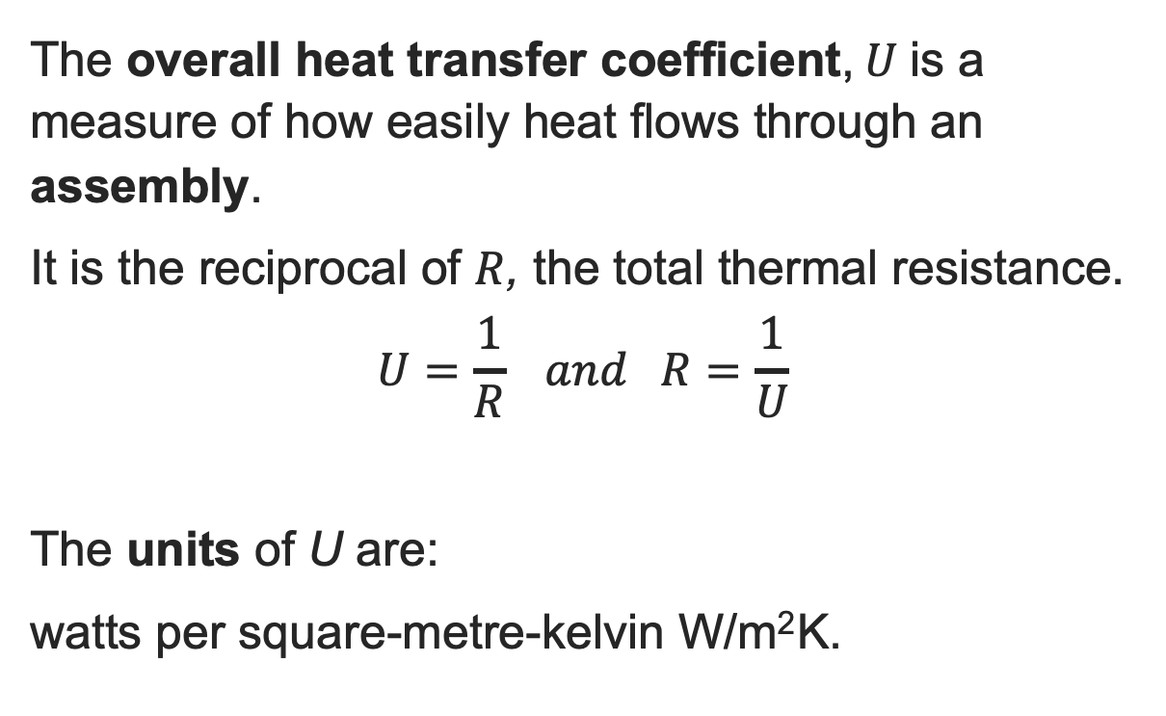
Overall heat transfer coefficient
Overall heat transfer coefficient and U-values
The overall heat transfer coefficient,$U$is a measure of how easily heat flows through an assembly.
It is the reciprocal of $R$, the total thermal resistance.
$$U=\frac{1}{R} and R=\frac{1}{U}$$
The units of U are:
watts per square-metre-kelvin W/m² K.
Remember that reciprocal of means 1 over, which is also known as the inverse.
Resource 4: Key mathematical heat principles

Slide 18
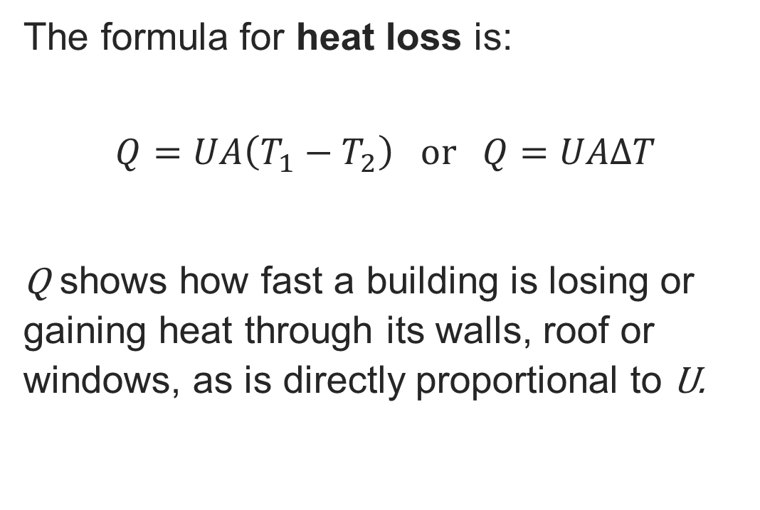
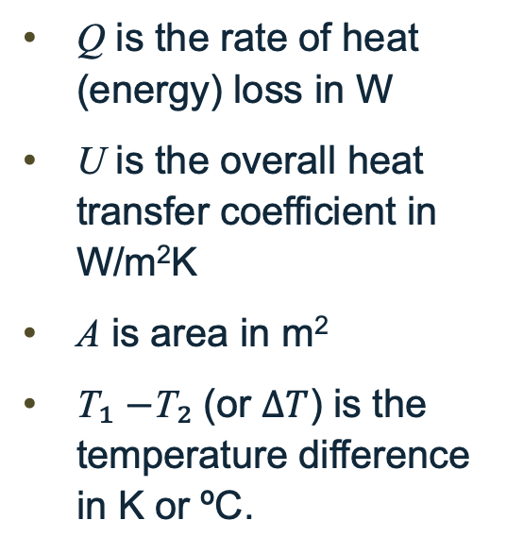
The heat loss formula
Overall heat transfer coefficient and U-values
The formula for heat loss is:
$$Q=UA\left(T_{1}−T_{2}\right) \text{or} Q=UAΔT$$
Q shows how fast a building is losing or gaining heat through its walls, roof or windows, as is directly proportional to U.
The variables
Q is the rate of heat (energy) loss in W
U is the overall heat transfer coefficient in W/m²K
A is area in m²
T₁ −T₂ (or $ΔT$) is the temperature difference in K or ºC.
Resource 4: Key mathematical heat principles

Slide 19
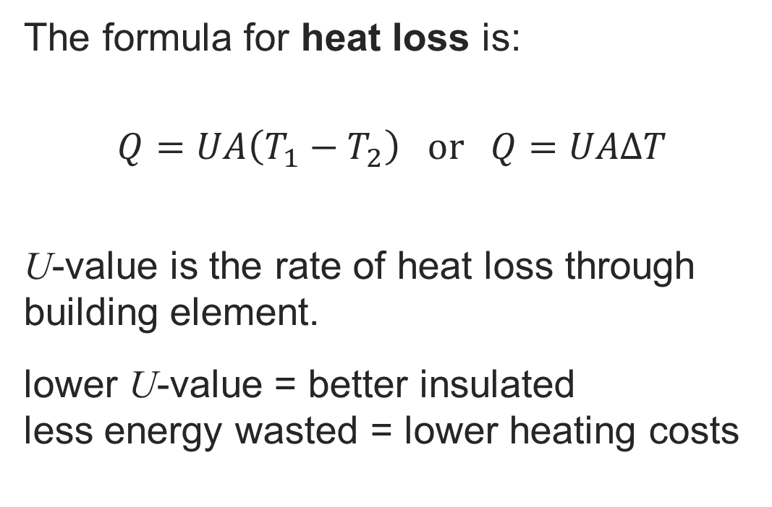
The heat loss formula
Overall heat transfer coefficient and U-values
The formula for heat loss is:
$$Q=UA\left(T_{1}−T_{2}\right) \text{or} Q=UAΔT$$
U-value is the rate of heat loss through building element.
lower U-value = better insulated
less energy wasted = lower heating costs
The variables
Q is the rate of heat (energy) loss in W
U is the overall heat transfer coefficient in W/m²K
A is area in m²
T₁ −T₂ (or $ΔT$) is the temperature difference in K or ºC.
Resource 4: Key mathematical heat principles

Slide 20
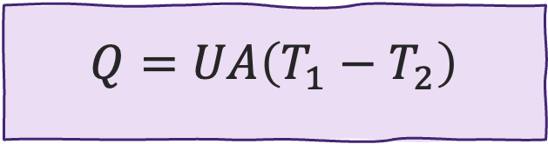
Example using the heat loss formula
Overall heat transfer coefficient and U-values
A server room has a flat roof of area 150 m² that has a U-value of U = 0.2 W/m²K.
The indoor temperature is set to 28°C. Calculate the rate of heat loss through the roof when the external temperature is 17°C.
$$Q=UA\left(T_{1}−T_{2}\right)$$
Resource 4: Key mathematical heat principles

Slide 21

Example using the heat loss formula: Answer
Overall heat transfer coefficient and U-values
A server room has a flat roof of area 150 m² that has a U-value of U = 0.2 W/m²K.
The indoor temperature is set to 28°C. Calculate the rate of heat loss through the roof when the external temperature is 17°C.
A single server generates around 300 W of heat, so, a roomful would generate thousands of watts, which is more than can escape through the roof.
If the cooling system fails in a server room, equipment overheats.
We calculate heat gain to size the Air Conditioning (AC) units.
Substitute the values into the formula:
$$Q = UA\left(T1​−T2​\right) \\ = 0.2 W/m^{2}K×150{ \text{m}}^{2}×\left(28−17\right)\text{K} \\ =330 \text{W}$$
Resource 4: Key mathematical heat principles

Slide 22
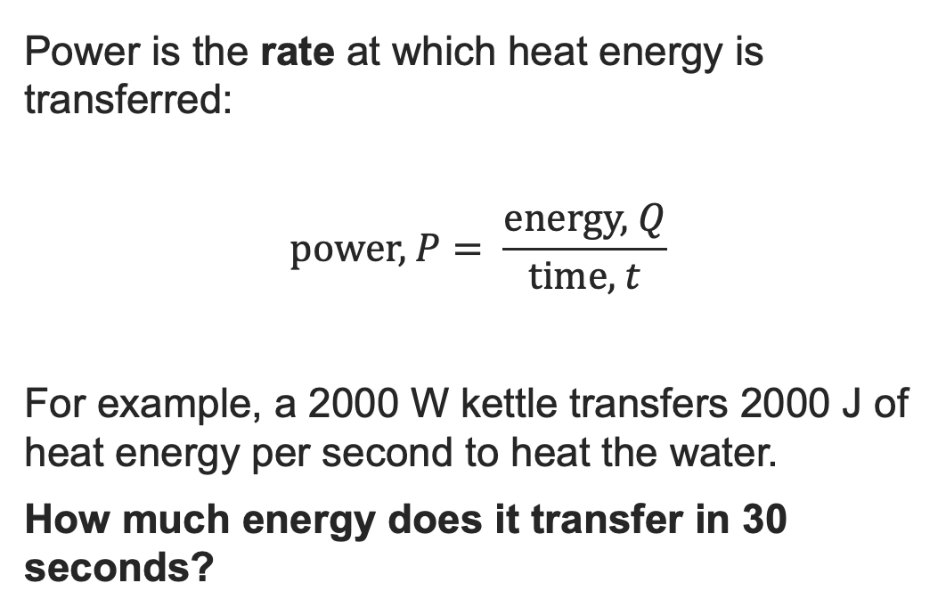
Power and heat
Power
Power is the rate at which heat energy is transferred:
$$\text{p}\text{ower}\text{, }P= \frac{\text{energy}\text{, }Q}{\text{time}\text{, }t}$$
For example, a 2000 W kettle transfers 2000 J of heat energy per second to heat the water.
How much energy does it transfer in 30 seconds?
The variables
Energy is heat transferred and measured in joules (J).
Time is measured in seconds (s).
Power is the rate heat is transferred, measured in watts (W).
Resource 4: Key mathematical heat principles

Slide 23
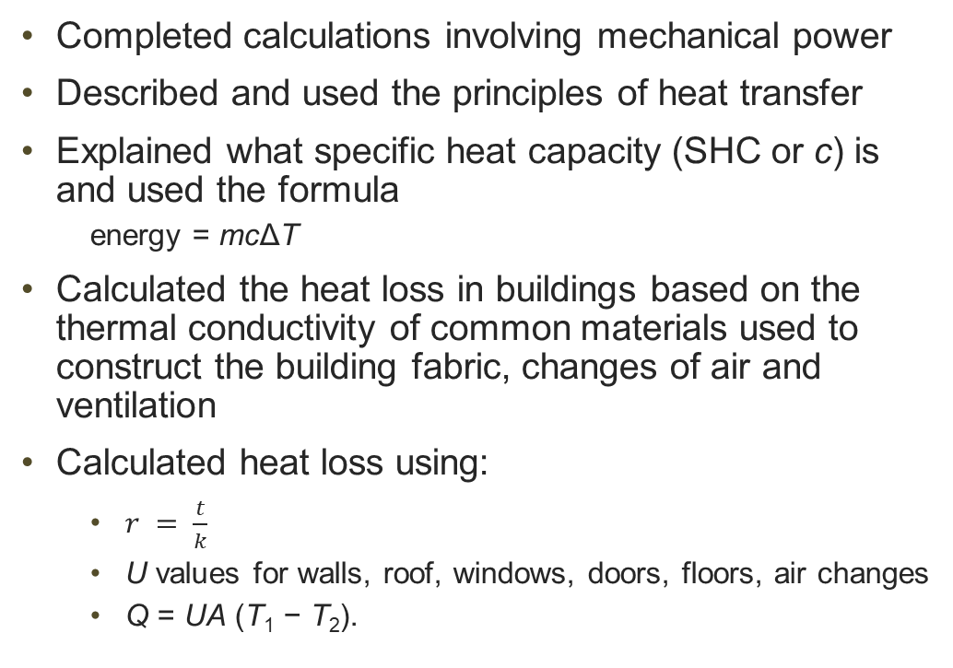
In this resource, we have:
Plenary
Completed calculations involving mechanical power
Described and used the principles of heat transfer
Explained what specific heat capacity (SHC or c) is and used the formula
  energy = mcΔT
Calculated the heat loss in buildings based on the thermal conductivity of common materials used to construct the building fabric, changes of air and ventilation
Calculated heat loss using:
  $r = \frac{t}{k}$
  U values for walls, roof, windows, doors, floors, air changes
  Q = UA (T₁ − T₂).
General competencies:
MC4 Using rules and formulae
MC5 Processing data
MC7 Interpreting and representing with mathematical diagrams
MC8 Communicating using mathematics
Resource 4: Key mathematical heat principles

Slide 24
Consolidation
Consolidation
Choose one of the research topics below to prepare a short presentation:
  the science and maths behind vacuum glazing compared to the more commonly used types of double glazing that use gases, and single glazing
  the pros and cons of heat pumps.
Present your findings in a subsequent lesson, either in small groups or to the class.
For the latter topic, think about whether you think heat pumps are a good idea or not for a traditional debate.
Resource 4: Key mathematical heat principles

