Slide 1
Building Services Engineering
Route: Construction
Topic: Practical mathematics
Resource 2: Key mathematical mechanics principles
Notes:
Image © Shutterstock/Gorodenkoff

Slide 2
Quiz questions
Quiz questions
Resource 2: Key mathematical mechanics principles

Slide 3
Question 1
Quiz questions
During an inspection of a commercial heat pump installation, you are reviewing the data from the energy meter that monitors how much energy the system consumes each day. The supervising engineer asks you to confirm which unit is used to measure energy so that the readings can be correctly entered into the commissioning report.
What are the units of energy?
A joules (J)
B newtons (N)
C watts (W)
D pascals (Pa)
Resource 2: Key mathematical mechanics principles

Slide 4
Question 1: Answer
Quiz questions
During an inspection of a commercial heat pump installation, you are reviewing the data from the energy meter that monitors how much energy the system consumes each day. The supervising engineer asks you to confirm which unit is used to measure energy so that the readings can be correctly entered into the commissioning report.
What are the units of energy?
A joules (J)
B newtons (N)
C watts (W)
D pascals (Pa)
joules measure energy
newtons measure force
watts measure power
pascals measure pressure
Resource 2: Key mathematical mechanics principles

Slide 5
Question 2
Quiz questions
A ladder has a mass of 24 kg.
Work out the weight of the ladder.
Take the acceleration due to gravity to be
10 m/s² to help with mental maths.
A 24 kg
B 0.24 N
C 240 N
D 240 kg
Resource 2: Key mathematical mechanics principles

Slide 6
Question 2: Answer
Quiz questions
A ladder has a mass of 24 kg.
Work out the weight of the ladder.
Take the acceleration due to gravity to be
10 m/s² to help with mental maths.
A 24 kg
B 0.24 N
C 240 N
D 240 kg
Weight is mass times acceleration due to gravity.
It is a force.
Weight and force have units N.
Resource 2: Key mathematical mechanics principles

Slide 7
Question 3
Quiz questions
A forklift truck is used to lift a pallet of bricks of mass 500 kg from the ground to a height of 6 m.
Calculate the work done by the forklift truck. Give your answer in kilojoules.
Resource 2: Key mathematical mechanics principles

Slide 8

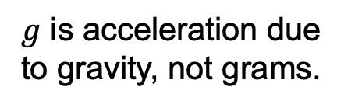
Question 3: Answer
Quiz questions
A forklift truck is used to lift a pallet of bricks of mass 500 kg from the ground to a height of 6 m.
Calculate the work done by the forklift truck. Give your answer in kilojoules.
$F=mg$
$F= 500 kg×9.8 m/s^{2}$
$F= 4900 N$
$W = Fd$
$W= 4900 N×6 m$
$W= 29 400 J$
$W= 29.4 kJ$
$g$ is acceleration due to gravity, not grams.
Resource 2: Key mathematical mechanics principles

Slide 9
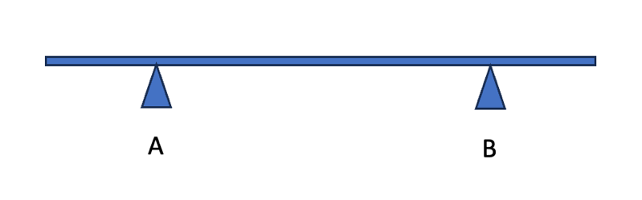
Question 4
Quiz questions
A scaffold board rests on two putlogs as shown in the diagram.
A weight of 40 N is placed 1.5 m to the right pivot B.
Calculate the value and direction of the moment, clearly stating the units.
Resource 2: Key mathematical mechanics principles

Slide 10
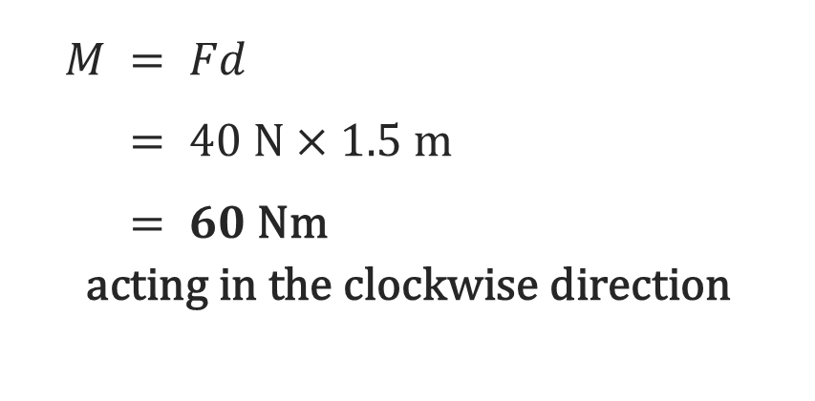
Question 4: Answer
Quiz questions
$M = Fd$
$M = 40 N×1.5 \text{m}$
$M = 60 \text{Nm}$
$\text{acting} \text{in} \text{the} \text{clockwise} \text{direction}$
A scaffold board rests on two putlogs as shown in the diagram.
A weight of 40 N is placed 1.5 m to the right pivot B.
Calculate the value and direction of the moment, clearly stating the units.
Moments have units Nm, not J.
Joules are for work done.
State the direction of the moment.
Resource 2: Key mathematical mechanics principles

Slide 11
Question 5
Quiz questions
A builder pushes a heavy wheelbarrow across level ground. The worker supplies an input power of 200 W. Due to rolling resistance, only 160 W is transferred into useful forward motion.
Calculate the mechanical efficiency of the task.
State one reason why the efficiency is less than 100%.
Resource 2: Key mathematical mechanics principles

Slide 12
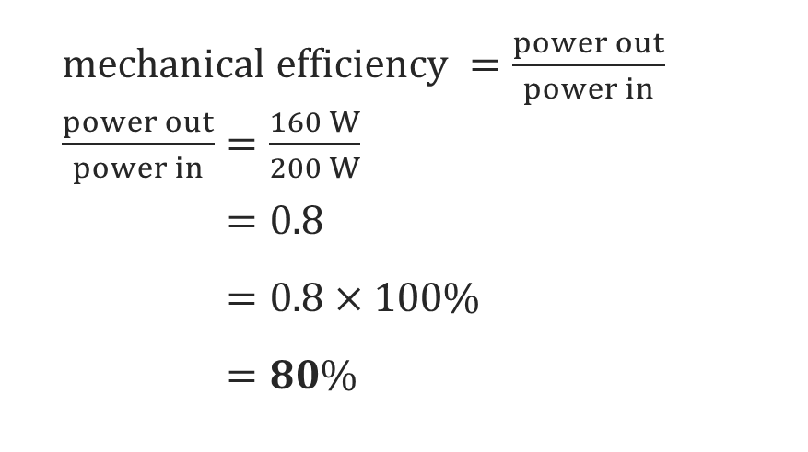
Question 5: Answer
Quiz questions
A builder pushes a heavy wheelbarrow across level ground. The worker supplies an input power of 200 W. Due to rolling resistance, only 160 W is transferred into useful forward motion.
Calculate the mechanical efficiency of the task.
State one reason why the efficiency is less than 100%.
$mechanical efficiency =\frac{power out}{power in}$
$\frac{power out}{power in}=\frac{160 W}{200 W}$
$\frac{power out}{power in}=0.8$
$\frac{power out}{power in}=0.8×100\%$
$\frac{power out}{power in}=80\%$
Valid reasons include: friction, resistance from soft/uneven ground, tyre deformation, side to side motion.
Resource 2: Key mathematical mechanics principles

Slide 13
Question 6
Quiz questions
A scissor lift lifts concrete blocks with a combined mass of 1500 kg through a height of 10 m.
Work out the power required to complete the task in 20 s.
Give your answer in kilowatts.
Resource 2: Key mathematical mechanics principles

Slide 14
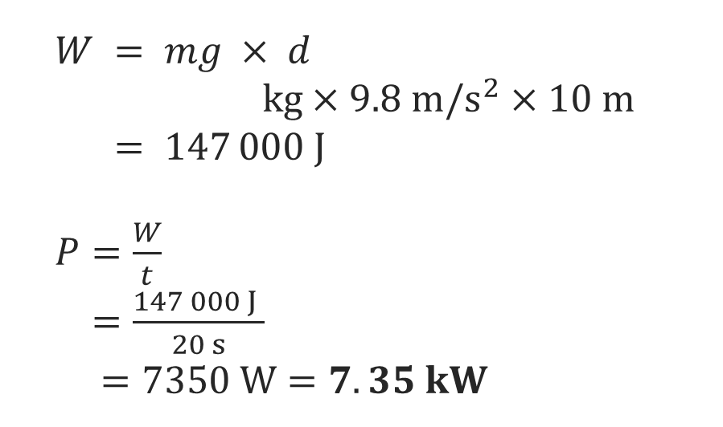
Question 6: Answer
Quiz questions
$W = mg × d$
$W = 1500 kg×9.8 m/s^{2}×10 m$
$W = 147 000 J$
$P=\frac{W}{t}$
$P=\frac{147 000 J }{20 s}$
$P =7350 W=7.35 kW$
A scissor lift lifts concrete blocks with a combined mass of 1500 kg through a height of 10 m.
Work out the power required to complete the task in 20 s.
Give your answer in kilowatts.
Power is the rate of work.
Remember to include units.
Resource 2: Key mathematical mechanics principles

