Slide 1
Building Services Engineering
Route: Construction
Topic: Practical mathematics
Resource 2: Key mathematical mechanics principles
Notes:
Image © Shutterstock/Gorodenkoff

Slide 2
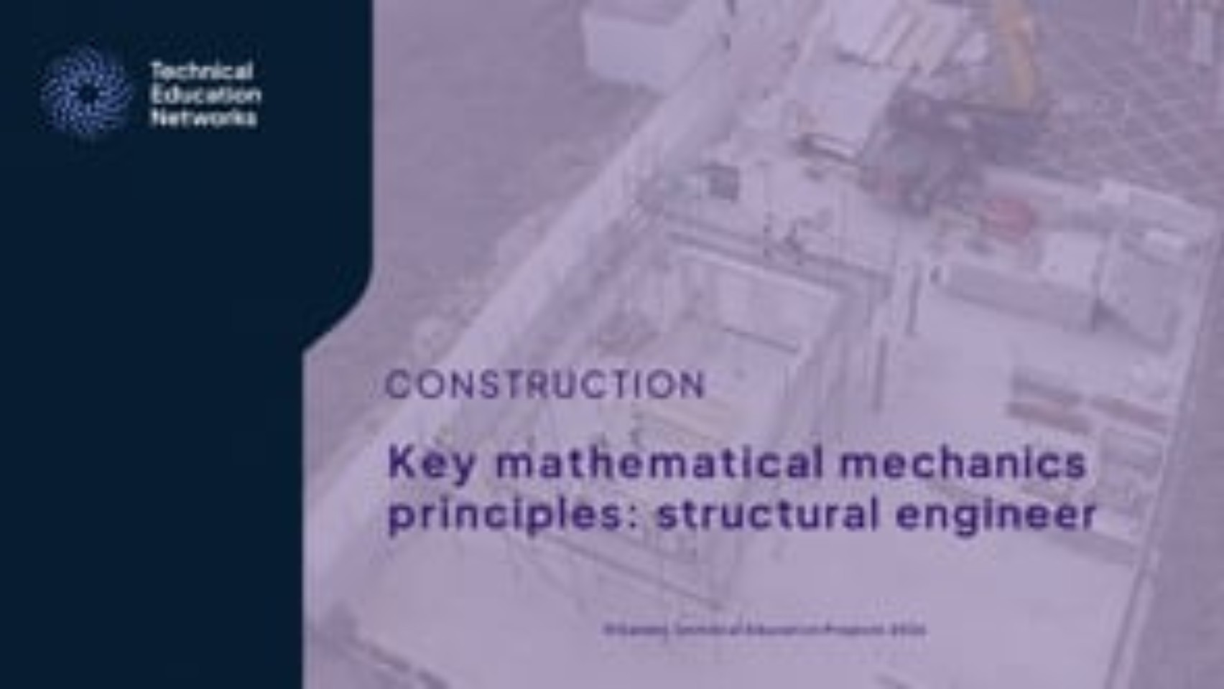
Key mathematical mechanics principles: structural engineer
Video
Resource 2: Key mathematical mechanics principles
Notes:
Key mathematical mechanics principles: structural engineer video: https://vimeo.com/1198454546/2632cafae6

Slide 3
In this resource, we will:
Introduction
Explain the effects of gravity in terms of acceleration
Explain the relationship between energy and power in terms of time
Describe how efficiency changes input and output power values including typical losses associated with efficiency
Describe the relationship between acceleration, force, work, energy, power, and work done
Explain the basic principles of levers, pulleys and moments
Complete calculations involving key formulae
General competencies:
MC4 Using rules and formulae
MC5 Processing data
MC7 Interpreting and representing with mathematical diagrams
MC8 Communicating using mathematics
Resource 2: Key mathematical mechanics principles

Slide 4
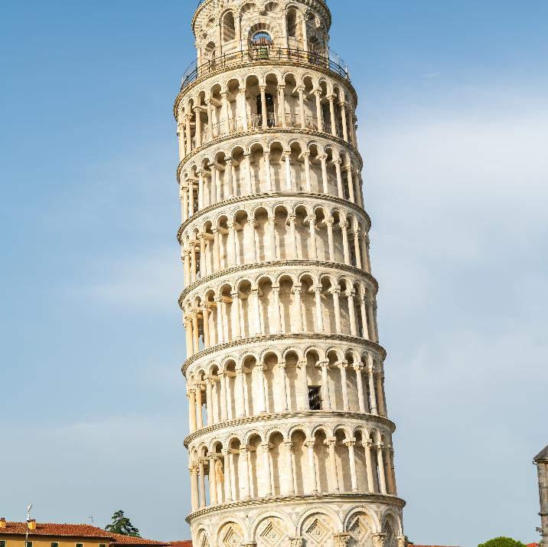
Gravitational freefall and mass
Forces
In the absence of air resistance, all objects fall at the same rate regardless of mass.
This idea is often instinctively rejected, but it is easy to prove.
The confusion arises because objects in air experience air resistance or drag, which acts in the opposite direction to their motion.
Resource 2: Key mathematical mechanics principles
Notes:
Image © Shutterstock/Collection Maykova

Slide 5
Acceleration due to gravity
Forces
TIP
If anyone attempts to argue this principle with you by dropping a piece of paper with another object, crumple the paper into a tight ball and repeat the experiment, or use a large block of printer paper!
Gravity causes objects to accelerate independently of their mass. On Earth, the gravitational acceleration is approximately 9.8 m/s².
This means that the velocity of a falling object increases by about 9.8 m/s every second, as long as no other forces (like air resistance) are acting on it.
Objects with mass attract each other, and how strong the attraction, depends on the mass of both objects. Because the Earth is so massive compared to most objects, only the mass of the Earth matters in calculations on Earth, so the attraction between them is considered constant: 9.8 m/s².
Resource 2: Key mathematical mechanics principles

Slide 6

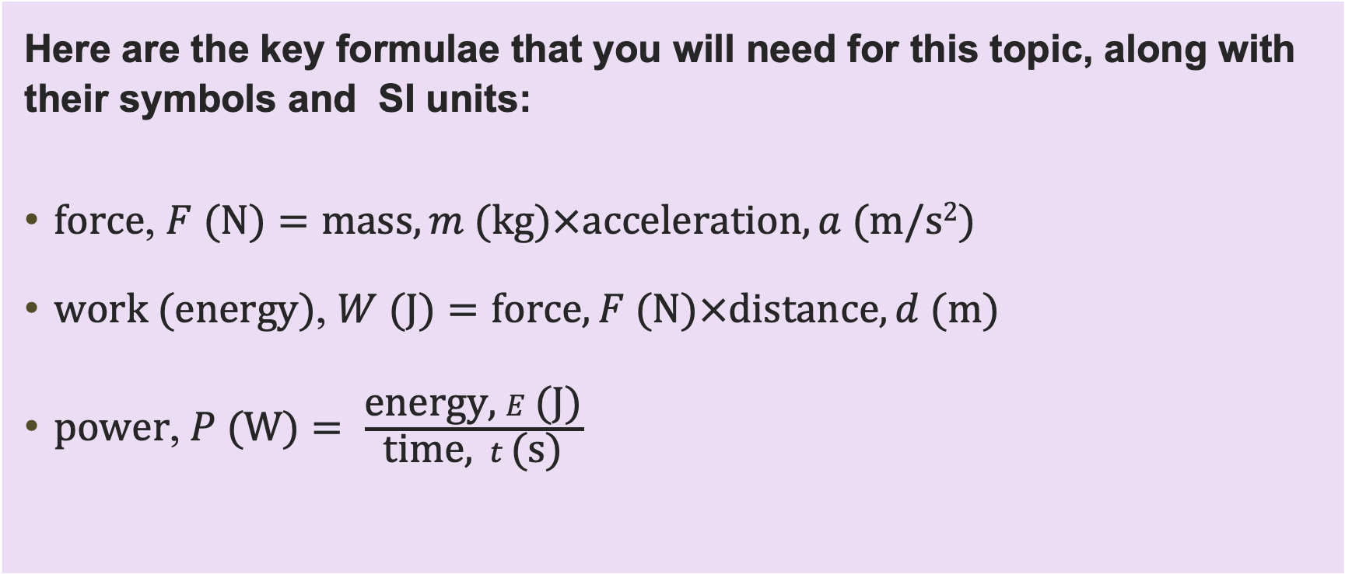
Key formulae for mechanical science principles
Forces
Here are the key formulae that you will need for this topic, along with their symbols and SI units:
force, $F \text{(}\text{N}\text{)}=\text{mass}, m \text{(}\text{kg}\text{)}×\text{acceleration}, a \text{(}\text{m}\text{/}\text{s}\text{2}\text{)}$
work (energy), $W \text{(}\text{J}\text{)}=\text{force}, F \text{(}\text{N}\text{)}×\text{distance}, d \text{(}\text{m}\text{)}$
power,$P \text{(}\text{W}\text{)}= \frac{\text{energy}\text{, }E\text{ (}\text{J}\text{)}}{\text{time}\text{, } t \text{(}\text{s}\text{)}}$
Resource 2: Key mathematical mechanics principles

Slide 7
Thinking in forces
Forces
Think of examples of each type of force.
  Tension: Pulling forces that stretch materials
  Compression: Pushing forces that compact materials
  Bending: Combined tension and compression creating curvature
  Torsion: Twisting forces causing rotational stress
Resource 2: Key mathematical mechanics principles

Slide 8
Thinking in forces: Answers
Forces
Think of examples of each type of force.
  Tension: Pulling forces that stretch materials
  Wires stretched between pylons
  Compression: Pushing forces that compact materials
  The weight of a building on concrete pillars
  Bending: Combined tension and compression creating curvature
  A shelf bending under the weight of books
  Torsion: Twisting forces causing rotational stress
  The twisting on a drive shaft
Resource 2: Key mathematical mechanics principles

Slide 9
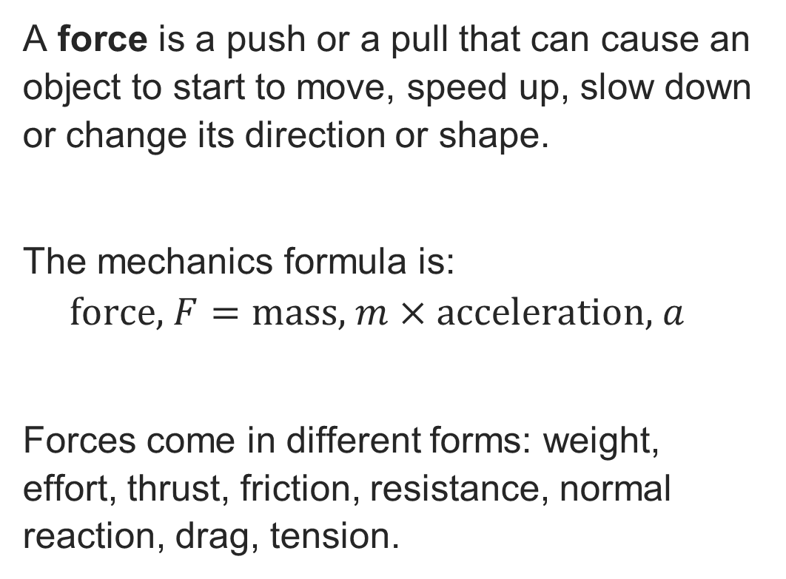
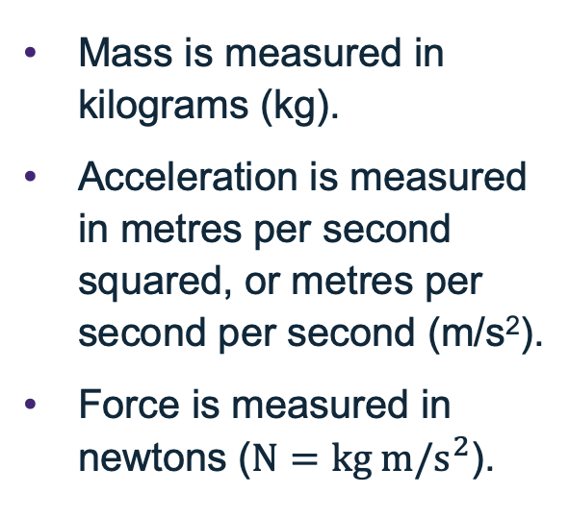
What is a force?
Forces
A force is a push or a pull that can cause an object to start to move, speed up, slow down or change its direction or shape.
The mechanics formula is:
$$\text{force}\text{, }F=\text{mass}\text{, }m×\text{acceleration}\text{, }a$$
Forces come in different forms: weight, effort, thrust, friction, resistance, normal reaction, drag, tension.
The variables
Mass is measured in kilograms (kg).
Acceleration is measured in metres per second squared, or metres per second per second (m/s²).
Force is measured in newtons ($N=\text{kg} \text{m}\text{/}{\text{s}}^{2}$).
Resource 2: Key mathematical mechanics principles

Slide 10
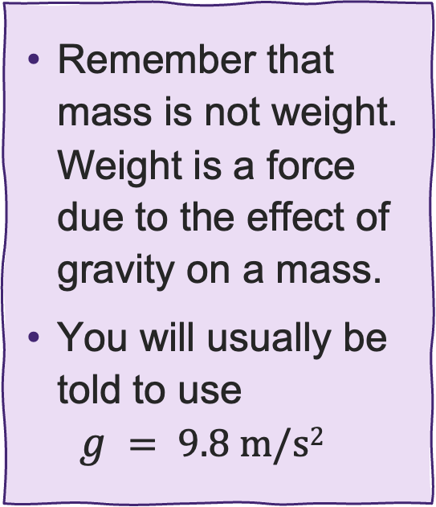
Calculating force
Forces
A carpenter needs to use 20 wooden joists.
She knows that one joist has a mass of 1.6 kg. Calculate the weight of the 20 joists.
Remember that mass is not weight. Weight is a force due to the effect of gravity on a mass.
You will usually be told to use
$g = 9.8 \text{m}\text{/}\text{s}\text{2}$
Resource 2: Key mathematical mechanics principles

Slide 11
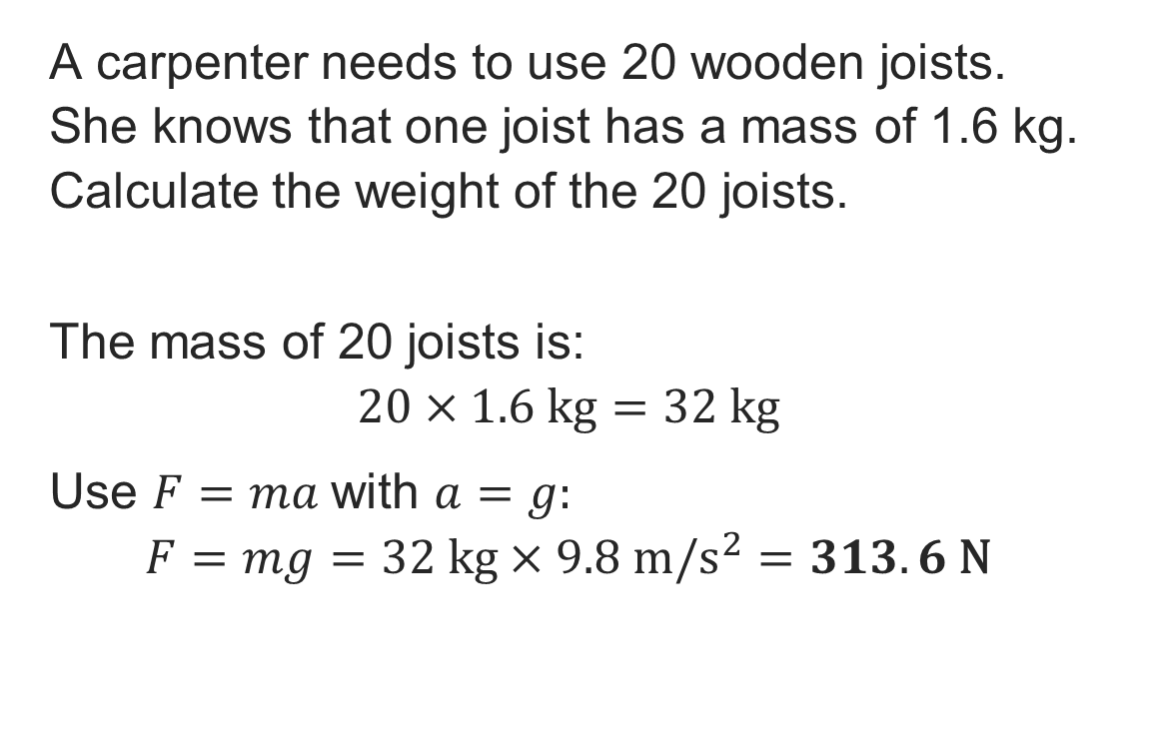
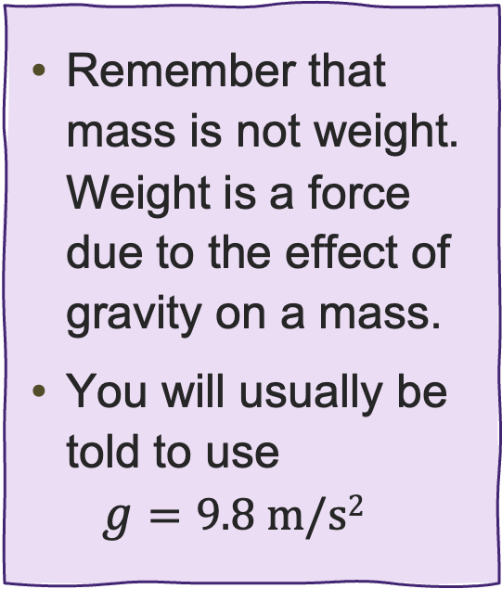
Calculating force: Answer
Forces
A carpenter needs to use 20 wooden joists.
She knows that one joist has a mass of 1.6 kg. Calculate the weight of the 20 joists.
The mass of 20 joists is:
$$20×1.6 \text{kg}=32 \text{kg}$$
Use $F=ma$with $a=g:$
$$F=mg=32 \text{kg}×9.8 m/s^{2}=313.6 \text{N}$$
Remember that mass is not weight. Weight is a force due to the effect of gravity on a mass.
You will usually be told to use
$g=9.8 \text{m}\text{/}\text{s}\text{2}$
Resource 2: Key mathematical mechanics principles

Slide 12
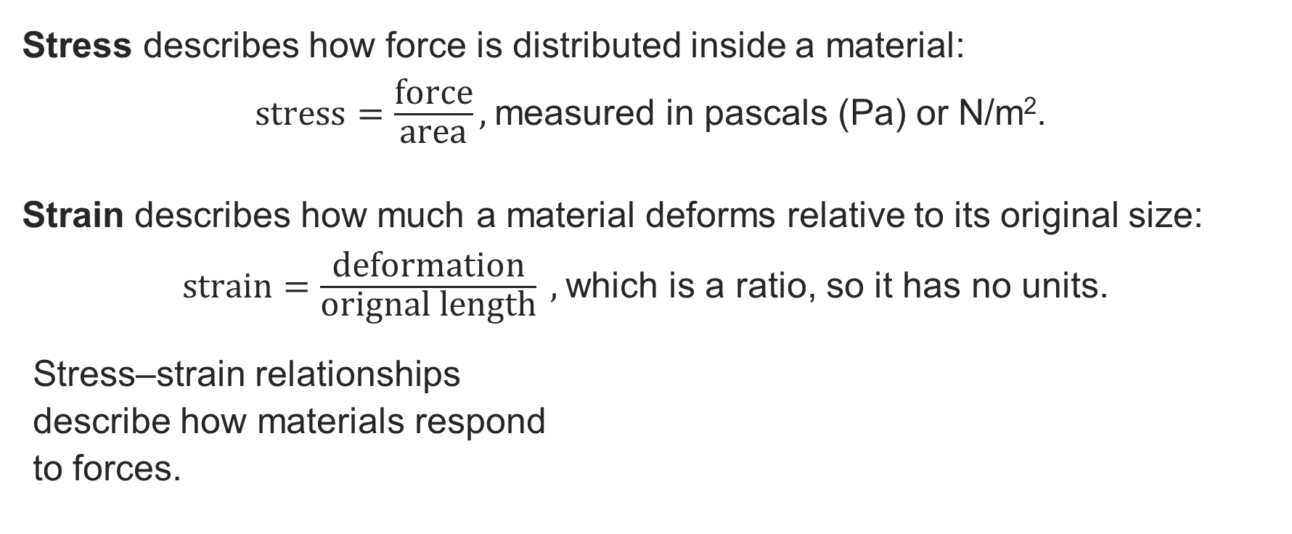
How materials respond to force
Forces
Stress describes how force is distributed inside a material:
$\text{s}\text{tress}=\frac{\text{force}}{\text{area}},$measured in pascals (Pa) or N/m².
Strain describes how much a material deforms relative to its original size:
$\text{strain}=\frac{\text{deformation}}{\text{orignal} \text{length}} ,$which is a ratio, so it has no units.
Stress–strain relationships
describe how materials respond
to forces.
Mini task
Which material has a higher strain under the same load: Rubber or concrete?
Resource 2: Key mathematical mechanics principles

Slide 13
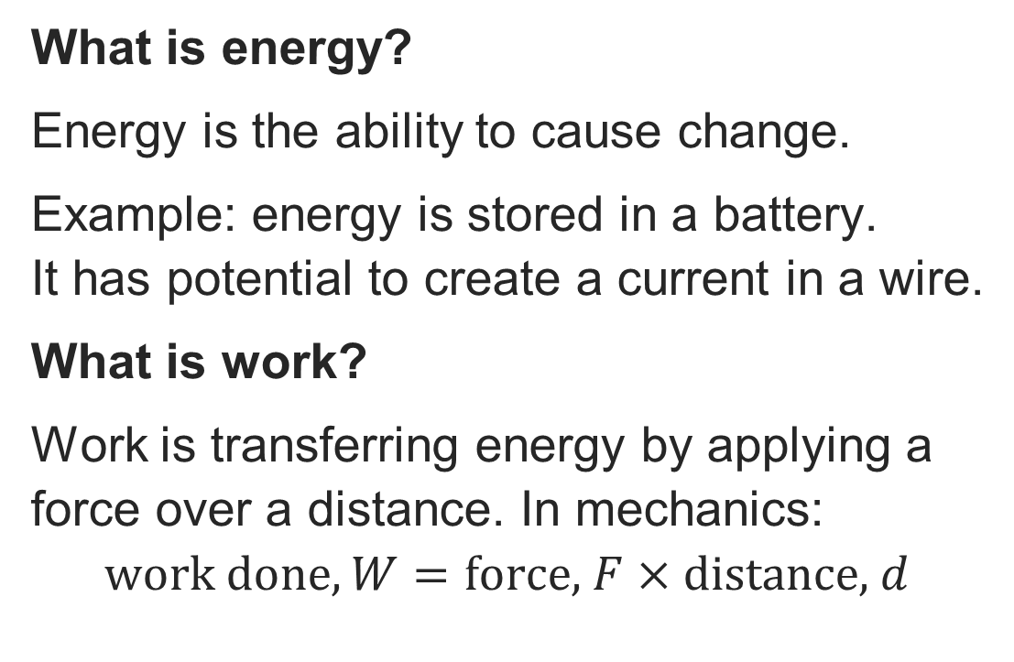
Energy and work done
Energy and work done
What is energy?
Energy is the ability to cause change.
Example: energy is stored in a battery.
It has potential to create a current in a wire.
What is work?
Work is transferring energy by applying a force over a distance. In mechanics:
$$work done, W=\text{force}\text{, }F×\text{distance}\text{, }d$$
The variables
Work done (energy) is measured in joules (J).
Power is measured in watts (W).
Time is measured in seconds (s).
If you are given hours or minutes in a question, remember to convert to seconds!
Resource 2: Key mathematical mechanics principles

Slide 14
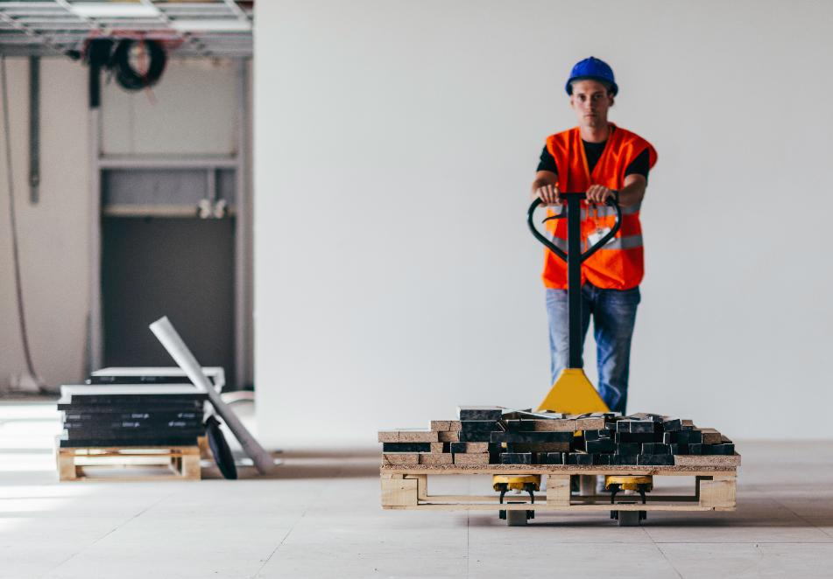
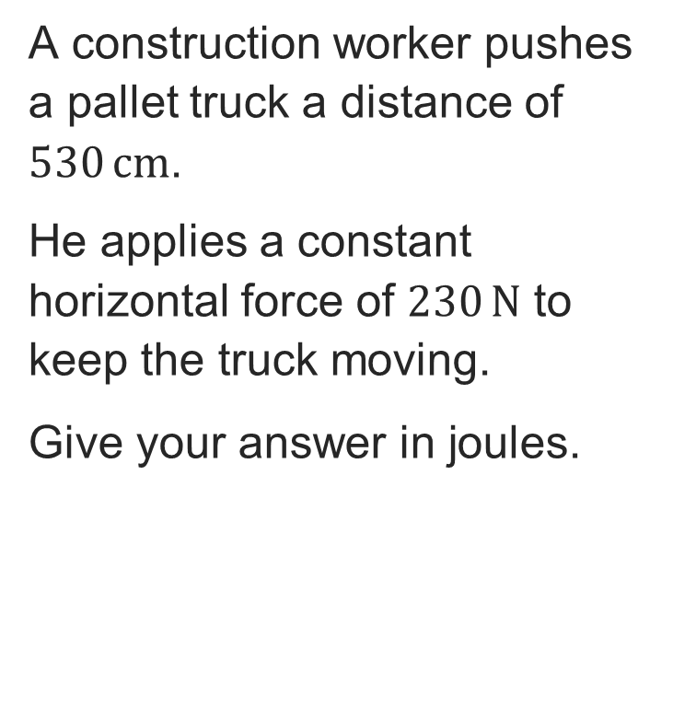
Calculating work done
Energy and work done
A construction worker pushes a pallet truck a distance of $530 \text{cm}$.
He applies a constant horizontal force of $230 \text{N}$ to keep the truck moving.
Give your answer in joules.
Resource 2: Key mathematical mechanics principles
Notes:
Image © Shutterstock/Microgen

Slide 15
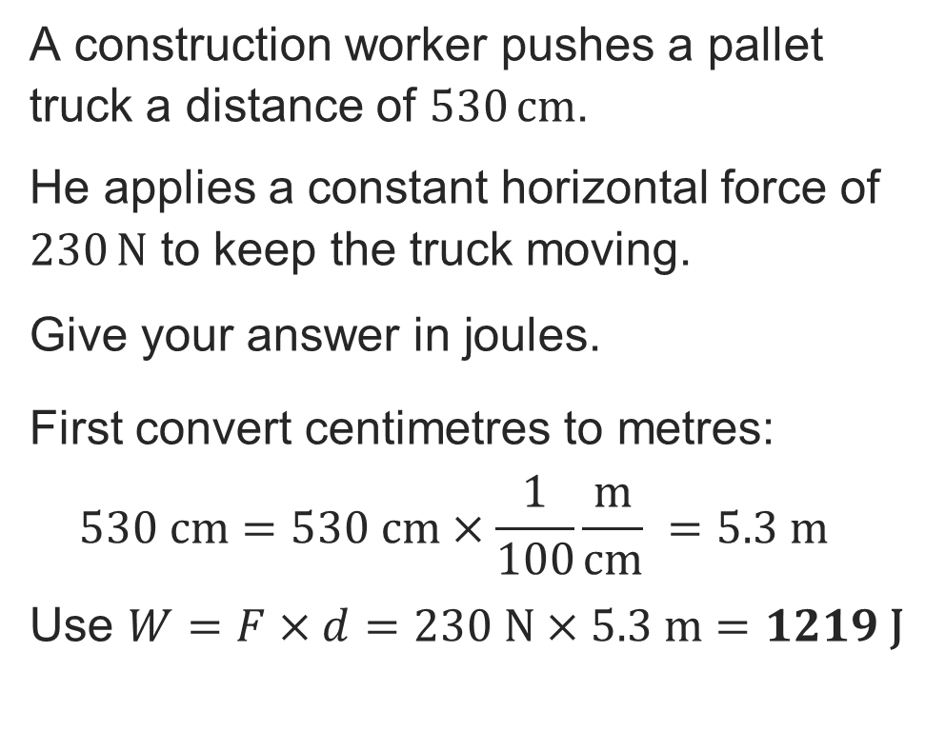
Calculating work done: Answer
Energy and work done
A construction worker pushes a pallet truck a distance of $530 \text{cm}$.
He applies a constant horizontal force of $230 \text{N}$ to keep the truck moving.
Give your answer in joules.
First convert centimetres to metres:
$$530 \text{cm}=530 \text{cm}×\frac{1}{100}\frac{\text{m}}{\text{cm}} =5.3 \text{m}$$
Use $W=F×d=230 \text{N}×5.3 \text{m}=1219 \text{J}$
EXAM TIP
Always show your reasoning clearly. You can never write down too much information, and sometimes just writing a formula will get you marks.
Resource 2: Key mathematical mechanics principles

Slide 16
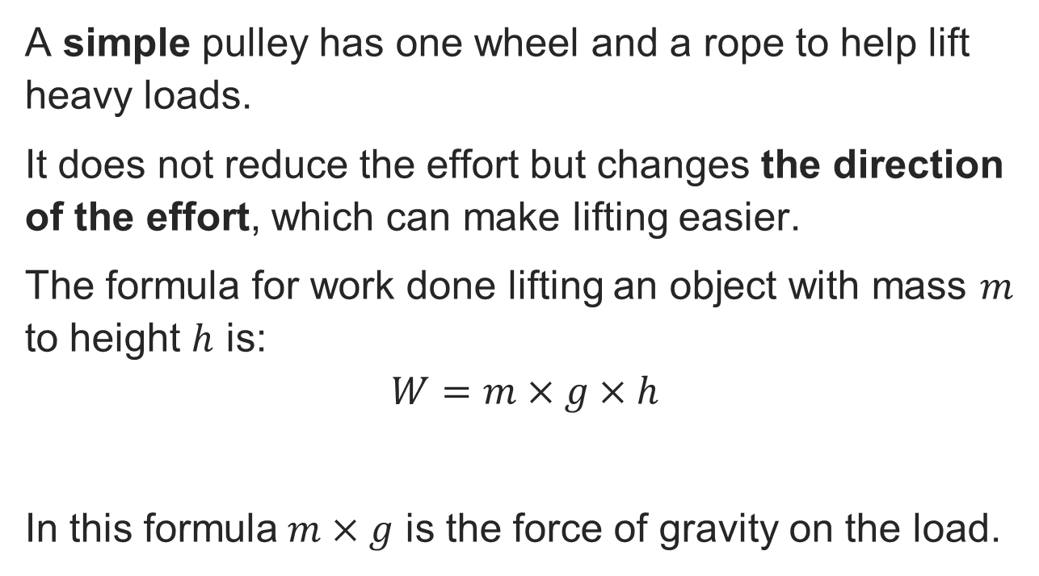
Simple pulley
Energy and work done
rope
wheel
A simple pulley has one wheel and a rope to help lift heavy loads.
It does not reduce the effort but changes the direction of the effort, which can make lifting easier.
The formula for work done lifting an object with mass $m$ to height $h$ is:
$$W=m×g×h$$
In this formula$m×g$ is the force of gravity on the load.
effort
load
Resource 2: Key mathematical mechanics principles

Slide 17
Pulleys that reduce effort
Energy and work done
fixed wheel
rope
free wheel
Pulleys can be designed reduce effort.
This pulley reduces the force required by half because there are two rope segments pulling on the load.
The user will need to pull the rope twice as far, so the same work is done over a longer distance, which reduces the force required.
½ load
load
effort
Resource 2: Key mathematical mechanics principles

Slide 18
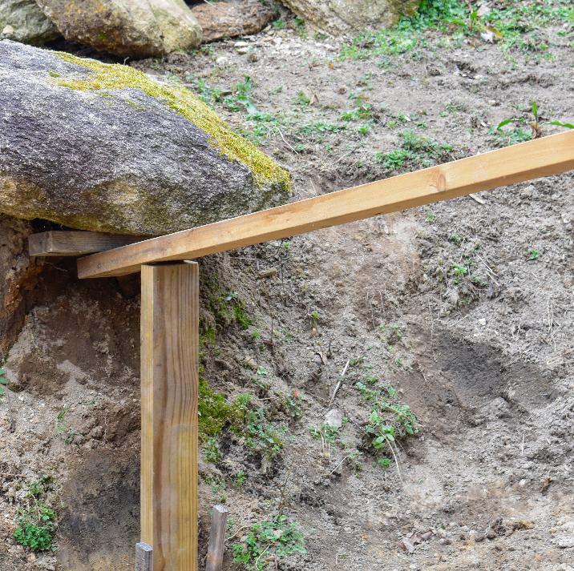
Levers as a tool
Moments and torque
More than 2000 years ago, the Greek philosopher Archimedes said:
"Give me a place to stand and a lever long enough, and I will move the world."
What do you think he meant by this?
Resource 2: Key mathematical mechanics principles
Notes:
Image © Shutterstock/Pat Marais

Slide 19
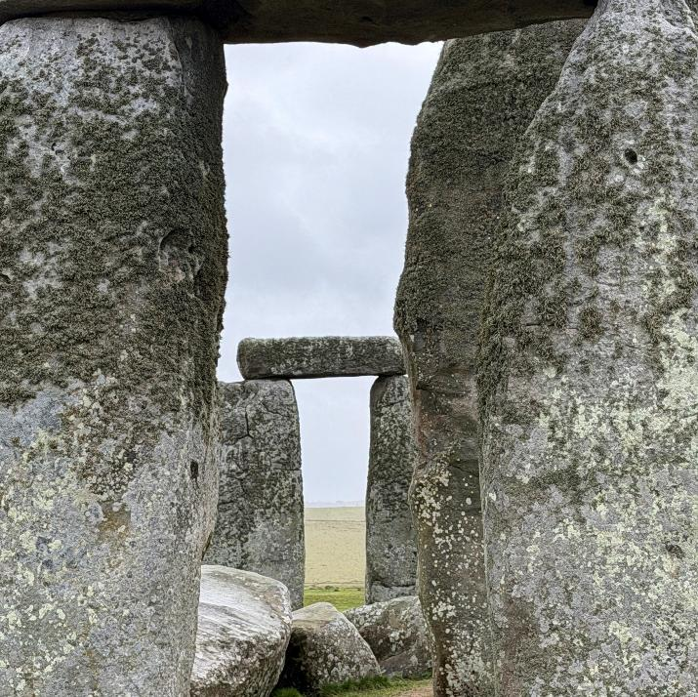
Some history of levers
Moments and torque
Whilst Archimedes was the first person known to write about levers, simple levers such as sticks and oars were used many years before he was born.
Levers were used in ancient Egypt and Mesopotamia to lift water and large stone structures known as obelisks.
They were also used to position the standing stones to create Stonehenge.
Resource 2: Key mathematical mechanics principles
Notes:
Image © Shutterstock/Second Saturn

Slide 20
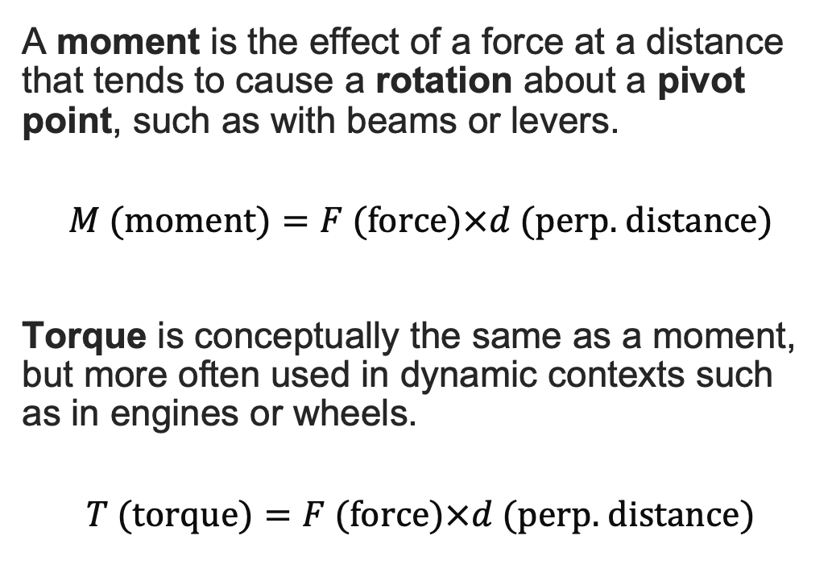
Moments and torque
Moments and torque
A moment is the effect of a force at a distance that tends to cause a rotation about a pivot point, such as with beams or levers.
$$M \text{(}\text{moment}\text{)}=F \text{(}\text{force}\text{)}×d \text{(}\text{perp}\text{. }\text{distance}\text{)}$$
Torque is conceptually the same as a moment, but more often used in dynamic contexts such as in engines or wheels.
$$T \text{(}\text{torque}\text{)}=F \text{(}\text{force}\text{)}×d \text{(}\text{perp}\text{. }\text{distance}\text{)}$$
The variables
Force is measured in newtons (N).
Distance is measured in metres, perpendicular from the pivot (m).
Moment measures the turning force in the direction of the force and is measured in newton-metres (Nm).
1 Nm = 1 J if work is done.
Resource 2: Key mathematical mechanics principles

Slide 21
How does a lever work?
Moments and torque
Levers provide a mechanical advantage by doing work over a longer distance.
There are three categories of lever:
Class 1: fulcrum located between effort and load.
Class 2: load located between fulcrum and effort.
Class 3: effort located between fulcrum and load.
effort (input force)
load
(opposing force)
rigid bar (beam)
fulcrum
Resource 2: Key mathematical mechanics principles

Slide 22
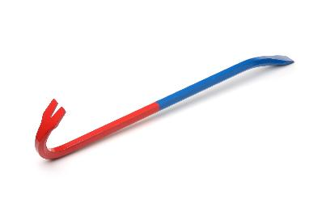
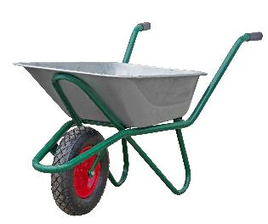
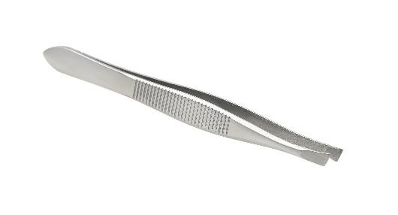
Three classes of lever
Moments and torque
Exercise
When each of these tools is being used, identify the typical positions of the fulcrum, effort and load, and thus the class of lever.
Resource 2: Key mathematical mechanics principles
Notes:
Image (left) (c) Shutterstock/Anton Starikov
Image (centre) (c) Shutterstock/Pedal to the Stock
Image (right) (c) Shutterstock/Passakorn sakulphan

Slide 23
Three classes of lever
Moments and torque
Exercise
Can you give another example of each class of lever?
load
(object)
effort
effort
effort (fingers)
load
(contents)
fulcrum
load
(object)
fulcrum
fulcrum
Resource 2: Key mathematical mechanics principles
Notes:
Image (left) (c) Shutterstock/Anton Starikov
Image (centre) (c) Shutterstock/Pedal to the Stock
Image (right) (c) Shutterstock/Passakorn sakulphan

Slide 24

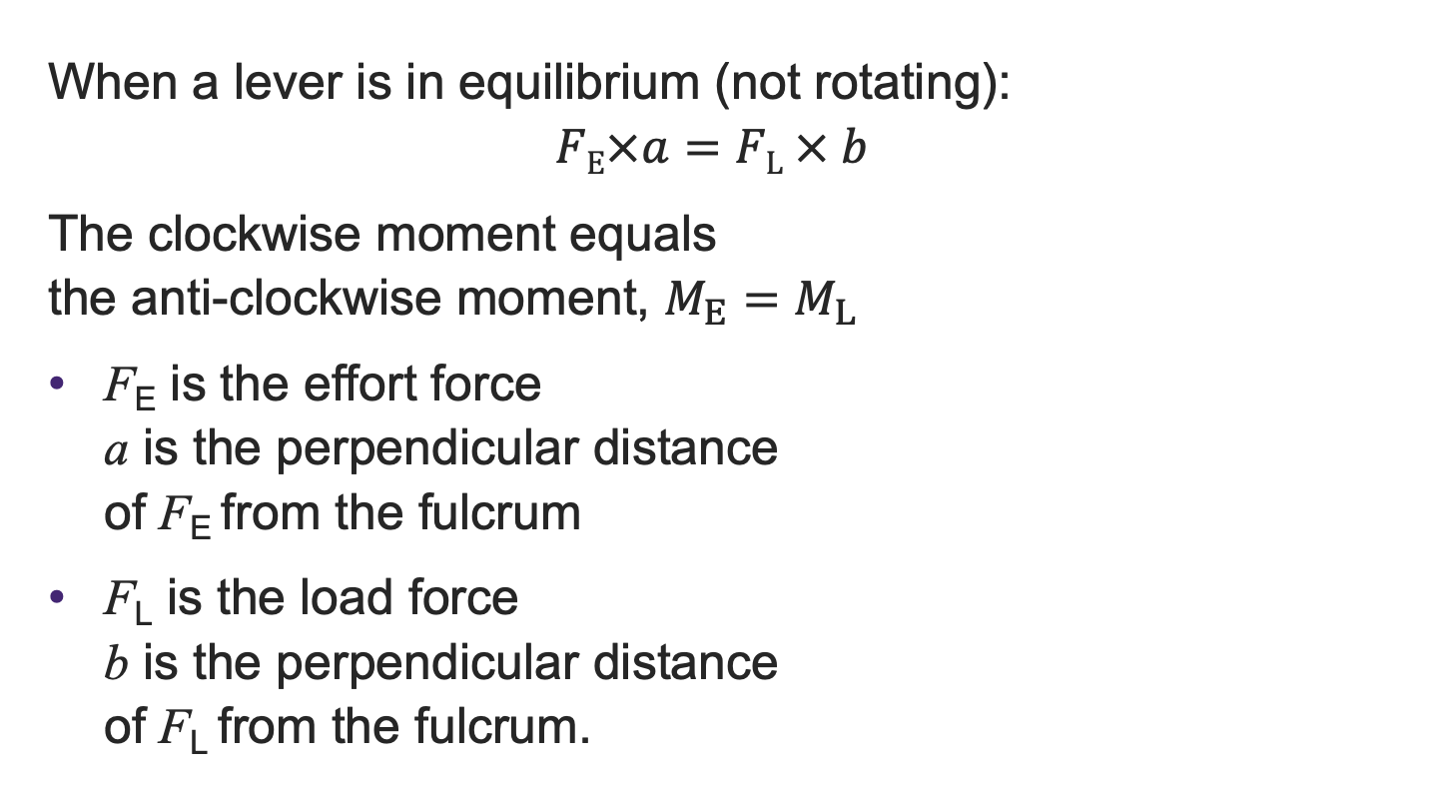





The theory of moments
Moments and torque
$$F_{E}$$
When a lever is in equilibrium (not rotating):
$$FE×a=FL × b$$
The clockwise moment equals
the anti-clockwise moment, $M_{E}=M_{L}$
F_{E} is the effort force
a is the perpendicular distance
of F_{E} from the fulcrum
F_{L} is the load force
b is the perpendicular distance
of F_{L} from the fulcrum.
$$F_{L}$$
a
b
$$F_{E}$$
a
$$F_{L}$$
b
$$F_{E}$$
a
b
$$F_{L}$$
Resource 2: Key mathematical mechanics principles

Slide 25

Calculating moments
Moments and torque
A plank is balanced on a fulcrum with a 50 N load placed 0.8 m from the fulcrum. An effort 1.4 m from the fulcrum is applied on the other side. Would an effort of 30 N be enough to lift the load?
$${\text{effort}\text{, }F}_{E}$$
0.8 m
1.4 m
50 N
Resource 2: Key mathematical mechanics principles

Slide 26
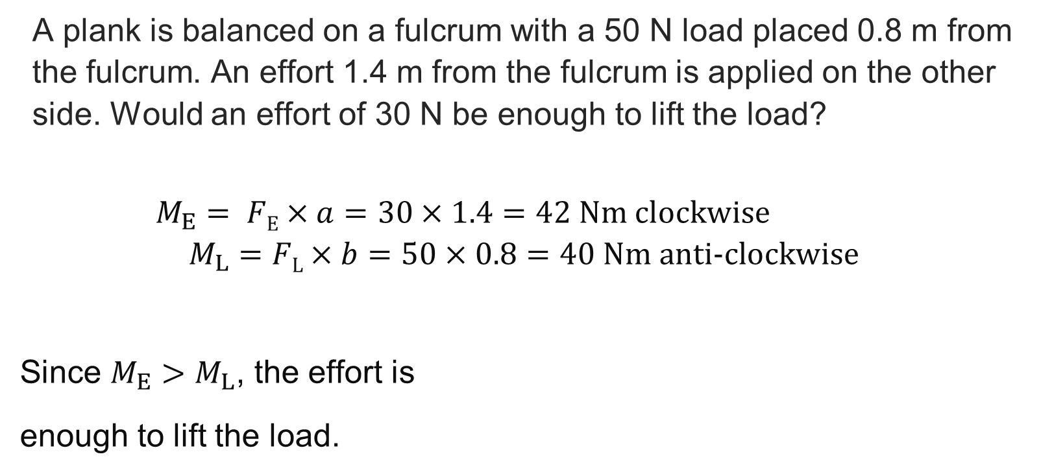
Calculating moments: Answer
Moments and torque
A plank is balanced on a fulcrum with a 50 N load placed 0.8 m from the fulcrum. An effort 1.4 m from the fulcrum is applied on the other side. Would an effort of 30 N be enough to lift the load?
$M_{E}= FE×a=30×1.4=42 \text{N}\text{m}$ clockwise
$$M_{L}=FL×b=50×0.8=40 \text{Nm} \text{anti}\text{−}\text{clockwise}$$
Since $M_{E}>M_{L}$, the effort is
enough to lift the load.
$${\text{effort}\text{, }F}_{E}$$
0.8 m
1.4 m
50 N
Resource 2: Key mathematical mechanics principles

Slide 27
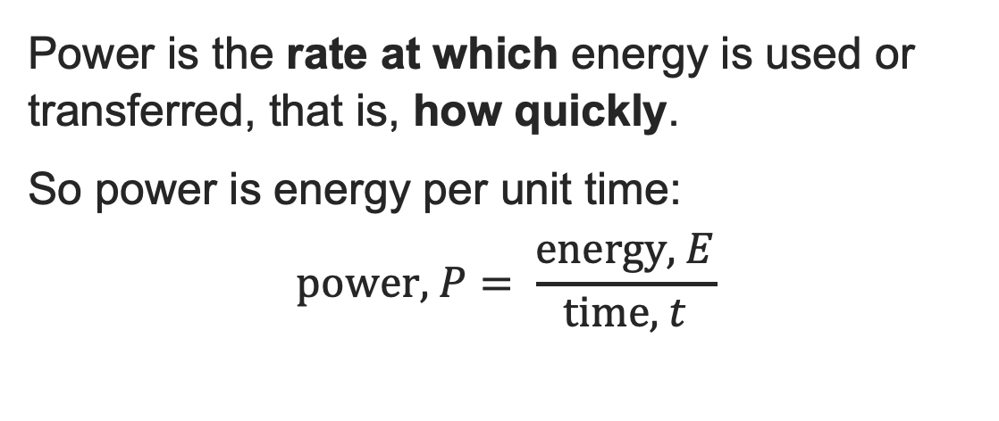
What is power?
Power
Power is the rate at which energy is used or transferred, that is, how quickly.
So power is energy per unit time:
$$\text{p}\text{ower}\text{, }P= \frac{\text{energy}\text{, }E}{\text{time}\text{, }t}$$
The variables
Energy is measured in joules (J).
Power is measured in watts (W) .
Time is measured in seconds (s).
If you are given hours or minutes in a question, remember to convert to seconds!
SITE TIP
We calculate power to size our generators.
Running a 12-kW concrete breaker will trip the supply of a 10-kW generator and stop work.
Resource 2: Key mathematical mechanics principles

Slide 28
Calculating power
Power
The worker in the previous question pushes the pallet truck the required distance in exactly 5 seconds. How much power, to the nearest integer, is required to move the pallet truck?
Data from the previous question:
force = 230 N
distance = 5.3 m
work done = 1219 J
Work done is the energy in the formula for this problem.
Resource 2: Key mathematical mechanics principles

Slide 29
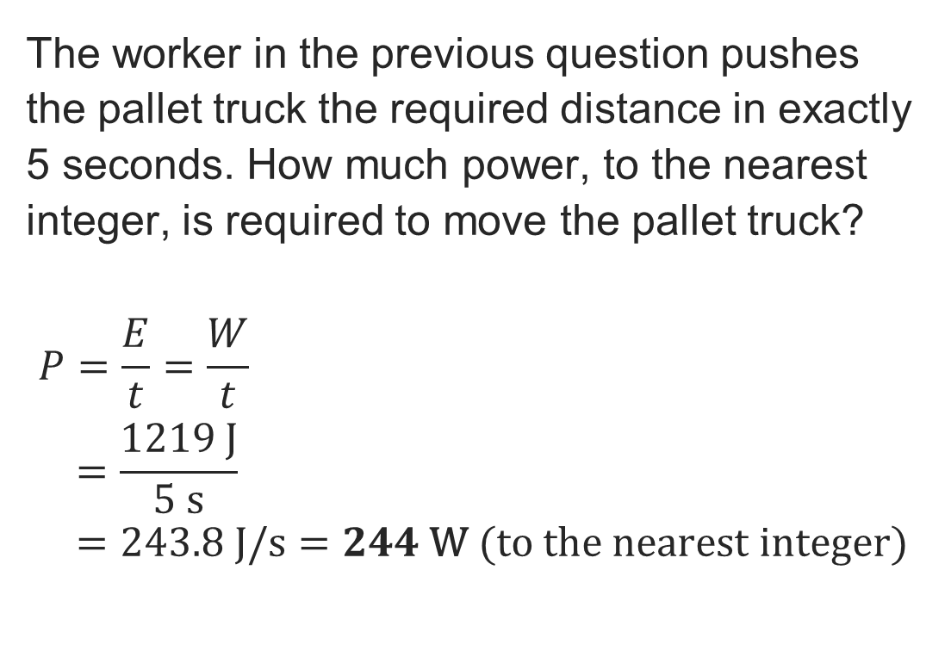
Calculating power: Answer
Power
The worker in the previous question pushes the pallet truck the required distance in exactly 5 seconds. How much power, to the nearest integer, is required to move the pallet truck?
$$P=\frac{E}{t}=\frac{W}{t} \\ =\frac{1219 \text{J}}{5 \text{s}} \\ =243.8 J/s=244 \text{W}\text{ (}\text{to} \text{the} \text{nearest} \text{integer}\text{)}$$
Data from the previous question:
force = 230 N
distance = 5.3 m
work done = 1219 J
Work done is the energy in the formula for this problem.
Resource 2: Key mathematical mechanics principles

Slide 30
Calculating hoist motor efficiency
Power
Using the data provided, how much more efficient is the modern motor than old electric motor? (Part L compliance)
Old motor
input: 10 kW
output: 7.5 kW
Modern motor
input:10 kW
output: 9.2 kW
Resource 2: Key mathematical mechanics principles

Slide 31
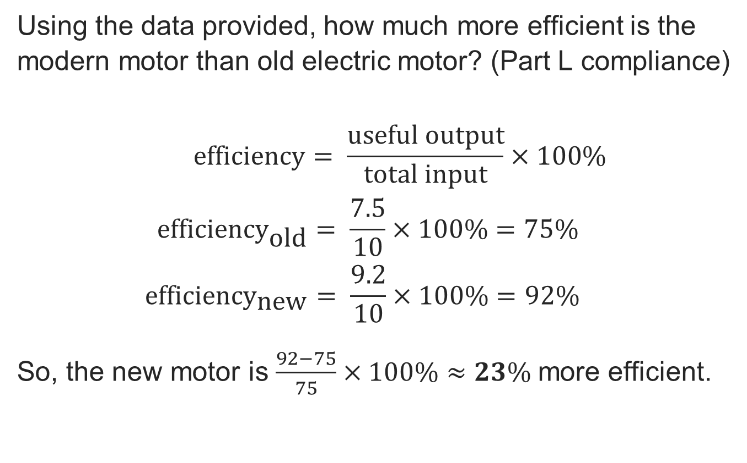
Calculating hoist motor efficiency: Answer
Power
Using the data provided, how much more efficient is the modern motor than old electric motor? (Part L compliance)
$$\text{e}\text{fficiency}= \frac{\text{useful} \text{output}}{\text{total} \text{input}}×100\% \\ {\text{e}\text{fficiency}}_{\text{old}}= \frac{\text{7.5}}{\text{10}}×100\%=75\% \\ {\text{e}\text{fficiency}}_{\text{new}}= \frac{\text{9}.2}{\text{10}}×100\%=92\%$$
So, the new motor is $\frac{92−75}{75}×100\%≈23\%$more efficient.
Old motor
input: 10 kW
output: 7.5 kW
Modern motor
input:10 kW
output: 9.2 kW
Resource 2: Key mathematical mechanics principles

Slide 32
In this resource, we have:
Plenary
Explained the effects of gravity in terms of acceleration
Explained the relationship between energy and power in terms of time
Described how efficiency changes input and output power values including typical losses associated with efficiency
Described the relationship between acceleration, force, work, energy, power, and work done
Explained the basic principles of levers, pulleys and moments
Completed calculations involving key formulae
General competencies:
MC4 Using rules and formulae
MC5 Processing data
MC7 Interpreting and representing with mathematical diagrams
MC8 Communicating using mathematics
Resource 2: Key mathematical mechanics principles

Slide 33
Consolidation
Consolidation
Choose one of the research topics below to prepare a short presentation:
  The mechanical principles behind reinforcing of the Millennium Bridge in London, due to excessive lateral sway.
  Disasters related to inaccurate load calculations as a result of inaccurate calculations.
Present your findings in a subsequent lesson, either in small groups or to the class.
Resource 2: Key mathematical mechanics principles

