Slide 1
Building Services Engineering
Route: Construction
Topic: Practical mathematics
Resource 1: Key mathematical science principles
Notes:
Image © Shutterstock/Gorodenkoff

Slide 2
Quiz questions
Resource 1: Key mathematical science principles

Slide 3
Question 1
Quiz questions
You are assisting on-site at a commercial plant room refurbishment. While lifting a new pump into position, an engineer explains that the support brackets must be able to withstand the force exerted by the pump during operation. The engineer hands you the product data sheet and asks you to confirm which unit of measurement is used to specify force.
Which of the following units is used to measure force?
A watts
B newtons
C kilograms
D joules
Resource 1: Key mathematical science principles

Slide 4
Question 1: Answer
Quiz questions
styles
You are assisting on-site at a commercial plant room refurbishment. While lifting a new pump into position, an engineer explains that the support brackets must be able to withstand the force exerted by the pump during operation. The engineer hands you the product data sheet and asks you to confirm which unit of measurement is used to specify force.
Which of the following units is used to measure force?
A watts
B newtons
C kilograms
D joules
watts measure power,
newtons measure force,
kilograms measure mass,
joules measure energy.
Resource 1: Key mathematical science principles

Slide 5
Question 2
Quiz questions
You are asked to check a sensor that measures extremely small pressure differences across a filter. The engineer reminds you that the sensor outputs readings in micropascals.
What does the prefix micro mean?
A 10⁶
B 10⁹
C 10⁻³
D 10⁻⁶
Resource 1: Key mathematical science principles

Slide 6
Question 2: Answer
Quiz questions
styles
You are asked to check a sensor that measures extremely small pressure differences across a filter. The engineer reminds you that the sensor outputs readings in micropascals.
What does the prefix micro mean?
A 10⁶ mega
B 10⁹ giga
C 10⁻³ milli
D 10⁻⁶ micro
Resource 1: Key mathematical science principles

Slide 7
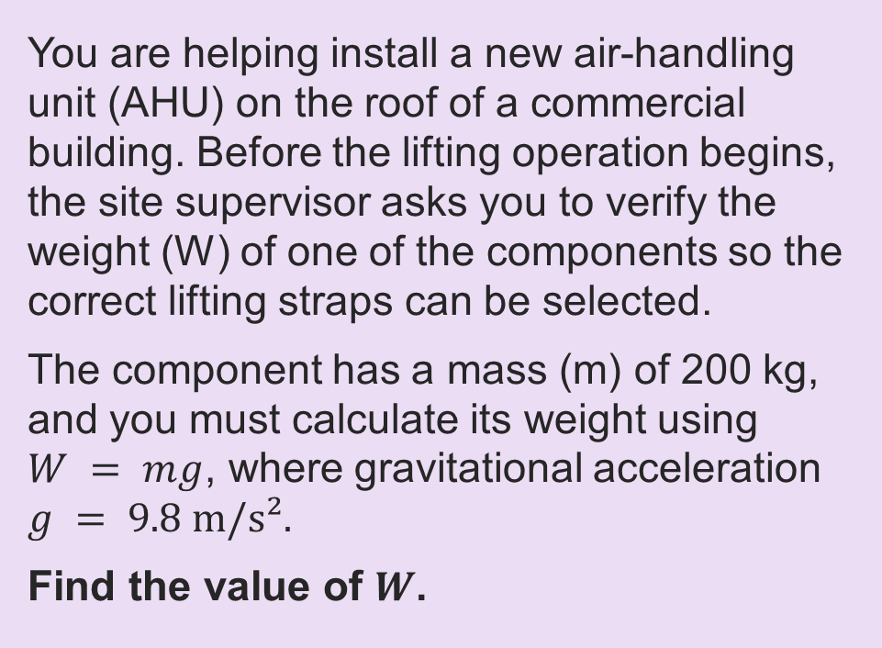
Question 3
Quiz questions
You are helping install a new air-handling unit (AHU) on the roof of a commercial building. Before the lifting operation begins, the site supervisor asks you to verify the weight (W) of one of the components so the correct lifting straps can be selected.
The component has a mass (m) of 200 kg, and you must calculate its weight using $W = mg$, where gravitational acceleration $g = 9.8 m/s².$
Find the value of $W$.
Resource 1: Key mathematical science principles

Slide 8
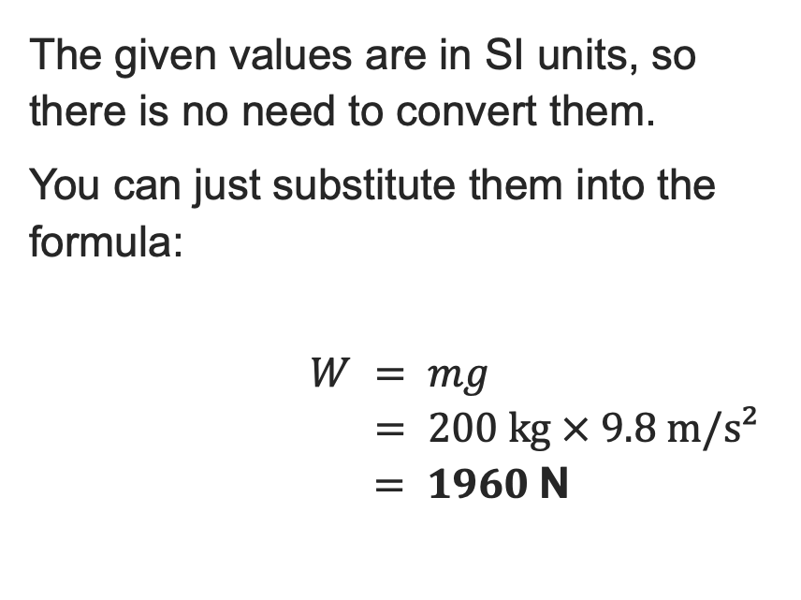
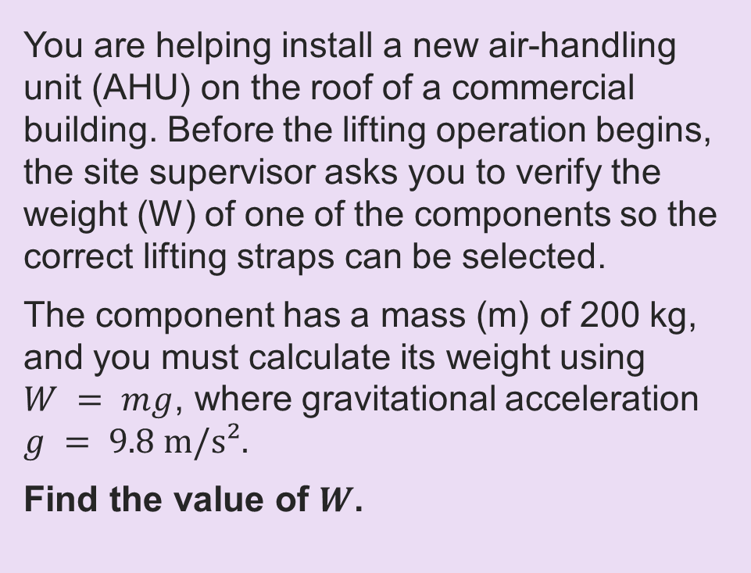
Question 3: Answer
Quiz questions
styles
You are helping install a new air-handling unit (AHU) on the roof of a commercial building. Before the lifting operation begins, the site supervisor asks you to verify the weight (W) of one of the components so the correct lifting straps can be selected.
The component has a mass (m) of 200 kg, and you must calculate its weight using $W = mg$, where gravitational acceleration $g = 9.8 m/s².$
Find the value of $W$.
The given values are in SI units, so there is no need to convert them.
You can just substitute them into the formula:
$$W = mg$$
$$= 200 kg × 9.8 m/s²$$
$$= 1960 \text{N}$$
Resource 1: Key mathematical science principles

Slide 9
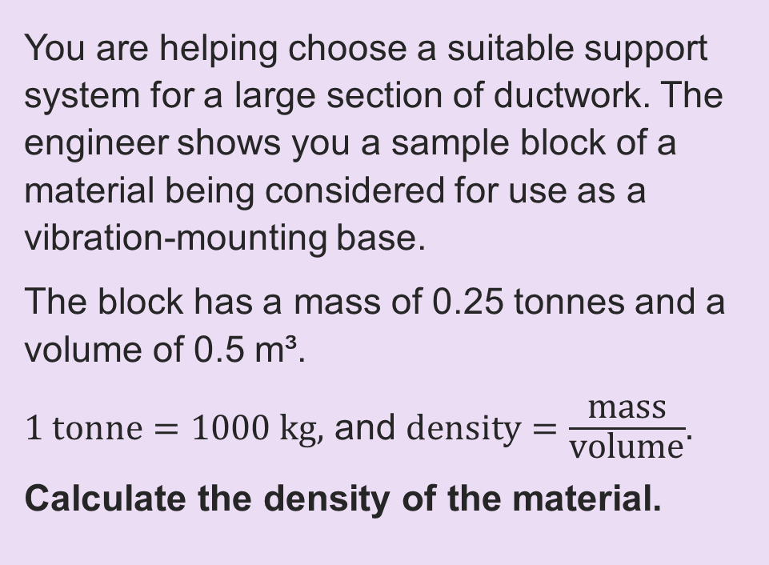
Question 4
Quiz questions
You are helping choose a suitable support system for a large section of ductwork. The engineer shows you a sample block of a material being considered for use as a vibration-mounting base.
The block has a mass of 0.25 tonnes and a volume of 0.5 m³.
$1 tonne=1000 kg,$ and $\text{density}=\frac{\text{mass}}{\text{volume}}$.
Calculate the density of the material.
Resource 1: Key mathematical science principles

Slide 10
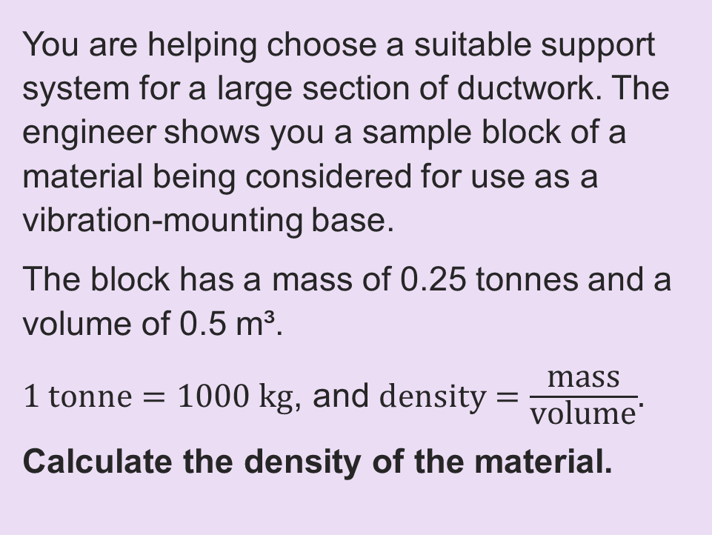
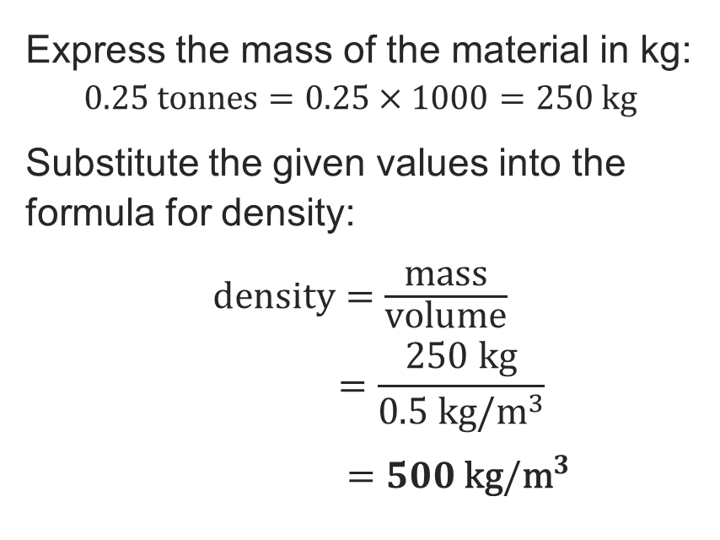
Question 4: Answer
Quiz questions
styles
You are helping choose a suitable support system for a large section of ductwork. The engineer shows you a sample block of a material being considered for use as a vibration-mounting base.
The block has a mass of 0.25 tonnes and a volume of 0.5 m³.
$1 tonne=1000 kg$, and $\text{density}=\frac{\text{mass}}{\text{volume}}$.
Calculate the density of the material.
Express the mass of the material in kg:
$$0.25 \text{tonnes}=0.25×1000=250 \text{kg}$$
Substitute the given values into the formula for density:
$\text{density}=\frac{\text{mass}}{\text{volume}}$
$$=\frac{250 kg}{0.5 \text{kg}/{\text{m}}^{3}}$$
$=500 \text{kg}/{\text{m}}^{3}$
Resource 1: Key mathematical science principles

Slide 11
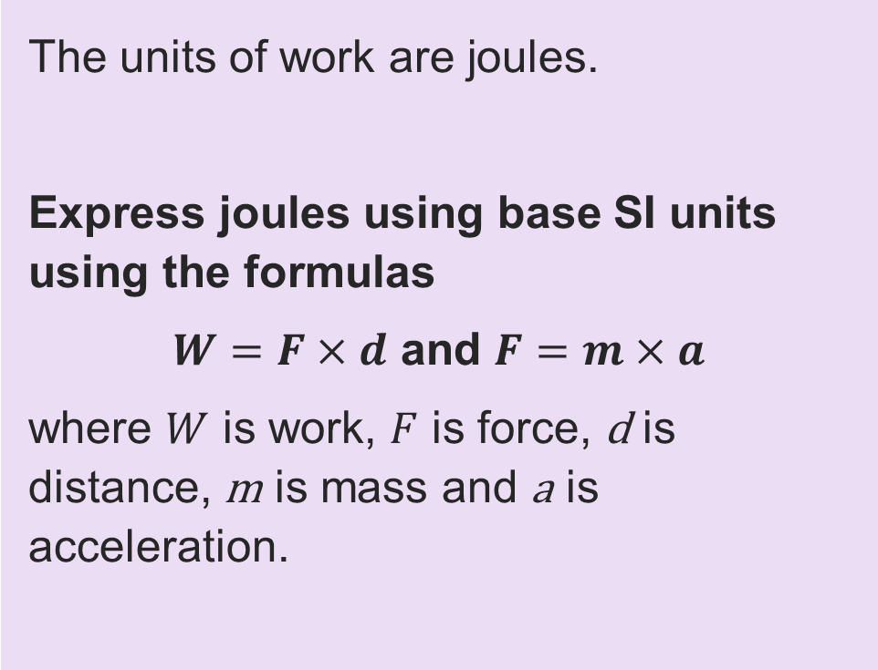
Question 5
Quiz questions
The units of work are joules.
Express joules using base SI units using the formulas
$W=F×d$ and $F=m×a$
where $W$ is work, $F$ is force, d is distance, m is mass and a is acceleration.
Resource 1: Key mathematical science principles

Slide 12
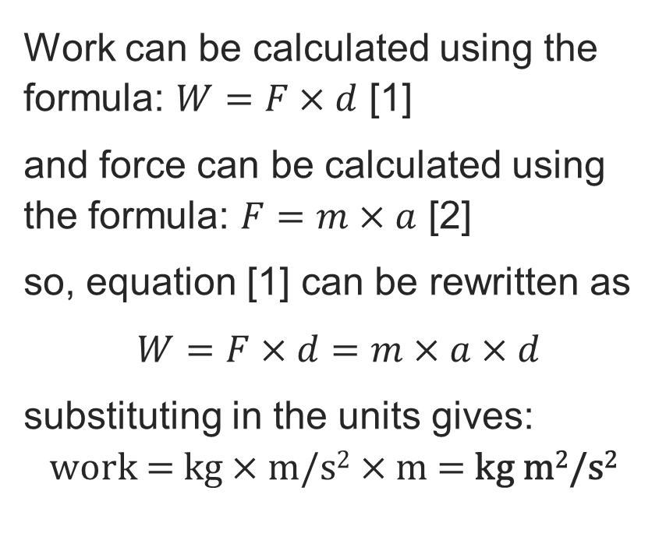
Question 5: Answer
Quiz questions
styles
The units of work are joules.
Express joules using base SI units using the formulas
$W=F×d$ and $F=m×a$
where $W$ is work, $F$ is force, d is distance, m is mass and a is acceleration.
Work can be calculated using the formula: $W=F×d$ [1]
and force can be calculated using the formula: $F=m×a$ [2]
so, equation [1] can be rewritten as
$W=F×d=m×a×d$
substituting in the units gives:
$$\text{work}\text{ = }\text{kg}×\text{m}\text{/}\text{s}\text{2}×\text{m}\text{ = }\text{kg} \text{m}\text{2}\text{/}\text{s}\text{2}$$
Resource 1: Key mathematical science principles

Slide 13
Question 6
Quiz questions
You are carrying out a routine inspection of a heating oil system in a rural property. The oil storage tank is cuboid-shaped with dimensions:
• Length: 3 m
• Width: 1.5 m
• Height: 50 cm
The gauge shows the tank is 40% full.
To estimate whether the household needs a delivery, you must calculate how much oil is currently in the tank.
Work out the volume of oil in the tank when it is 40% full.
Resource 1: Key mathematical science principles

Slide 14
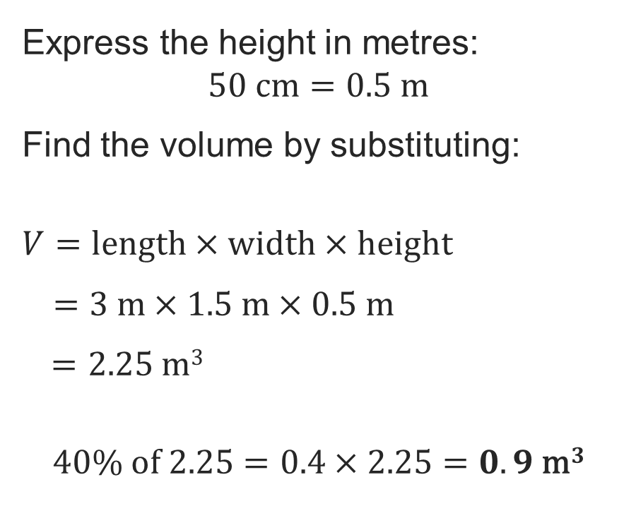
Question 6: Answer
Quiz questions
You are carrying out a routine inspection of a heating oil system in a rural property. The oil storage tank is cuboid-shaped with dimensions:
• Length: 3 m
• Width: 1.5 m
• Height: 50 cm
The gauge shows the tank is 40% full.
To estimate whether the household needs a delivery, you must calculate how much oil is currently in the tank.
Work out the volume of oil in the tank when it is 40% full.
Express the height in metres:
$$50 \text{cm}=0.5 \text{m}$$
Find the volume by substituting:
$$V=length×width×height$$
$=3 m×1.5 m×0.5 m$
$=2.25 \text{m}3$
$$40\% of 2.25=0.4×2.25=0.9 \text{m}3$$
Resource 1: Key mathematical science principles

Slide 15
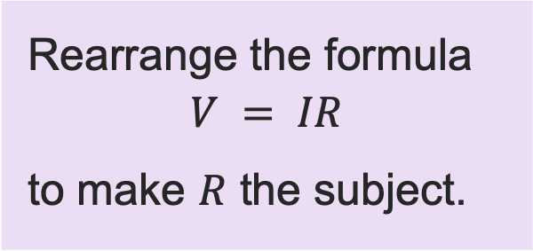

Question 7
Quiz questions
Rearrange the formula
$$V = IR$$
to make $R$ the subject.
A $R =VI$
B $R=\frac{I}{V}$
C $R=\frac{V}{I}$
D $R =IV$
Resource 1: Key mathematical science principles

Slide 16







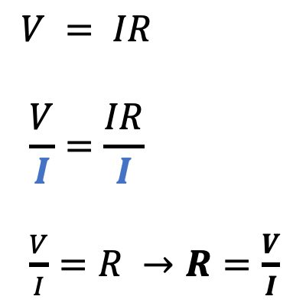

Question 7: Answer
Quiz questions
Rearrange the formula
$$V = IR$$
to make $R$ the subject.
A $R =VI$
B $R=\frac{I}{V}$
C $R=\frac{V}{I}$
D $R =IV$
$$V$$
$$÷$$
$$÷$$
$$×$$
$$V = IR$$
$$\frac{V}{I}=\frac{IR}{I}$$
$\frac{V}{I}=R →R=\frac{V}{I}$
$$I$$
$$R$$
Divide both sides by $I$
$I$ cancels on right hand side, leaving $R$
Resource 1: Key mathematical science principles

