Slide 1
Building Services Engineering
Route: Construction
Topic: Practical mathematics
Resource 1: Key mathematical science principles
Notes:
Image © Shutterstock/Gorodenkoff

Slide 2

Key mathematical science principles for construction
Video
Resource 1: Key mathematical science principles
Notes:
Key mathematical science principles for construction video: https://vimeo.com/1206423682/021b2a347c

Slide 3
In this resource, we will:
Introduction
Explain key mathematical science principles and their importance
Communicate effectively using mathematical language
Use good mathematical practice and layout
Give examples of construction contexts for the use of key mathematical principles
Use the formulae for weight, efficacy of lamps, and thermal expansion
General competencies:
MC2 Estimating, calculating and error spotting
MC4 Using rules and formulae
MC7 Interpreting and representing with mathematical diagrams
MC8 Communicating using mathematics
Resource 1: Key mathematical science principles

Slide 4
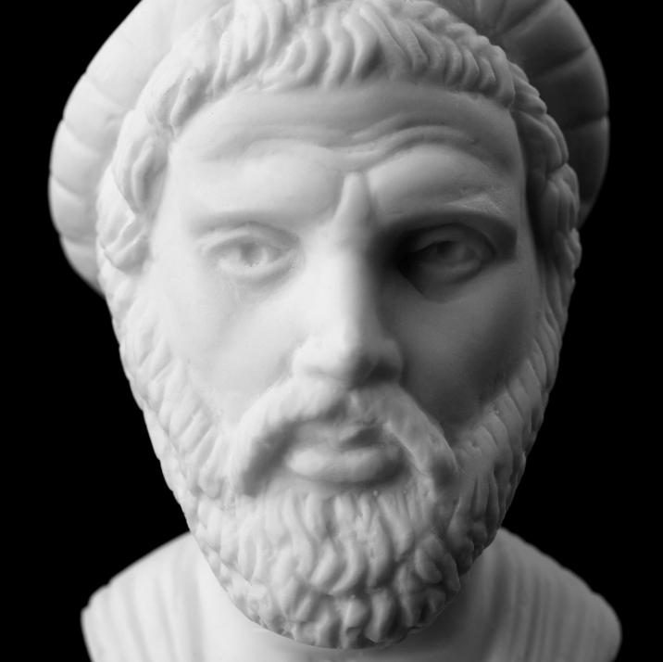
Mathematics
Quantities and units
The word Mathematics comes from the ancient Greek word μάθημα (mathima).
It meant learning or knowledge.
It still means lesson in modern Greek.
The Greek philosopher and mathematician Pythagoras was the first person to use the word.
Resource 1: Key mathematical science principles
Notes:
Image © Shutterstock/Vasileios Karafillidis

Slide 5
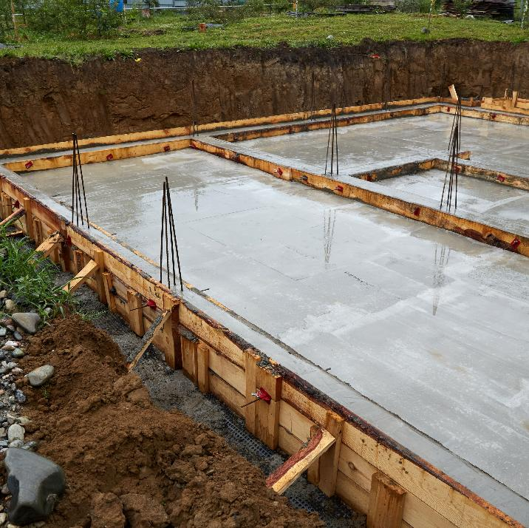
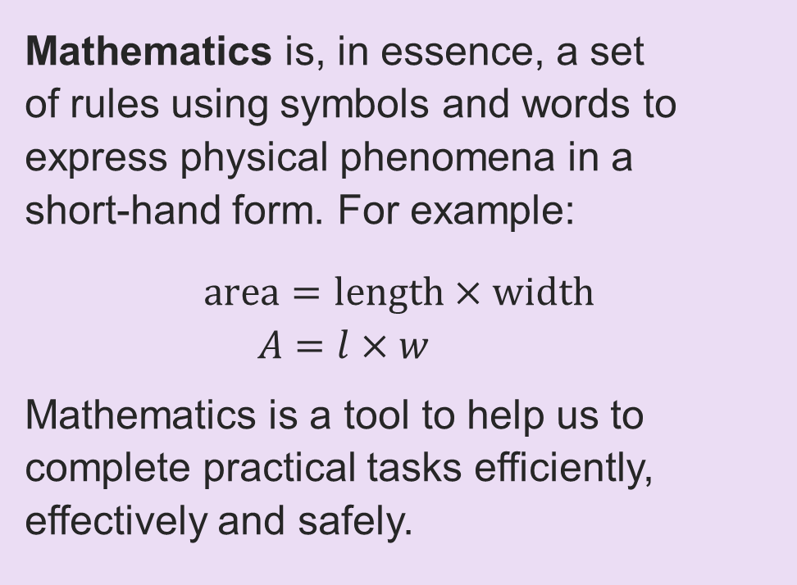
Mathematics
Quantities and units
Mathematics is, in essence, a set
of rules using symbols and words to express physical phenomena in a
short-hand form. For example:
$$\text{area}=\text{length}×\text{width} \\ A=l×w$$
Mathematics is a tool to help us to complete practical tasks efficiently, effectively and safely.
Resource 1: Key mathematical science principles
Notes:
Image © Shutterstock/Viktorya Telminova

Slide 6
Quantities and units
Quantities and units
A unit is a standardised quantity used to measure properties.
You may have encountered quantities such as:
mass in grams, kilograms or ounces
time in seconds, minutes or hours
length in metres, inches, centimetres or feet
temperature in degrees Fahrenheit or Celsius.
YOU TRY
What other units have you used in your work, studies or everyday life?
Resource 1: Key mathematical science principles

Slide 7
Base SI units
Quantities and units
SI units, from the International System of Units, ensure consistent units are used in calculations.
In the UK and the US, Imperial units are commonly used.
People tend to give their weight in stones and pounds, their height in feet and inches, and order their drinks in pints or ounces.
Why are SI units preferred in construction?
QUANTITY | UNIT
mass | kilogram (kg)
time | second (s)
length | metre (m)
current | ampere (A)
temperature | Kelvin (K)
Luminous intensity | candela (cd)
Resource 1: Key mathematical science principles

Slide 8
Converting time to SI units
Quantities and units
The SI unit for time is seconds (s).
To convert minutes to seconds, multiply by 60.
To convert hours to seconds, multiply by 3600.
Sometimes you might want to convert back.
To convert seconds to minutes, divide by 60.
To convert seconds to hours, divide by 3600.
There are:
60 seconds in a minute.
There are:
60 minutes in an hour.
So, there are:
60 × 60 = 3600
seconds in an hour.
Resource 1: Key mathematical science principles

Slide 9
Converting time to SI units: Quick Quiz
Quantities and units
What do you need to do to convert these?
minutes to hours
hours to minutes
seconds to minutes
minutes to seconds
seconds to hours
hours to seconds
Resource 1: Key mathematical science principles

Slide 10
Converting time to SI units: Quick Quiz: Answers
Quantities and units
What do you need to do to convert these?
minutes to hours divide by 60
hours to minutes multiply by 60
seconds to minutes divide by 60
minutes to seconds multiply by 60
seconds to hours divide by 3600
hours to seconds multiply by 3600
Resource 1: Key mathematical science principles

Slide 11
Derived SI units common in construction
Quantities and units
Derived SI units express more complex quantities in terms of the base SI units.
TRADE LINKS
Electrical: amps/volts (essential for safety)
Plumbing: bar/pascals (pressure testing)
HVAC: m³/s
(air flow rates)
QUANTITY | UNIT
force | newton (N)
pressure | pascal (Pa)
energy | joules (J)
power | watt (W)
voltage | volts (V)
resistance | ohms (Ω)
luminous flux | lumens (lm)
frequency | hertz (Hz)
velocity | metres per second (m/s)
resistivity | ohm metres (Ω·m)
Resource 1: Key mathematical science principles

Slide 12
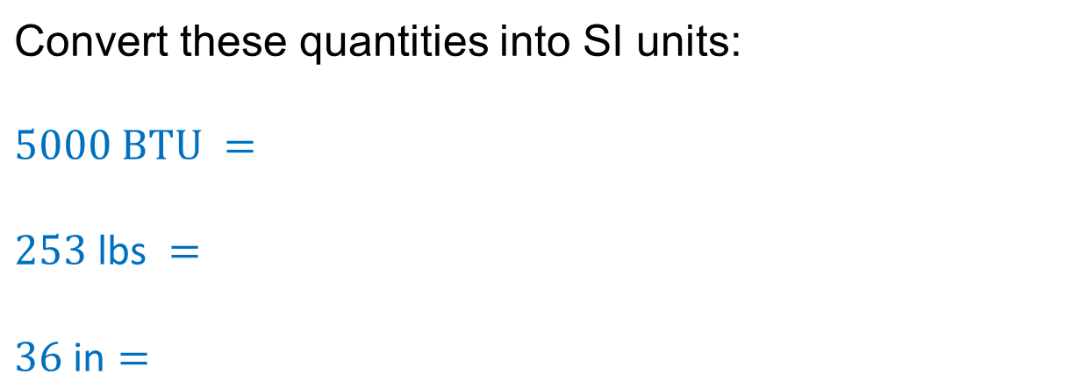
Converting between units
Quantities and units
Sometimes you will need to convert non-standard units to SI units by multiplying or dividing by a conversion factor.
Convert these quantities into SI units: $$5000 BTU =$$ $$253 \text{lbs} =$$ $$36 \text{in}=$$
Here are some common conversion factors:
1 in | = | 2.54 cm
1 m | = | 100 cm
1 kg | = | 2.2 lbs
1 BTU | = | 1055 J
Resource 1: Key mathematical science principles

Slide 13
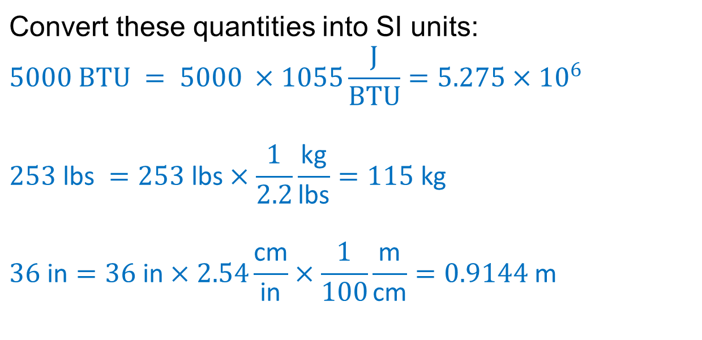
Converting between units: Answers
Quantities and units
Sometimes you will need to convert non-standard units to SI units by multiplying or dividing by a conversion factor.
Convert these quantities into SI units: $$5000 BTU = 5000 ×1055\frac{J}{BTU}=5.275×{10}^{6}$$ $$253 \text{lbs} =253 \text{lbs}×\frac{1}{2.2}\frac{\text{kg}}{\text{lbs}}=115 \text{kg}$$ $$36 \text{in}=36 \text{in}×2.54\frac{\text{cm}}{\text{in}}×\frac{1}{100}\frac{\text{m}}{\text{cm}}=0.9144 \text{m}$$
Here are some common conversion factors:
1 in | = | 2.54 cm
1 m | = | 100 cm
1 kg | = | 2.2 lbs
1 BTU | = | 1055 J
Resource 1: Key mathematical science principles

Slide 14
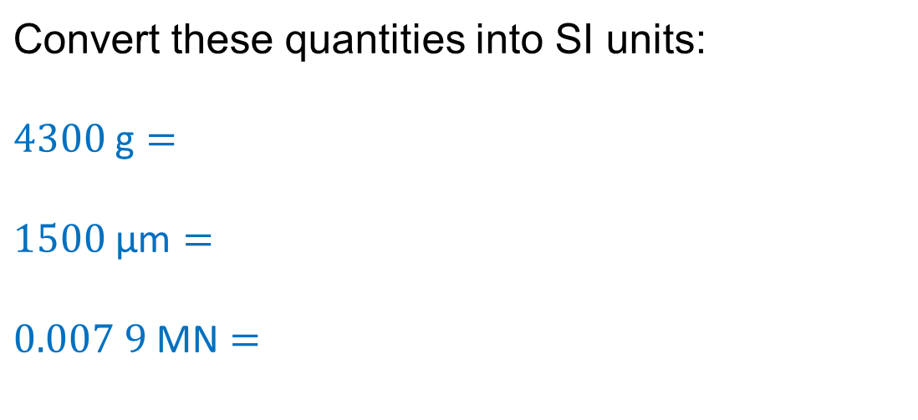
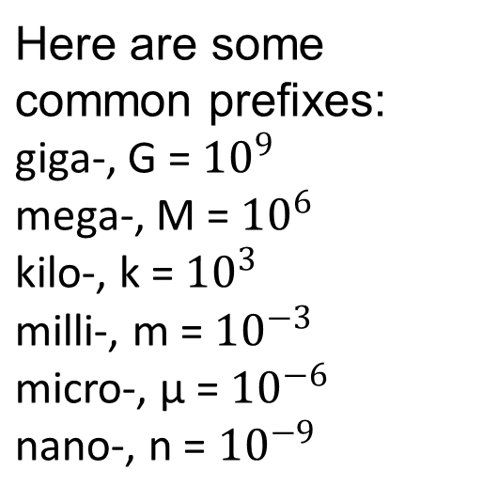
Prefixes and standard form
Quantities and units
SI units often have prefixes for making very large or small numbers easier to read. They need to be converted to SI units before being used in calculations.
Here are some common prefixes: giga-, G = ${10}^{9}$ mega-, M = ${10}^{6}$ kilo-, k = ${10}^{3}$ milli-, m = ${10}^{−3}$ micro-, µ = ${10}^{−6}$ nano-, n = ${10}^{−9}$
Convert these quantities into SI units: $$4300 \text{g}=$$ $$1500 \text{µ}\text{m}=$$ $$0.007 9 \text{MN}=$$
Resource 1: Key mathematical science principles

Slide 15
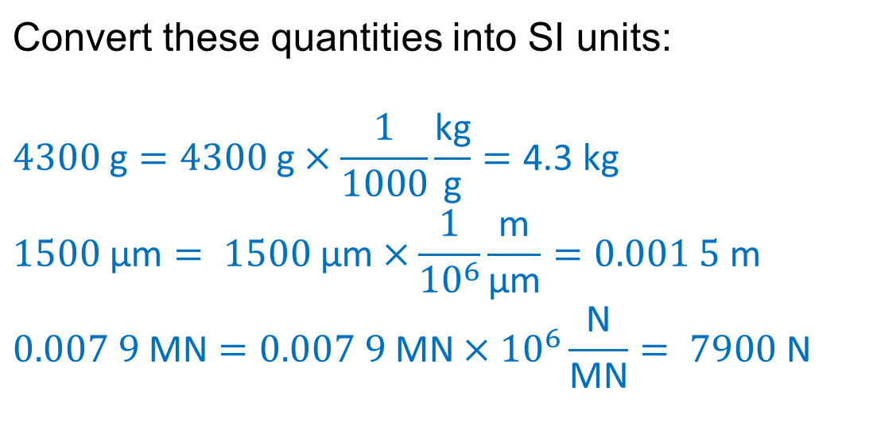
Prefixes and standard form: Answers
Quantities and units
SI units often have prefixes for making very large or small numbers easier to read. They need to be converted to SI units before being used in calculations.
Here are some common prefixes: giga-, G = ${10}^{9}$ mega-, M = ${10}^{6}$ kilo-, k = ${10}^{3}$ milli-, m = ${10}^{−3}$ micro-, µ = ${10}^{−6}$ nano-, n = ${10}^{−9}$
Convert these quantities into SI units: $$4300 \text{g}=4300 \text{g}×\frac{1}{1000}\frac{\text{kg}}{\text{g}}=\text{4.3 }\text{kg}$$ $$1500 \text{µ}\text{m}= 1500 \text{µ}\text{m}×\frac{1}{{10}^{6}}\frac{\text{m}}{\text{µ}\text{m}}=0.001 5 \text{m}$$ $$0.007 9 \text{MN}=0.007 9 \text{MN}×{10}^{6}\frac{\text{N}}{\text{MN}}= 7900 \text{N}$$
Resource 1: Key mathematical science principles

Slide 16
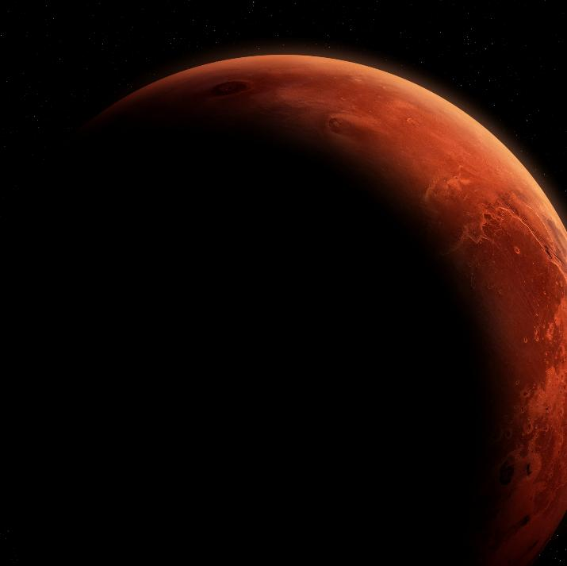
The importance of SI units
Quantities and units
By using SI units, we can communicate and compare our calculations, research, plans and data without confusion.
One famous unit error occurred in 1999 when the NASA Mars climate orbiter burned up in the Martian atmosphere.
This was a simple but catastrophic error caused by a unit mismatch: pound‑force was used instead of newtons.
Resource 1: Key mathematical science principles
Notes:
Image © Shutterstock/buradaki

Slide 17



The importance of SI units in construction
Quantities and units
Safety assured
Precise calculations prevent structural failure
Safety assured
Meets British and European requirements
Error prevention
Eliminates calculation mistakes
Mini task
Name two situations when mixing up units could cause a problem.
Resource 1: Key mathematical science principles

Slide 18
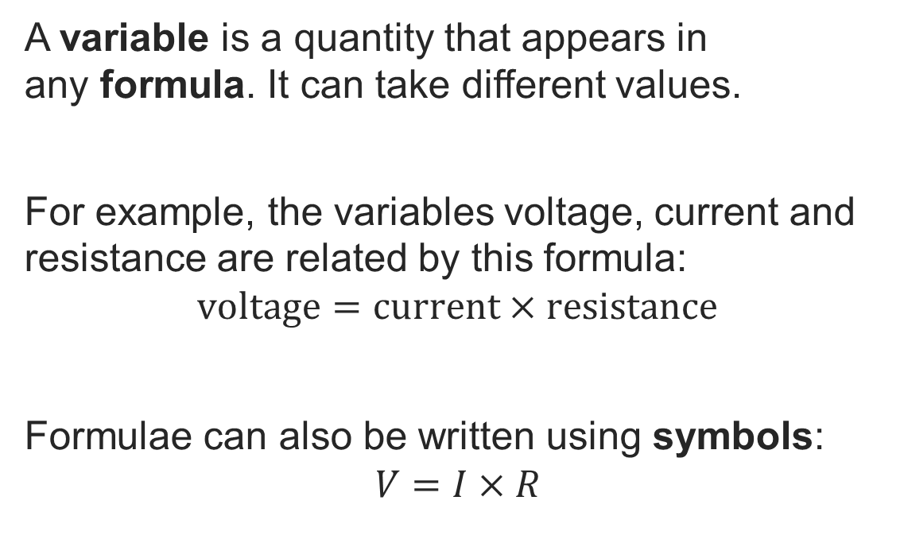
Variables and formulae
Substitution
A variable is a quantity that appears in
any formula. It can take different values.
For example, the variables voltage, current and resistance are related by this formula:
$$\text{voltage}=\text{current}×\text{resistance}$$
Formulae can also be written using symbols:
$$V=I×R$$
YOU TRY
Write the formula for the area of a rectangle using words and symbols.
Resource 1: Key mathematical science principles

Slide 19
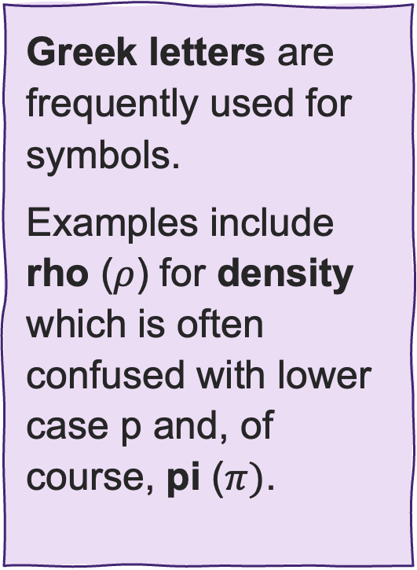
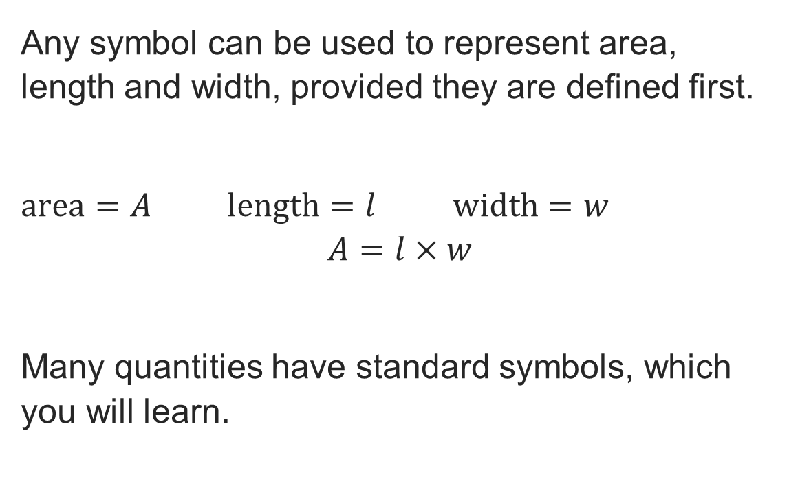
Variables and formulae: rectangle
Substitution
Any symbol can be used to represent area, length and width, provided they are defined first.
$area=A$ $length=l$ $width=w$
$$A=l×w$$
Many quantities have standard symbols, which you will learn.
Greek letters are frequently used for symbols.
Examples include rho ($ρ$) for density which is often confused with lower case p and, of course, pi ($π$).
Resource 1: Key mathematical science principles

Slide 20
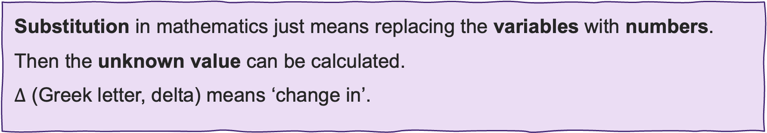

Variables and formulae: substitution
Substitution
Consider the formula:
change in length = coefficient of thermal expansion ×
change in temperature × original length
In symbols, this is usually written as: $ΔL=α×ΔT×L$
So, if you were given $α$, $L$ and $ΔT$, you could work out $∆L$by substitution.
Substitution in mathematics just means replacing the variables with numbers.
Then the unknown value can be calculated.
$∆$ (Greek letter, delta) means ‘change in’.
Resource 1: Key mathematical science principles

Slide 21
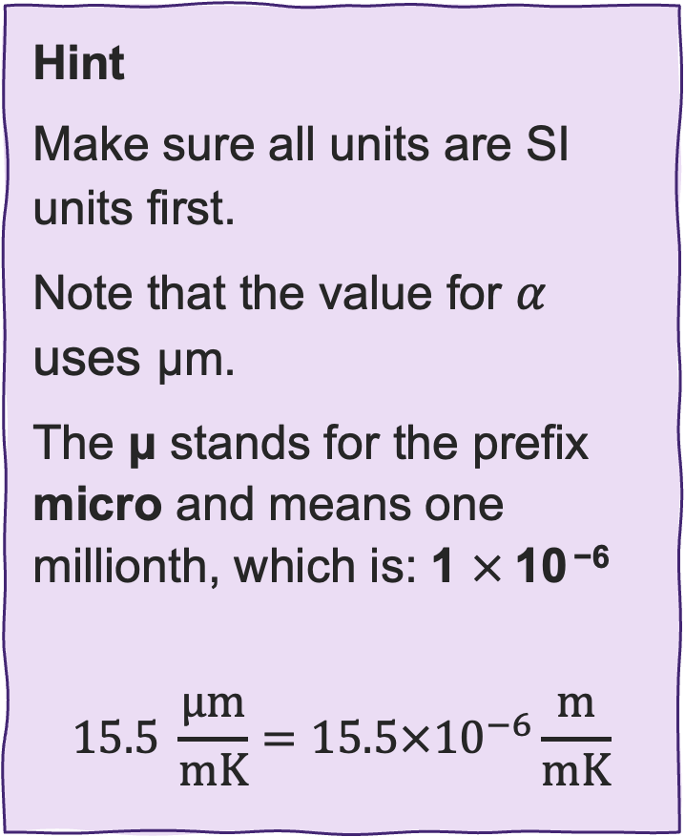

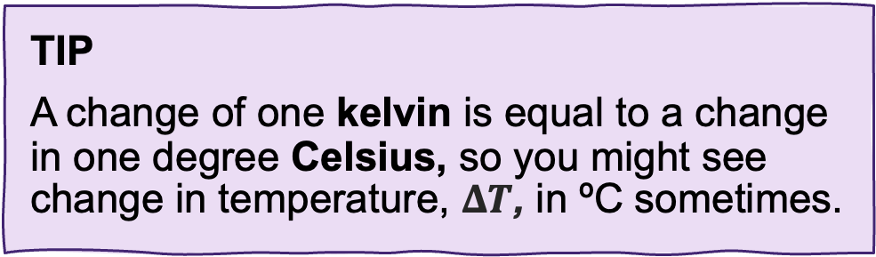
Substitution
Substitution
Hint
Make sure all units are SI units first.
Note that the value for $α$ uses μm.
The μ stands for the prefix micro and means one millionth, which is: 1 $×$10 ⁻⁶
$$\text{15.5} \frac{\text{μ}\text{m}}{\text{mK}}=15.5×{10}^{−6}\frac{\text{m}}{\text{mK}}$$
Consider the thermal expansion equation
$$∆L = α × ∆T × L$$
Given $α = \text{15.5} \frac{\text{μ}\text{m}}{\text{mK}} ∆T = \text{5} °\text{C} L = \text{2 }\text{m}$
Work out $ΔL$ by substituting the values.
TIP
A change of one kelvin is equal to a change in one degree Celsius, so you might see change in temperature, $ΔT$, in ºC sometimes.
Resource 1: Key mathematical science principles

Slide 22
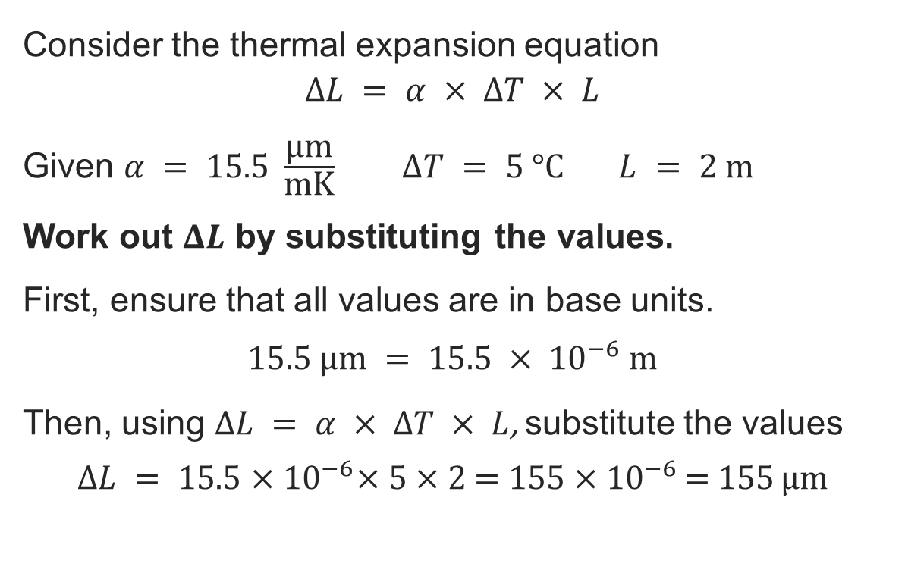
Substitution: Answer
Substitution
Consider the thermal expansion equation
$$∆L = α × ∆T × L$$
Given $α = \text{15.5} \frac{\text{μ}\text{m}}{\text{mK}} ∆T = \text{5} °\text{C} L = \text{2 }\text{m}$
Work out $ΔL$ by substituting the values.
First, ensure that all values are in base units.
$$15.5 μm = 15.5 × {10}^{−6} m$$
Then, using $∆L = α × ∆T × L$, substitute the values
$$∆L = \text{15.5}\text{ ×} {10}^{−6}\text{× 5 × 2 }\text{= }\text{155 ×}{ 10}^{−6 }\text{= }\text{155} \text{μ}\text{m}$$
Exam tip
Make sure you are familiar with how to enter these kinds of numbers in your calculator!
Resource 1: Key mathematical science principles

Slide 23
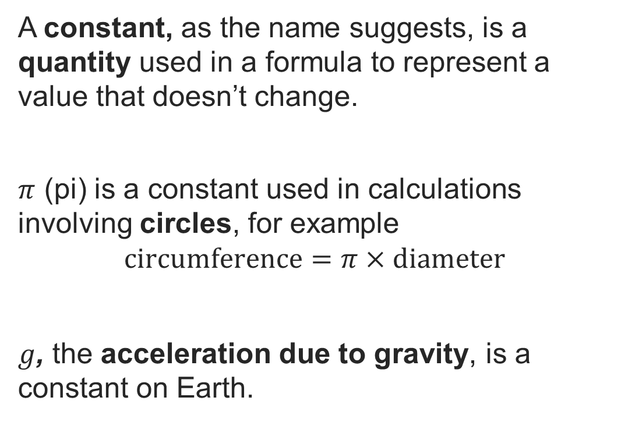
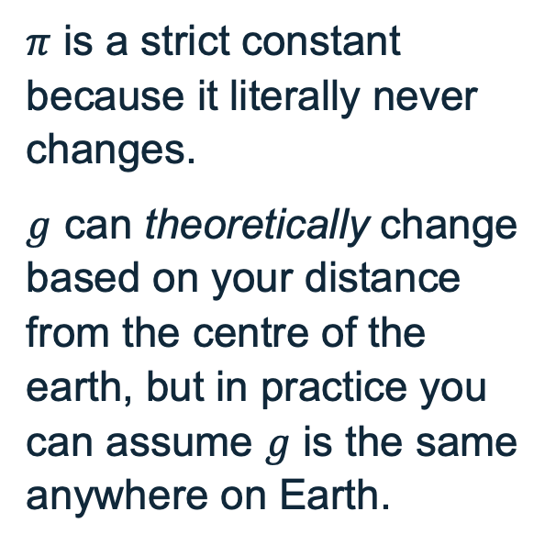
Constants
Substitution
A constant, as the name suggests, is a quantity used in a formula to represent a value that doesn’t change.
$π$ (pi) is a constant used in calculations involving circles, for example
$$\text{circumference}=π×\text{diameter}$$
$g$, the acceleration due to gravity, is a constant on Earth.
NOTE
$π$ is a strict constant because it literally never changes.
$g$ can theoretically change based on your distance from the centre of the earth, but in practice you can assume $g$ is the same anywhere on Earth.
Resource 1: Key mathematical science principles

Slide 24
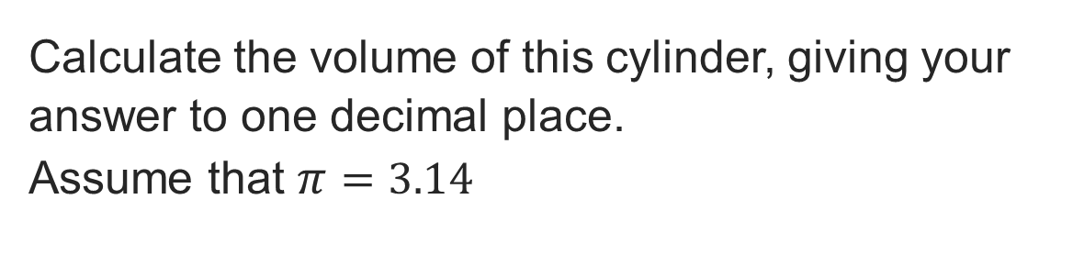
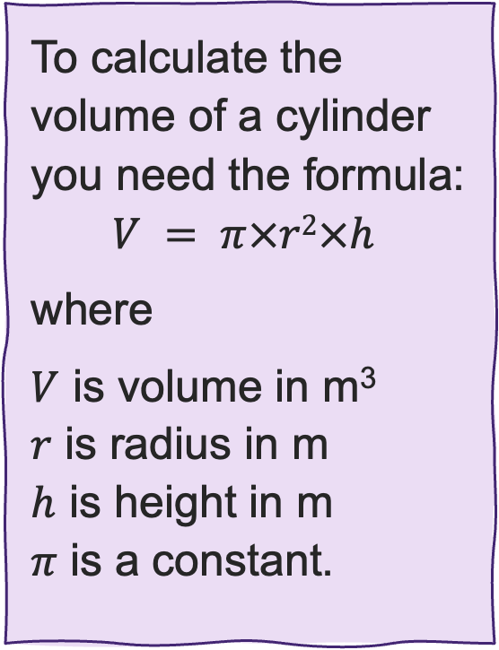
Substitution: Volume
Substitution
Calculate the volume of this cylinder, giving your answer to one decimal place.
Assume that $π=3.14$
To calculate the volume of a cylinder you need the formula:
$$V = π×r2×h$$
where
$V$ is volume in m³
$r$ is radius in m
$h$ is height in m
$π$ is a constant.
2 m
3 m
Resource 1: Key mathematical science principles

Slide 25
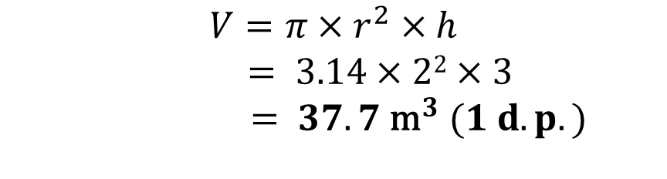
Substitution: Volume: Answer
Substitution
Calculate the volume of this cylinder, giving your answer to one decimal place.
Assume that $π=3.14$
To calculate the volume of a cylinder you need the formula:
$$V = π×r2×h$$
where
$V$ is volume in m³
$r$ is radius in m
$h$ is height in m
$π$ is a constant.
2 m
$$V=π×r^{2}×h$$
$$= 3.14×22×3$$
$= 37.7 {\text{m}}^{3} (1 d.p.)$
3 m
Resource 1: Key mathematical science principles

Slide 26
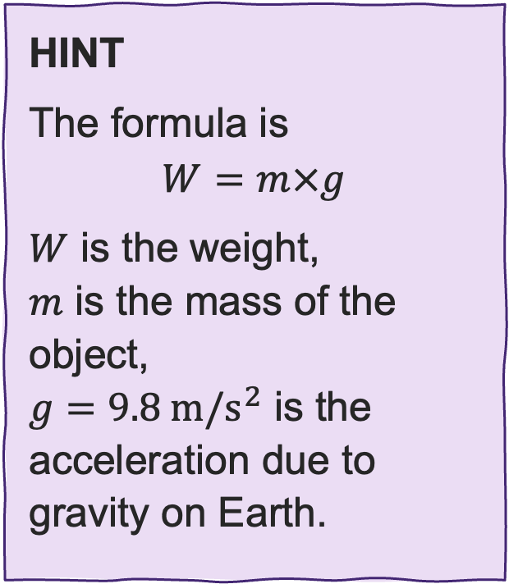
Substitution: Weight
Substitution
Calculate the weight of 37 700 kg of water.
Give your answer to three significant figures.
HINT
The formula is
$$W=m×g$$
$W$ is the weight,
$m$ is the mass of the object,
$g=9.8 m/s^{2}$ is the acceleration due to gravity on Earth.
Resource 1: Key mathematical science principles

Slide 27
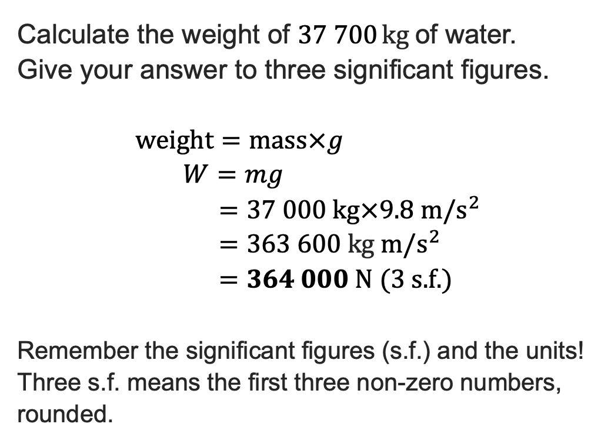
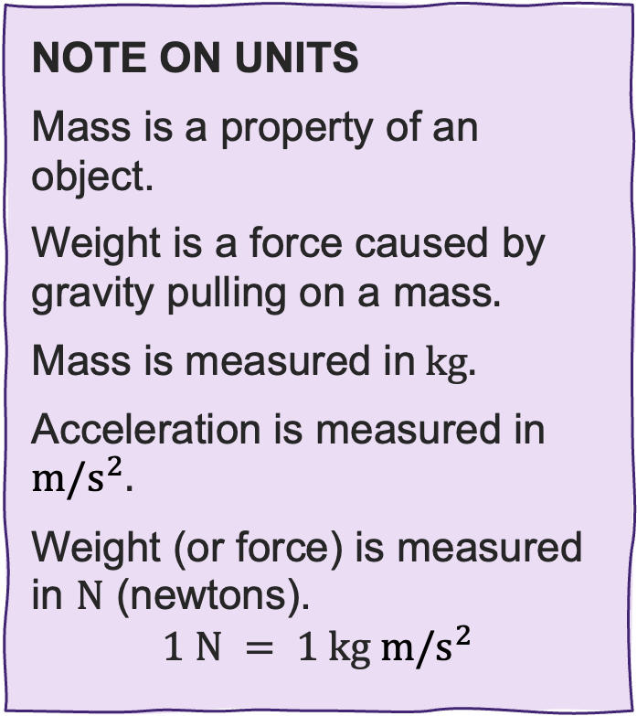
Substitution: Weight: Answer
Substitution
NOTE ON UNITS
Mass is a property of an object.
Weight is a force caused by gravity pulling on a mass$.$
Mass is measured in kg.
Acceleration is measured in $m/s^{2}$.
Weight (or force) is measured in N (newtons).
$$1 \text{N} = 1 \text{kg} m/s^{2}$$
Calculate the weight of 37 700 kg of water.
Give your answer to three significant figures.
$$\text{weight}=\text{mass}×g \\ W=mg \\ =37 000 \text{kg}×9.8 m/s^{2} \\ =363 60\text{0 }\text{kg} m/s^{2} \\ =364 000 \text{N}\text{ (}\text{3 }\text{s}\text{.}\text{f}\text{.)}$$
Remember the significant figures (s.f.) and the units!
Three s.f. means the first three non-zero numbers, rounded.
Resource 1: Key mathematical science principles

Slide 28
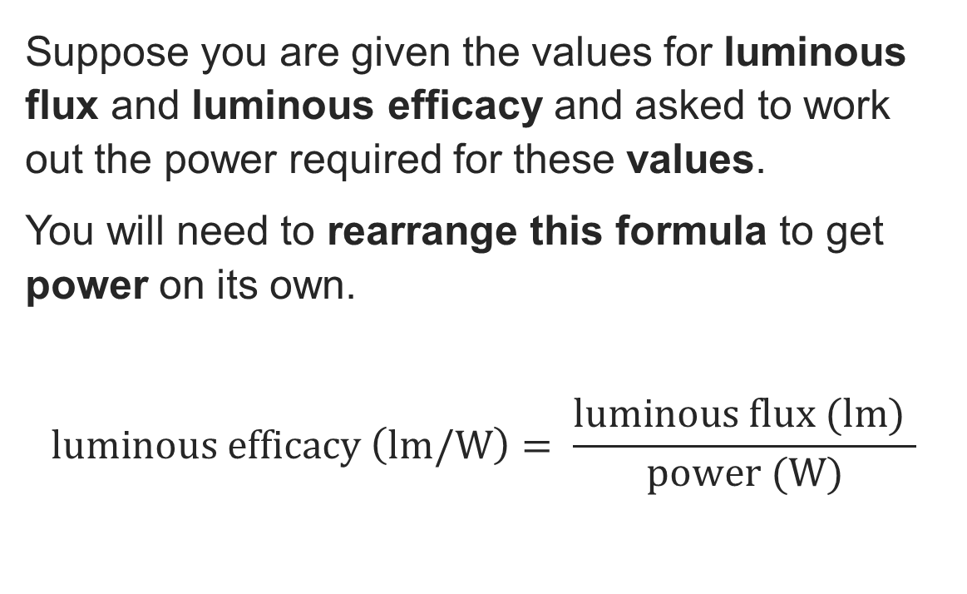
Rearranging a formula
Rearranging formulae
Suppose you are given the values for luminous flux and luminous efficacy and asked to work out the power required for these values.
You will need to rearrange this formula to get power on its own.
$$\text{luminous} \text{efficacy} \left(lm/W\right)= \frac{\text{luminous} \text{flux} (\text{lm}) }{\text{power} (\text{W})}$$
The formula for luminous efficacy is as shown, but usually this is a property that will be provided and it is the power required that is needed, so the formula needs rearranging.
Resource 1: Key mathematical science principles

Slide 29
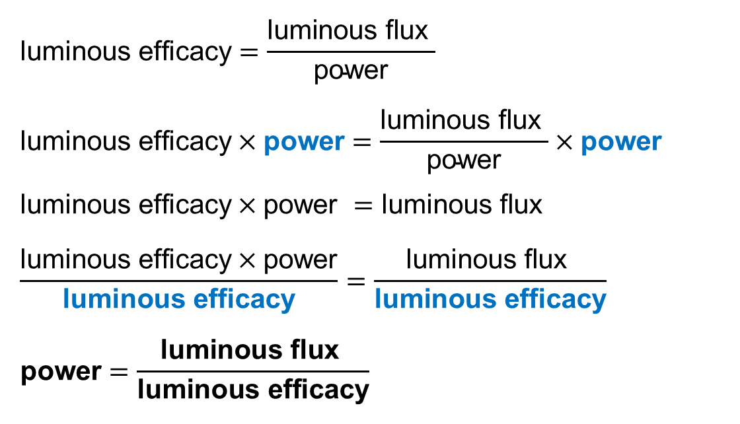
Rearranging a formula: Answer
Rearranging formulae
$$\text{luminous} \text{efficacy}=\frac{\text{luminous} \text{flux} }{\text{power}}$$
$$\text{luminous} \text{efficacy}×\text{power}=\frac{\text{luminous} \text{flux} }{\text{power}}×\text{power}$$
$$\text{luminous} \text{efficacy}×\text{power} =\text{luminous} \text{flux}$$
$$\frac{\text{luminous} \text{efficacy}×\text{power}}{\text{luminous} \text{efficacy}}=\frac{\text{luminous} \text{flux} }{\text{luminous} \text{efficacy}}$$
$$\text{power}=\frac{\text{luminous} \text{flux} }{\text{luminous} \text{efficacy}}$$
Rearrange to make power the subject.
Multiply both sides by power.
Cancel power on right side.
Divide both sides by luminous efficacy.
Cancel. Now power is the subject.
Resource 1: Key mathematical science principles

Slide 30








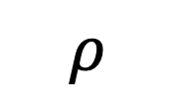

Rearranging a formula: Triangle method
Rearranging formulae
The triangle method can help you remember how to rearrange formulae with three variables such as
$mass$ = $density×volume$
$$m=ρ×V$$
$$m$$
$$ρ= \frac{m}{V}$$
$$÷$$
$$÷$$
$$×$$
$$ρ$$
$$V= \frac{m}{ρ}$$
$$V$$
Resource 1: Key mathematical science principles

Slide 31

Rearranging the density formula
Rearranging formulae
The density of water is 1000 kg/m³.
Find the mass of 37.7 m³ of water.
Rearrange $ρ= \frac{m}{V}$ to find the mass.
HINT
Multiply both sides by V to make m the subject or use the triangle method.
Resource 1: Key mathematical science principles

Slide 32
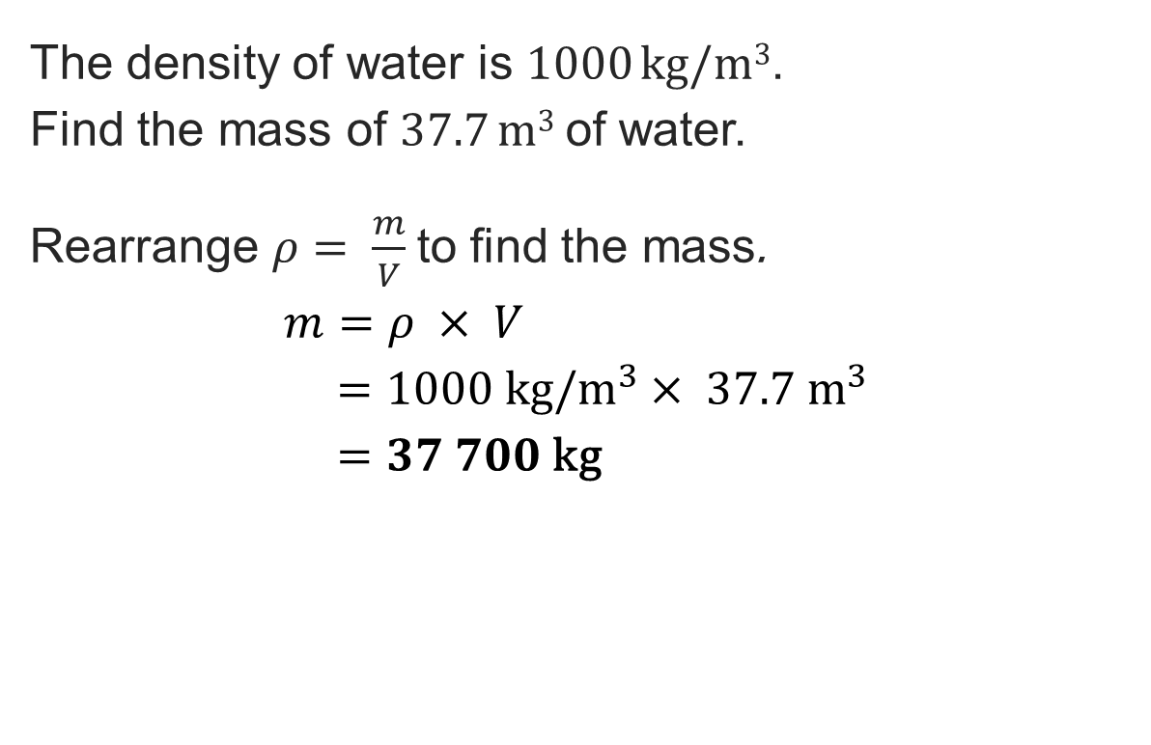
Rearranging the density formula: Answer
Rearranging formulae
The density of water is 1000 kg/m³.
Find the mass of 37.7 m³ of water.
Rearrange $ρ= \frac{m}{V}$ to find the mass.
$$m=ρ × V \\ =1000 kg/m^{3}× 37.7{ \text{m}}^{3} \\ =37 700 \text{kg}$$
SITE TIP
Density calculations are used to make sure delivery vehicles are not overloaded. A transit van has a weight limit – knowing the density of concrete versus timber is vital.
Note how the equals are aligned throughout.
This is good mathematical communication.
Resource 1: Key mathematical science principles

Slide 33

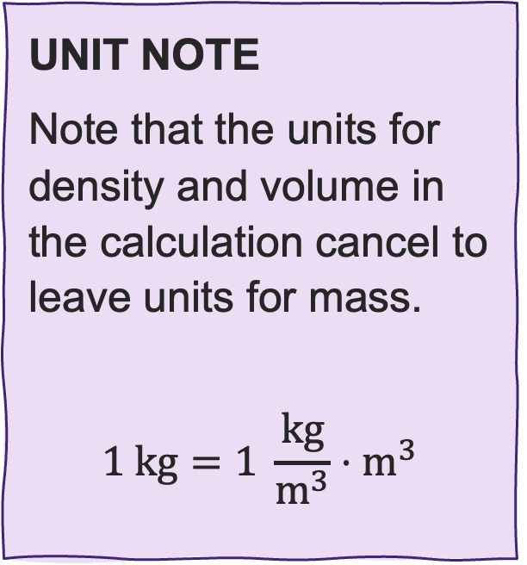
Rearranging the density formula: Note
Rearranging formulae
The density of water is 1000 kg/m³.
Find the mass of 37.7 m³ of water.
Rearrange $ρ= \frac{m}{V}$ to find the mass.
$$m=ρ×V \\ =1000 kg/m^{3}× 37.7{ \text{m}}^{3} \\ =37 700 \text{kg}$$
UNIT NOTE
Note that the units for density and volume in the calculation cancel to leave units for mass.
$$1 \text{kg}=1 \frac{\text{kg}}{{\text{m}}^{3}}⋅{\text{m}}^{3}$$
Resource 1: Key mathematical science principles

Slide 34
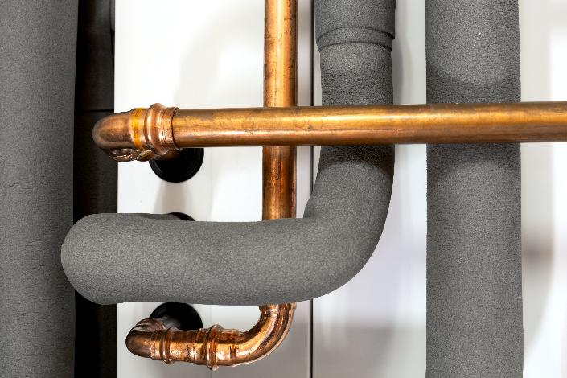
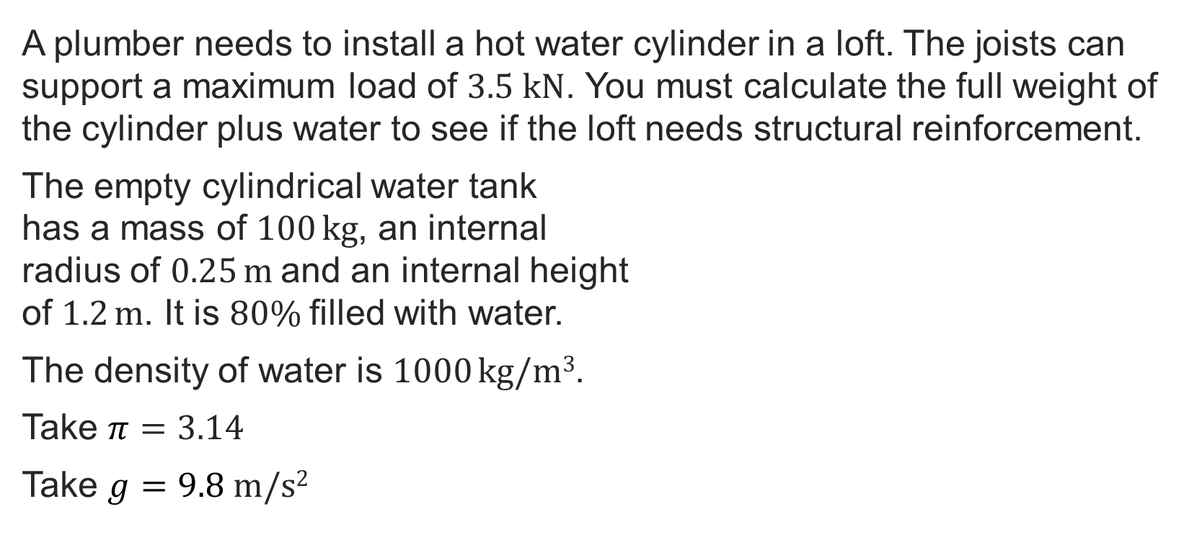
Exam-style question
Exam-style question
A plumber needs to install a hot water cylinder in a loft. The joists can support a maximum load of $3.5 \text{kN}$. You must calculate the full weight of the cylinder plus water to see if the loft needs structural reinforcement.
The empty cylindrical water tank
has a mass of $100 \text{kg}$, an internal
radius of $\text{0.25} \text{m}$and an internal height
of $\text{1.2} \text{m}$. It is $\text{80\% }$filled with water.
The density of water is $1000 \text{kg}\text{/}\text{m}\text{3}$.
Take $π=3.14$
Take $g=9.8 \text{m}\text{/}\text{s}\text{2}$
Resource 1: Key mathematical science principles
Notes:
Image © Shutterstock/SSKH-Pictures

Slide 35
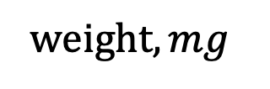
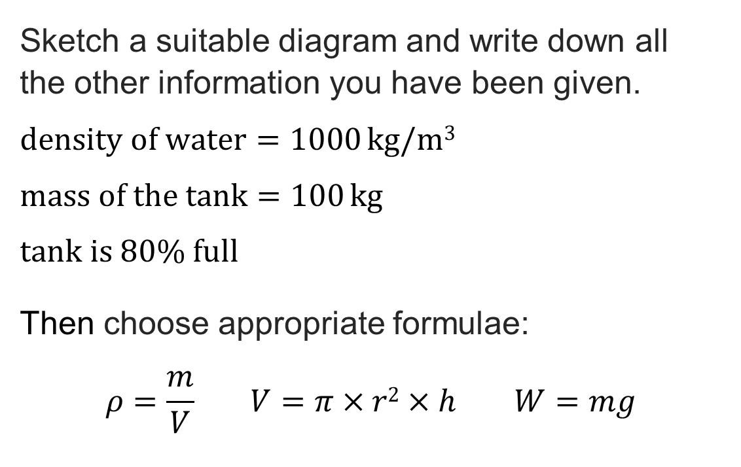


Exam-style question: Answer
Exam-style question
Sketch a suitable diagram and write down all
the other information you have been given.
$\text{density} \text{of} \text{water}=\text{1000} \text{kg}\text{/}\text{m}\text{3}$
$\text{mass} \text{of} \text{the} \text{tank}=100 \text{kg}$
$\text{tank} \text{is}\text{ 80\% }\text{full}$
Then choose appropriate formulae:
$$ρ=\frac{m}{V} V=π×r2×h W=mg$$
$$r=0.25 \text{m}$$
$$h=1.2 \text{m}$$
$$\text{w}\text{eight}, mg$$
Resource 1: Key mathematical science principles

Slide 36
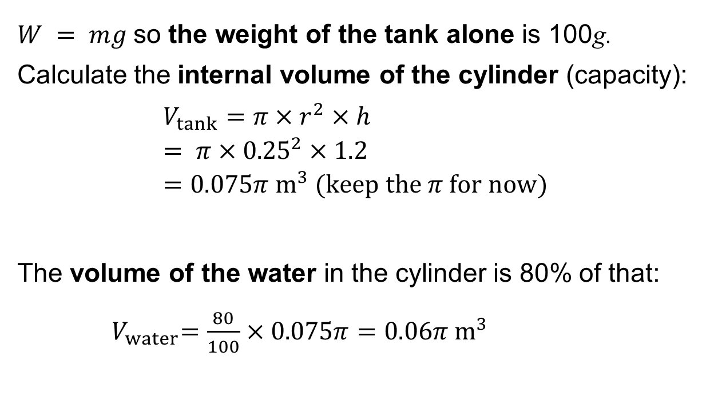
Exam-style question: Answer
Exam-style question
$W = mg$so the weight of the tank alone is 100g.
Calculate the internal volume of the cylinder (capacity):
$$V_{tank}=π×r^{2}×h \\ = π×{0.25}^{2}×1.2 \\ =0.075π {\text{m}}^{3} \text{(}\text{keep} \text{the} π \text{for} \text{now}\text{)}$$
The volume of the water in the cylinder is 80% of that:
${ V}_{water}=\frac{80}{100}×0.075π=0.06π {\text{m}}^{3}$
$$r=0.25 \text{m}$$
$$h=1.2 \text{m}$$
$$\text{w}\text{eight}, mg$$
Resource 1: Key mathematical science principles

Slide 37
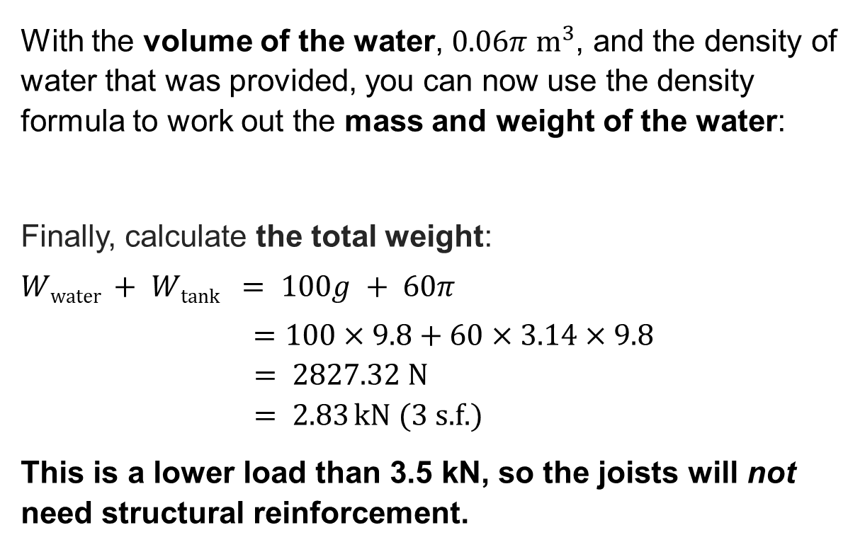
Exam-style question: Answer
Exam-style question
With the volume of the water, $0.06π {\text{m}}^{3}$, and the density of water that was provided, you can now use the density formula to work out the mass and weight of the water:
Finally, calculate the total weight:
$$Wwater + Wtank = 100g + 60π$$
$=100×9.8+60×3.14×9.8$
$= 2827.32 \text{N}$
$$= 2.83 \text{kN} \text{(}\text{3} \text{s}\text{.}\text{f}\text{.)}$$
This is a lower load than 3.5 kN, so the joists will not need structural reinforcement.
$$r=0.25 \text{m}$$
$$h=1.2 \text{m}$$
$$\text{w}\text{eight}, mg$$
Resource 1: Key mathematical science principles

Slide 38
In this resource, we have:
Plenary
Explained key mathematical science principles and their importance
Communicated effectively using mathematical language
Used good mathematical practice and layout
Given examples of construction contexts for the use of key mathematical principles
Used the formulae for weight, efficacy of lamps, and thermal expansion
General competencies:
MC2 Estimating, calculating and error spotting
MC4 Using rules and formulae
MC7 Interpreting and representing with mathematical diagrams
MC8 Communicating using mathematics
Resource 1: Key mathematical science principles

Slide 39
Consolidation
Consolidation
Choose one of the research topics below to prepare a short presentation:
  A well-known example of structural collapse because of inaccurate calculations
  Why kelvin is used as a base SI unit
  How imperial units relate to everyday phenomena, why do we tend to use these in daily life?
Present your findings in a subsequent lesson, either in small groups or to the class.
Resource 1: Key mathematical science principles

