Slide 1
Digital Software Development
Route: Digital
Using AI in software production
Lesson 3: AI in software development
Notes:
Image © Shutterstock/Gorodenkoff

Slide 2
In this lesson, we will:
Introduction
Explain how AI can accelerate development
Identify weaknesses in AI-generated code
Distinguish between correctness and robustness
Evaluate code quality beyond “does it run?”
Justify responsible use of AI in a development workflow
Skills:
1. Be able to reflectively evaluate
5. Apply a logical approach to solving problems to identify and fix defects
General competencies:
English:
E5 Synthesise information
E6 Take part in discussions
Digital:
D1 Use digital technology and media effectively
D6 Code and program
Lesson 3: AI in software development

Slide 3
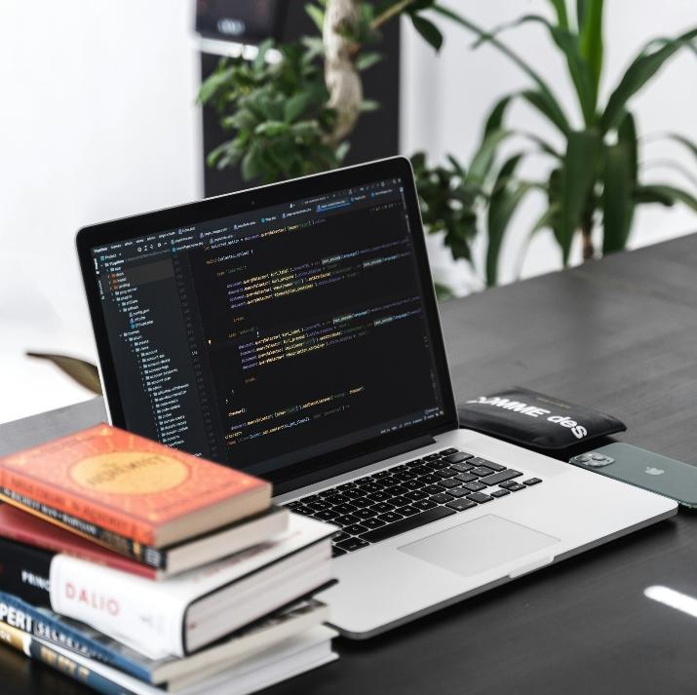
AI vs software developer
Introduction
If AI can write code, what is the role of the software developer?
Lesson 3: AI in software development
Notes:
Image © Unsplash/AltumCode

Slide 4
Correctness vs robustness
Introduction
Correctness
Code works under expected conditions.
Syntax and logic is correct.
Robustness
Code can handle unexpected conditions safely.
Code works in different circumstances.
Lesson 3: AI in software development

Slide 5
Evaluate the AI code
Introduction
This code snippet was generated by AI. It runs. Is it good code?
1 | def calculate_average(numbers):
2 | total = 0
3 | for i in range(len(numbers)):
4 | total + = numbers[i]
5 | return total / len(numbers)
6
7 | user_input = input(“Enter numbers separated by commas: “)
8 | nums = user_input.split(“,”)
9 | print(“Average:”, calculate_average(nums))
Lesson 3: AI in software development

Slide 6
Evaluate the AI code
Introduction
There is no data-type conversion on input.
The code would crash when trying to perform calculations, as a blank input will cause a division by zero and a non-numeric input would cause a runtime error.
The code assumes perfect user behaviour.
There is no feedback for invalid inputs.
Lesson 3: AI in software development

Slide 7
Correctness vs robustness
Introduction
Correctness
AI can usually produce code that is correct under perfect input.
Robustness
AI produced code might not be safe under realistic conditions.
Lesson 3: AI in software development

Slide 8
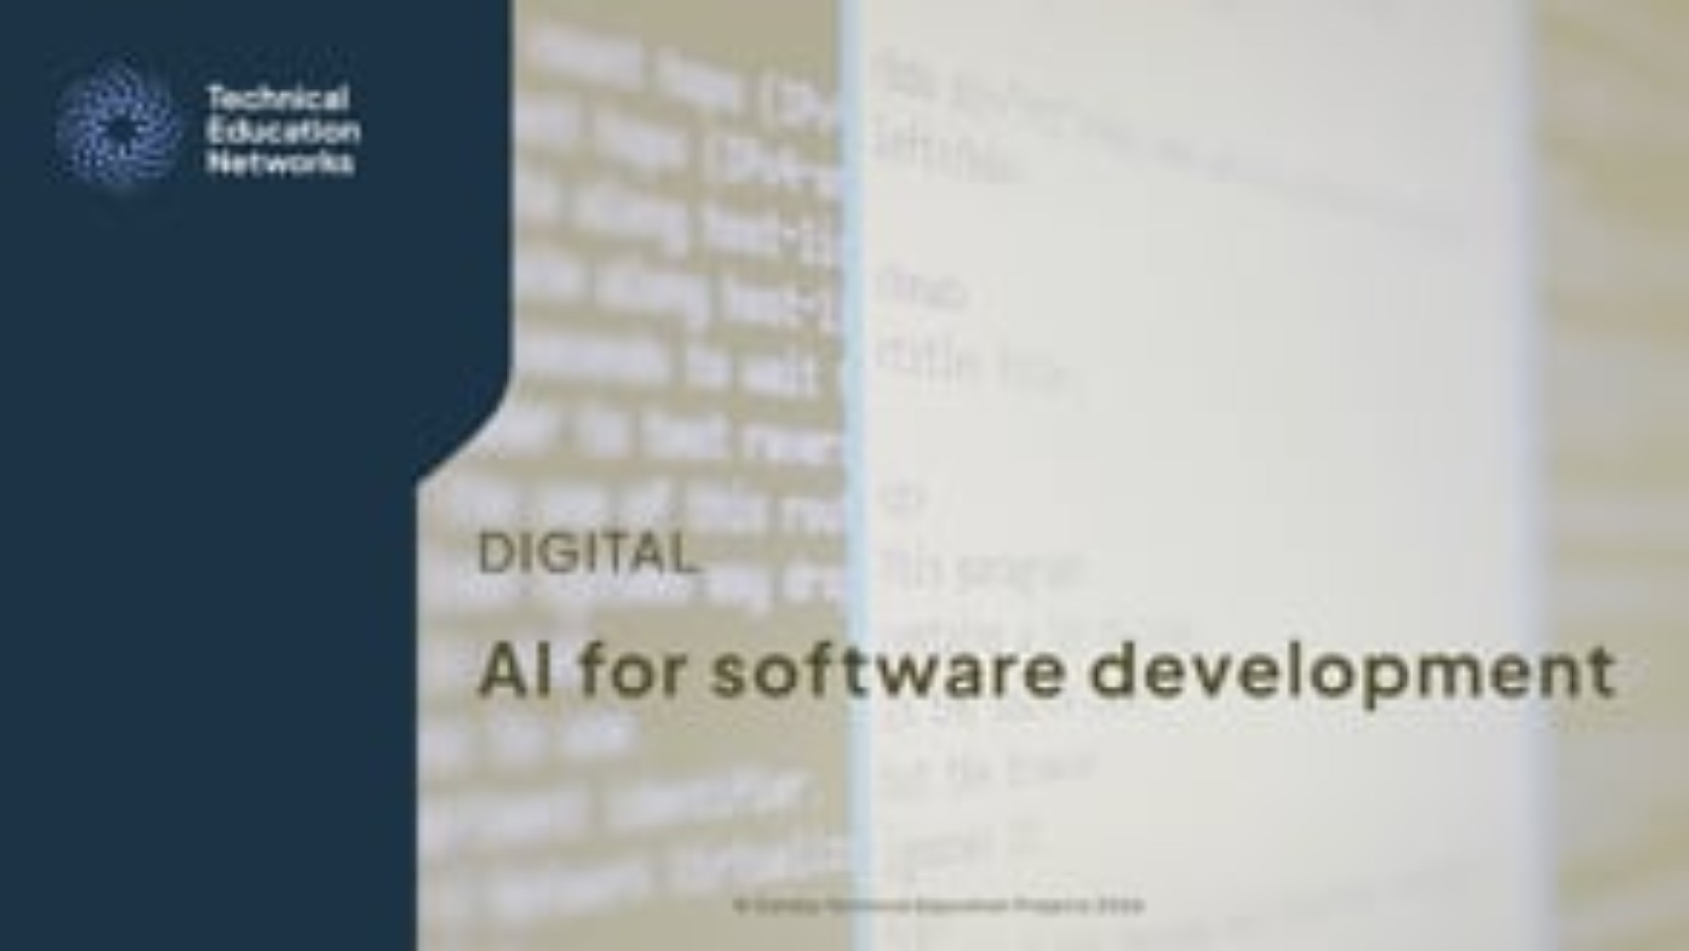
AI for software development
Activity 1
Lesson 3: AI in software development
Notes:
AI for software development video: https://vimeo.com/1219874369

Slide 9
Activity 1: AI in software development
Activity 1
Task 2: Answer the questions about the scenario.
Scenario: A developer uses a public AI tool to create some authentication code. They copy this AI-generated code into a live system without reviewing it. The code stores passwords in plain text.
Task 3: Evaluate the use of AI tools in software development.
Resources needed
Activity 1 Worksheet
Activity 1 Worksheet answers
Lesson 3: AI in software development

Slide 10
AI vs professional developer
Activity 1
Characteristics of AI
Predicts likely patterns
Assumes well-formed input
Does not proactively protect against misuse
Optimises for concise answers
Skills of professional developer
Anticipate misuse
Validate inputs
Handle failure safely
Design defensively
Lesson 3: AI in software development

Slide 11
Activity 2: AI debugging assistant
Activity 2
Task 1: Choose a code snippet and manually fix the errors and explain your steps. Then, prompt AI to do the same.
Task 2: Evaluate and compare your explanation and the AI explanation.
Resources needed
Activity 2 Worksheet
Activity 2 Worksheet answers
An AI tool
Lesson 3: AI in software development

Slide 12
Evaluate and reflect
Activity 2
Does the AI appear to understand the program’s intent, or only the surface-level errors?
What did the activity reveal about the limitations of using AI for debugging?
What did you learn about the importance of explaining your reasoning as a developer?
What are the risks when AI explanations sound correct, but may not be?
How could you improve your prompts next time to improve the AI output?
Lesson 3: AI in software development

Slide 13
Activity 3: Evaluating AI code
Activity 3
Task 1: Run the AI generated Python code provided.
Task 2: Evaluate the code.
Task 3: Create a new version of the code which is more robust and maintainable.
Resources needed
Activity 3 Worksheet
Activity 3 Worksheet answers
Code
Commented code
Improved code
Lesson 3: AI in software development

Slide 14

Integrating AI-generated code snippets
Activity 4
You may use AI tools to help generate snippets of code for a larger solution.
AI-generated snippets must be integrated properly into the rest of the code.
As a developer, it is important to understand how pieces fit together and modify them to work within your architecture.
Lesson 3: AI in software development
Notes:
Image © Shutterstock/By SeventyFour

Slide 15
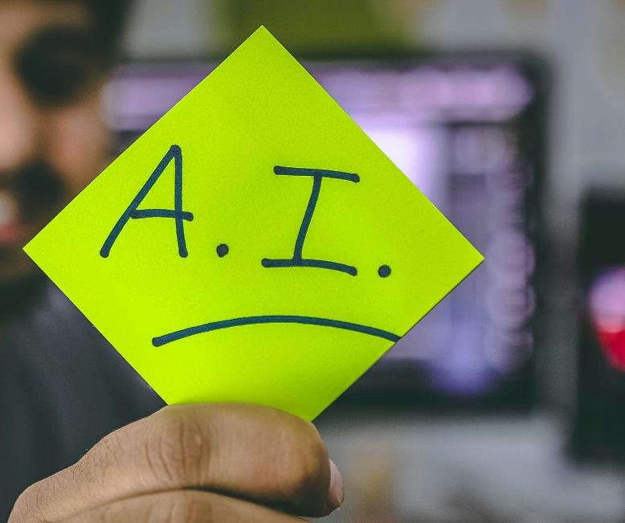
Documenting AI use
Activity 4
When AI has been used to support the development of new code, it is important to document its use.
Documentation of AI use helps organisations be transparent and accountable.
It allows teams to check and understand where in a system they may need to apply extra scrutiny.
Lesson 3: AI in software development
Notes:
Image © Unsplash/Hitesh Choudhary

Slide 16
AI use: What to document
Activity 4
Prompts: record every prompt exactly as entered into the AI tool. Include initial attempts and all subsequent refinements. This helps the output to be reproduced in future.
Refinements: record every modification made to AI-generated code. It is useful to explain why the modification was made.
AI outputs: record complete code outputs from each prompt. Include the time/date of when you generated the output.
Iterative process: keep records of each iteration of the process from the initial output to the final implementation. Clearly label versions (v1, v2, v3) and summarise improvements between each iteration.
Lesson 3: AI in software development

Slide 17
Activity 4: Integrating AI code
Activity 4
Use an AI tool to generate code snippets for the required functionality.
Integrate the AI code into the Coffee shop template code provided. You will need to make sure the program runs correctly and document the process.
Resources needed
Activity 4 Worksheet
Activity 4 Worksheet answers
Coffee shop template
Lesson 3: AI in software development

Slide 18
Plenary: Using AI responsibly scenario
Plenary
Read through the scenario on the Plenary Worksheet.
Answer the question: Should the code be deployed? Justify your decision.
Resources needed
Plenary Worksheet
Lesson 3: AI in software development

Slide 19
Plenary: Using AI responsibly scenario
Plenary
AI is not a replacement for developer reasoning. It is a modelling tool that must be critically evaluated.
Professional developers need to verify outputs, question assumptions and maintain accountability.
AI can generate working code. It cannot guarantee robustness or maintainability.
AI is not context aware.
Lesson 3: AI in software development

Slide 20
In this lesson, we have:
Plenary
Explained how AI can accelerate development
Identified weaknesses in AI-generated code
Distinguished between correctness and robustness
Evaluated code quality beyond “does it run?”
Justified responsible use of AI in a development workflow
Skills:
1. Be able to reflectively evaluate
5. Apply a logical approach to solving problems to identify and fix defects
General competencies:
English:
E5 Synthesise information
E6 Take part in discussions
Digital:
D1 Use digital technology and media effectively
D6 Code and program
Lesson 3: AI in software development

Slide 21
Consolidation
Consolidation
To what extent can AI-generated code by considered production-ready?
Consider:
correctness and robustness;
how AI works;
accountability;
how you know AI-generated code works;
documentation.
Lesson 3: AI in software development

