Slide 1
Engineering and Manufacturing
Route: Engineering and Manufacturing
Topic: Fundamentals of electronics
Resource 2: Practical project on dimmer switches
Notes:
Image © Shutterstock/CrizzyStudio

Slide 2
In this resource, we will:
Introduction
Design, assemble and test an LED dimmer circuit on a breadboard
Measure voltages and currents to diagnose circuit performance
Calculate actual transistor gain and compare it to manufacturer specifications
Evaluate our LED dimmer design
Skills:
MPC-CSD Evaluate and quality assure processes and outcomes
General competencies:
English:
EC5 Synthesise information
Maths:
MC1 Measuring with precision
MC2 Estimating, calculating and error spotting
MC4 Using rules and formulae
Digital:
DC1 Use digital technology and media effectively
Resource 2: Practical project on dimmer switches

Slide 3
Task: LED dimmer circuit
Activity 1
A client needs a lighting solution for a cinema room. Design and build a circuit that dims an LED, for use in this room. It is important that the brightness changes smoothly to maintain visual comfort, enhance ambience, reduce eye fatigue, and achieve energy efficiency.
It should conform to safety requirements, work reliably, and its components should not become warm.
Resources needed
R2 Worksheet
R2 Worksheet answers
R2 Data sheet
Resource 2 Practical project on dimmer switches

Slide 4
Equipment
Activity 1
You will be provided with equipment including:
an LED;
a potentiometer (the next slide includes a reminder of its function);
two resistors for the LED;
a transistor acting as a switch or current amplifier;
a battery (5–9 V);
a breadboard.
Resources needed
R2 Worksheet
Resource 2 Practical project on dimmer switches

Slide 5
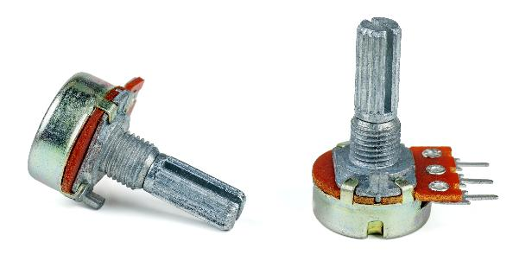
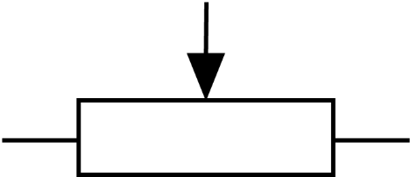
Potentiometer
Activity 1
A potentiometer is a variable resistor with three terminals (one of which is movable).
It acts to provide a varying resistance, depending on the position of the slider contact. This can be used to provide a varying voltage output.
Examples of use: volume controls, light switch dimmers, position sensors.
Resource 2 Practical project on dimmer switches
Notes:
Image (top) © Shutterstock/Ivaschenko Roman

Slide 6
Activity 1: Part 1 – Simulation
Activity 1: Part 1
Using R2 Worksheet, read the instructions for Activity 1 Part 1 Simulation and answer questions to check your understanding.
Now follow the instructions to perform the simulation and prototype your LED dimmer circuit using Circuit Wizard or Tinkercad®.
Resources needed
R2 Worksheet
Resource 2 Practical project on dimmer switches

Slide 7
Activity 1: Part 2 – Circuit diagram
Activity 1: Part 2
Follow the instructions for question 1 and draw the circuit diagram you simulated in Part 1.
Use pencil or CAD software to complete the task.
Example circuits are shown on the next two slides.
Write your answers to question 2.
Resources needed
R2 Worksheet
R2 Worksheet answers
Resource 2 Practical project on dimmer switches

Slide 8
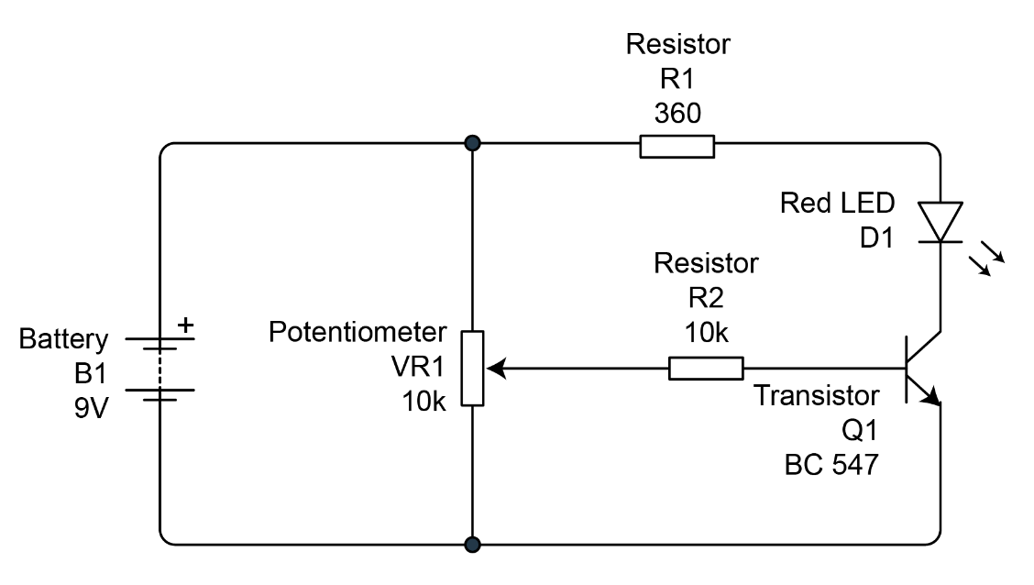
Sample circuit (using Circuit Wizard)
Activity 1: Part 2
Resource 2 Practical project on dimmer switches

Slide 9
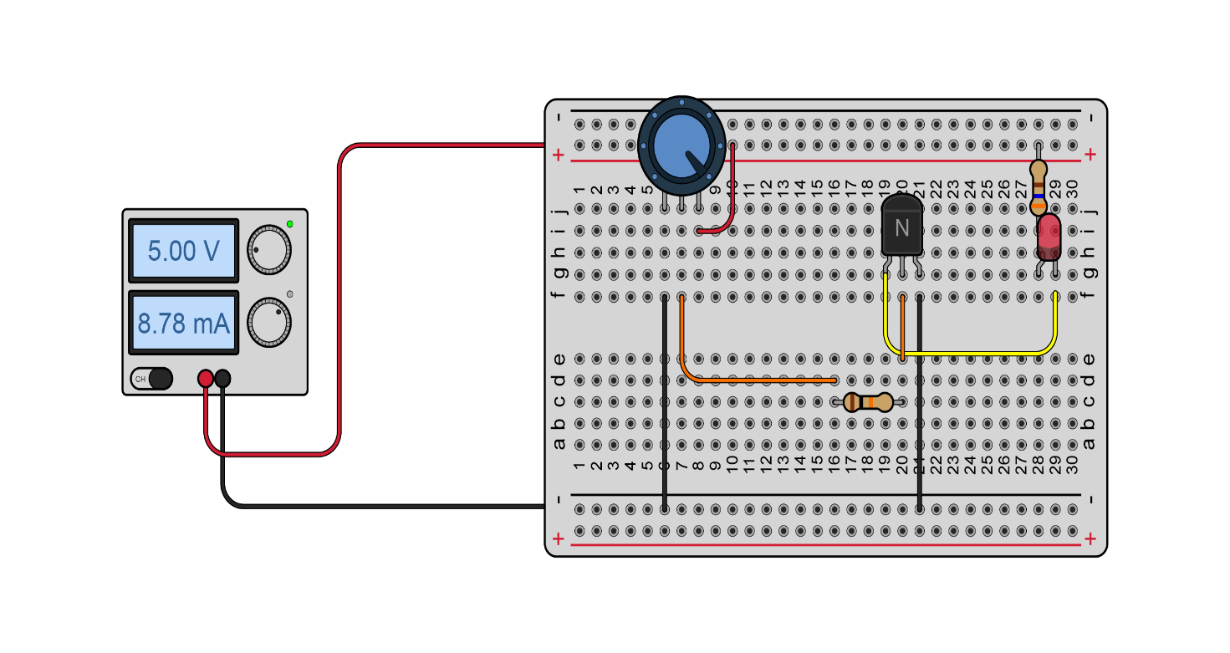
Sample circuit (using Tinkercad®)
Activity 1: Part 2
Resource 2 Practical project on dimmer switches

Slide 10
Activity 2: Calculations and considerations
Activity 2
Follow the steps in Activity 2 to help you carry out calculations and check your circuit is operating within safe power limits and that it meets the client’s requirements.
The next three slides include an example of how to calculate resistance to help you tackle question 1.
Resources needed
R2 Worksheet
R2 Worksheet answers
R2 Data sheet
Resource 2 Practical project on dimmer switches

Slide 11
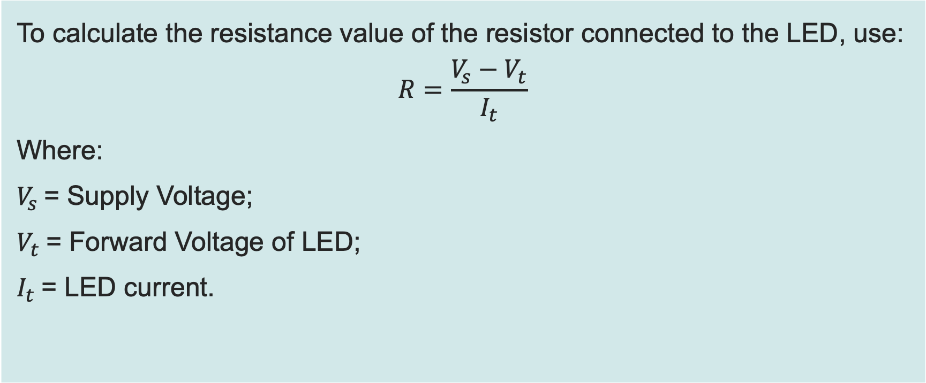
Resistance calculation worked example
Activity 2
To calculate the resistance value of the resistor connected to the LED, use:
$$R=\frac{V_{s}−V_{t}}{I_{t}}$$
Where:
$V_{s}$= Supply Voltage;
$V_{t}$= Forward Voltage of LED;
$I_{t}$= LED current.
Resource 2 Practical project on dimmer switches

Slide 12
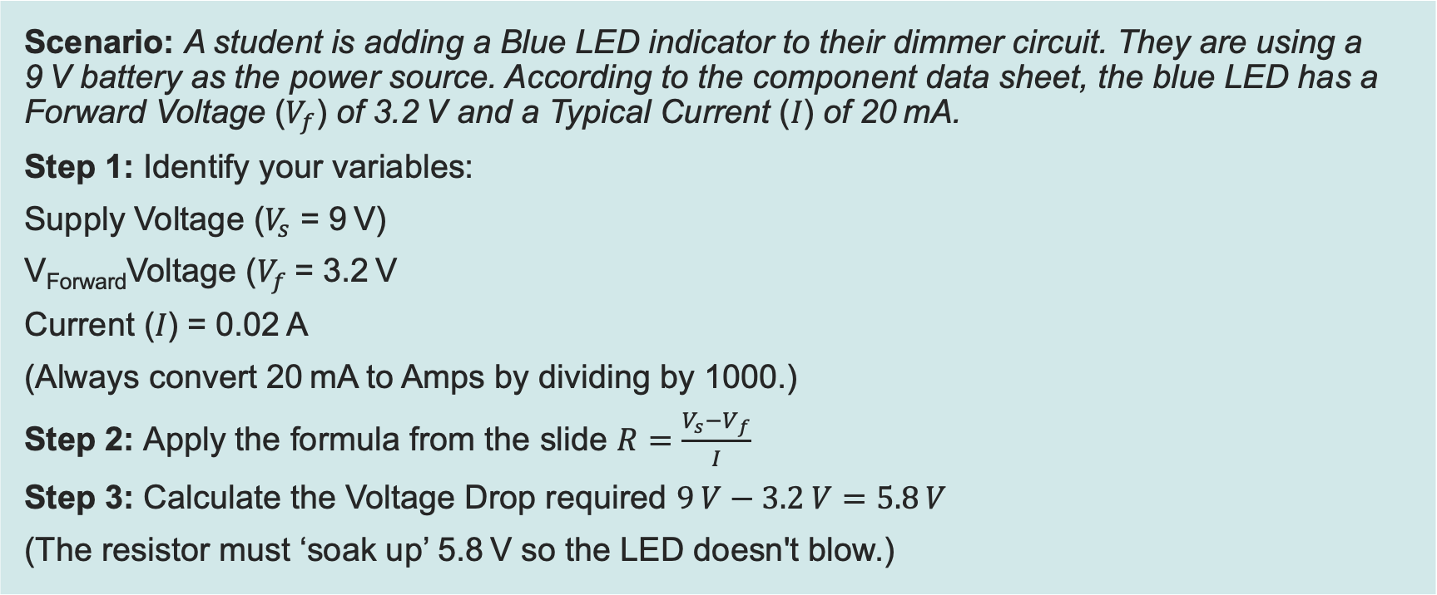
Worked example: Sizing a resistor for a high-intensity blue LED
Activity 2
Scenario: A student is adding a Blue LED indicator to their dimmer circuit. They are using a 9 V battery as the power source. According to the component data sheet, the blue LED has a Forward Voltage ($V_{f}$) of 3.2 V and a Typical Current (𝐼) of 20 mA.
Step 1: Identify your variables:
Supply Voltage ($V_{s}$ = 9 V)
V_{Forward}Voltage ($V_{f}$= 3.2 V
Current (𝐼) = 0.02 A
(Always convert 20 mA to Amps by dividing by 1000.)
Step 2: Apply the formula from the slide $R=\frac{V_{s}−V_{f}}{I}$
Step 3: Calculate the Voltage Drop required $9 V−3.2 V=5.8 V$
(The resistor must ‘soak up’ 5.8 V so the LED doesn't blow.)
Resource 2 Practical project on dimmer switches

Slide 13
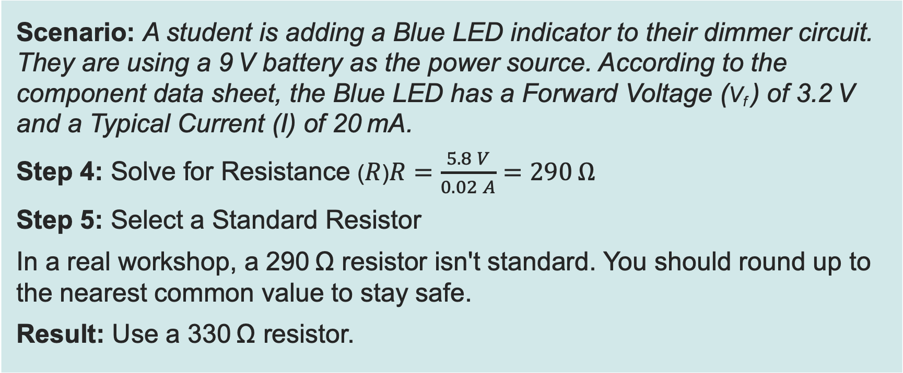
Worked example: Sizing a resistor for a high-intensity blue LED
Activity 2
Scenario: A student is adding a Blue LED indicator to their dimmer circuit. They are using a 9 V battery as the power source. According to the component data sheet, the Blue LED has a Forward Voltage (V_{f} ) of 3.2 V and a Typical Current (I) of 20 mA.
Step 4: Solve for Resistance ($R$)$R=\frac{5.8 V}{0.02 A}=290 Ω$
Step 5: Select a Standard Resistor
In a real workshop, a 290 Ω resistor isn't standard. You should round up to the nearest common value to stay safe.
Result: Use a 330 Ω resistor.
Resource 2 Practical project on dimmer switches

Slide 14
Activity 3: Practical
Activity 3
Follow the steps on R2 Worksheet Activity 3 to build your circuit board.
Test it and record the measurements on your worksheet.
Resources needed
R2 Worksheet
R2 Worksheet answers
Resource 2 Practical project on dimmer switches

Slide 15
Activity 4: Evaluation
Activity 4
Work through the criteria in Activity 4 on your worksheet to evaluate the success of your LED dimmer project.
Resources needed
R2 Worksheet
R2 Worksheet answers
Resource 2 Practical project on dimmer switches

Slide 16
In this resource, we have:
Plenary
Designed, assembled and tested an LED dimmer circuit on a breadboard
Measured voltages and currents to diagnose circuit performance
Calculated actual transistor gain and compared it to manufacturer specifications
Evaluated our LED dimmer design
Skills:
MPC-CSD Evaluate and quality assure processes and outcomes
General competencies:
English:
EC5 Synthesise information
Maths:
MC1 Measuring with precision
MC2 Estimating, calculating and error spotting
MC4 Using rules and formulae
Digital:
DC1 Use digital technology and media effectively
Resource 2 Practical project on dimmer switches

