Slide 1
Management and Administration
Route: Business and Administration
Topic: Research skills
Lesson 3: Data analysis
Notes:
Image © Shutterstock/nampix

Slide 2
In this lesson, we will:
Introduction
analyse data from a research report and evaluate the accuracy, validity and reliability of its use
analyse the data provided in the research report to understand its importance to Fit Life Performance and its decision to open a new gym in the city centre
evaluate the findings and outcomes of the research by analysing its limitations and how it could be improved.
Skills
CSF: Undertaking research
General competencies
English:
EC2 Present information and ideas
EC4 Summarise information/ideas
EC5 Synthesise information
Maths:
MC5 Processing data
MC8 Communicating using mathematics
Digital:
DC1 Use digital technology and media effectively
Lesson 3: Data analysis

Slide 3
Data analysis
Introduction
Data analysis is the process of examining, organising and interpreting data to identify patterns, trends and useful information that can help answer research questions or support decision-making.
In the context of this assignment, you will be expected to:
analyse data (accuracy, reliability, validity);
interrogate data;
reflect on findings and outcomes.
Lesson 3: Data analysis

Slide 4

Question
Introduction
What does it mean when data is
accurate, reliable and valid?
Lesson 3: Data analysis

Slide 5
Data accuracy
Introduction
Example
What is meant by accurate data?
Accurate data is correct, precise and free from mistakes or bias.
How is data made accurate?
Ask clear and specific questions.
Record answers carefully.
Use a large enough sample size.
Avoid leading questions.
Double-check results.
A gaming company surveys 200 teenagers about their favourite game genre.
Accurate question:
“What type of games do you play most often?”
Inaccurate question:
“Don’t you think action games are the best?”
The second question encourages a certain answer, making the data less accurate.
Lesson 3: Data analysis

Slide 6
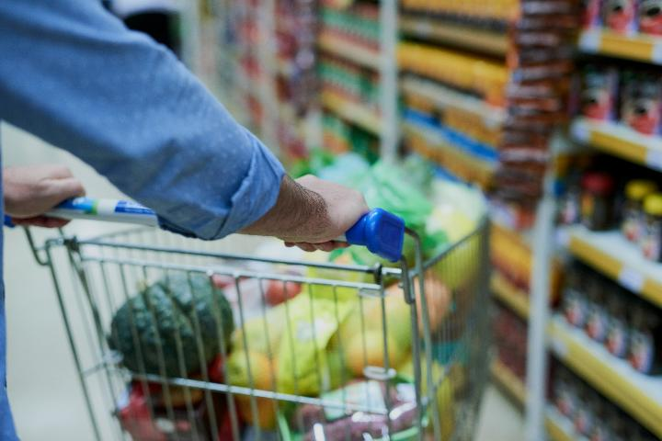
Data reliability
Introduction
Example
What is meant by reliable data?
Reliable data is trustworthy (from a reputable source) and consistent. If the research was repeated, it would produce similar results.
How is data made reliable?
Use the same questions for everyone.
Carry out research in the same conditions.
Use standard methods.
Use a large sample size to yield a more precise estimate of the target population.
Repeat the research to compare results.
If two researchers observing customers in a shop both record similar behaviours, the observations are reliable.
Lesson 3: Data analysis
Notes:
Image © Shutterstock/PeopleImages

Slide 7
Data validity
Introduction
Example
What is meant by valid data?
Valid data measures what the researcher intended to measure.
How is data made valid?
Make questions relevant to the research aim.
Target the correct audience.
Avoid vague or confusing questions.
Use suitable research methods.
A music streaming company wants to know what features teenagers want in an app.
Valid method
Survey teenagers aged 13–18.
Invalid method
Survey retired adults.
The second method is invalid because retired adults are not the target audience.
Lesson 3: Data analysis

Slide 8

Analysing data
Activity 1
Read the research report for Fit Life Performance.
Assess the accuracy, reliability and validity of the data provided in the research report.
Lesson 3: Data analysis
Notes:
Image © Shutterstock/Zurijeta
Hand out copies of Research report: Fit Life Performance.
Hand out copies of Activity 1 Worksheet. Suggested answers are provided.

Slide 9
Reliability
Activity 1
Reliability = consistency
Reliable data usually:
shows clear trends;
has similar responses;
would likely produce the same result again.
Less reliable data usually:
has mixed responses;
is subjective;
depends on personal interpretation.
Lesson 3: Data analysis

Slide 10
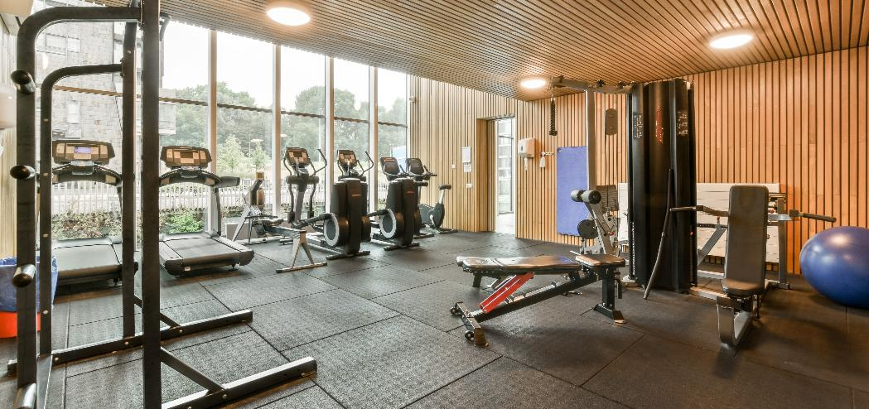
Interrogating data
Activity 2
Interrogate the research report:
  What is the data telling us?
  What evidence or statistics support this point?
  Why is this important to the business?
  What should the business do next because of this information?
Point + Evidence + Impact
→ Recommendation
Lesson 3: Data analysis
Notes:
Image © Shutterstock/Procreators
Hand out copies of Activity 2 Worksheet. Suggested answers are provided.

Slide 11

Reflection on findings and outcomes
Activity 3
Reflect on your research findings and outcomes.
Link your findings and outcomes to the research report and explain how they could contribute to any final decisions.
Point + Evidence + Impact
→ Recommendation
Lesson 3: Data analysis
Notes:
Image © Shutterstock/New Africa
Hand out copies of Activity 3 Worksheet. Suggested answers are provided.

Slide 12
In this lesson, we have:
Plenary
analysed data from a research report and evaluated the accuracy, validity and reliability of its use
analysed the data provided in the research report to understand its importance to Fit Life Performance and its decision to open a new gym in the city centre
evaluated the findings and outcomes of the research by analysing its limitations and how it could be improved.
Skills
CSF: Undertaking research
General competencies
English:
EC2 Present information and ideas
EC4 Summarise information/ideas
EC5 Synthesise information
Maths:
MC5 Processing data
MC8 Communicating using mathematics
Digital:
DC1 Use digital technology and media effectively
Lesson 3: Data analysis

