Slide 1
Construction
Route: Construction
Topic: Calculating construction costs
Lesson 2: Bills of quantities
Notes:
Image © Shutterstock/Dragon Images

Slide 2
In this lesson, we will:
Introduction
Skills:
CS1 Produce reports and presentations for construction professionals, clients or for non-technical audiences such as the public
CS3 Follow standard processes to produce unit rates, bills of quantities and their costing documentation
General competencies:
English:
E2 Present information and ideas
E5 Synthesise information
Maths:
M2 Estimate, calculate and spot errors
M4 Use rules and formulae
M5 Process data
M8 Communicate using mathematics
M9 Cost a project
Digital:
D3 Communicate and collaborate
Explain the importance of accurate cost estimation in the construction industry
Describe the purpose of a Bill of Quantities (BoQ) and explain how it supports cost management in construction projects
Complete the pricing of a BoQ using provided unit rates
Lesson 2: Bills of quantities

Slide 3
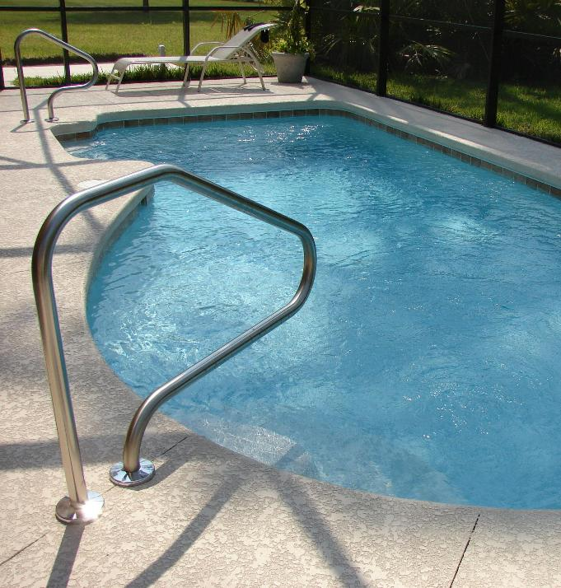
Building a swimming pool
Introduction
What costs are involved in building a swimming pool?
Sort these into the four main categories of construction costs:
  Material costs
  Plant costs
  Labour costs
  Preliminary costs
Lesson 2: Bills of quantities
Notes:
Image © Pexels/Pixabay

Slide 4
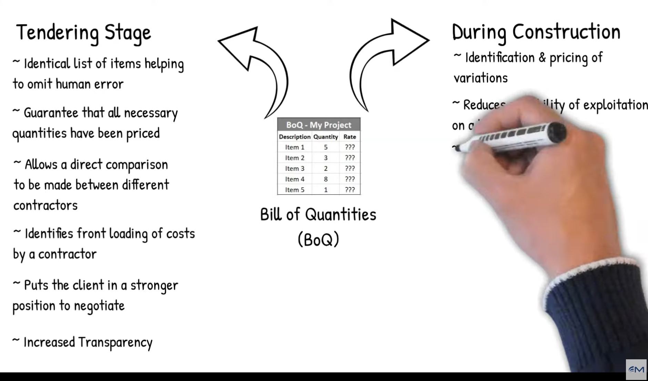
Bill of Quantities (BoQ)
Activity 1
A BoQ contains measured items. These are descriptions of parts of a construction project with associated quantities.
The items are measured in accordance with a standard method such as NRM 2 or CESMM4.
Contractors can provide accurate pricing for the project and ensure that everyone involved understands the scope of the work.
BoQ are unique to each project, but they are compiled from a quantified list of standardised items.
Lesson 2: Bills of quantities
Notes:
Bills of Quantities explained video: https://youtu.be/ouhkzuULHnA

Slide 5

Tendering
Activity 1
The BoQ serves as a basis for pricing and tendering.
Tendering is the process by which contractors submit bids to carry out a construction project or supply goods and services.
The client invites selected contractors to submit a price for the work, based on tender documents which may include BoQ specifications and drawings.
The client reviews the bids, considering price, timeline, and quality, before selecting the most suitable contractor.
Lesson 2: Bills of quantities
Notes:
Image © Pexels/Pixabay

Slide 6
Types of BoQ
Activity 1
Trade Activity BoQs
Items related to one specific trade area (e.g. carpentry and masonry) are grouped together. These documents follow the content and order of the tabulated work sections of the NRM 2 document.
Elemental BoQ
Items are grouped by building elements such as external walls, windows, doors.
Bill of Approximate Quantities
These are used where all work has to be remeasured on completion.
Lesson 2: Bills of quantities

Slide 7
Differences between types of BoQ
Activity 1
Trade BoQ
More concise
Quicker to price than Elemental BoQ
However, they are not as easy to use for future cost planning
Elemental BoQ
each element has all the work items associated with that element grouped together. This method provides good sources of information for future cost planning, but it is a larger document and therefore is more time consuming to price by the estimator.
Bill of Approximate Quantities
are used when the full extent of the works are not known at the time of tender, e.g. if the design is not fully complete.
Lesson 2: Bills of quantities

Slide 8
Work sections in a Trade BoQ
Activity 1
This table shows the work sections
of substructures and superstructures in a BoQ following the format of NRM 2.
There are 41 tabulated work sections in NRM 2, but each project will only select those items that are required.
NRM 2 Ref | NRM 2 Tabulated Work Section
3 | Demolitions
5 | Excavation and filling
11 | In-situ concrete works
13 | Precast concrete
14 | Masonry
16 | Carpentry
18 | Tile and slate roof and wall coverings
22 | General joinery
23 | Windows, screens and lights
24 | Doors, shutters and hatches
25 | Stairs, walkways and balustrades
27 | Glazing
28 | Floor, wall ceiling and roof finishes
29 | Decoration
32 | Furniture, fittings and equipment
33 | Drainage above ground
38 | Mechanical services
39 | Electrical services
Lesson 2: Bills of quantities

Slide 9
Work sections in a BoQ
Activity 1
This table shows the work sections for the external works in a BoQ following the format of NRM 2.
Site works include: hard surfacing of roads and footpaths, paving, site furniture, sports surfacing, line marking, etc.
Soft landscaping includes: cultivating, seeding, turfing, trees, shrubs, hedging, planting, protection, etc.
NRM 2 Ref | NRM 2 Tabulated Work Section
34 | Drainage below ground
35 | Site works
36 | Fencing
37 | Soft landscaping
Lesson 2: Bills of quantities

Slide 10
Final summary in a BoQ: Example
Activity 1
Preliminaries are covered by tabulated work section 1 of NRM 2 (pages 50–119).
Sums from the different bills within BoQs are brought together into a final summary.
Preliminaries | (from page 1) | £
Substructures | (from page 3) | £
Superstructures | (from page 4) | £
External works | (from page 5) | £
Prime cost (PC) and Provisional Sums | (from page 6) | £
Sub-total |  | £
Director’s adjustment (+/-) |  | £
Total carried to form of tender |  | £______
There is no entry for Bill 2 (page 2) as this is typically the ‘preambles’ which includes specification of materials and workmanship and does not normally include any items for pricing.
The carried forwards amounts are from
the ‘collections’ at the end of each bill.
Lesson 2: Bills of quantities

Slide 11
Pricing a BoQ
Activity 1
item cost = quantity × unit rate
For example, the brick work cost is:
item cost = 25 m² × £85.00
= £2,125.00
Item No | Description | Quantity | Unit | Unit rate (£) | Total (£)
(a) | Excavate for foundation | 5 | m³ | 20.00 | 100.00
(b) | Concrete for foundation | 3 | m³ | 75.00 | 225.00
(c) | Half brick wall in facings | 25 | m² | 85.00 | 2,125.00
Total |  |  |  |  | 2,450.00
What would the total cost be for 100 square metres of brick work if the unit rate for brick work is £50.00 per square metre?
Lesson 2: Bills of quantities

Slide 12
Pricing BoQ: Practice
Activity 1
Complete the BoQ using the worksheet.
Resources:
L2 Activity 1 Worksheet
Calculator
Lesson 2: Bills of quantities

Slide 13
Answers: Exercise 1
Activity 1
Item No | Description | Quantity | Unit | Rate (£) | Total (£)
(a) | Excavate foundation trench | 10 | m³ | 35.00 | 350.00
(b) | Concrete for foundation | 5 | m³ | 95.00 | 475.00
(c) | Brickwork (outer leaf) | 20 | m² | 72.00 | 1,440.00
(d) | Concrete block (inner leaf) | 20 | m² | 42.00 | 840.00
(e) | Insulation in cavity | 18 | m² | 10.00 | 180.00
(f) | DPC over 300 mm widths | 18 | m² | 6.00 | 108.00
(g) | Plastering on inner leaf | 18 | m² | 27.00 | 486.00
Total |  |  |  |  | 3,879.00
Lesson 2: Bills of quantities

Slide 14
Answers: Exercise 2
Activity 1
Item No | Description | Quantity | Unit | Rate (£) | Total (£)
(a) | Roof trusses | 10 | No | 95.00 | 950.00
(b) | Supply and fix roofing felt | 100 | m² | 6.00 | 600.00
(c) | Softwood tile battens | 350 | m | 2.30 | 805.00
(d) | Roof tiling | 100 | m² | 24.00 | 2,400.00
(e) | Ridge tiles | 30 | m | 12.00 | 360.00
(f) | Flashing around chimney | 5 | m | 35.00 | 175.00
(g) | 100 mm gutter | 20 | m | 15.00 | 300.00
(h) | 75 mm downpipes | 11 | m | 14.00 | 154.00
Total |  |  |  |  | 5,744.00
Lesson 2: Bills of quantities

Slide 15
Answers: Exercise 3
Activity 1
Item No | Description | Quantity | Unit | Rate (£) | Total (£)
(a) | Wiring for lighting points | 25 | No | 65.00 | 1,625.00
(b) | Install power sockets | 20 | No | 55.00 | 1,100.00
(c) | Consumer unit installation | 1 | No | 350.00 | 350.00
(d) | Supply and fix lighting fittings | 15 | No | 25.00 | 375.00
(e) | Install circuit breakers in panel board | 10 | No | 50.00 | 500.00
(f) | Installation of outdoor lighting | 5 | No | 40 | 200.00
(g) | Builders work in connection with electrical installations |  | Item | 250.00 | 250.00
(h) | Final testing and commissioning |  | Item | 150.00 | 150.00
Total |  |  |  |  | 4,550.00
Lesson 2: Bills of quantities

Slide 16
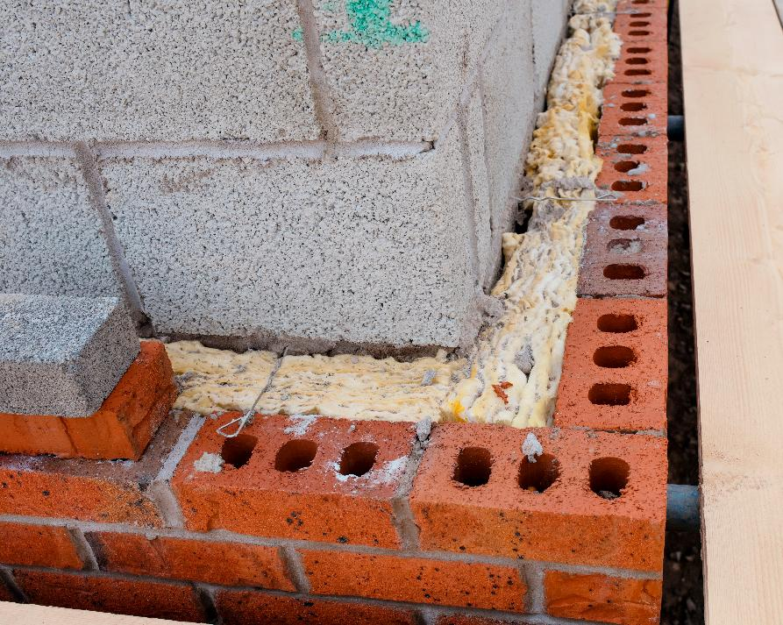
Case study: Work in progress on-site
Activity 1
Read Activity 1 Case study.
In pairs, role play the discussion which might take place between the quantity surveyor’s assistant and the contractor.
Lesson 2: Bills of quantities
Notes:
Image © Shutterstock/Irene Miller

Slide 17
Standard Method of Measurement (SMM)
Activity 2
A BoQ is prepared according to a SMM to ensure consistency and accuracy across projects.
This standardised approach provides a clear set of guidelines for measuring and describing various construction tasks, materials and components.
By adhering to a standard method, quantity surveyors and contractors can reduce ambiguities, minimise disputes, and make accurate cost estimates.
Lesson 2: Bills of quantities

Slide 18
New Rules of Measurement (NRM)
Activity 2
Research the NRM guidelines that help construction professionals measure and manage project costs consistently.
Find out:
  why the NRM was created;
  what is different about NRM1, NRM2, NRM3;
  why the NRM is important.
Create an A1 poster that explains the NRM.
Resources:
Activity 2 poster checklist
Lesson 2: Bills of quantities

Slide 19
Similarities and differences
Plenary
Item | Description | Quantity | Unit | Rate per unit | Total amount
a) | Excavation of soft clay and silty soil including disposal up to a depth of 1.5 m | 414 | m³ | £72.79 | £30,135.06
b) | Supply, erecting, fitting, centring of formwork, including dismantling as per drawing number xxx | 121 | m² | £715.82 | £86,614.22
c) | Reinforcement steelwork for wall including, supplying cutting, bending, placing and fixing | 594.33 | kg | £91.77 | £54,541.66
Total |  |  |  |  | £171,290.94
Lesson 2: Bills of quantities

Slide 20
In this lesson, we have:
Plenary
Skills:
CS1 Produce reports and presentations for construction professionals, clients or for non-technical audiences such as the public
CS3 Follow standard processes to produce unit rates, bills of quantities and their costing documentation
General competencies:
English:
E2 Present information and ideas
E5 Synthesise information
Maths:
M2 Estimate, calculate and spot errors
M4 Use rules and formulae
M5 Process data
M8 Communicate using mathematics
M9 Cost a project
Digital:
D3 Communicate and collaborate
Explained the importance of accurate cost estimation in the construction industry
Described the purpose of a BoQ and explained how it supports cost management in construction projects
Completed the pricing of a BoQ using provided unit rates
Lesson 2: Bills of quantities

Slide 21
Consolidation
Consolidation
In groups, produce your own section of a BoQ for a specific task. For example, replacing a flat roof or wiring an extension.
Swap your BoQ with another group. Give the other group some feedback:
  Were all costs included?
  Was the BoQ presented clearly?
  Did it have a timescale for which it was valid?
  Did the descriptions meet the NRM requirements?
Lesson 2: Bills of quantities

Slide 22
Consolidation
Consolidation
Watch this video about NRM:
https://youtu.be/1QUhFYUwuyg
Reflect on the content of your poster and your learning about BoQ and cost control.
Write a couple of paragraphs summarising:
  what you have learnt;
  what you did well;
  what improvements you could make.
Lesson 2: Bills of quantities
Notes:
Construction Methods of Measurement – Explained video: https://youtu.be/1QUhFYUwuyg

