Slide 1
Engineering and Manufacturing
Route: Engineering and Manufacturing
Topic: Basic principles of hydraulics and pneumatics
Resource 1: Introduction
Notes:
Image © Shutterstock/Parilov

Slide 2
In this resource, we will:
Introduction
Use augmented reality (AR) models to visualise system components and understand their function in real-world contexts
Compare hydraulic and pneumatic systems, identifying advantages, limitations, and suitable applications
Interpret engineering diagrams for fluid power systems, identifying ISO symbols and flow directions
Produce engineering drawings and hydraulic/pneumatic system diagrams using recognised fluid power symbols
General competencies:
English:
EC4 Summarise information/ideas
EC5 Synthesise information
Maths:
MC2 Estimating, calculating and error spotting
MC4 Using rules and formulae
Digital:
DC1 Use digital technology and media effectively
Resource 1: Introduction

Slide 3

AR: Hydraulic car braking system
Activity 1
https://mxarviewer.azurewebsites.net/ARView/V/2d0d8ba1-1a3d-4009-862b-f70c2cb93cb1
Resources needed
AR: Hydraulic car braking system
R1 AR Guide Hydraulics
R1 Activity 1 worksheet
When you have accessed the hydraulic car braking system AR, complete the Independent observation checklist on the worksheet.
Resource 1: Introduction

Slide 4

AR: Pneumatic nail gun
Activity 1
https://mxarviewer.azurewebsites.net/ARView/V/9d7cd072-2fc6-47be-87d9-a7a8302df6e9
Resources needed
AR: Pneumatic nail gun
R1 AR Guide Pneumatics
R1 Activity 1 worksheet
When you have accessed the pneumatic nail gun AR, complete the Independent observation checklist on the worksheet.
Resource 1: Introduction

Slide 5
Producing engineering diagrams
Activity 2
You are going to use your AR viewer and an information sheet to help you to produce your own labelled engineering diagrams for:
a hydraulic car braking system;
a pneumatic nail gun.
Resources needed:
R1 Information sheet
R1 Activity 2 Worksheet
R1 Activity 2 Worksheet answers
AR: Hydraulic car braking system
AR: Pneumatic nail gun
Resource 1: Introduction

Slide 6
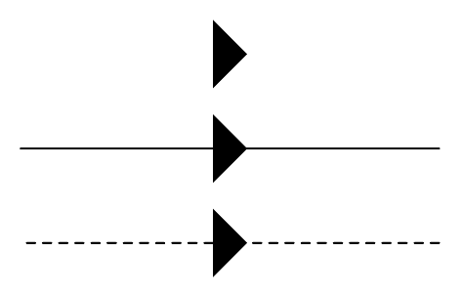
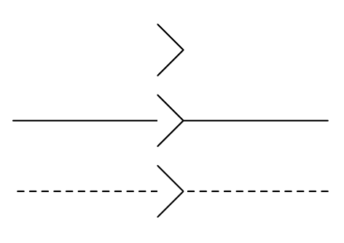
ISO 1219 standard symbols recap
Activity 2
Flow direction indicator | Symbol
Hydraulic flow: SOLID (filled) triangle pointing in the direction of flow
Pneumatic flow: HOLLOW (unfilled) triangle pointing in the direction of flow
Resource 1: Introduction

Slide 7
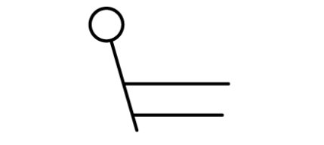
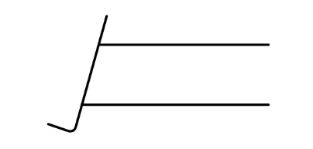
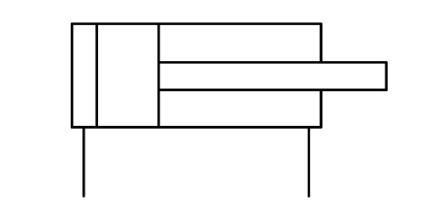
ISO 1219 standard symbols recap
Activity 2
Hydraulic braking system | Symbol
Brake lever
Brake pedal
Master cylinder
Resource 1: Introduction

Slide 8
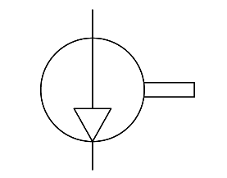
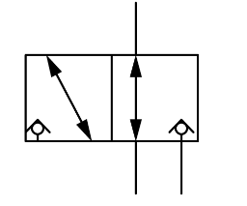
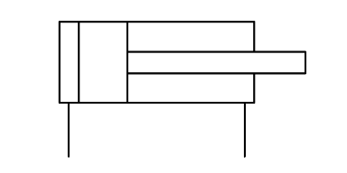
ISO 1219 standard symbols recap
Activity 2
Pneumatic nail gun | Symbol
Compressor
Poppet valve (no return)
Drive cylinder/ actuator
Resource 1: Introduction

Slide 9
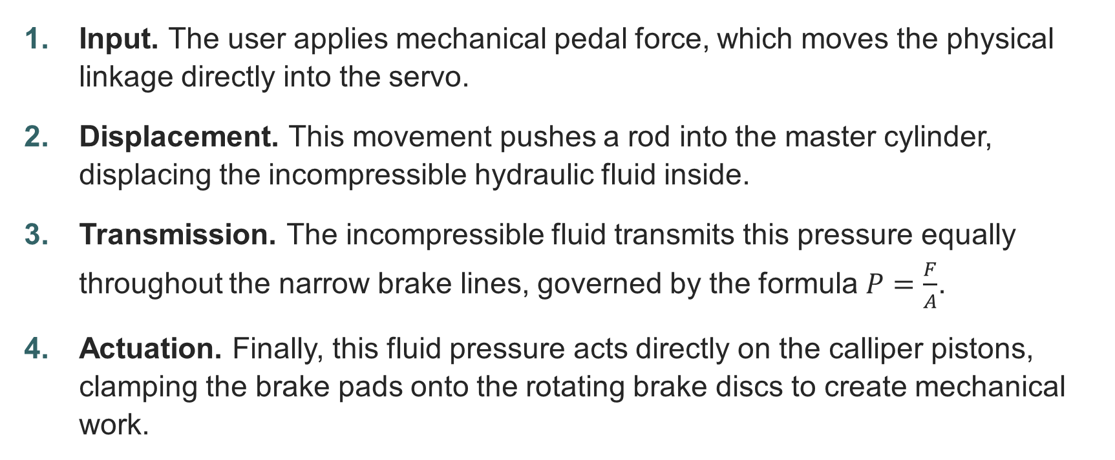
Hydraulic car braking system sequence
Activity 2
Input. The user applies mechanical pedal force, which moves the physical linkage directly into the servo.
Displacement. This movement pushes a rod into the master cylinder, displacing the incompressible hydraulic fluid inside.
Transmission. The incompressible fluid transmits this pressure equally throughout the narrow brake lines, governed by the formula $P=\frac{F}{A}$.
Actuation. Finally, this fluid pressure acts directly on the calliper pistons, clamping the brake pads onto the rotating brake discs to create mechanical work.
Resource 1: Introduction

Slide 10
Pneumatic nail gun sequence
Activity 2
Safety. Pressing the nozzle against a surface disengages the mechanical lock, safely releasing the trigger mechanism.
Input. Pulling the trigger opens the 3/2-way directional control valve to initiate the system.
Expansion. Compressed air expands rapidly, rushing from the main storage chamber into the drive cylinder.
Actuation. This fast-moving, expanding air propels the internal piston forward, instantly driving the nail home.
Resource 1: Introduction

Slide 11
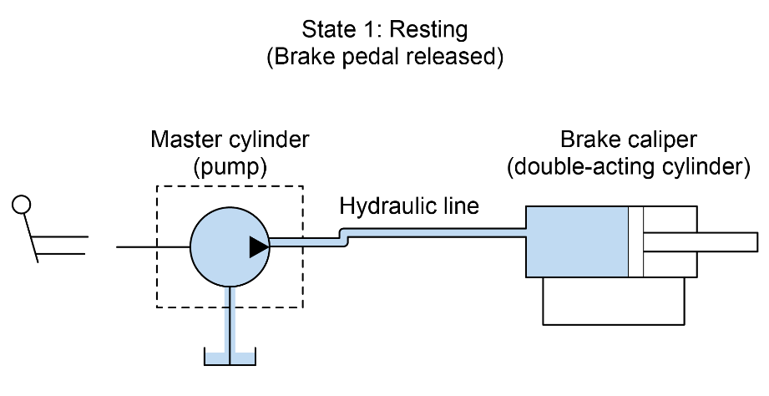
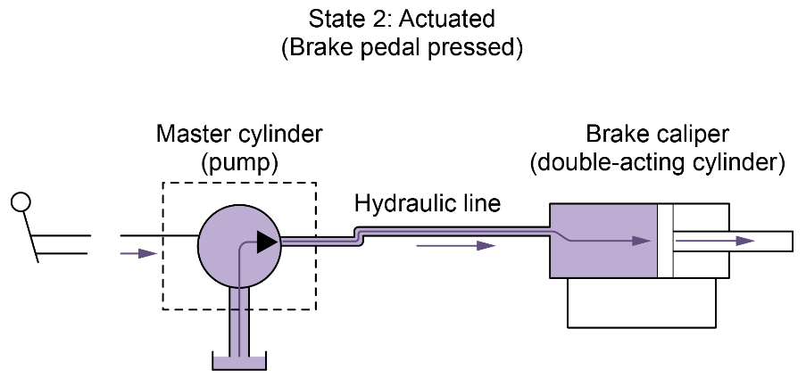
Hydraulic car braking system diagram
Activity 2
Resource 1: Introduction

Slide 12
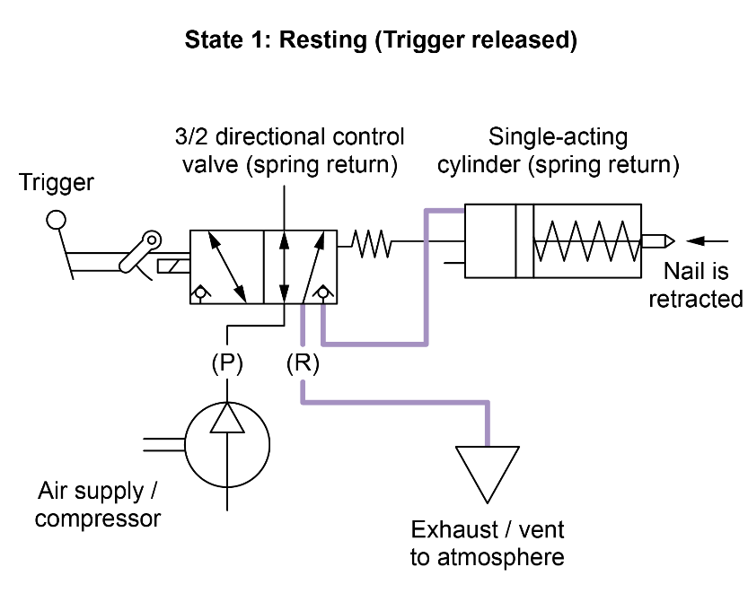
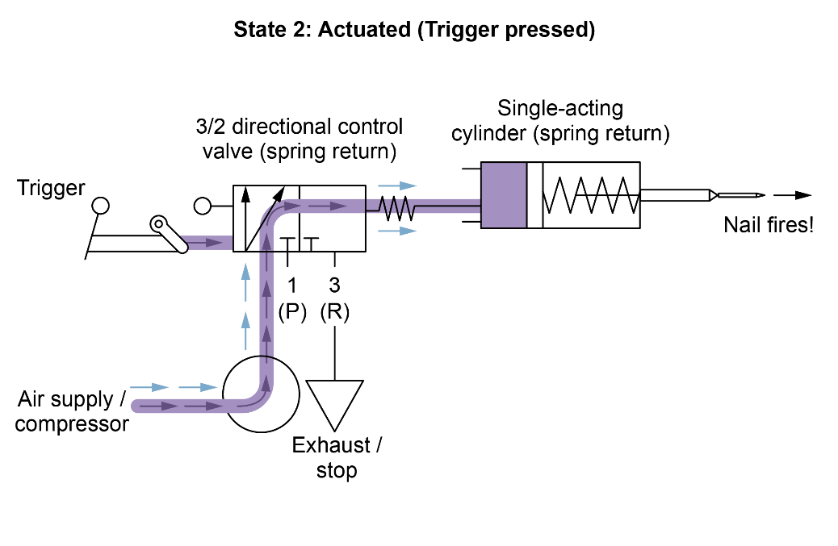
Pneumatic nail gun diagram
Activity 2
Resource 1: Introduction

Slide 13
Pascal’s law – worksheet
Activity 3
Complete the questions in the worksheet.
Compare your answers with those on the Worksheet answers.
Resources needed:
R1 Activity 3 Worksheet
R1 Activity 3 Worksheet answers
Resource 1: Introduction

Slide 14
Pascal’s law recap
Activity 3
Pascal’s law states that pressure applied to a confined fluid is transmitted equally in all directions throughout the fluid.
Because pressure (P) is equal to force (F) divided by area (A), a small force applied to a small cylinder can be multiplied into a much larger force at a larger cylinder.
Resource 1: Introduction

Slide 15
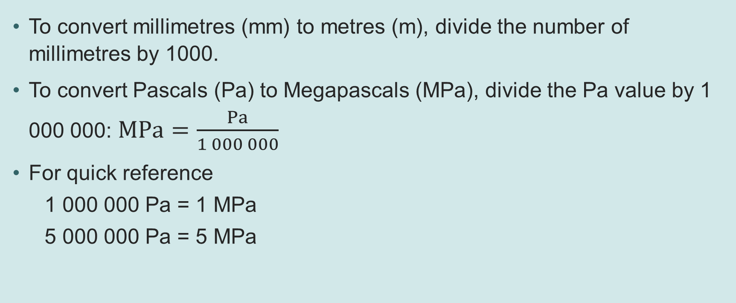
Unit conversion
Activity 3
To convert millimetres (mm) to metres (m), divide the number of millimetres by 1000.
To convert Pascals (Pa) to Megapascals (MPa), divide the Pa value by 1 000 000: $MPa=\frac{Pa}{1 000 000}$
For quick reference
  1 000 000 Pa = 1 MPa
  5 000 000 Pa = 5 MPa
Resource 1: Introduction

Slide 16
Plenary
Plenary
Complete the questions in the Plenary Worksheet.
Compare your answers against those on the Worksheet answers.
Resources needed:
R1 Information sheet
R1 Plenary Worksheet
R1 Plenary Worksheet answers
Resource 1: Introduction

Slide 17
In this resource, we have:
Plenary
Used augmented reality (AR) models to visualise system components and understand their function in real-world contexts
Compared hydraulic and pneumatic systems, identifying advantages, limitations, and suitable applications
Interpreted engineering diagrams for fluid power systems, identifying ISO symbols and flow directions
Produced engineering drawings and hydraulic/pneumatic system diagrams using recognised fluid power symbols
General competencies:
English:
EC4 Summarise information/ideas
EC5 Synthesise information
Maths:
MC2 Estimating, calculating and error spotting
MC4 Using rules and formulae
Digital:
DC1 Use digital technology and media effectively
Resource 1: Introduction

Slide 18
Consolidation
Work independently or in small groups to research drum brakes and hydraulic presses.
Produce an A4 information poster containing the following information:
  uses of hydraulic systems
  uses of pneumatic systems
  advantages and disadvantages of both systems.
Resources needed:
R1 Poster checklist
Resource 1: Introduction

