Slide 1
Health
Route: Health and Science
Topic 1: The development, impact and management of disorders
Resource 1 – Disorders quiz
Notes:
Image © Shutterstock/NT_Studio

Slide 2
In this resource, you will:
Check your understanding of the causes, symptoms and treatments of:
  coronary heart disease (CHD)
  chronic obstructive pulmonary disease (COPD)
  diabetes
  chronic kidney disease (CKD)
General competencies:
English:
E5 Synthesise information
Resource 1: Disorders quiz

Slide 3
Disorders quiz
The following quiz contains 20 quick questions to check your understanding of the causes, symptoms and treatments of four disorders:
Coronary heart disease (CHD);
Chronic obstructive pulmonary disease (COPD);
Diabetes;
Chronic kidney disease (CKD).
Resource 1: Disorders quiz

Slide 4
Coronary Heart Disease
1. Identify the main cause of coronary heart disease (CHD). (1 mark)
Lack of control of blood glucose levels
Build-up of fatty deposits in the coronary arteries
Deficiency of iron in the blood
Viral infection of the heart muscle
Resource 1: Disorders quiz

Slide 5
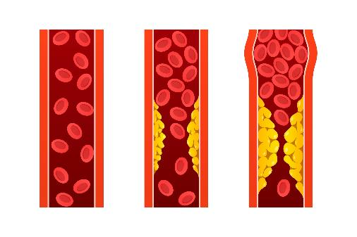
Coronary Heart Disease
1. Identify the main cause of coronary heart disease (CHD). (1 mark)
Lack of control of blood glucose levels
Build-up of fatty deposits in the coronary arteries
Deficiency of iron in the blood
Viral infection of the heart muscle
Answer
B. Build-up of fatty deposits in the coronary arteries (1)
This is also known as an atheroma.
Resource 1: Disorders quiz
Notes:
Image © Shutterstock/Maman Suryaman

Slide 6
Coronary Heart Disease
2. Identify the main symptom of angina.
(1 mark)
Dizziness
Chest pain
Extreme thirst
Headaches
Resource 1: Disorders quiz

Slide 7
Coronary Heart Disease
2. Identify the main symptom of angina.
(1 mark)
Dizziness
Chest pain
Extreme thirst
Headaches
Answer
B. Chest pain (1)
Pain is felt in the chest due to reduced blood flow to the heart.
Find out about more symptoms here: www.nhs.uk/conditions/coronary-heart-disease/
Resource 1: Disorders quiz

Slide 8
Coronary Heart Disease
3. Identify how CHD affects the respiratory system. (1 mark)
Causes muscle weakness and fatigue
Leads to dizziness and fainting
Causes a shortness of breath and fluid build-up in the lungs
Reduces kidney function
Resource 1: Disorders quiz

Slide 9
Coronary Heart Disease
3. Identify how CHD affects the respiratory system. (1 mark)
Causes muscle weakness and fatigue
Leads to dizziness and fainting
Causes a shortness of breath and fluid build-up in the lungs
Reduces kidney function
Answer
C. Causes a shortness of breath and fluid build-up in the lungs (1)
All of these are effects on the body of CHD, but the question only asks about the respiratory system.
Resource 1: Disorders quiz

Slide 10
Coronary Heart Disease
4. Identify which of the following is a lifestyle treatment for CHD. (1 mark)
Beta-blockers
Statins
Coronary bypass surgery
Regular exercise
Resource 1: Disorders quiz

Slide 11
Coronary Heart Disease
4. Identify which of the following is a lifestyle treatment for CHD. (1 mark)
Beta-blockers
Statins
Coronary bypass surgery
Regular exercise
Answer
D. Regular exercise (1)
Other lifestyle changes include stopping smoking and eating more healthily. Click here for more information on ways people can lower their risk of CHD www.bhf.org.uk
A and B are medications and C involves surgery.
Resource 1: Disorders quiz

Slide 12
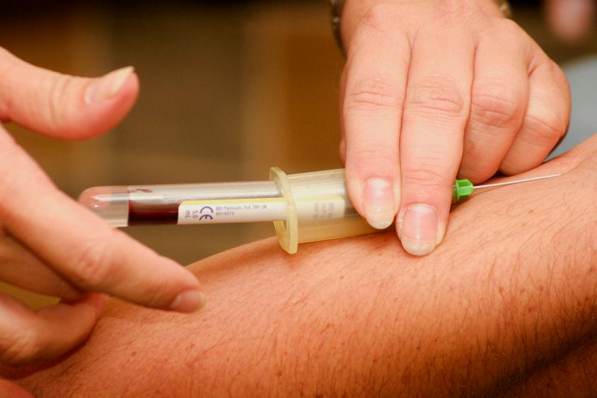
Coronary Heart Disease
5. Explain the purpose of blood tests in managing CHD. (2 marks)
Explain means you should state the reasons for something happening – so what the blood test measures and why.
Resource 1: Disorders quiz
Notes:
Image © Unsplash/Hush Naidoo Jade Photography

Slide 13
Coronary Heart Disease
5. Explain the purpose of blood tests in managing CHD. (2 marks)
Answer
Measure cholesterol levels (1) (By measuring cholesterol levels) the effectiveness of treatments can be determined/If statins are effective, cholesterol levels should fall (1)
Refer to the CHD fact file for a summary of causes, symptoms and treatments of CHD.
Resource 1: Disorders quiz
Notes:
Image © Unsplash/Hush Naidoo Jade Photography

Slide 14

Chronic Obstructive Pulmonary Disease
1. State two risk factors of chronic obstructive pulmonary disease (COPD). (2 marks)
State means write down, or list – you do not need to explain why they are risk factors.
Resource 1: Disorders quiz
Notes:
Image © Unsplash/WESTOCK PRODUCTIONS

Slide 15
Chronic Obstructive Pulmonary Disease
1. State two risk factors of chronic obstructive pulmonary disease (COPD). (2 marks)
Answers
Any two from:
smoking (1)
(repeated exposure to irritants) silica/dust fumes/chemicals/cleaning products (1)
Find out more about preventing COPD here www.nhs.uk/conditions/chronic-obstructive-pulmonary-disease-copd/
Resource 1: Disorders quiz
Notes:
Image © Unsplash/WESTOCK PRODUCTIONS

Slide 16
Chronic Obstructive Pulmonary Disease
2. Identify which of the following statements explains how COPD affects the lungs. (1 mark)
The alveoli increase in size, improving gas exchange.
The bronchi become inflamed and widened, allowing more airflow.
The alveoli walls are damaged, reducing surface area for gas exchange.
The lungs become stronger due to increased mucus production.
Resource 1: Disorders quiz

Slide 17
Chronic Obstructive Pulmonary Disease
2. Identify which of the following statements explains how COPD affects the lungs. (1 mark)
The alveoli increase in size, improving gas exchange.
The bronchi become inflamed and widened, allowing more airflow.
The alveoli walls are damaged, reducing surface area for gas exchange.
The lungs become stronger due to increased mucus production.
Answer
C. The alveoli walls are damaged, reducing surface area for gas exchange. (1)
Mucus production does increase to remove irritants, but this increases the risk of infection as the thick, sticky mucus makes it harder for the body to clear pathogens from the airways.
Resource 1: Disorders quiz

Slide 18
Chronic Obstructive Pulmonary Disease
3. Identify how COPD can impact the renal system. (1 mark)
It causes a loss in bone density and weakened muscles.
The heart works harder to pump blood through damaged lungs, increasing risk of CHD.
It impairs kidney function from low oxygen and medication effects.
It leads to poor wound healing.
Resource 1: Disorders quiz

Slide 19
Chronic Obstructive Pulmonary Disease
3. Identify how COPD can impact the renal system. (1 mark)
It causes a loss in bone density and weakened muscles.
The heart works harder to pump blood through damaged lungs, increasing risk of CHD.
It impairs kidney function from low oxygen and medication effects.
It leads to poor wound healing.
Answer
C. It impairs kidney function from low oxygen and medication effects. (1)
All of these are effects on the body of COPD, but the question only asks about the renal system – a group of organs that includes the kidneys and bladder whose primary function is to filter waste products and excess fluid from the blood to produce urine.
Resource 1: Disorders quiz

Slide 20
Chronic Obstructive Pulmonary Disease
4. There are several types of medication used to treat the symptoms of COPD. Match the medication to its use. (2 marks)
Medication Use
Steroids Thin mucus
Antibiotics Treat infections
Mucolytics Reduce inflammation
Resource 1: Disorders quiz

Slide 21
Chronic Obstructive Pulmonary Disease
4. There are several types of medication used to treat the symptoms of COPD. Match the medication to its use. (2 marks)
Medication Use
Steroids Thin mucus
Antibiotics Treat infections
Mucolytics Reduce inflammation
Answer
Award 2 marks if all correct; award 1 mark if one answer correct.
Steroids – Reduce inflammation
Mucolytics – Thin mucus
Antibiotics – Treat infections during flare-ups
Resource 1: Disorders quiz

Slide 22

Chronic Obstructive Pulmonary Disease
5. Explain how spirometry helps in the management of COPD. (2 marks)
Explain means you should state the reasons for something happening – so what does spirometry measure and what does this show?
Resource 1: Disorders quiz
Notes:
Image © Shutterstock/Photoroyalty

Slide 23
Chronic Obstructive Pulmonary Disease
5. Explain how spirometry helps in the management of COPD. (2 marks)
Answer
Any two from:
measures lung function (FEV1 and FVC) before and after using an inhaler
reduced values indicate airflow obstruction
improvement after inhaler use shows responsiveness.
Refer to the COPD Fact file for a summary of causes, symptoms and treatments of COPD.
Resource 1: Disorders quiz
Notes:
Image © Shutterstock/Photoroyalty

Slide 24
Diabetes
Identify what causes type 1 diabetes.
(1 mark)
Insulin-resistant cells
Autoimmune destruction of insulin-producing cells in the pancreas
Hormonal changes during pregnancy
Poor diet
Resource 1: Disorders quiz

Slide 25
Diabetes
1. Identify what causes type 1 diabetes.
(1 mark)
Insulin-resistant cells
Autoimmune destruction of insulin-producing cells in the pancreas
Hormonal changes during pregnancy
Poor diet
Answer
B. Autoimmune destruction of insulin-producing cells in the pancreas (1)
Make sure you know the difference between the three main types of diabetes: www.nhs.uk/conditions/diabetes/
Resource 1: Disorders quiz

Slide 26

Diabetes
2. List two risk factors for type 2 diabetes.
(2 marks)
List means write down, or state – you do not need to explain why they are risk factors.
Resource 1: Disorders quiz
Notes:
Image © Shutterstock/Sweet Life

Slide 27
Diabetes
2. List two risk factors for type 2 diabetes.
(2 marks)
Answer
Any two from:
obesity
poor diet
physical inactivity.
Resource 1: Disorders quiz
Notes:
Image © Shutterstock/Sweet Life

Slide 28
Diabetes
3. Identify which statements about gestational diabetes are true. (2 marks)
Develops during pregnancy
Hormonal changes reduce insulin productivity
Disorder usually disappears after giving birth
Increases risk of type 1 diabetes later in life
Resource 1: Disorders quiz

Slide 29
Diabetes
3. Identify which statements about gestational diabetes are true. (2 marks)
Develops during pregnancy
Hormonal changes reduce insulin productivity
Disorder usually disappears after giving birth
Increases risk of type 1 diabetes later in life
Answer
True (1)
False. Hormonal changes reduce sensitivity to insulin.
True (1)
False. It increases the risk of developing type 2 diabetes.
Resource 1: Disorders quiz

Slide 30
Diabetes
4. Identify which of the following treatments is most appropriate for managing type 1 diabetes. (1 mark)
Weight loss and metformin
Insulin therapy and regular blood glucose monitoring
Healthy diet and exercise
Antibiotics
Resource 1: Disorders quiz

Slide 31
Diabetes
4. Identify which of the following treatments is most appropriate for managing type 1 diabetes. (1 mark)
Weight loss and metformin
Insulin therapy and regular blood glucose monitoring
Healthy diet and exercise
Antibiotics
Answer
B. Insulin therapy and regular blood glucose monitoring (1)
See www.diabetes.org.uk for more information on managing diabetes.
Resource 1: Disorders quiz

Slide 32
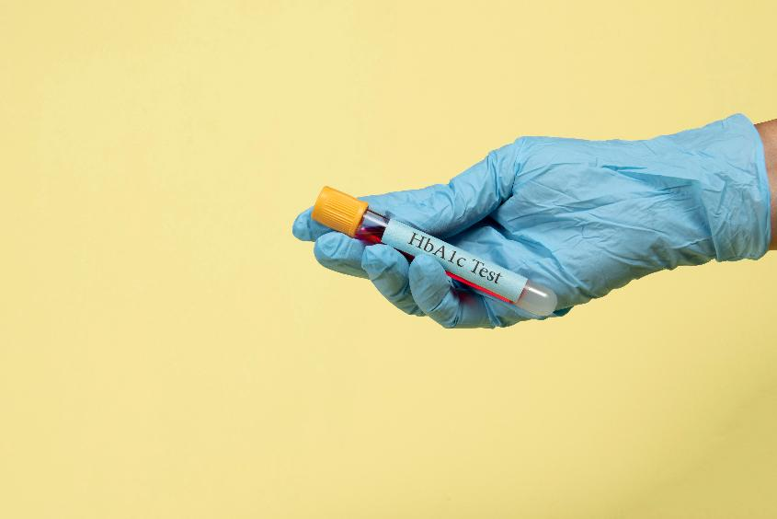
Diabetes
5. Explain the purpose of the HbA1c test in diabetes management. (2 marks)
Explain means you should state the reasons for something happening – so what the blood test measures and why.
Resource 1: Disorders quiz
Notes:
Image © Shutterstock/Celso Pupo

Slide 33
Diabetes
5. Explain the purpose of the HbA1c test in diabetes management. (2 marks)
Answer
To assess average blood glucose over the past 2–3 months. (1)
Target for most people with diabetes is to have a level below 48 mmol/mol (6.5%). (1)
Refer to the Diabetes Fact file for a summary of causes, symptoms and treatments of diabetes.
Resource 1: Disorders quiz
Notes:
Image © Shutterstock/Celso Pupo

Slide 34
Chronic Kidney Disease
Many health conditions increase the risk of a person developing chronic kidney disease (CKD).
Name two of these health conditions. (2 marks)
Name means write down, or state.
Resource 1: Disorders quiz

Slide 35
Chronic Kidney Disease
Many health conditions increase the risk of a person developing chronic kidney disease (CKD).
Name two of these health conditions. (2 marks)
Answer
  Any two from:
  diabetes
  high blood pressure
  recurrent kidney infections
  genetic conditions
  autoimmune diseases
  other appropriate condition.
  For more information see www.nhs.uk/conditions/kidney-disease/
Resource 1: Disorders quiz

Slide 36
Chronic Kidney Disease
2. Identify which organ system is directly affected when CKD leads to calcium and phosphate imbalance. (1 mark)
Reproductive system
Nervous system
Skeletal system
Digestive system
Resource 1: Disorders quiz

Slide 37
Chronic Kidney Disease
2. Identify which organ system is directly affected when CKD leads to calcium and phosphate imbalance. (1 mark)
Reproductive system
Nervous system
Skeletal system
Digestive system
Answer
C. Skeletal system (1)
The imbalance of calcium and phosphate leads to bone weakness.
Resource 1: Disorders quiz

Slide 38
Chronic Kidney Disease
3. Identify the test which is commonly used to assess the severity of kidney damage.
(1 mark)
Electrocardiogram (ECG)
Estimated glomerular filtration rate (eGFR)
HbA1c test
Spirometer
Resource 1: Disorders quiz

Slide 39
Chronic Kidney Disease
3. Identify the test which is commonly used to assess the severity of kidney damage.
(1 mark)
Electrocardiogram (ECG)
Estimated glomerular filtration rate (eGFR)
HbA1c test
Spirometer
Answer
B. Estimated glomerular filtration rate (eGFR) – a lower GFR indicates more severe kidney damage. eGFR is an estimated value commonly used in practice because it can be calculated from a standard blood test, making it quicker and easier to obtain. GFR, however, is the actual measured reading and requires a much lengthier procedure.
Resource 1: Disorders quiz

Slide 40
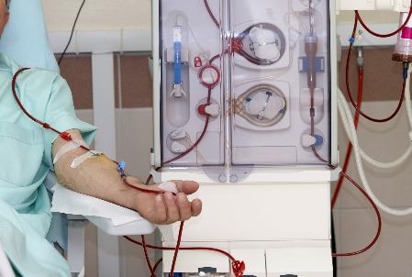
Chronic Kidney Disease
4. Identify which statements about dialysis are true. (2 marks)
Removes waste products such as urea
Regulates water and electrolyte balance
Stimulates new kidney tissue growth
Reduces blood sugar levels
Resource 1: Disorders quiz
Notes:
Image © Shutterstock/pics five

Slide 41
Chronic Kidney Disease
4. Identify which statements about dialysis are true. (2 marks)
Removes waste products such as urea
Regulates water and electrolyte balance
Stimulates new kidney tissue growth
Reduces blood sugar levels
Answer
A (1)
B (1)
Dialysis mimics the action of the kidneys, removing waste and preventing toxins building up.
Click here for more information on dialysis kidneycareuk.org/
Resource 1: Disorders quiz
Notes:
Image © Shutterstock/pics five

Slide 42

Chronic Kidney Disease
5. Explain why patients with a kidney transplant must take immunosuppressants for the rest of their life. (2 marks)
Explain means you should state the reasons for something happening – so what do immunosuppressants do?
Resource 1: Disorders quiz
Notes:
Image © Unsplash/Navy Medicine

Slide 43
Chronic Kidney Disease
5. Explain why patients with a kidney transplant must take immunosuppressants for the rest of their life. (2 marks)
Answer
To prevent their immune system from recognising the transplanted kidney as foreign (1) and attacking it (rejection) (1)
Refer to the CKD Fact file for a summary of causes, symptoms and treatments of CKD.
Resource 1: Disorders quiz

Slide 44
In this resource, you have:
Checked your understanding of the causes, symptoms and treatments of:
  coronary heart disease (CHD)
  chronic obstructive pulmonary disease (COPD)
  diabetes
  chronic kidney disease (CKD)
General competencies:
English:
E5 Synthesise information
Resource 1: Disorders quiz

