Slide 1
Design, Surveying and Planning for Construction
Route: Construction
Topic: Design a sustainable youth community hub
Notes:
<photo credit © Shutterstock/PeopleImages>

Slide 2
The project
Introduction
You are part of a design team appointed by Woodmarket City Council.
You must:
develop a proposal for a sustainable, single-storey youth community hub;
respond to a brownfield site and supporting reports;
balance client requirements, stakeholder needs and site constraints;
produce a justified, industry-informed proposal.
Key question: How do professionals turn project information into justified design decisions?
Pre-release research
Notes:
Use this slide to set the professional context. Avoid reteaching technical content; students will apply what they have already learnt.

Slide 3
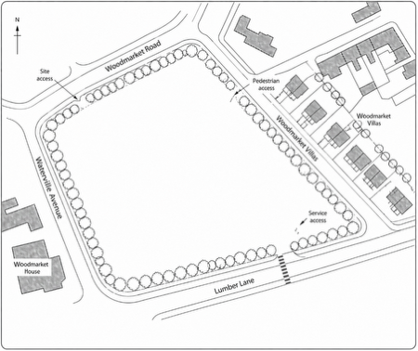
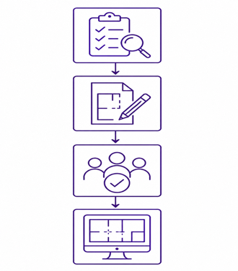
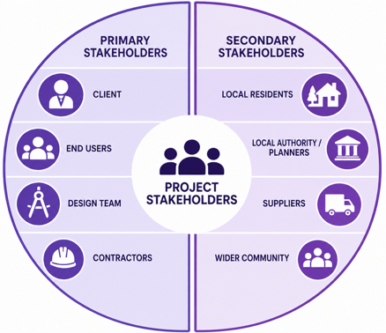
How the project works
Introduction
The project is guided, but you should make and justify your own decisions.
Project Brief
Project Workbook
Glossary + Pre-release
Scenario, client information, drawings, reports and stakeholder letters
Activities, prompts, tables, calculations, drawings and checkpoints
Terminology and preparatory research to support independent work
Task 1: Response to the client brief, site analysis and initial project planning
Notes:
Explain that the project brief is the evidence source, the workbook is the process, and the slide deck simply launches tasks.

Slide 4
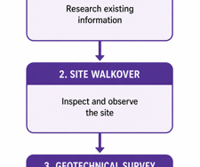
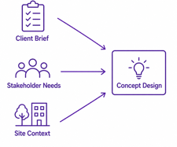
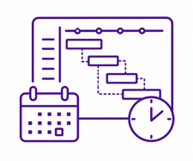

Your four tasks
Introduction
Task 1
Task 2
Task 3
Task 4
Analyse the brief and site
Develop the design
Plan and cost
Respond as a team
Interpret evidence before design begins
Create and justify a safe, sustainable proposal
Test feasibility in terms of time and cost
Compare options and make a justified recommendation
Key question: What evidence will you need to make credible
project decisions?
Task 1: Response to the client brief, site analysis and initial project planning
Notes:
Present the four tasks as a sequence. Each task builds evidence for the next task.
<photo credit © Shutterstock/wavebreakmedia>

Slide 5
Working independently
Introduction
You must:
use the project brief as your main source of evidence;
complete workbook activities clearly and professionally;
make decisions rather than wait for one 'correct' answer;
explain the implications of information, not just list it;
justify your choices using evidence from the project.
Teacher support: This will focus on questioning, progress checks and targeted help. You still need to make your own professional judgements.
Task 1: Response to the client brief, site analysis and initial project planning
Notes:
Set expectations early. The teacher acts as facilitator and challenger, not as a provider of solutions.

Slide 6
Design, Surveying and Planning for Construction
Route: Construction
Topic: Design a sustainable youth community hub
Task 1: Response to the client brief, site analysis and initial project planning
Notes:
<photo credit © Shutterstock/PeopleImages>

Slide 7
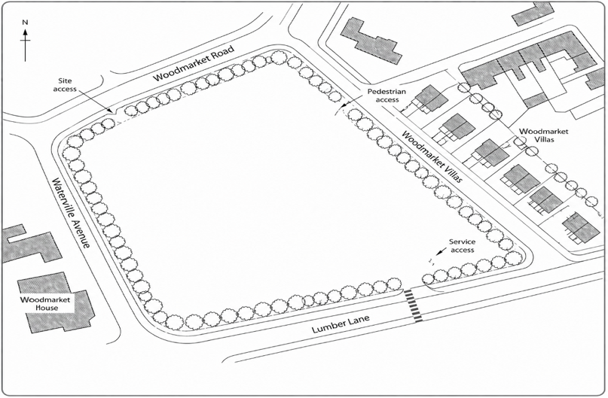
Interpreting the client brief
Activity 1.1
Before developing a design, you must understand the:
client requirements and success criteria;
stakeholder needs and concerns;
site constraints and opportunities;
ground, contamination, access and planning issues;
early implications for design and delivery.
Key question: What does this information mean for the design?
Task 1: Response to the client brief, site analysis and initial project planning
Notes:
Emphasise that Task 1 is about analysis, not jumping straight into design.

Slide 8
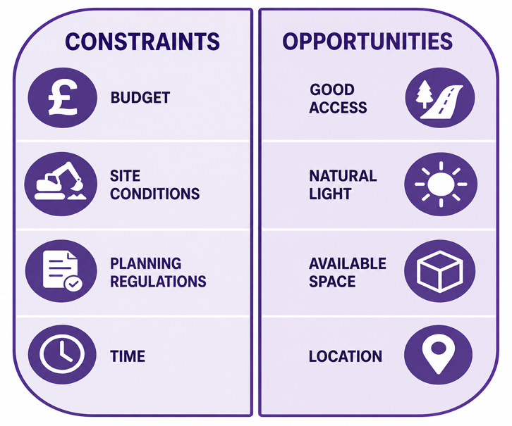
Project constraints and opportunities
Activities 1.2, 1.7, 1.8
Compile the following evidence:
Annotated brief or structured summary
Client requirements and success criteria
Stakeholder analysis
Annotated site analysis
Risks, constraints and opportunities
Task 1: Response to the client brief, site analysis and initial project planning
Notes:
Use the visual icons as reminders of evidence types. Students should use the workbook to structure their analysis.

Slide 9

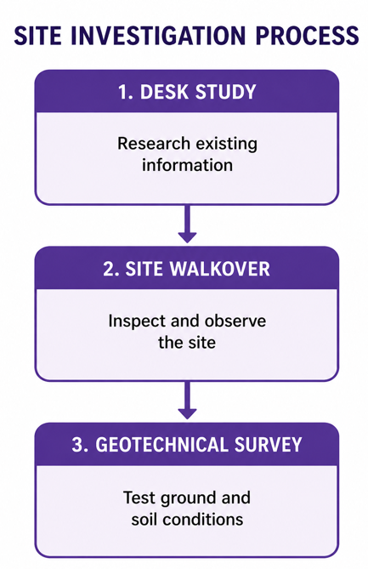
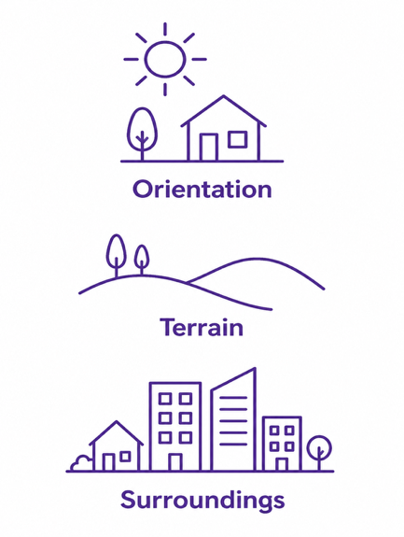
Stakeholders and site analysis
Activities 1.3–1.4, 1.5–1.9
Keep asking: What is the implication of this evidence?
Task 1: Response to the client brief, site analysis and initial project planning
Notes:
Use the visual icons as reminders of evidence types. Students should use the workbook to structure their analysis.

Slide 10
Checkpoint: End of Task 1
Checkpoint
Consider
What evidence from the brief, reports, drawings or stakeholder letters supports your findings?
Which finding is the most significant, and why?
How will this evidence influence a later design decision?
Key question: Is your analysis strong enough to make design decisions?
Task 1: Response to the client brief, site analysis and initial project planning
Notes:
This checkpoint is a readiness check, not an additional assessed activity.

Slide 11
Design, Surveying and Planning for Construction
Route: Construction
Topic: Design a sustainable youth community hub
Task 2: Design proposal and design justification
Notes:
<photo credit © Shutterstock/PeopleImages>

Slide 12
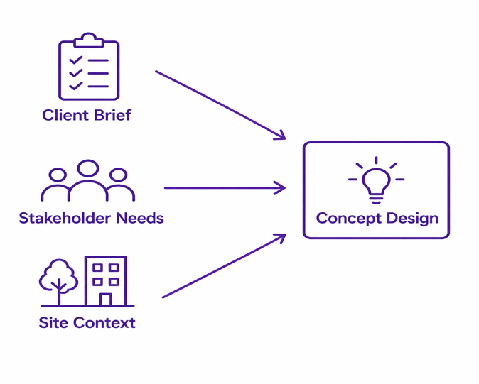
Progression outline
Introduction
Use your analysis from Task 1 to develop a proposal that is safe, sustainable, inclusive, functional and buildable. You must:
compare options before selecting a solution;
show layout, orientation, access and circulation;
select suitable materials and construction methods;
address sustainability, accessibility and safety;
justify decisions using project evidence.
Key question: How does your design respond to the brief, stakeholders and site?
Task 2: Design proposal and design justification
Notes:
Position Task 2 as design development. Students should make decisions and justify them using Task 1 evidence.

Slide 13

What you need to produce
Introduction
Your design evidence should show:
how you have compared and selected the materials and construction method;
your concept ideas, with a developed layout or floor plan;
accessibility, sustainability and safety responses;
basic regulatory considerations;
a clear design justification linked to evidence.
Task 2: Design proposal and design justification
Notes:
Ensure students understand that attractive drawings are not enough. The proposal must be technically and contextually justified.
<photo credit © Shutterstock/PeopleImages>

Slide 14
Checkpoint: End of Task 2
Checkpoint
Consider
Which evidence from Task 1 directly influenced your design?
What comparison evidence supports your chosen materials and construction method?
What change have you made after reviewing regulations, risks or stakeholder needs?
Key question: Can someone else understand and test your design proposal?
Task 2: Design proposal and design justification
Notes:
Students should not move to programme and cost until they have a defined proposal.

Slide 15
Design, Surveying and Planning for Construction
Route: Construction
Topic: Design a sustainable youth community hub
Task 3: Project planning and costing documentation
Notes:
<photo credit © Shutterstock/PeopleImages>

Slide 16

Feasibility test
Introduction
Test whether your proposal is practical in terms of sequence, time and cost. You must:
sequence the work;
identify dependencies;
estimate durations;
calculate early costs;
comment on feasibility.
Key question: Is your design realistic to build in terms of time and cost?
Task 3: Project planning and costing documentation
Notes:
Task 3 links the design to delivery. The focus is early-stage feasibility, not detailed tendering.
<photo credit © Shutterstock/Drazen Zigic>

Slide 17
What you need to produce
Introduction
Planning evidence
Work breakdown or construction sequence
Key dependencies
Durations and possible overlaps
Simple programme or Gantt-style chart
Costing evidence
Floor-area and material quantity calculations
Wastage allowances
Material and labour cost calculations
Total estimated element cost
Working, units and assumptions
Feasibility commentary
Planning and costing should help you explain whether or not the project
is feasible.
Task 3: Project planning and costing documentation
Notes:
This slide separates planning and costing evidence to avoid students treating Task 3 as costing only.

Slide 18
Checkpoint: End of Task 3
Checkpoint
Consider
What evidence shows that your construction sequence is logical?
Which calculations and assumptions support your cost estimate?
What does your programme and cost evidence show about project feasibility?
Key question: Can you explain how your design choices affect time and cost?
Task 3: Project planning and costing documentation
Notes:
Check that students can show calculations and explain assumptions.

Slide 19
Design, Surveying and Planning for Construction
Route: Construction
Topic: Design a sustainable youth community hub
Task 4: Team response to a project problem
Notes:
<photo credit © Shutterstock/PeopleImages>

Slide 20

Additional client problem
Introduction
Following further consultation with the contractor, the client is concerned about:
construction cost;
programme duration;
disruption on the constrained brownfield site.
The design team has been asked to investigate whether greater use of off-site manufacture and standardisation could improve project delivery and reduce cost while maintaining the client’s key requirements.
Key question: Where could off-site manufacture or standardisation improve delivery of the youth hub?
Task 4: Team response to a project problem
Notes:
Introduce the additional client problem at the start of Task 4. Emphasise that off-site manufacture is an option to investigate, not a predetermined solution. Students should use evidence from their existing proposals and previous project work.
<photo credit © Shutterstock/Drazen Zigic>

Slide 21

Identifying off-site opportunities
Activity 4.1
Use the individual proposals as project evidence to:
identify common or repetitive building elements;
consider where elements could be standardised;
identify opportunities for off-site manufacture;
consider potential benefits and limitations;
select at least three opportunities for further appraisal.
You are not choosing the best individual design.
Key question: Which building elements are most suitable for standardisation or off-site manufacture, and why?
Task 4: Team response to a project problem
Notes:
Students should not rank individual proposals. Each proposal is used as evidence to identify opportunities that may be applicable across the youth hub project. Encourage consideration of cost, programme, logistics, quality, sustainability, health and safety, design flexibility and buildability.
<photo credit © Shutterstock/PeopleImages>

Slide 22

Appraising options and agreeing a response
Activity 4.2
Identify: Which opportunities from Activity 4.1 should be investigated further?
Compare: What are the benefits, limitations, risks and trade-offs of at least three credible approaches?
Agree: Which option, or combination of options, provides the best overall balance for this project?
Justify: What evidence from Tasks 1, 2 and 3 supports the team recommendation?
Consider the impact on: Cost and programme, site logistics and disruption, quality and sustainability, safety and accessibility, and design flexibility and buildability.
Task 4: Team response to a project problem
Notes:
Teams should compare at least three credible approaches using consistent project criteria. Challenge unsupported claims that off-site manufacture will automatically be cheaper, quicker or more sustainable. The final recommendation may combine approaches where this provides a stronger project response.
<Photo credit © Shutterstock/Zamrznuti tonovi>

Slide 23
Checkpoint: End of Task 4
Checkpoint
Consider
What evidence from Tasks 1, 2 and 3 supports your
recommended approach?
How does your option appraisal demonstrate the benefits, limitations
and trade-offs?
Why is the recommended level of off-site manufacture or
standardisation appropriate for this project?
Key question: How strongly can you justify your final recommendation using the available evidence?
Task 4: Team response to a project problem
Notes:
Use this as the final readiness check before presentation and individual reflection.

Slide 24
Design, Surveying and Planning for Construction
Route: Construction
Topic: Design a sustainable youth community hub
Project completion and reflection
Notes:
<photo credit © Shutterstock/PeopleImages>

Slide 25
Project completion and reflection
Follow-up / consolidation
You have now practised how professionals:
respond to a client brief;
analyse site and stakeholder information;
develop and justify a design proposal;
consider risk, regulation, programme and cost;
work as a team to solve a new project problem.
Key question: How well does your final proposal respond to the requirements of the brief, site, stakeholders, risks, cost and client?
Project completion and reflection

