Slide 1
Craft and Design
Route: Creative and Design
Topic: Creative economy – industries, organisations and monetisation models
Lesson 1: Industries in the creative economy
Notes:
Image © Shutterstock/Chokniti-Studio

Slide 2

Knowledge retrieval
Introduction
Look at your bag or backpack and consider:
three creative activities that helped to produce it;
three non-creative activities that helped to get it to you.
Lesson 1: Industries in the creative economy
Notes:
Image © Shutterstock/Prostock-studio

Slide 3
In this lesson, we will:
Introduction
define the creative economy;
distinguish between creative and non-creative industries;
identify business, design, production and technical activities;
analyse activities within a creative business;
              use evidence to justify business decisions;
assess the benefits and relationships between the different industries and activities.
Skills
CS2: Generating ideas
CS4: Developing ideas
General competencies
English:
E2: Present information and ideas
E4: Summarise information/ideas
E5: Synthesise information
E6: Take part in/leading discussions
Digital:
D3: Communicate and collaborate
Lesson 1: Industries in the creative economy

Slide 4

  Case study: LoopStudio
Activity 1
LoopStudio is a sustainable designer-maker business.
It repurposes unusual materials (e.g. vehicle seatbelts) to manufacture functional, visually striking bags and accessories, and a limited clothing range.
The label combines creative practice with business activities.
Products are sold online and in galleries.
Can LoopStudio survive through creativity alone?
Lesson 1: Industries in the creative economy
Notes:
Image © Shutterstock/Mita Stock Images

Slide 5
The creative economy and its industries
Activity 1
Film
Television
Broadcasting and video
Publishing
Music/performing arts
Digital
Craft and design
CREATIVE INDUSTRIES
CREATIVE ECONOMY
Legal
Financial
Logistical
Marketing and communications
Human resources
NON-CREATIVE INDUSTRIES
Lesson 1: Industries in the creative economy

Slide 6
Key creative industry activities
Activity 2
BUSINESS ACTIVITIES
Commissioning
Fund-raising
Workforce
management
Budgeting
Scheduling
Marketing
Promotion
Distribution
DESIGN ACTIVITIES
Idea generation
Research
Concept development
Product development
Service development
PRODUCTION ACTIVITIES
Pre-production
Resource use
Concept production and delivery
Content creation
Post-production
TECHNICAL ACTIVITIES
Ensuring technical requirements are
met for:
materials;
resources;
equipment;
archiving.
Lesson 1: Industries in the creative economy

Slide 7
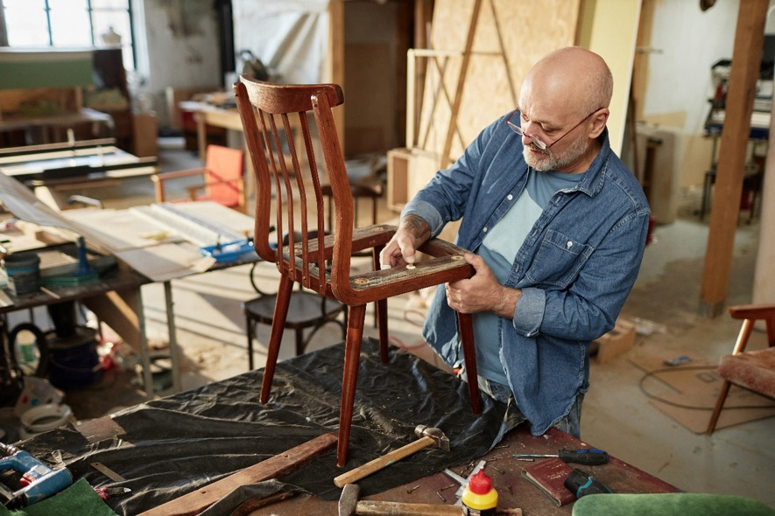
Creative economy activities
Activity 2
Creative businesses carry out a combination of different activities to help them succeed.
These include activities that:
develop creative ideas;
produce innovative products or services;
ensure products meet customer requirements.
Lesson 1: Industries in the creative economy
Notes:
Image © Shutterstock/SeventyFour

Slide 8

Activities in action
Activity 2
Research a creative brand to see how they put the four key activities into action. Choose your own brand or use one of the following:
                RÆBURN (www.raeburndesign.co.uk/)
                Emma Bridgewater (www.emmabridgewater.co.uk/)
                Tatty Devine (www.tattydevine.com)
                Matthew Burt (https://matthewburt.com)
Complete Lesson 1 Activity 2a
Lesson 1: Industries in the creative economy
Notes:
Image © Shutterstock/DC Studio

Slide 9

Getting the product to the customer
Activity 2
Designing and producing new products is important. However, it is just as important for businesses to get the right products and services to the customer on time.
Completing all these activities in the most efficient way is essential to business success.
Complete Lesson 1 Activity 2b
Lesson 1: Industries in the creative economy
Notes:
Image © Shutterstock/yurakrasil

Slide 10

Business success – analysis challenge
Activity 3
Discussion
Working in pairs, consider how each of the following categories might contribute to LoopStudio’s success:
business;
design;
production;
technical.
Lesson 1: Industries in the creative economy
Notes:
Image © Shutterstock/Seregam

Slide 11

Case study – decision-based dilemmas
Activity 3
LoopStudio has received a
cash injection to help develop
the business.
Demand for their products has steadily increased.
Decisions must be made in the best interests of the brand.
Complete Lesson 1 Activity 3
Lesson 1: Industries in the creative economy
Notes:
Image © Shutterstock/EyeFound

Slide 12
Exam practice – ‘Name/Give’
Plenary
Name two activity categories that take
place within creative businesses. (2 marks)
Give two examples of technical activities. (2 marks)
Remember
Simply identify or name information.
Keep your answer short.
No explanation is needed.
Each correct activity gains 1 mark.
Complete Lesson 1 Plenary
Lesson 1: Industries in the creative economy

Slide 13
In this lesson, we have:
Plenary
defined the creative economy;
distinguished between creative and
non-creative industries;
identified business, design, production and technical activities;
analysed activities within a creative business;
              used evidence to justify business decisions;
assessed the benefits and relationships between the different industries and activities.
Skills
CS2: Generating ideas
CS4: Developing ideas
General competencies
English:
E2: Present information and ideas
E4: Summarise information/ideas
E5: Synthesise information
E6: Take part in/leading discussions
Digital:
D3: Communicate and collaborate
Lesson 1: Industries in the creative economy

Slide 14

Creative economy detective
Consolidation
This is your opportunity to investigate further the creative and non-creative industries you have identified in this lesson.
Remember to:
consider hidden contributors;
use topic-specific terminology;
provide evidence.
Complete Lesson 1 consolidation activity
independently in your own time
Lesson 1: Industries in the creative economy
Notes:
Image © Shutterstock/Africa Studio

Slide 15
Craft and Design
Route: Creative and Design
Topic: Creative economy – industries, organisations and monetisation models
Lesson 2: Characteristics of organisations within the creative economy
Notes:
Image © Shutterstock/Chokniti-Studio

Slide 16

Knowledge retrieval
Introduction
THINK
How do organisations differ from each other?
Lesson 2: Characteristics of organisations within the creative economy

Slide 17
In this lesson, we will:
Introduction
identify characteristics of different organisations in the creative economy;
explain differences between small- and medium-sized enterprises (SMEs), limited companies, charities, corporations and not-for-profits;
apply characteristics of organisations to a real creative business.
Skills
CS2: Generating ideas
CS4: Developing ideas
General competencies
English:
E2: Present information and ideas
E4: Summarise information/ideas
E5: Synthesise information
E6: Take part in/leading discussions
Digital:
D3: Communicate and collaborate
Lesson 2: Characteristics of organisations within the creative economy

Slide 18

Organisations in the creative economy
Introduction
Organisations include:
corporations;
limited companies (Ltd);
small and medium-sized enterprises (SMEs);
not-for-profits;
charities.
Understanding the characteristics of these organisations helps us to compare how they operate and how they contribute to the creative economy using their creativity as an economic resource.
Lesson 2: Characteristics of organisations within the creative economy
Notes:
Image © Shutterstock/Archiwiz

Slide 19
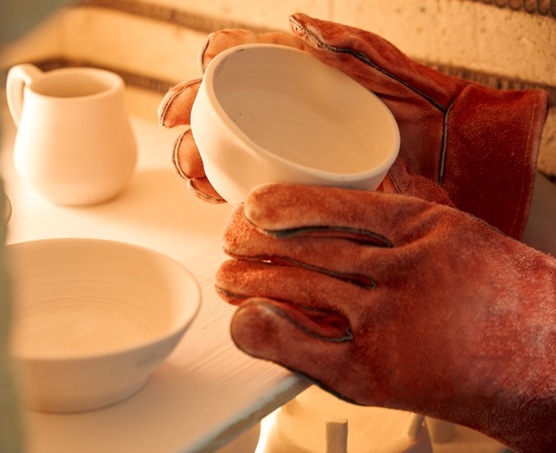
Case study: Fire & Form Ltd
Activity 1
Fire & Form Ltd is a pottery and ceramics enterprise.
It has around 15 employees who perform multiple activities and are adept at change.
It operates out of an industrial unit.
It has an online store and sells to the public, as well as taking commissions from other businesses.
What clues suggest Fire & Form Ltd is a small enterprise?
Lesson 2: Characteristics of organisations within the creative economy
Notes:
Image © Shutterstock/Svitlana Hulko

Slide 20
Main purposes of creative organisations
Activity 1
MAIN PURPOSE
EXAMPLES
Make profit
Limited companies/
corporations/SMEs
(e.g. a design studio)
Support industries
Sector skills bodies (e.g. UK Fashion and Textiles – UKFT)
Support creativity
Creative bodies
(e.g. Crafts Council)
Benefit public
Charities
(e.g. Heritage Crafts)
Can two organisations in the same creative sector have different purposes?
Lesson 2: Characteristics of organisations within the creative economy

Slide 21

Characteristics of organisations
Activity 2
Characteristics help to describe, identify and compare organisations.
These characteristics help us to understand:
  how an organisation operates;
  who it serves;
  how it generates income.
One of the easiest ways to classify an organisation is by its size.
Complete Lesson 2 Activity 2a
Lesson 2: Characteristics of organisations within the creative economy
Notes:
Image © Shutterstock/Zamrznuti tonovi

Slide 22
Sector skills bodies
Activity 2
Lesson 2: The characteristics of different types of organisations operating within the creative economy
Sector skills bodies like the Goldsmiths’ Foundation (www.thegoldsmiths.co.uk) support skills development within goldsmithing, silversmithing and jewellery, as well as wider creative industries.
Discussion
How might membership of a sector skills body help Fire & Form Ltd?
Characteristics | Explanation
Not-for-profit | Not commercially driven
Industry experts | Led by key sector figures
Develop standards | Set occupational standards
Improve workforce | Reduce skills gap
Support industry | Improve sector performance
Lesson 2: Characteristics of organisations within the creative economy

Slide 23
Creative bodies
Activity 2
Creative bodies, such as the Crafts Council and Creative UK, develop and support creativity in individuals and businesses.
Activities | Impact
Support creative practitioners | Professional growth
Provide funding opportunities | Investment in projects
Offer sector representation | Champions its members
Develop and support creativity | Business development
Complete Lesson 2 Activity 2b
Lesson 2: Characteristics of organisations within the creative economy

Slide 24
Micro-, small- and medium-sized enterprises
Activity 2
Organisations are categorised according to
staff numbers:
  Micro-enterprise: 1 to 9 employees
  Small-enterprise: 10 to 49 employees
  Medium-enterprise: 20 to 249 employees
These enterprises make up many of the creative businesses in the UK.
Small-and medium-sized enterprises (SMEs) are often flexible, innovative and customer focused.
Discussion
Why might SME staff perform multiple tasks?
Complete Lesson 2
Activity 2c
Lesson 2: Characteristics of organisations within the creative economy

Slide 25

Corporations
Activity 2
Corporations are large organisations that operate
as separate legal entities – the business exists independently from the people who own it.
What distinguishes a corporation?
Shareholder ownership
Significant financial resources
Substantial turnover
Access to international markets
Large workforces
Structured decision-making via multi-level management and specialist departments
How might having access to significant financial resources benefit a business?
Lesson 2: Characteristics of organisations within the creative economy
Notes:
Image © Shutterstock/Pressmaster

Slide 26

Limited companies
Activity 2
Limited companies (Ltd) can be large or small private organisations.
They have limited liability, meaning owners risk only what they invest or guarantee.
They must pay corporation tax and file annual accounts.
They rely on directors to manage operations.
They sell goods or services for profit.
Lesson 2: Characteristics of organisations within the creative economy
Notes:
Image © Shutterstock/BATKA

Slide 27

Not-for-profit organisations
Activity 2
Not-for-profits operate to achieve social, educational, cultural and community outreach objectives rather than to generate profit for owners or shareholders.
Surplus finance is reinvested according to its corporate social responsibilities (CSR).
The operational drivers do not financially benefit the board of trustees or any private individual.
Not-for-profits are not eligible for charity
tax relief.
What happens to any surplus income generated by a not-for-profit organisation?
Lesson 2: Characteristics of organisations within the creative economy
Notes:
Image © Shutterstock/PeopleImages

Slide 28

Charities
Activity 2
Within the creative economy, charities are established for public benefit using:
    arts education;
    heritage crafts;
    public access to creative activities.
They are eligible for charity tax relief.
They are subject to charity law and legislation.
      They can generate income but must use it to
      support their charitable aims.
They develop craft skills outside of mainstream education.
Lesson 2: Characteristics of organisations within the creative economy
Notes:
Image © Shutterstock/Yuliya Koldovska

Slide 29
Exam practice – ‘Explain’
Plenary
Remember
Explain two characteristics of a not-for profit organisation. (4 marks)
Identify two accurate characteristics – worth 1 mark each.
Explain each characteristic clearly – worth 1 mark each.
Use the structure: point then justification.
Complete Lesson 2 Plenary
Lesson 2: Characteristics of organisations within the creative economy

Slide 30
In this lesson, we have:
Plenary
identified characteristics of different organisations in the creative economy;
explained differences between small- and medium-sized enterprises (SMEs), limited companies, charities, corporations and not-for-profits;
applied characteristics of organisations to a real creative business.
Skills
CS2: Generating ideas
CS4: Developing ideas
General competencies
English:
E2: Present information and ideas
E4: Summarise information/ideas
E5: Synthesise information
E6: Take part in/leading discussions
Digital:
D3: Communicate and collaborate
Lesson 2: Characteristics of organisations within the creative economy

Slide 31
Organisation detective
Consolidation
A business magazine has published a short profile on three different organisations.
Identify the most likely type of organisation.
Explain one characteristic that helped you identify it, and why that characteristic is important.
Evaluate which organisation is likely to have the greatest impact on its local community. Explain your answer.
Decide: A local council wants to fund a year-long creative outreach programme. Which organisation should receive the funding?
Complete Lesson 2 consolidation activity independently in your own time
Lesson 2: Characteristics of organisations within the creative economy

Slide 32
Craft and Design
Route: Creative and Design
Topic: Creative economy – industries, organisations and monetisation models
Lesson 3: How creative products and services make money
Notes:
Image © Shutterstock/Chokniti-Studio

Slide 33
Making money
Introduction
THINK
What does ‘monetise’ mean?
Name one way a creative practitioner or organisation makes money.
What is revenue?
What is profit?
Why might a customer buy bespoke jewellery rather than mass-produced jewellery?
Lesson 3: How creative products and services make money

Slide 34
In this lesson, we will:
Introduction
recall and explain how the three main monetisation models generate income:
  commissioned
  self-generated
  subscription;
assess the benefits and challenges of each model in relation to:
creative control
financial stability
risk;
discuss the suitability of different monetisation models for a creative business.
Skills
CS2: Generating ideas
CS4: Developing ideas
General competencies
English:
E2: Present information and ideas
E4: Summarise information/ideas
E5: Synthesise information
E6: Take part in/leading discussions
Digital:
D3: Communicate and collaborate
D4: Process and analyse numerical data
Lesson 3: How creative products and services make money

Slide 35
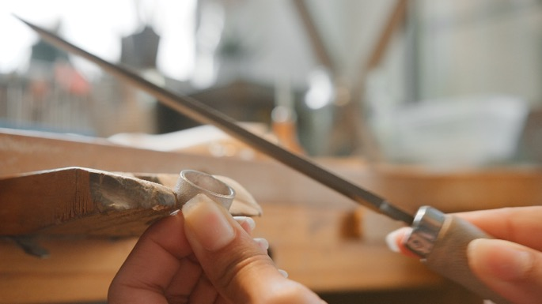
Case study: Argent & Co.
Introduction
Argent & Co. is a small independent UK jewellery business. It creates sustainable, handcrafted jewellery (necklaces, rings, earrings and bracelets) using recycled materials. It offers ready-to-buy collections and bespoke commissions.
Product key features
Handcrafted by skilled makers.
Made entirely from recycled silver.
Undertakes commissioned jewellery projects.
Sells directly to customers through its own website and craft fairs.
Offers a monthly subscription service.
Focuses on sustainability and ethical production.
Lesson 3: How creative products and services make money
Notes:
Image © Shutterstock/Monkey Business Images

Slide 36
Why monetisation models matter
Activity 1
Every creative organisation must decide:
how customers will buy their work;
how income will be generated;
how often customers will pay for a product or service;
who owns the creative work;
how the business can remain financially sustainable.
Models
The monetisation models used to help practitioners make these decisions are:
commissioned;
self-generated;
subscription;
combined.
Lesson 3: How creative products and services make money

Slide 37

Commissioned model
Activity 1
This involves a bespoke product, content or service created at the request of a client.
Business | Commissioned product | Client
Jewellery designer | Wedding ring | Individual
Graphic designer | Company logo | Organisation
Photographer | Photographs | Publisher
Architect | House design | Housing charity
What benefits and challenges exist when designing specifically for one client?
Lesson 3: How creative products and services make money
Notes:
Image © Shutterstock/feedbackstudio

Slide 38
Self-generated model
Activity 1
This involves income solely generated from the actions of an individual or business.
Sources of revenue | Selling example
Direct-to-customer sales | Selling handcrafted ceramics through a company website or Etsy store.
Workshops | Running a Make your own silver ring jewellery workshop for paying customers.
Intellectual property rights (IPR) | Licensing an original design to another company for use in its product range.
Lesson 3: How creative products and services make money

Slide 39
Subscription model
Activity 1
This involves income generated through recurring payments from users who agree to receive products or services at regular intervals.
Argent & Co.
“The Silver Circle”
Members pay £20 per month to receive:
      early access to new collections;
      10–15% member discount on purchases;
      free shipping on all orders;
      exclusive members-only jewellery designs;
      quarterly jewellery care kit or small silver accessory.
TV/FILM STREAMING SERVICES
Monthly
streaming
ONLINE LEARNING PLATFORM
On-demand creative skills tutorials
MUSIC STREAMING
Premium membership
Lesson 3: How creative products and services make money

Slide 40
Combined model
Activity 1
This involves a creative individual or business using two or more monetisation models at the same time to generate income from different sources.
Self-generated
(IPR or collection sales)
+
Commissioned
(bespoke bracelet)
+
Subscription
(Silver Circle monthly membership)
Think–Pair–Share
Which combination would be best for Argent & Co?
A. Self-generated + Commissioned
B. Self-generated + Subscription
C. All three models
Justify your answer.
Multiple
= funding
sources
Complete Lesson 3 Activity 1
Lesson 3: How creative products and services make money

Slide 41
Creative control
Activity 2
The amount of freedom a creator/business has over its products, designs and ideas.
MONETISATION MODEL
Argent & Co. example
SELF-GENERATED
Argent & Co. launches its own jewellery collection
HIGH
COMBINED
SUBSCRIPTION
Subscribers receive membership perks
MEDIUM
COMMISSIONED
Customer requests a bespoke wedding ring
LOWER
Complete Lesson 3 Activity 2
LEVEL OF CREATIVE CONTROL
Lesson 3: How creative products and services make money
Notes:
Image author’s own

Slide 42

Financial stability
Activity 2
This means having predictable, reliable income that helps a business survive and grow.
Discussion
Why might a combined monetisation approach be safer than relying only on jewellery sales?
Lesson 3: How creative products and services make money

Slide 43
Risk
Activity 3
Risk is the possibility that a business may lose money or fail to achieve its objectives.
COMMISSIONED
A customer may be unhappy with the final product. Possible outcomes: complaints, reputational damage, loss of future recommendations.
SELF-GENERATED
The creator may invest time and money developing a new jewellery collection that does not appeal to customers. Possible outcomes: unsold stock, wasted resources.
SUBSCRIPTION
Subscribers may feel the monthly benefits are no longer worthwhile and cancel their memberships. Possible outcomes: reduced customer loyalty, loss of consistent and recurring income.
COMBINED
Managing multiple revenue streams can increase workload and complexity. Possible outcomes: quality, customer service, impacts on delivery times if not managed correctly.
Lesson 3: How creative products and services make money

Slide 44
Pitch preparation
Activity 3
For your pitch:
State your recommended option.
Give two or three key reasons to justify your choice.
Explain why it offers the best investment opportunity.
Conclude with a clear recommendation.
Remember to:
give a clear recommendation;
support it with evidence;
justify your choice;
stay focused;
stick to the time limit.
Complete Lesson 3 Activity 3
Lesson 3: How creative products and services make money

Slide 45
Exam practice – ‘Discuss’
Plenary
Consider:
Why might a subscription
service generate more predictable income?
Why could subscriber cancellations be a challenge?
How might customer expectations affect creative control?
What is the risk to the business?
What is the impact on workload?
Discuss the factors a craft maker should consider when deciding whether to introduce a subscription service. (9 marks)
Complete Lesson 3 Plenary
Lesson 3: How creative products and services make money

Slide 46
In this lesson, we have:
Plenary
recalled and explained how the three main monetisation models generate income:
  commissioned
  self-generated
  subscription;
assessed the benefits and challenges of each model in relation to:
creative control
financial stability
risk;
discussed the suitability of different monetisation models for a creative business.
Skills
CS2: Generating ideas
CS4: Developing ideas
General competencies
English:
E2: Present information and ideas
E4: Summarise information/ideas
E5: Synthesise information
E6: Take part in/leading discussions
Digital:
D3: Communicate and collaborate
D4: Process and analyse numerical data
Lesson 3: How creative products and services make money

Slide 47
Monetisation models and business
Consolidation
1. Choose a real creative business from the list provided.
2. Identify the monetisation model(s).
3. Apply your learning.
Based on your findings, answer the following questions:
Which monetisation model does the business appear to rely on most?
What is one potential benefit of this model?
What is one potential challenge of this model?
Would you recommend introducing another monetisation model? Justify your answer.
Complete Lesson 3 consolidation activity independently in your own time
Lesson 3: How creative products and services make money

